Slide 1
Development of a Meshless Method to Study Multibody Systems using CFD
David Kennett
Prof Ken Badcock
School of Engineering
University of Liverpool
Liverpool, L69 3BX
United Kingdom
Email: d.kennett@liv.ac.uk
Notes:
1

Slide 2
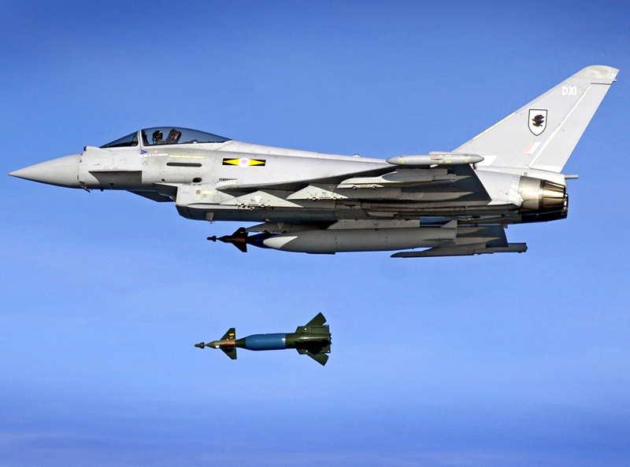
Motivation
Moving bodies in relative motion.
Applications such as store release.
Difficult to simulate using conventional finite volume methods.
RAF Typhoon releasing a Paveway 2 (Photo: SAC Babbs Robinson)
Notes:
Shows flow structure and schematic showing some aerodynamic problems helicopters encounter in forward flight.
The total loads that a rotor experiences is dependant on the local loads experienced by each part of the blade. In hover flight alone, the loads vary along the blade, from low speed at the root and compressible flow at the tip, and so the blade design changes along the span. In addition, you have blade-tip vortex interaction.
With the addition of relative air flow in forward flight, you also have stall and flow reversal on the retreating blade, and transonic flow causing shock waves on the advancing side.
All of these complicate the design of the blade as more compromises must be made.
2

Slide 3
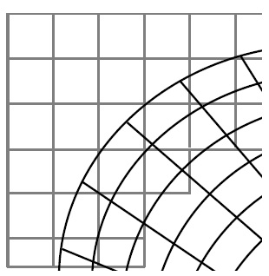
Alternative Methods
The Chimera (overset) grid method:
Generate individual component meshes for each body (or components of the body) separately.
Overlap the meshes to form the computational domain and identify cells to establish the communication between the meshes.
Flow solution is interpolated between the meshes using the identified interpolation cells.
Notes:
Shows flow structure and schematic showing some aerodynamic problems helicopters encounter in forward flight.
The total loads that a rotor experiences is dependant on the local loads experienced by each part of the blade. In hover flight alone, the loads vary along the blade, from low speed at the root and compressible flow at the tip, and so the blade design changes along the span. In addition, you have blade-tip vortex interaction.
With the addition of relative air flow in forward flight, you also have stall and flow reversal on the retreating blade, and transonic flow causing shock waves on the advancing side.
All of these complicate the design of the blade as more compromises must be made.
3

Slide 4
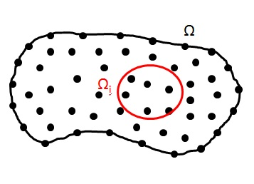
Overview of the Meshless Method
We can write the function as
where p(x) is a vector of base monomials
and α is the vector of coefficients that must be determined
For a least squares scheme then we require that there are more points than monomials (ie n≥m) so the system is over-determined. Then solve the normal equations:
Notes:
Shows flow structure and schematic showing some aerodynamic problems helicopters encounter in forward flight.
The total loads that a rotor experiences is dependant on the local loads experienced by each part of the blade. In hover flight alone, the loads vary along the blade, from low speed at the root and compressible flow at the tip, and so the blade design changes along the span. In addition, you have blade-tip vortex interaction.
With the addition of relative air flow in forward flight, you also have stall and flow reversal on the retreating blade, and transonic flow causing shock waves on the advancing side.
All of these complicate the design of the blade as more compromises must be made.
4

Slide 5
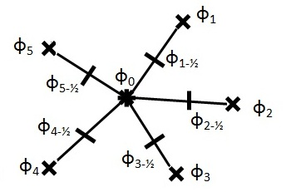
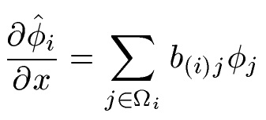
Overview of the Solver Method
D.J. Kennett, S. Timme, J. Angulo, K.J. Badcock,
“An Implicit Meshless Method for Application in Computational Fluid Dynamics” International Journal for Numerical Methods in Fluids, 2012, doi:10.1002/fld.3698
The shape function is unique for each “edge” in the cloud. For a conservation law of the form:
We require the flux derivatives. Then in terms of the shape function
Notes:
Shows flow structure and schematic showing some aerodynamic problems helicopters encounter in forward flight.
The total loads that a rotor experiences is dependant on the local loads experienced by each part of the blade. In hover flight alone, the loads vary along the blade, from low speed at the root and compressible flow at the tip, and so the blade design changes along the span. In addition, you have blade-tip vortex interaction.
With the addition of relative air flow in forward flight, you also have stall and flow reversal on the retreating blade, and transonic flow causing shock waves on the advancing side.
All of these complicate the design of the blade as more compromises must be made.
5

Slide 6
Temporal discretisation
To solve this equation an implicit method is used:.
Linearise the residual vector in time to give the Jacobian matrix:
Rearrange to give the steady state system:.
Krylov Subspace Iterative Method with approximate Jacobian matrices used to solve the system.
Jameson’s dual time stepping scheme is used to give the time accurate system to solve.
Notes:
Search and rescue? Need speed, manoeuvrability etc. Leads to optimizations such as the BERP blade.
Lynx – fast 200 mph, small radius 6.5m approx, but range is low 328mi.
Sea king – not very fast and quite a large diameter – more than 9m radius, so not very manoeuverable. But has good range – over 700 mi.
6

Slide 7
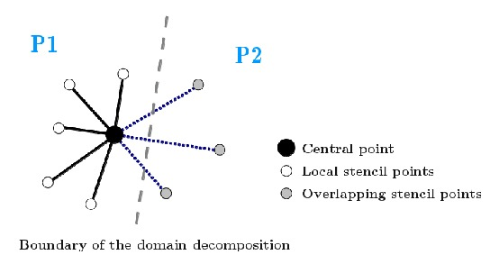
Parallel Implementation
Domain is decomposed using METIS library.
There are two point classes for each partition: interior points and communication points.
Interior points are those assigned to each processor according to the decomposition.
Communication points are the points belonging to stencils of interior points, but are not interior points of the partition (these stencils lie along the partitions boundaries).
Explicit MPI message passing instructions are used for communication.

Slide 8
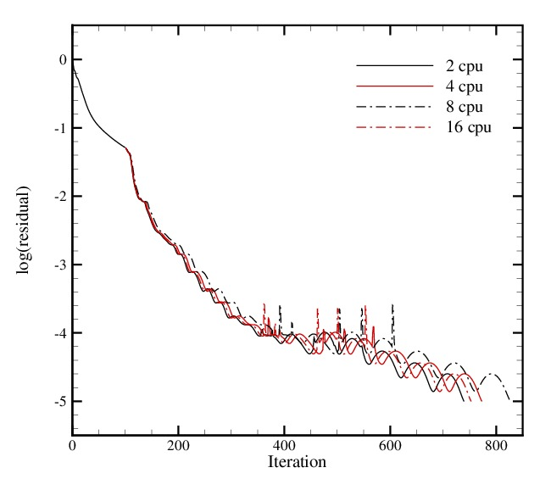
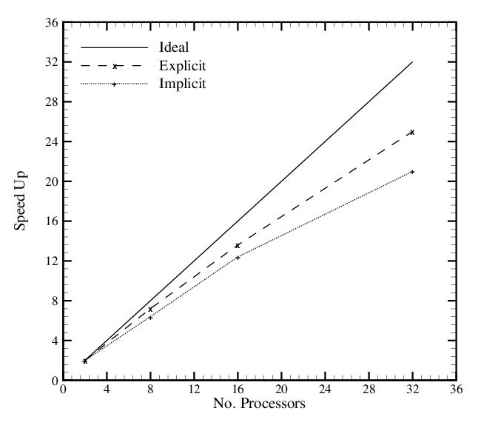
Parallel Implementation
Jacobian matrix is divided up among the processors using same decomposition.
Use of approximate Jacobian matrix reduces the communication required since there are fewer overlapping points.
There is no parallel communication when forming the preconditioner matrix: it is formed locally from each processor.

Slide 9
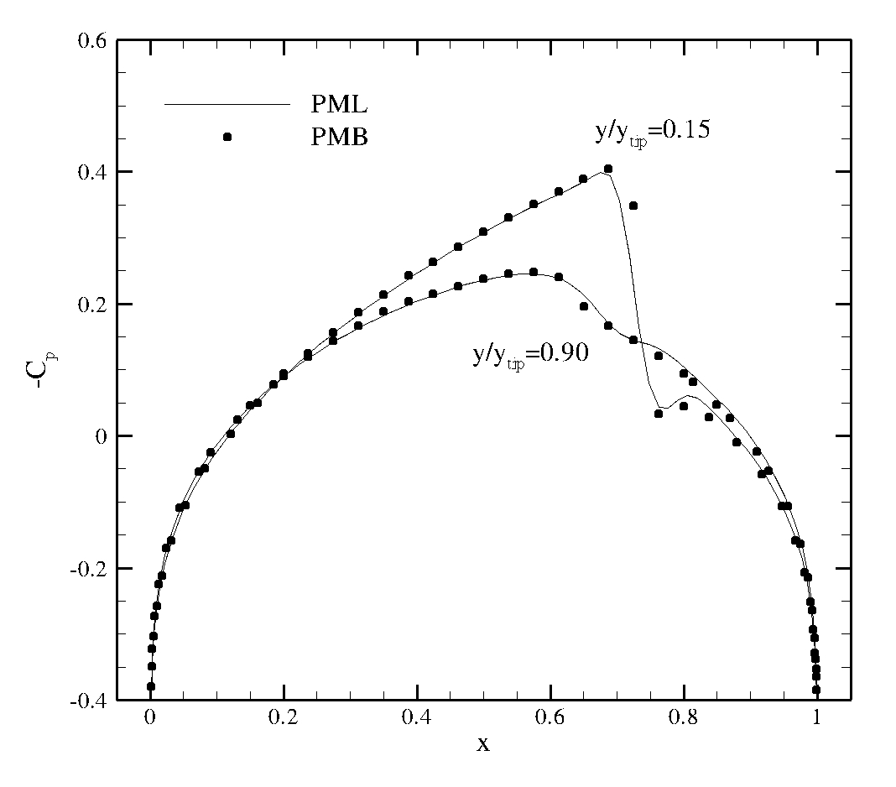
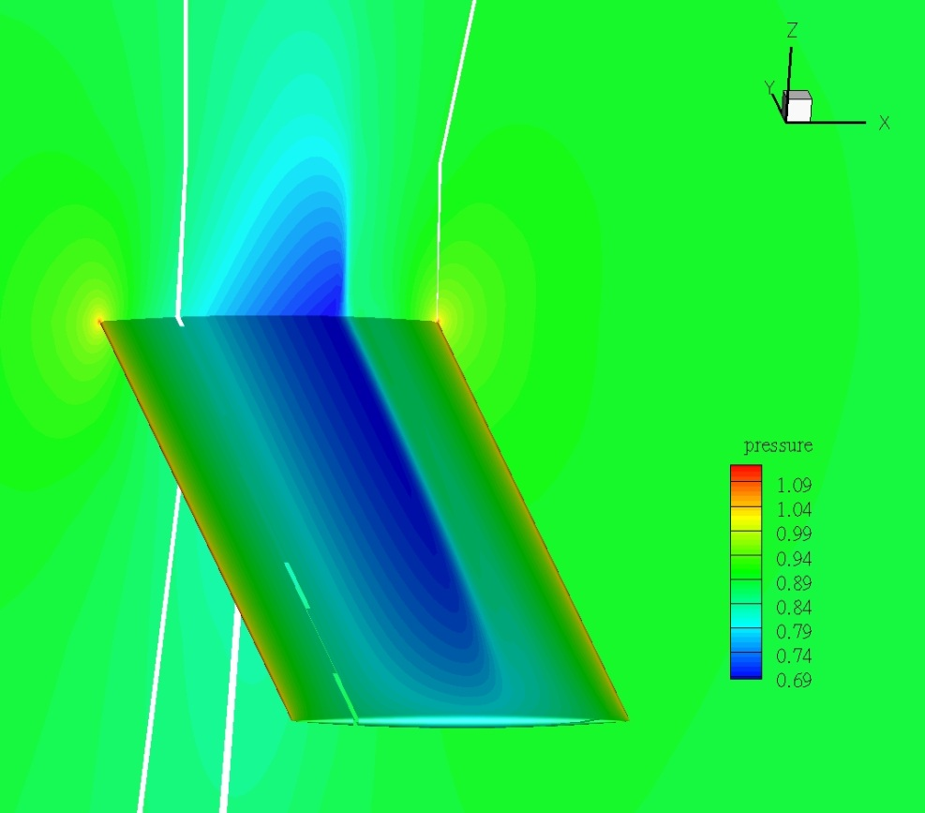
3D Results
3D Goland wing at M=0.9, aoa=0.
Notes:
Search and rescue? Need speed, manoeuvrability etc. Leads to optimizations such as the BERP blade.
Lynx – fast 200 mph, small radius 6.5m approx, but range is low 328mi.
Sea king – not very fast and quite a large diameter – more than 9m radius, so not very manoeuverable. But has good range – over 700 mi.
9

Slide 10
Preprocessor
The point distributions currently come from overlapping CFD meshes generated around each body or component separately.
Preprocessor stage basically consists of two components:
Ensure the boundaries are respected (points within/behind walls etc).
Stencil selection of the interior points to give the most accurate results.
D.J. Kennett, S. Timme, J. Angulo, K.J. Badcock, “Semi-Meshless Stencil Selection for Anisotropic Point Distributions” International Journal of Computational Fluid Dynamics, 2012, Vol. 26, No. 9-10, pp. 463-487

Slide 11
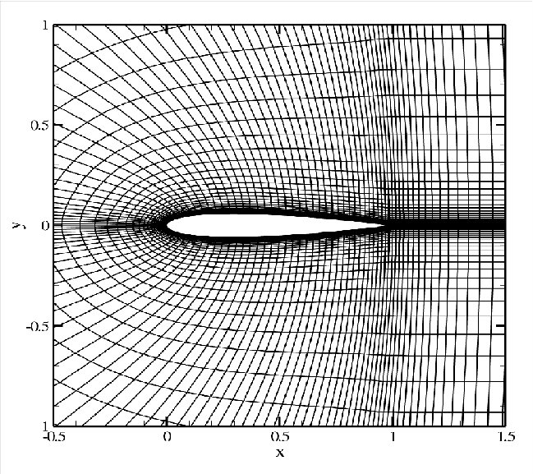
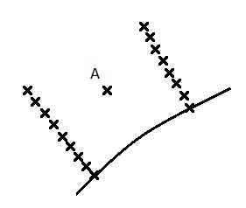
Stencil selection
Grids are anisotropic in regions where the flow is expected to vary.
Nearest neighbour algorithms give very poor stencils in the regions of most interest.
Notes:
Main rotor figure of merit versus year of development showing sustained improvements in aerodynamic efficiency.
Hover efficiency has been more studied than forward flight, although a lot of effort is now beginning to be put into forward flight.
Rotor efficiency is commonly measured by FM. The use of FM is restricted to rotors with the same disk loading.
This curve shows that improvements have been made over the years, but that the improvements are getting smaller, suggesting that more revolutionary ways of improving rotorcraft aerodynamics is going to be required, potentially through better aerodynamic optimization techniques.
11

Slide 12
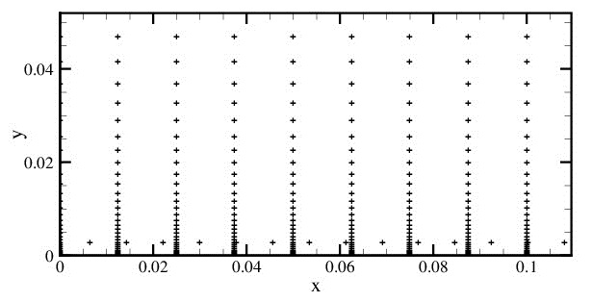
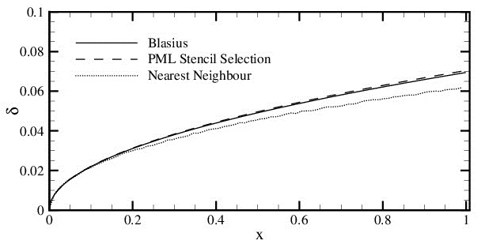
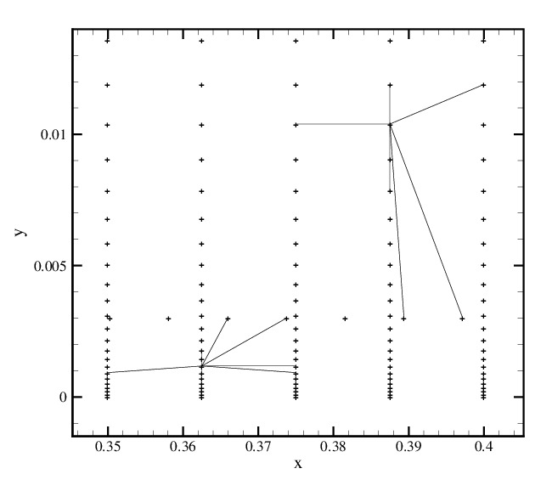
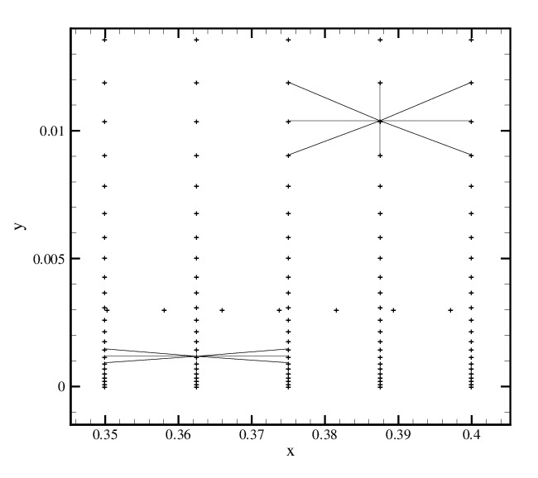

Slide 13
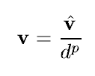
Stencil selection
Use the original connectivity of the input domains to help in the selection : semi-meshless.
v
Define the resolving vector to point in the direction in which we expect the flow to vary the most.
It is best to have very fine stencils in this direction, so that the least squares procedure can approximate the function better.
*
*
γ
The length of this vector should reflect the strength of the expected gradients in this region.
We use an inverse distance method, with the distance being the finest distance in the original grid stencil.
Notes:
Main rotor figure of merit versus year of development showing sustained improvements in aerodynamic efficiency.
Hover efficiency has been more studied than forward flight, although a lot of effort is now beginning to be put into forward flight.
Rotor efficiency is commonly measured by FM. The use of FM is restricted to rotors with the same disk loading.
This curve shows that improvements have been made over the years, but that the improvements are getting smaller, suggesting that more revolutionary ways of improving rotorcraft aerodynamics is going to be required, potentially through better aerodynamic optimization techniques.
13

Slide 14
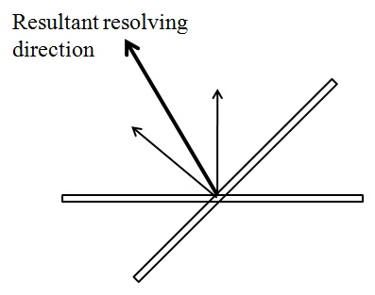
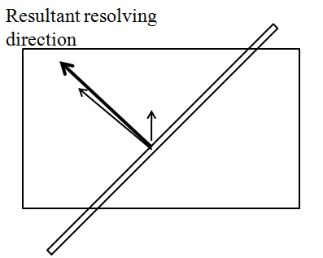
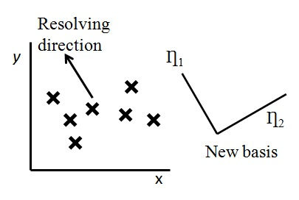
Stencil selection
Sum resolving vectors of the overlapping grids and use the resultant direction to select the best points.
Define a new coordinate system in the direction of the resolving direction.
Notes:
Main rotor figure of merit versus year of development showing sustained improvements in aerodynamic efficiency.
Hover efficiency has been more studied than forward flight, although a lot of effort is now beginning to be put into forward flight.
Rotor efficiency is commonly measured by FM. The use of FM is restricted to rotors with the same disk loading.
This curve shows that improvements have been made over the years, but that the improvements are getting smaller, suggesting that more revolutionary ways of improving rotorcraft aerodynamics is going to be required, potentially through better aerodynamic optimization techniques.
14

Slide 15
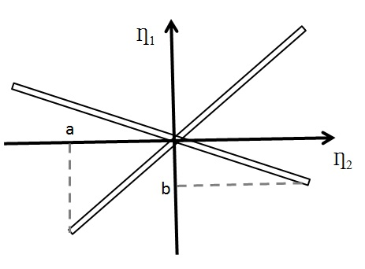
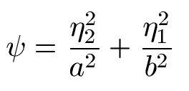
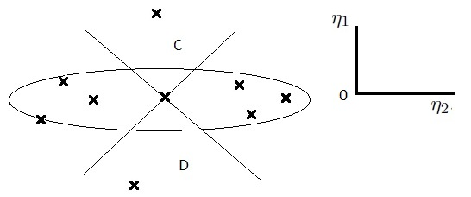
Stencil selection
Define an elliptic merit function for the points in this new coordinate system.
Reduces to the equation of a circle for more regular point distributions.
Use the merit function to select points in each quadrant around the star point.
Notes:
Main rotor figure of merit versus year of development showing sustained improvements in aerodynamic efficiency.
Hover efficiency has been more studied than forward flight, although a lot of effort is now beginning to be put into forward flight.
Rotor efficiency is commonly measured by FM. The use of FM is restricted to rotors with the same disk loading.
This curve shows that improvements have been made over the years, but that the improvements are getting smaller, suggesting that more revolutionary ways of improving rotorcraft aerodynamics is going to be required, potentially through better aerodynamic optimization techniques.
15

Slide 16
The solver and preprocessor can solve the Euler, laminar and RANS equations (with Spalart Allmaras turbulence model) in two dimensions.
There is some sensitivity to the point distributions used, particularly with the RANS equations; for example, if points overlap so they are very close together or they overlap so there are multiple points all in a straight line (resulting in a poorly conditioned least squares system).
Future work may look towards improving this with adaptive stencil schemes, which use some initial flow solution to select stencils, or simply removing difficult points from the domain.

Slide 17
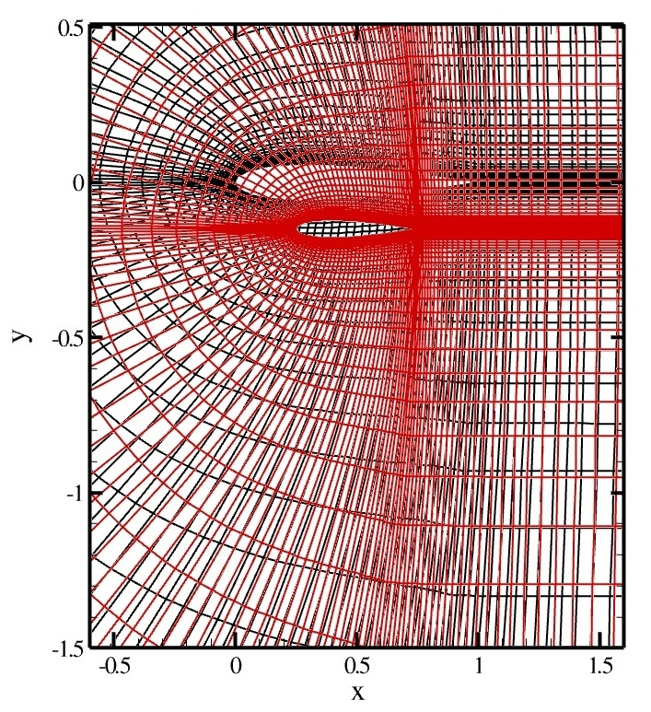
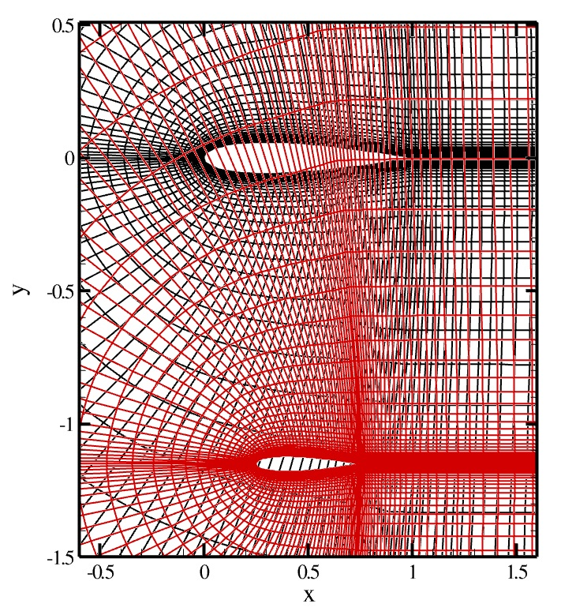
Results
NACA 0012 aerofoil with “store” located beneath. Forced descent.
Notes:
Main rotor figure of merit versus year of development showing sustained improvements in aerodynamic efficiency.
Hover efficiency has been more studied than forward flight, although a lot of effort is now beginning to be put into forward flight.
Rotor efficiency is commonly measured by FM. The use of FM is restricted to rotors with the same disk loading.
This curve shows that improvements have been made over the years, but that the improvements are getting smaller, suggesting that more revolutionary ways of improving rotorcraft aerodynamics is going to be required, potentially through better aerodynamic optimization techniques.
17

Slide 18
Results
NACA 0012 aerofoil with “store” located beneath. Forced descent.
Laminar flow.
M=0.5,
aoa=0,
Re=5000
Initial State
Pressure contours
Notes:
Main rotor figure of merit versus year of development showing sustained improvements in aerodynamic efficiency.
Hover efficiency has been more studied than forward flight, although a lot of effort is now beginning to be put into forward flight.
Rotor efficiency is commonly measured by FM. The use of FM is restricted to rotors with the same disk loading.
This curve shows that improvements have been made over the years, but that the improvements are getting smaller, suggesting that more revolutionary ways of improving rotorcraft aerodynamics is going to be required, potentially through better aerodynamic optimization techniques.
18

Slide 19
Results
NACA 0012 aerofoil with “store” located beneath. Forced descent.
Laminar flow.
M=0.5,
aoa=0,
Re=5000
Initial State
Pressure contours
Notes:
Main rotor figure of merit versus year of development showing sustained improvements in aerodynamic efficiency.
Hover efficiency has been more studied than forward flight, although a lot of effort is now beginning to be put into forward flight.
Rotor efficiency is commonly measured by FM. The use of FM is restricted to rotors with the same disk loading.
This curve shows that improvements have been made over the years, but that the improvements are getting smaller, suggesting that more revolutionary ways of improving rotorcraft aerodynamics is going to be required, potentially through better aerodynamic optimization techniques.
19

Slide 20
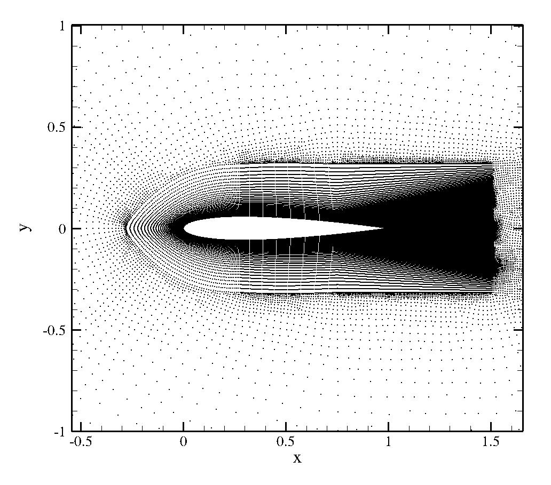
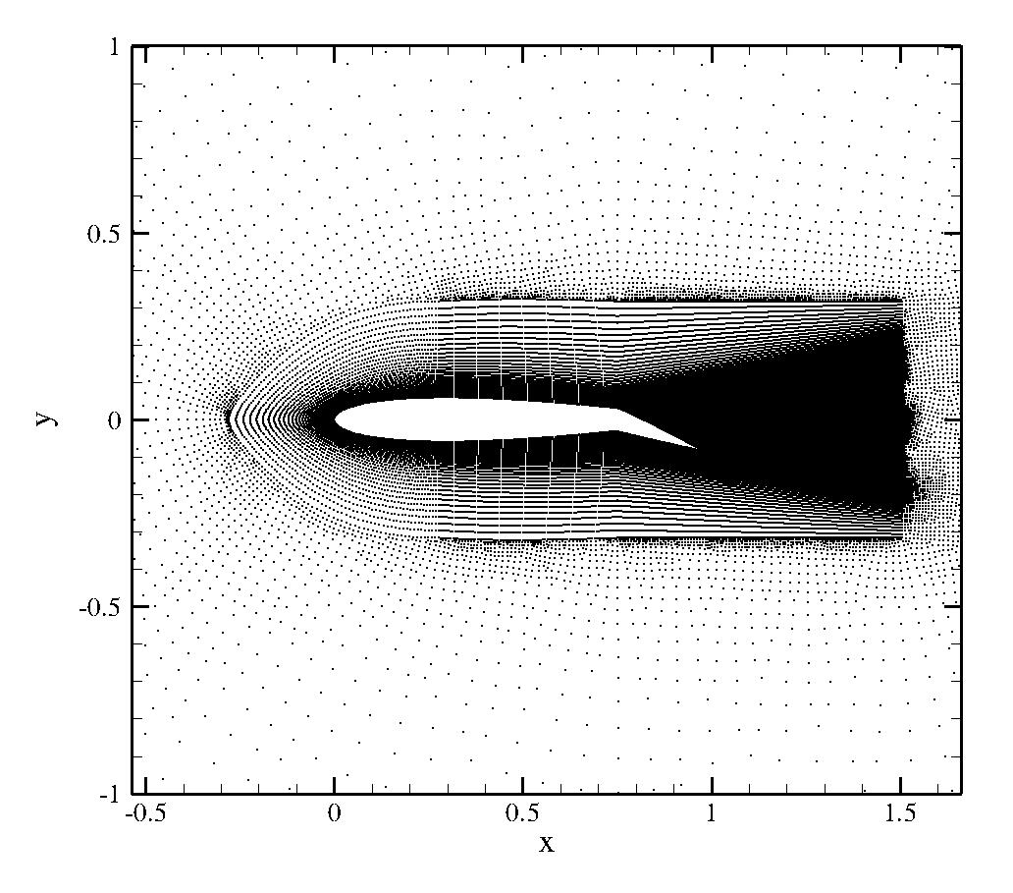
Results
Two input domains consisting of a truncated NACA 0012 aerofoil (body) and control surface overlap at various control surface angles of deflection.

Slide 21
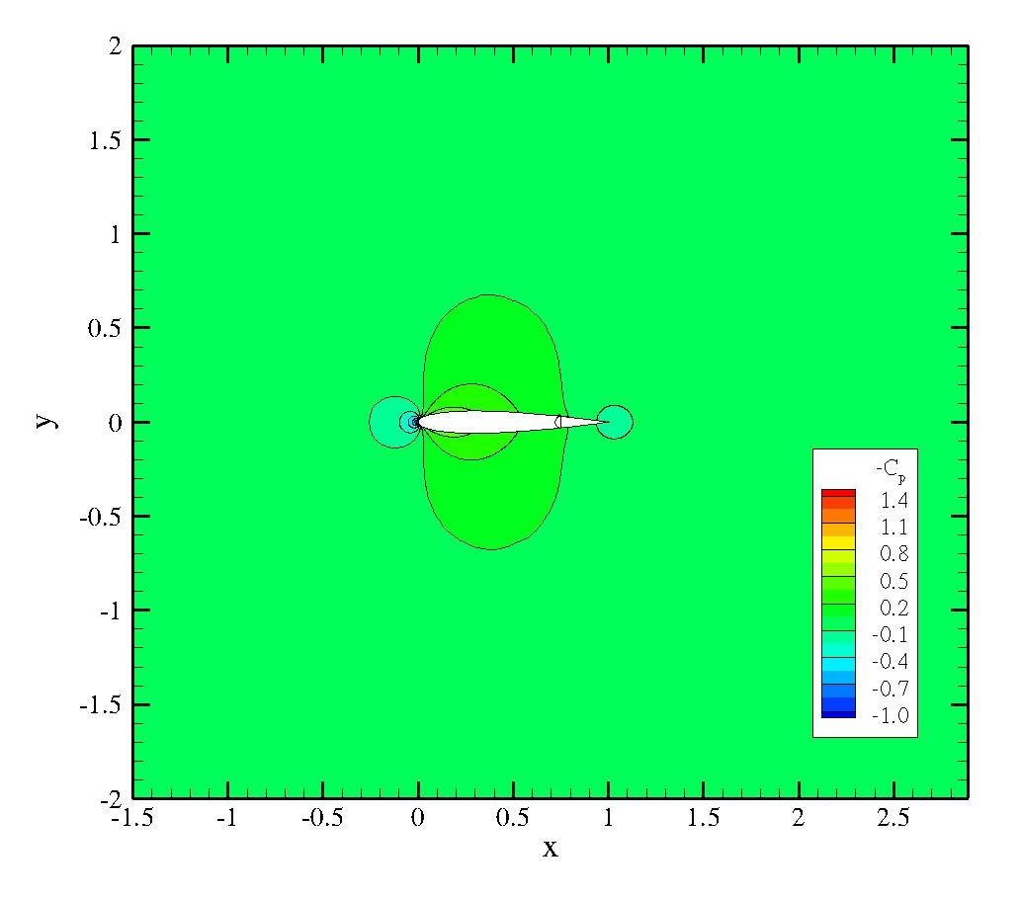
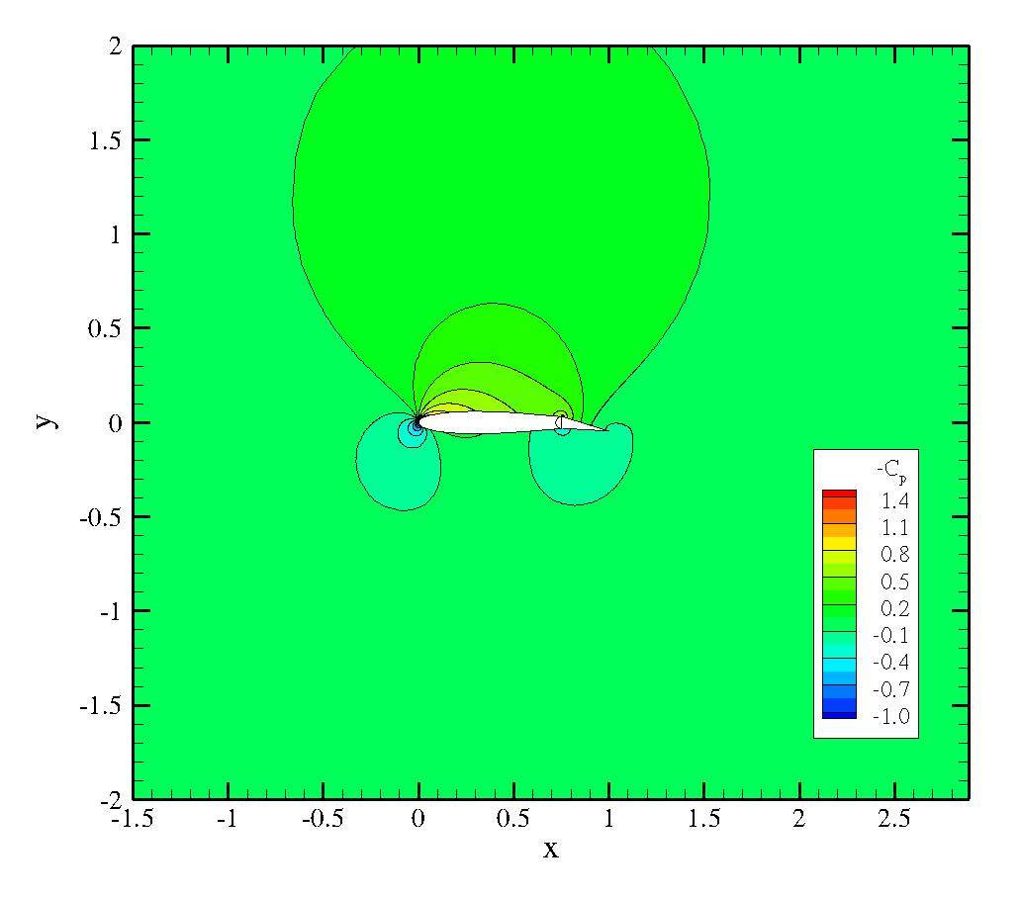
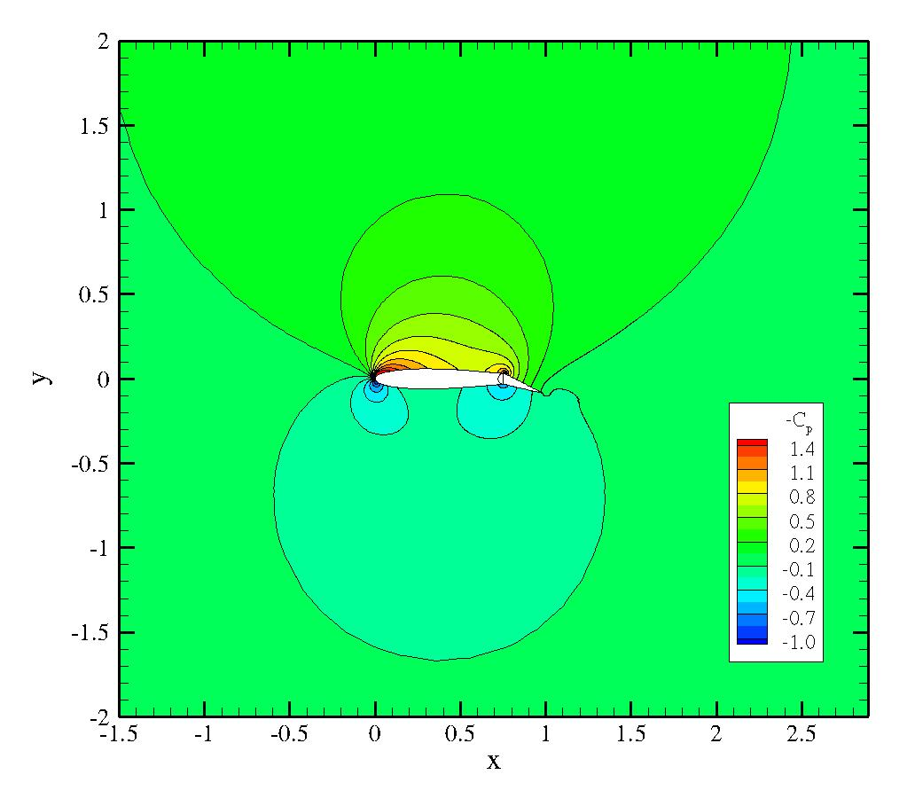
RANS results at M=0.2 and Re=5 million at 0°, 10° and 20° control surface angle of deflection.

Slide 22
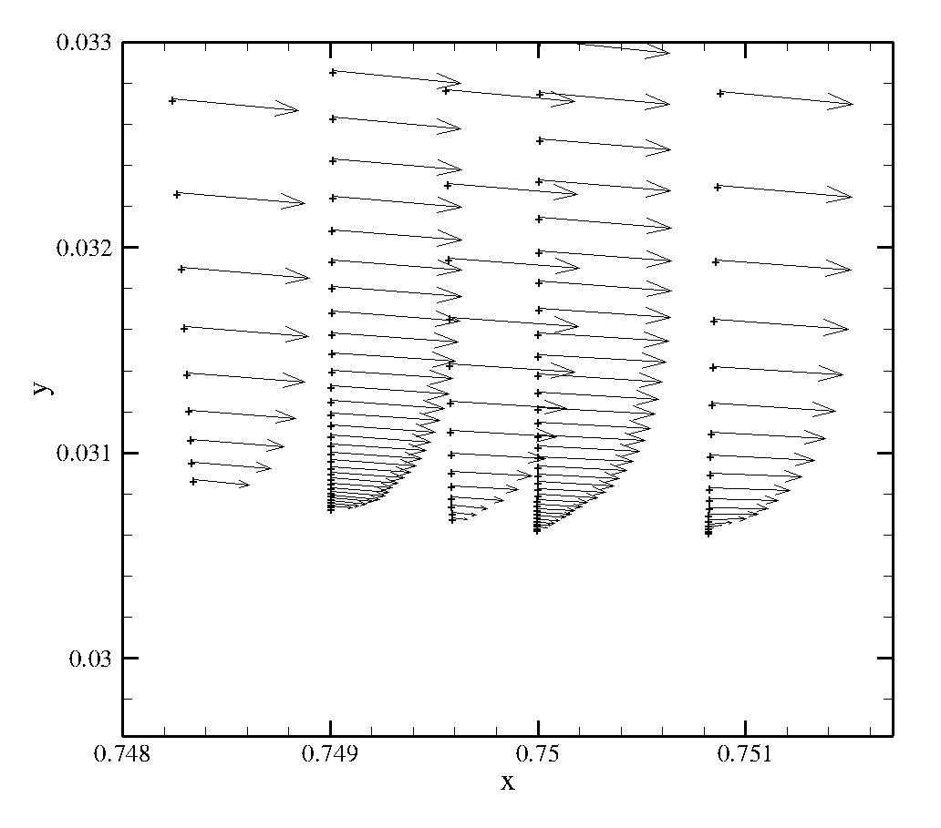
Points belonging to control surface
Results
Close up of the boundary layer region at the junction between the two bodies (at x=0.75).
Points belonging to body

Slide 23
Inviscid control surface deflection, unsteady test case.
Mach 0.3
Control surface deflection +/-5°.
Pressure contours.

Slide 24
Stencil selection changes for 3D
2D and 4D search trees 3D and 6D search trees
Segments intersecting Elements intersecting
Ray-segment intersections Ray-element intersections
Elliptical merit function Ellipsoidal merit function
Quadrant search Variation on octant search

Slide 25
Check for boundary overlap
1
1
2
2
Check if element 1 intersects the plane containing element 2 using scalar product with normal.

Slide 26
Find the line (in green) that defines the intersection between the plane containing element 1, and the plane containing element 2. This line must exist because of the previous test.
1
The elements intersect one another ONLY if both elements intersect the line with line intervals that overlap ........
2

Slide 27
More robust to take a projection of the elements onto a 2D plane.
1
1
No intersection
2
2
1
Intersection
2

Slide 28
X_{2,1}
In
n₁
2
n₁
2
X_{2,2}
In
1
x_{centre,1}
1
Out
X_{2,3}
Normal tests to determine which points do not form the continuation of the new boundary.

Slide 29
Edge
Edge
Two bodies intersect. We use the complete edges of the original elements as a base to create the new elements, which will be triangles.
Body 1
Body 2
Edge
Edge
Edge
Determine the list of candidate points for the third point, belonging to the other body, for each edge.
Body 1
Body 2
Edge

Slide 30
Body 1
Body 2
A form of Delaunay triangulation is performed to create the new elements (shown in red) to join the two bodies where the boundary elements intersected.

Slide 31
Blanking points
The same as the 2D method with rays intersecting elements instead of line segments.
Very simple to find where the ray
between 2 points intersects the plane
containing an element.
Project the intersection point and
element coordinates onto a 2D plane
(prevents underflow).
Determine if the point lies inside the
element.

Slide 32
Blanking
The method of blanking points that lie inside a solid body is then the same as
for the 2D case.
For the flood operation, the same function in the code is used for both the
2D and 3D cases.
It only remains to select the stencils.......

Slide 33
Defining the local resolving vector in 3D
We define the resolving vector from the coordinates of the points in the original
grid stencil.
Find the principal axes of inertia from the inertia tensor (eigenvalues) of the points.
There are, in 3D, two possible directions of anisotropy.

Slide 34
z
Defining the local resolving vector in 3D
y
x
z
y
x

Slide 35
Selecting the points
Same procedure of summing resolving vectors. The merit function is now an ellipsoid in the new basis.
In 2D we then select the best points within quadrants around the star.
Ƞ1
Ƞ3
In 3D there is a cone pointing in each direction of “non anisotropy”, which is divided into quadrants. The remaining sectors are also split into quadrants in the plane of anisotropy – 12 sectors and 26 points in total are selected.

Slide 36
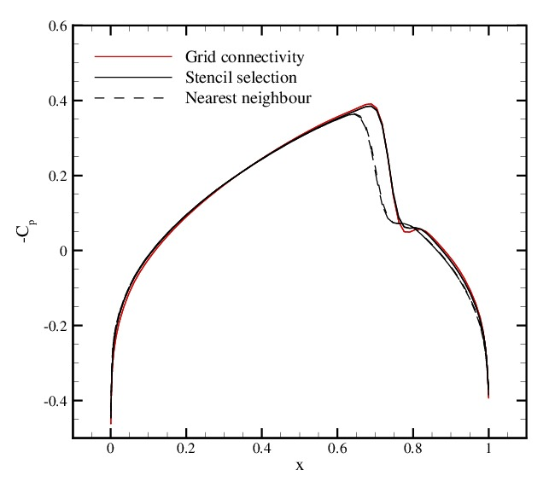
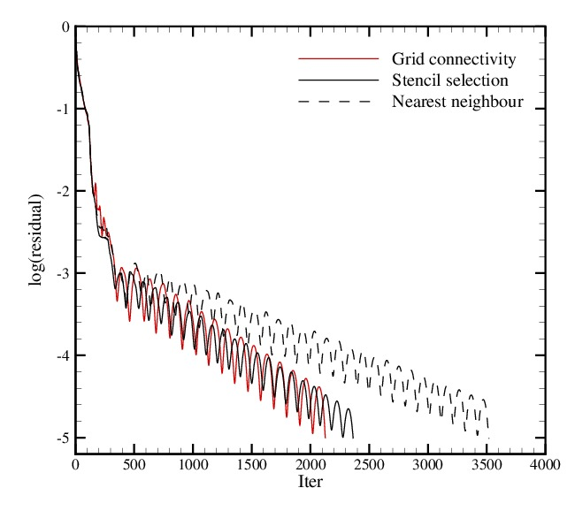
Latest results
Used the stencil selection on the Goland wing on its own. Euler results are compared with the solution obtained using the original grid connectivity in PML and a simple nearest neighbour algorithm.
Mach 0.9 and slice at 15% of span length from the root.

Slide 37
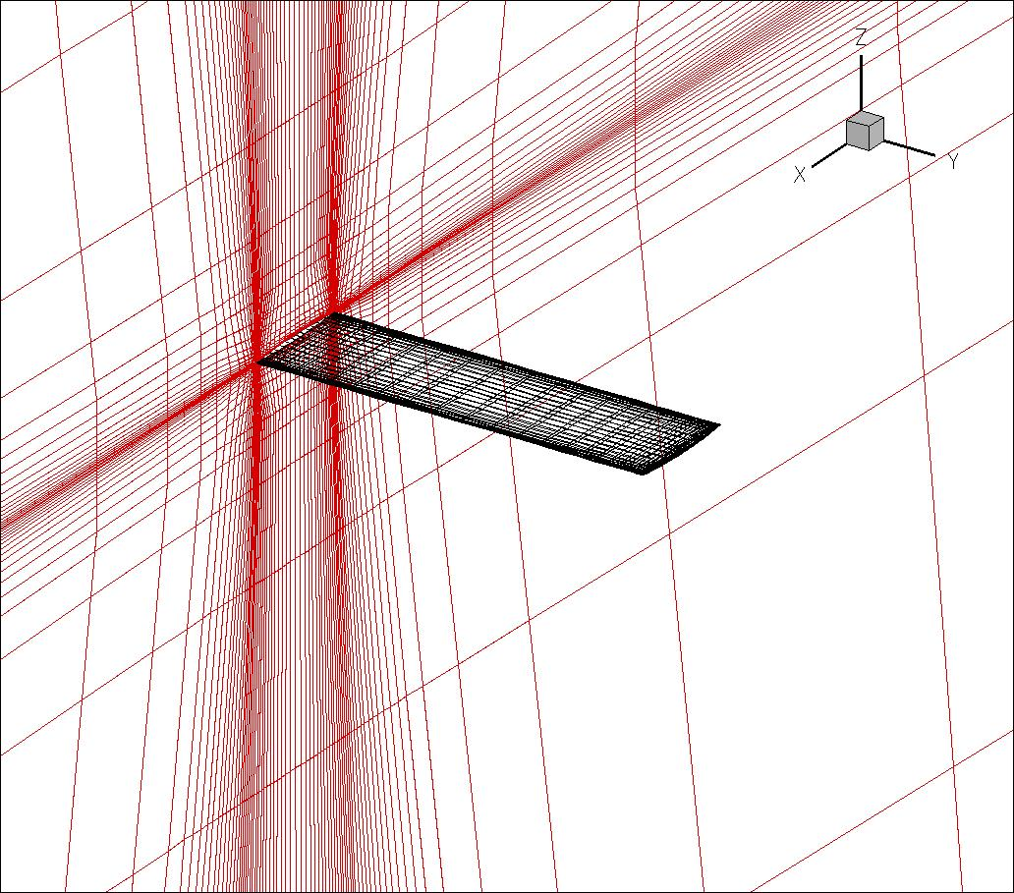
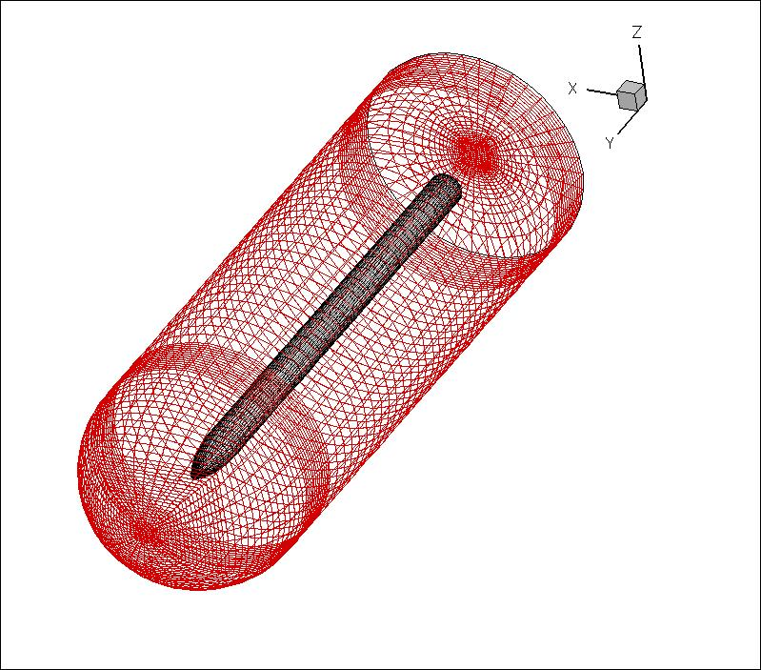
3D sample test case
Overlap the meshes for the Goland wing (187523 points) shown before and a simple store geometry (62623 points).

Slide 38
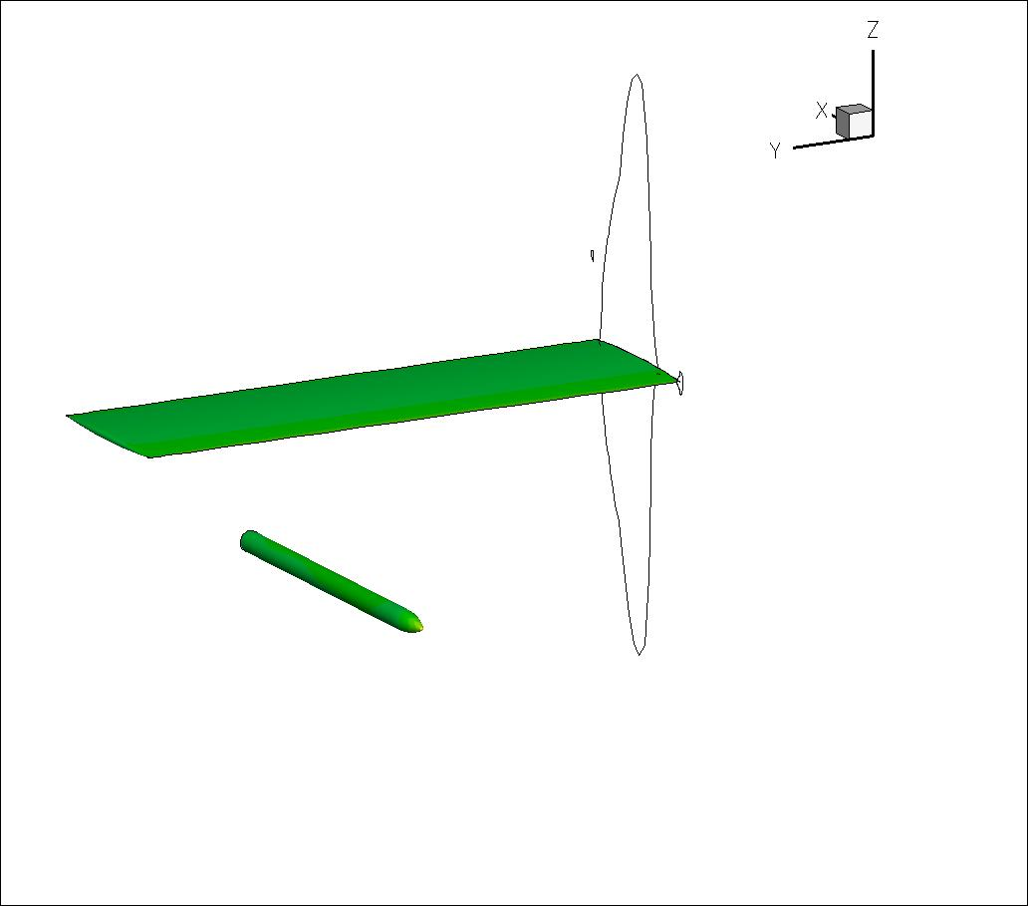
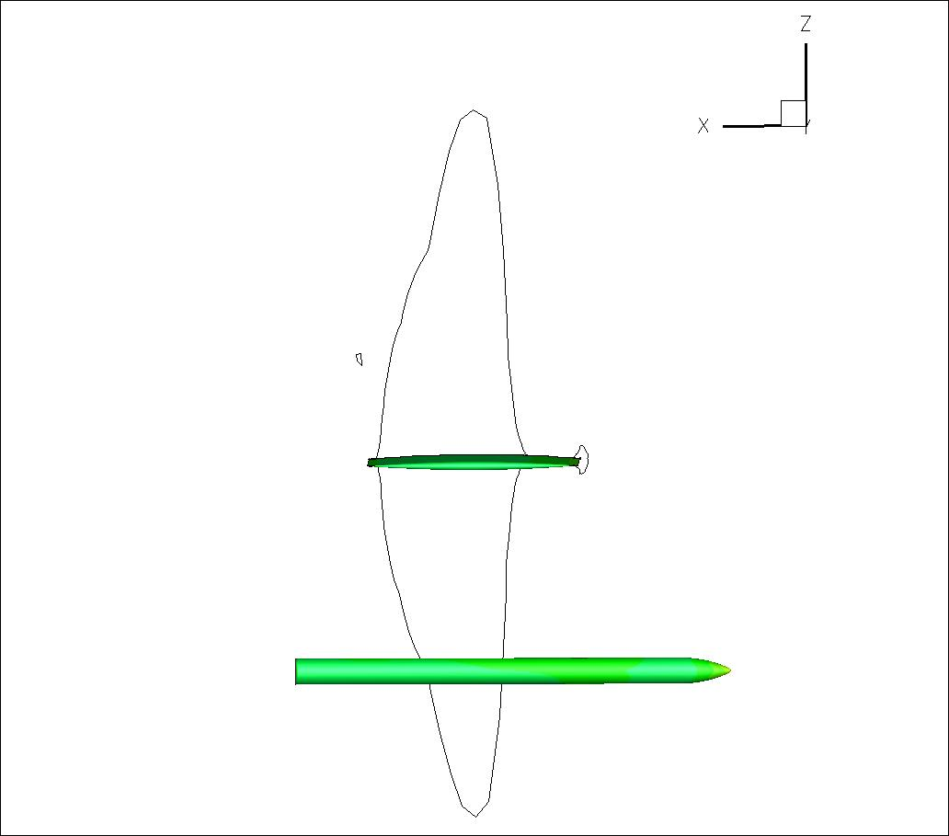
Latest results
Store release test case converges in a first order simulation.
Inviscid pressure contours at Mach 0.8 and 0° angle of attack.

Slide 39
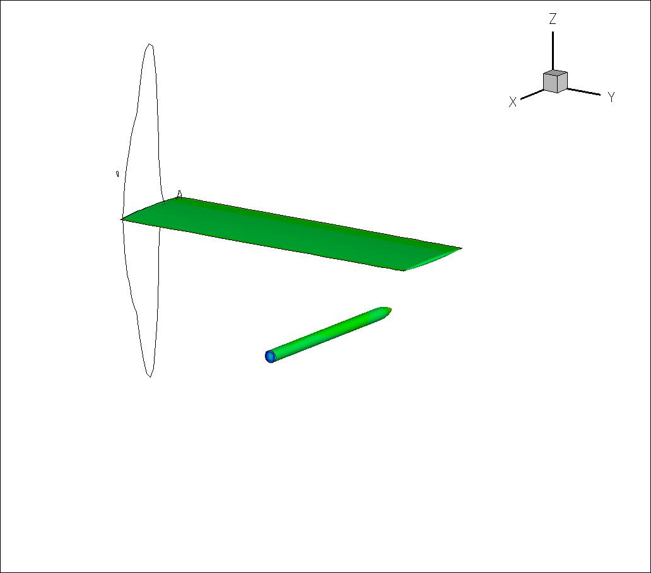
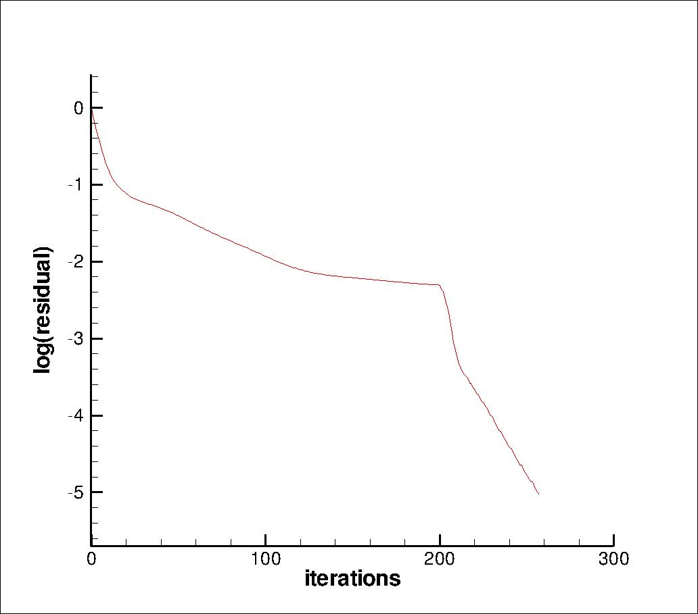
Latest results
Store release test case converges in a first order simulation.
Pressure contours at Mach 0.8 and 0° angle of attack.

Slide 40
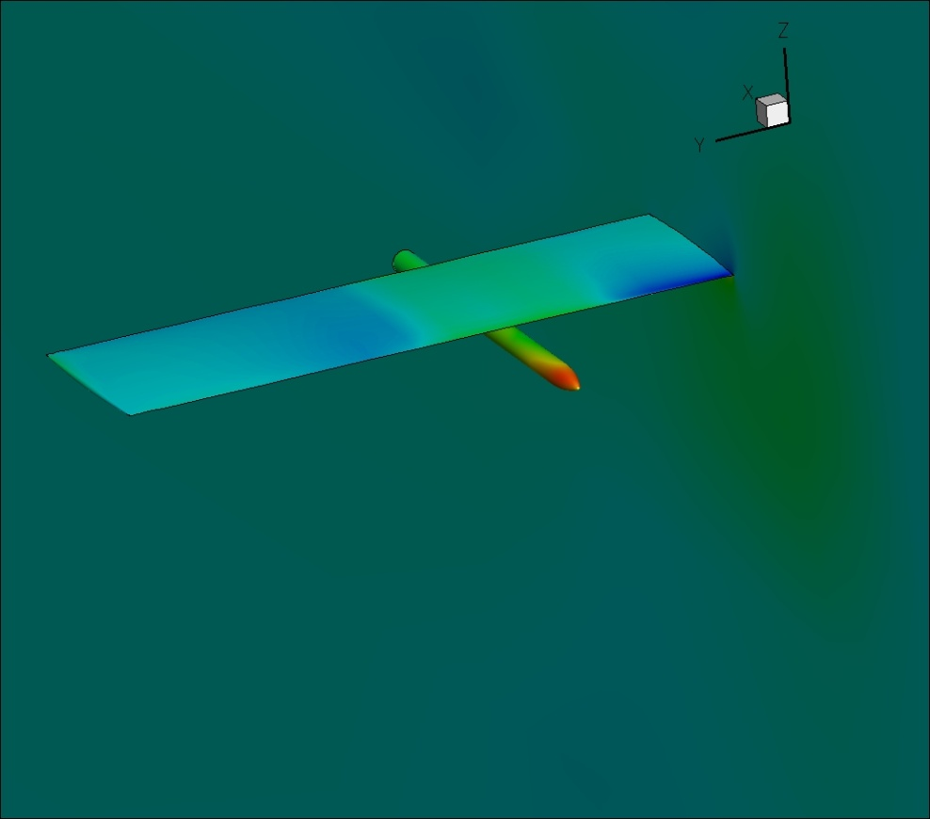
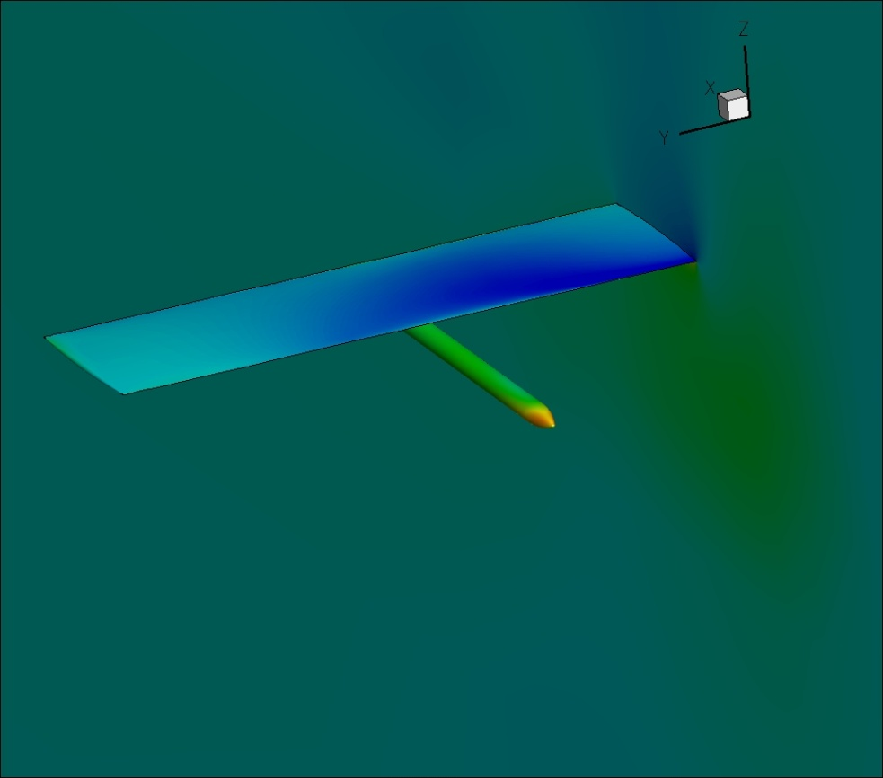
Unsteady, moving body simulation. Second order inviscid results at Mach 0.5.
Pressure coefficient plots.
Total of 0.25 million points.
Relative cost per time step : Stencil selection time ~6 sec.
Solver time ~37 sec

Slide 41
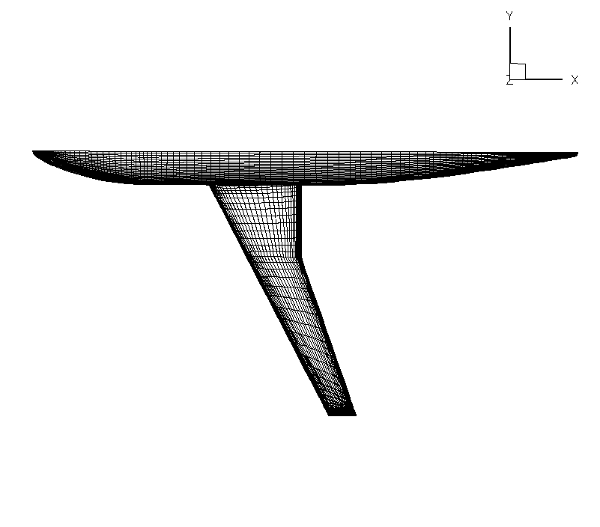
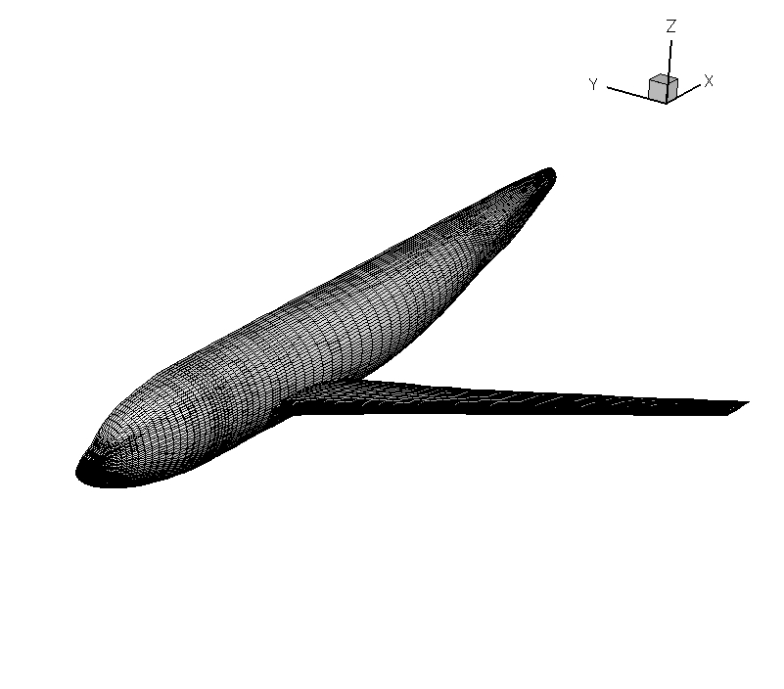
DLR F6 fuselage-wing configuration
Fuselage (including symmetry plane and far field) of 2.5 million points and wing geometry of 0.6 million points intersecting to form configuration.
Stencil selection time approximately 2 minutes.

Slide 42
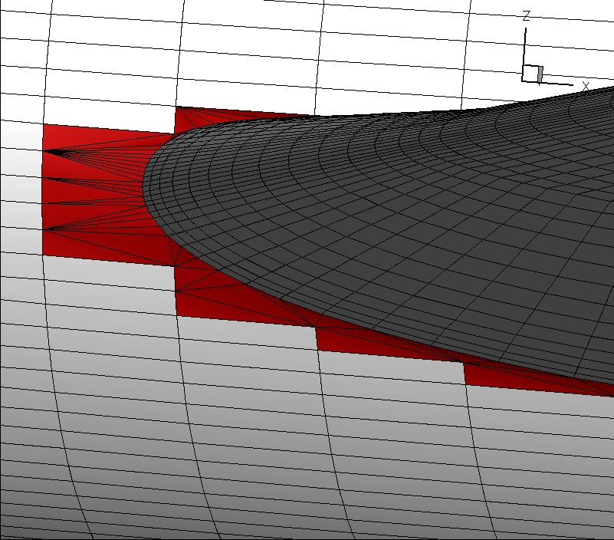
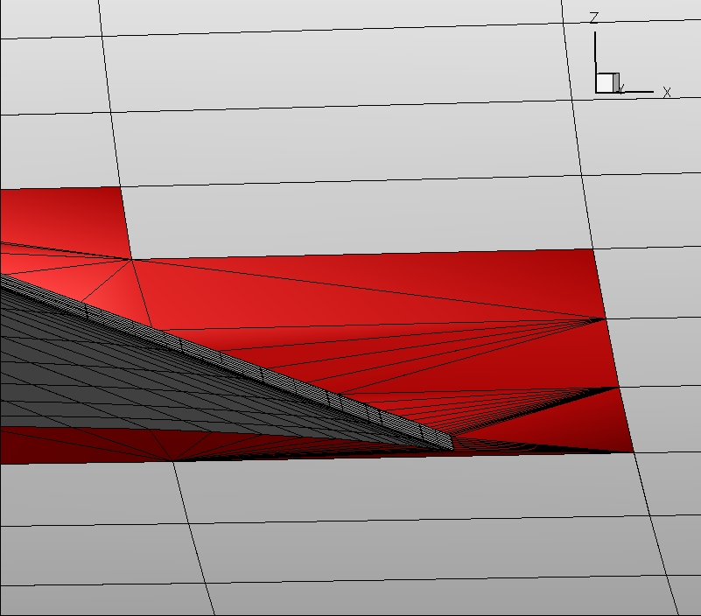
DLR F6 fuselage-wing configuration
Close up of intersection location and the new elements created (in red), which are all triangles, linking the two bodies.

Slide 43
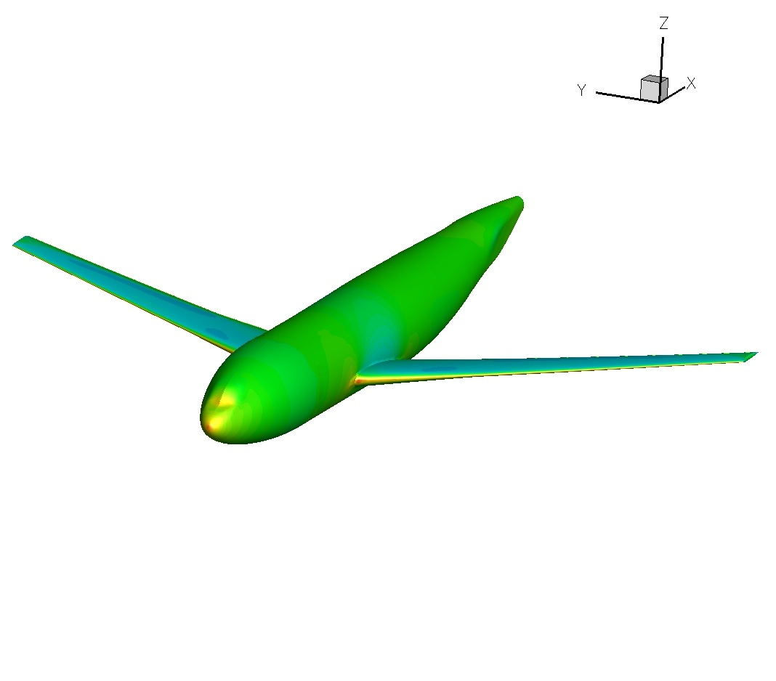
DLR F6 fuselage-wing configuration
Pressure contours for M=0.8, AoA=0.0° inviscid flow conditions.

Slide 44
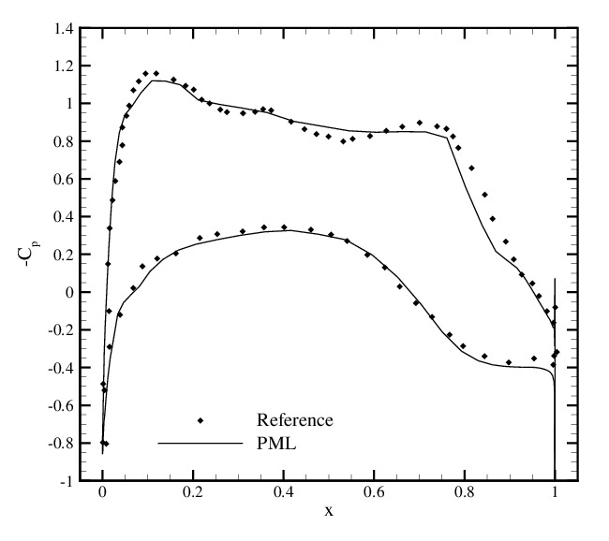
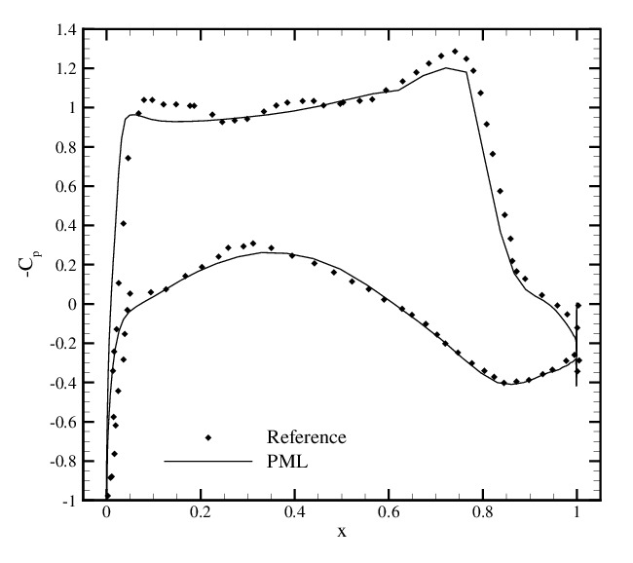
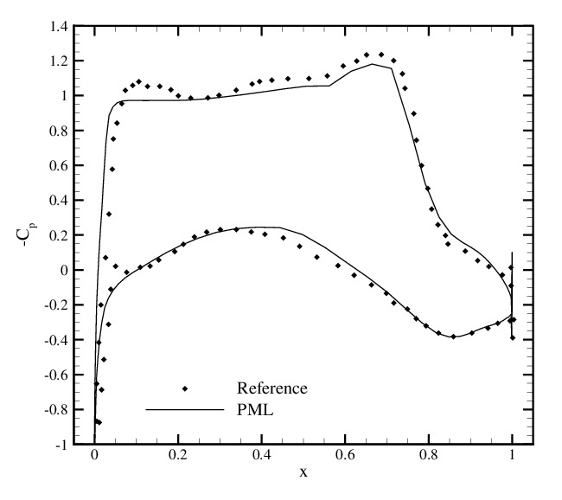
Pressure cofficient plots at 25%, 50% and 75% span length from the wing root.
Results are compared with data from:
Martin, Andrés, Widhalm, Bitrián, Lozano “CAD-based Aerodynamic Shape Design Optimisation with the DLR Tau Code” Paper ICAS 2010-2.6.1 27th Congress of International Council of the Aeronautical Sciences, 2010, Nice, France

Slide 45
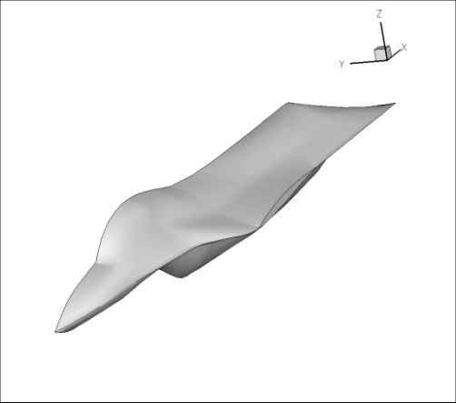
Open Source Fighter (OSF) case
Fuselage
Wing
Launcher
Hor/Vert Stabiliser

Slide 46
Open Source Fighter (OSF) case
Pressure contours for M=0.85, AoA=2.12° inviscid flow conditions.

Slide 47
Open Source Fighter (OSF) case
Pressure coefficient plots at spanwise location 59% and 85% for M=0.85, AoA=2.12° inviscid flow conditions.

Slide 48
Open Source Fighter (OSF) case

Slide 49
Future
Test procedure for moving domains.
Simulate store release from fighter using parallel preprocessor.
Will look into adaptive stencil selections and the possibility of adding/removing points to improve accuracy and convergence.
Robust solver and stencil selection to solve RANS equations.
Publications
D.J. Kennett, S. Timme, J. Angulo, K.J. Badcock, “Semi-Meshless Stencil Selection for Anisotropic Point Distributions” International Journal of Computational Fluid Dynamics, 2012, Vol. 26, No. 9-10, pp. 463-487
D.J. Kennett, S. Timme, J. Angulo, K.J. Badcock, “An Implicit Meshless Method for Application in Computational Fluid Dynamics” International Journal for Numerical Methods in Fluids, 2012, doi:10.1002/fld.3698

Slide 50
PML with SOLAR
Visited Filton for 4 weeks Jan-Feb 2012 with the main purpose of implementing a SOLAR->PML output, so that SOLAR meshes could be used with PML.

Slide 51
PML with SOLAR
PML can only work with triangles and quadrilateral elements on the surfaces; so a triangulation of elements larger than this was performed on the SOLAR meshes.
Stencils were created for each point, using the points making up the cells that the point belonged to.
Too large to run using implicit solver.
Too unstable for second order.
Run through meshless preprocessor to limit the size of stencils.

Slide 52
PML with SOLAR
M6 wing.
280 thousand points.
M=0.84
Aoa=3.06°

Slide 53
PML with SOLAR

Slide 54
PML with SOLAR

Slide 55
PML with SOLAR

Slide 56
PML with SOLAR

