Slide 2
Model Order Reduction and Control of Flexible Aircraft
N.D.Tantaroudas
K.J.Badcock,A.Da Ronch
University of Liverpool, UK
Southampton, 10 October 2013
FlexFlight: Nonlinear Flexibility Effects on Flight Dynamics
Control of Next Generation Aircraft

Slide 3
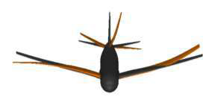
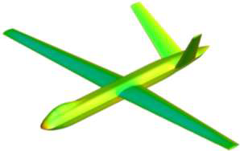
Overview
Model Reduction
2dof aerofoil-Experimental Investigation
- Model Identification
Linear ROM+Control(Linear Aero)-Flutter Suppression by LQR
UAV configuration-Beam Code
- Model Identification of the Structural Model-Implementation(Beam Code)
- Model Order Reduction
- Control design Using Reduced Models for Worst Gust Case
Flight Dynamics of Flexible Aircraft
Rigid Body Case
Flexible Case/Rigid Body coupled with Structural Dynamics
Nonlinear Controller synthesis
Feedback-I/O Linearization
SOS and SDP for Lyapunov Based Approaches

Slide 4
Model Reduction
eigenvalue problem of Jacobian A
FOM projection onto aeroelastic eigenmodes
Da Ronch, A., Tantaroudas, N.D., Timme, S., and Badcock, K.J., "Model Reduction for Linear and Nonlinear Gust Loads Analysis," 54th AIAA/ASME/ASCE/AHS/ASC Structures, Structural Dynamics, and Materials Conference, Boston, Massachusetts, 08-11 Apr. 2013. doi: 10.2514/6.2013-1492

Slide 5
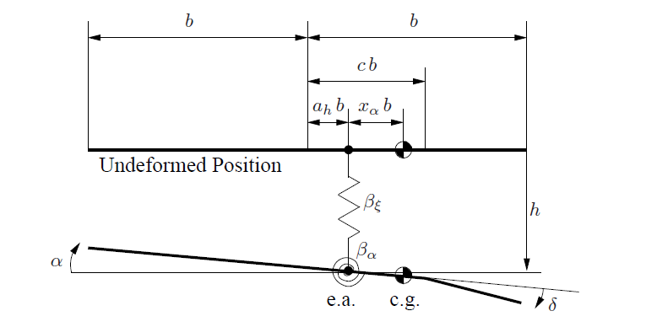
2Dof-Aerofoil-Experimental Investigation 1/8
2dof of freedom aerofoil
-FOM/NFOM-12 states
-ROM/NROM-2/3(gust)
LQR control
Based on ROM
Applied on FOM/NFOM
Flutter Suppression
Gust Load Alleviation
Papatheou, E., Tantaroudas, N. D., Da Ronch, A., Cooper, J. E., and Mottershead, J. E., ”Active
Control for Flutter Suppression: An Experimental Investigation,” IFASD–2013–8D, International
Forum on Aeroelasticity and Structural Dynamics (IFASD), Bristol, U.K., 24–27 Jun, 2013

Slide 6
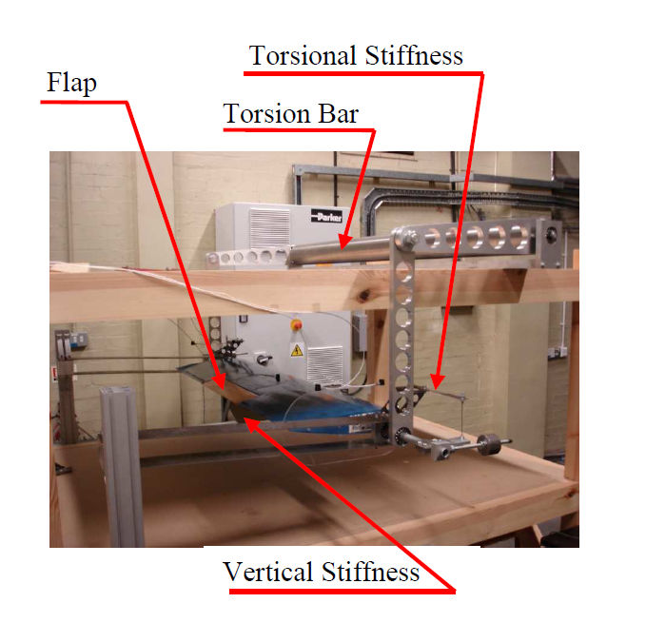
2Dof-Aerofoil-Experimental Investigation 2/8
Experimental Setup
Model Matching

Slide 7
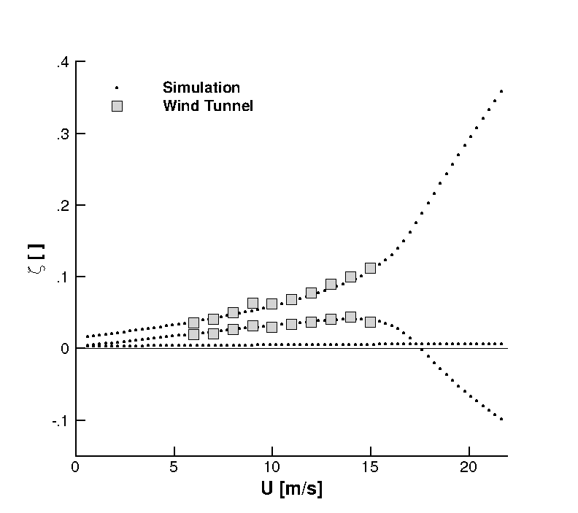
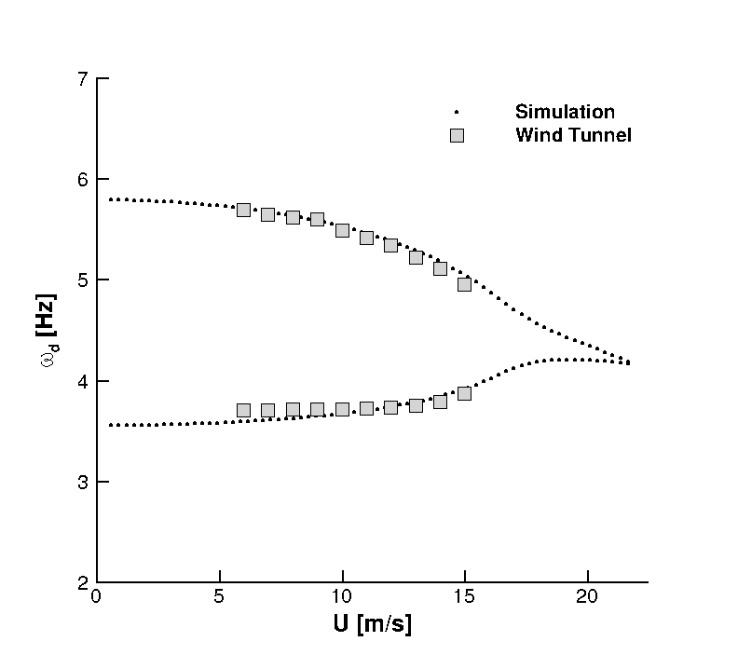
2Dof-Aerofoil-Experimental Investigation 3/8
Model Matching
Experimental Flutter Speed:17.5 m/s
Simulation Flutter Speed:17.63 m/s

Slide 8
2Dof-Aerofoil-Experimental Investigation 4/8
Control Approach-Algorythm- Linear Quadratic Regulator
Calculate ROM at a certain freestream speed.
Formulate Control Problem by splitting the states in Real and Imaginary parts
2) Derive Reduced Matrices to form dynamics:
3) Solve Riccati:
4)Minimize Cost Function:
5)Feedback: which leads to a state feedback

Slide 9
2Dof-Aerofoil-Experimental Investigation 5/8
Control Approach-Algorythm
Assume an equivalent control by
using the Eigenvectors :
7) Solve Linear System : to calculate new feedback gain
8)Full State Feedback:
9) Using what is measurable
10)Feedback Implementation-Integration Scheme(FOM Closed Loop)
11)Flap rotation contstrained:

Slide 10
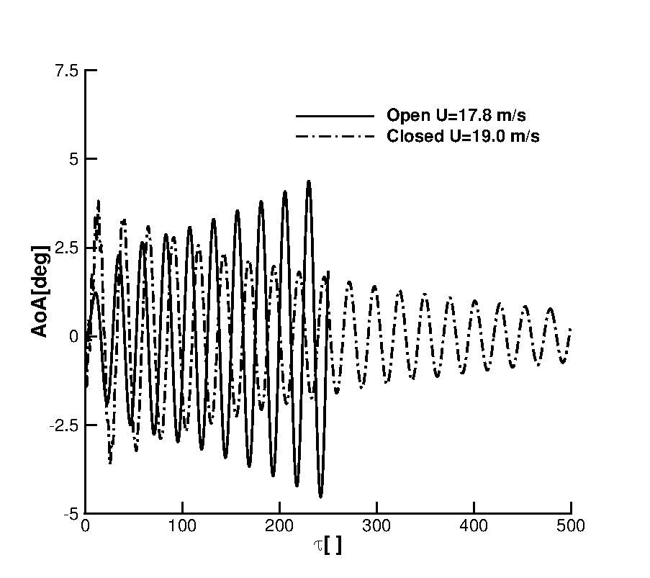
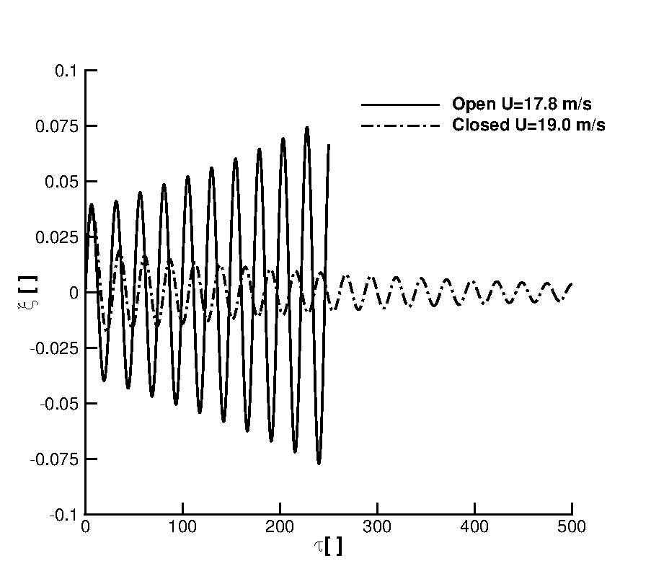
2Dof-Aerofoil-Experimental Investigation 6/8
Initial Plunge Velocity:0.01
Flutter:17.63m/s

Slide 11
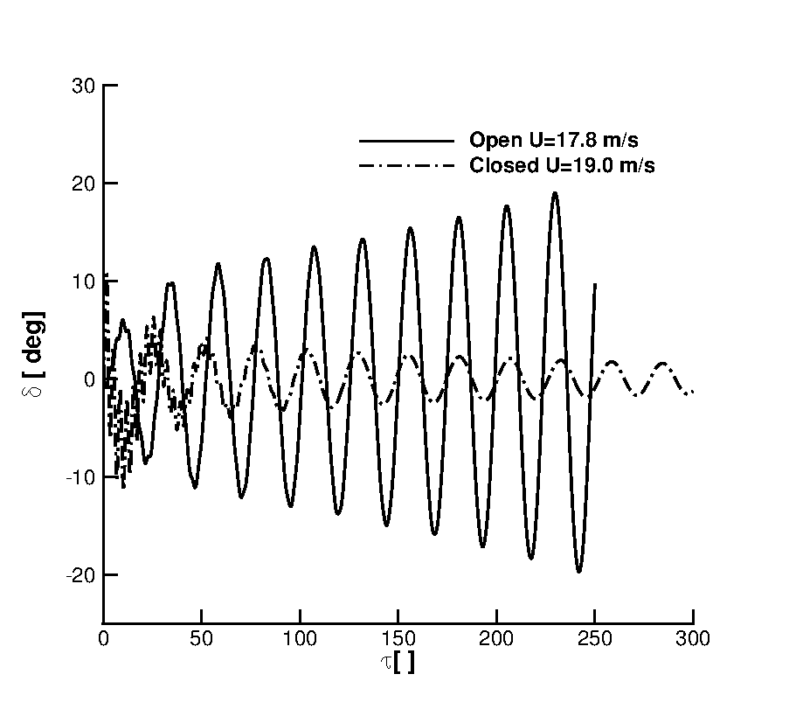
2Dof-Aerofoil-Experimental Investigation 7/8
Realistic Flap deflection
Initial Plunge Velocity:0.01

Slide 12
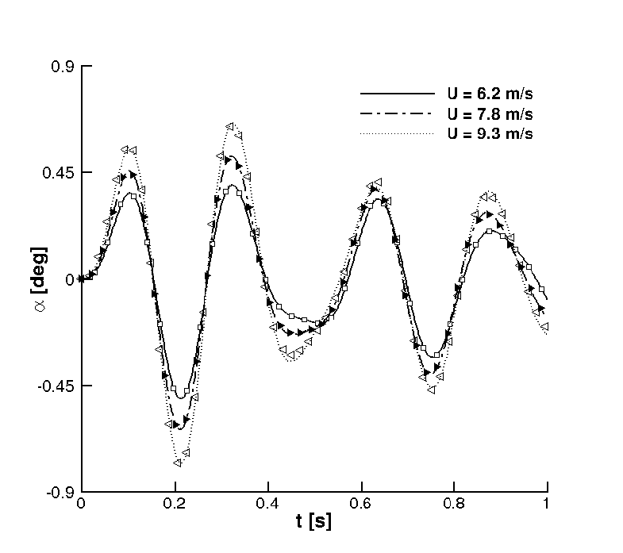
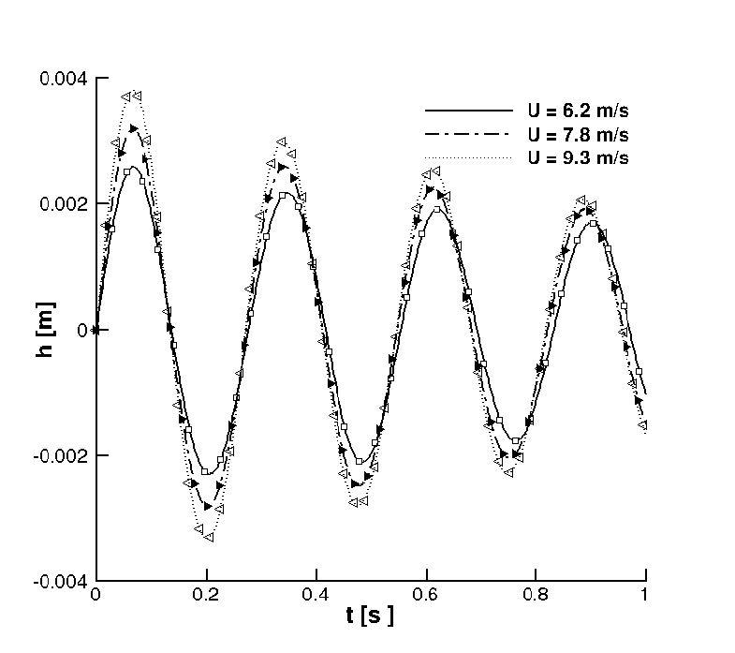
2Dof-Aerofoil-Experimental Investigation 8/8
ROM in the freestream speed
Compensate for Controller’s Adaptivity
Initial Plunge Velocity:0.01
Da Ronch, A., Tantaroudas, N. D., Badcock, K. J., and Mottershead, J. E., ”Aeroelastic Control of
Flutter: from Simulation to Wind Tunnel Testing,” Control ID: 1739874, AIAA Science and Technology
Forum and Exposition, National Harbor, MD, 13–17 Jan, 2014

Slide 13
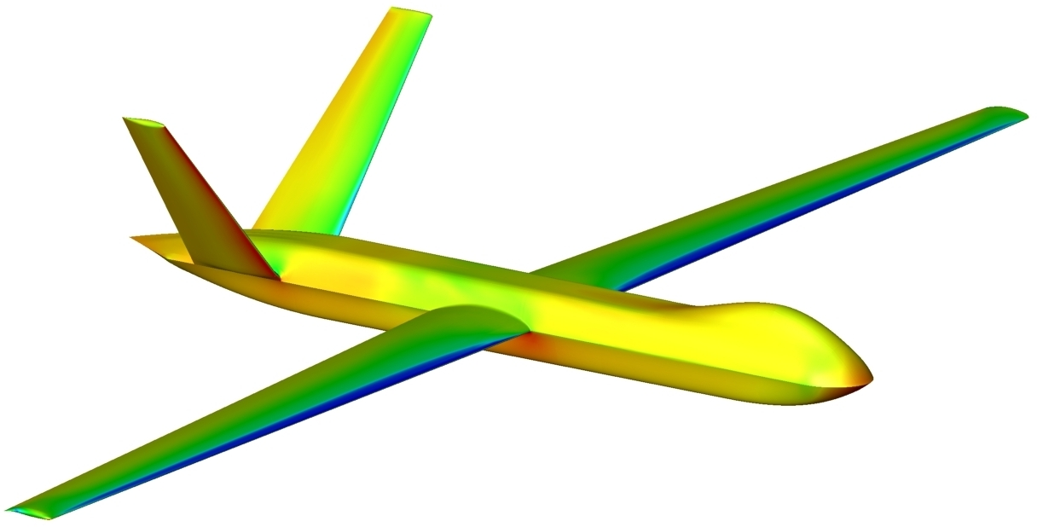
UAV Configuration
DSTL UAV[P. Hopgood]
Wing
-Span:16.98m
-Taper Ratio:0.44
-Root Chord:1.666m
-Tip Chord:0.733m
-Control Surface:16/100chord
Tail
-Dihedral:45deg
-Taper Ratio: 0.487
-Root Chord:1.393m
-Tip Chord:0.678m
-Control Surface:25/100 chord

Slide 14
Model Identification
Beam Reference system –j-node:
Finite Element equation-dimensional form :
Modal Analysis(Nastran)
Match the frequency of the most important Bending Modes
Match the Shape of the deformation
Limitations
High frequency modeshapes difficult to be matched

Slide 15
Mode Identification
Part | Original Model -Hz | Beam Model –Hz | Modeshape
Wing | 3.56 | 3.48 | Wing First Bending
Wing | 7.75 | 6.99 | Wing Second Bending
Wing | 11.5 | 7.79 | Wing First In-Plane Bending
Wing | 14.9 | 12.20 | Wing First Torsion
Wing | 15.7 | 17.6 | Wing Third Bending
Wing | 24.6 | 27.6 | Wing Fourth Bending
Tail | 45.4 | 34.8 | Tail First Bending
Tail | 94.1 | 87.9 | Tail First Torsion

Slide 16
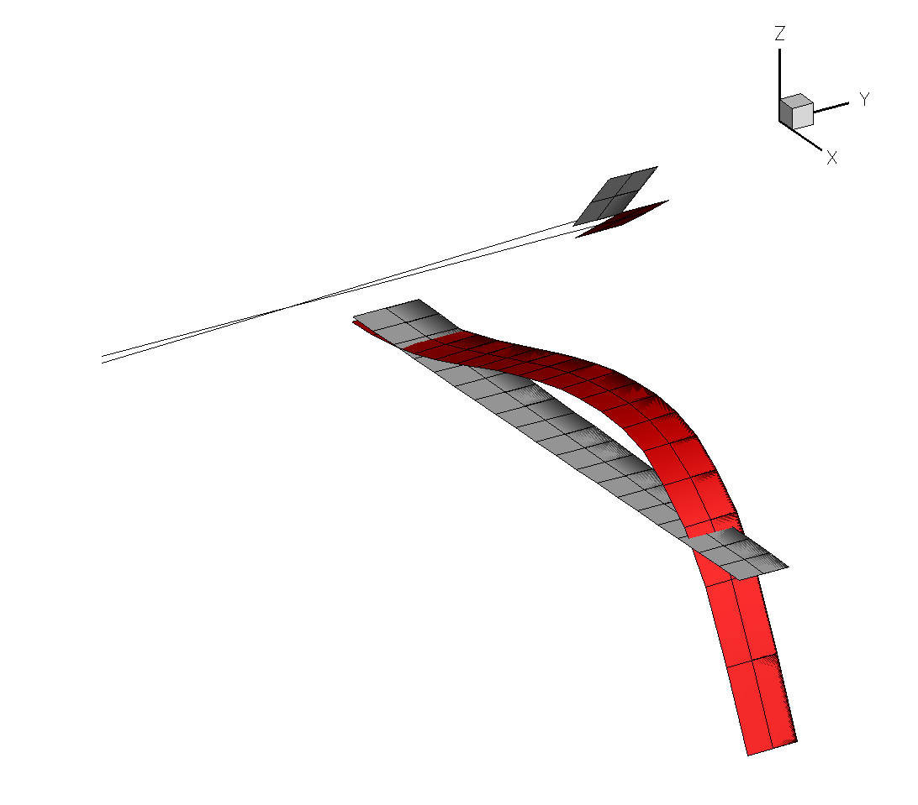
Model Identification
f=3.48Hz

Slide 17
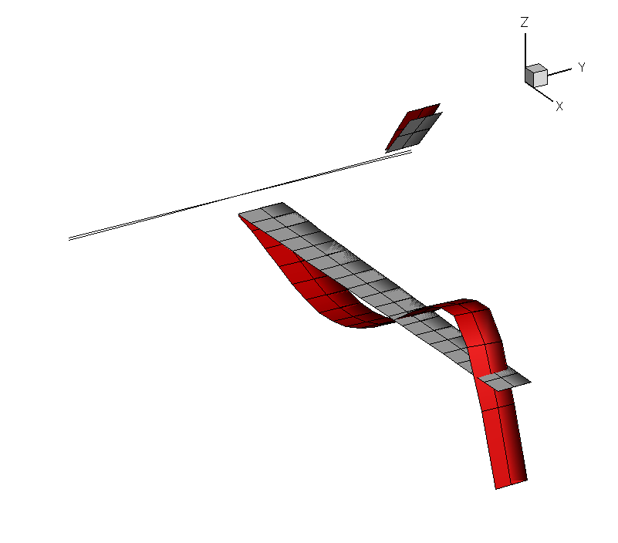
Model Identification
f=6.99Hz

Slide 18
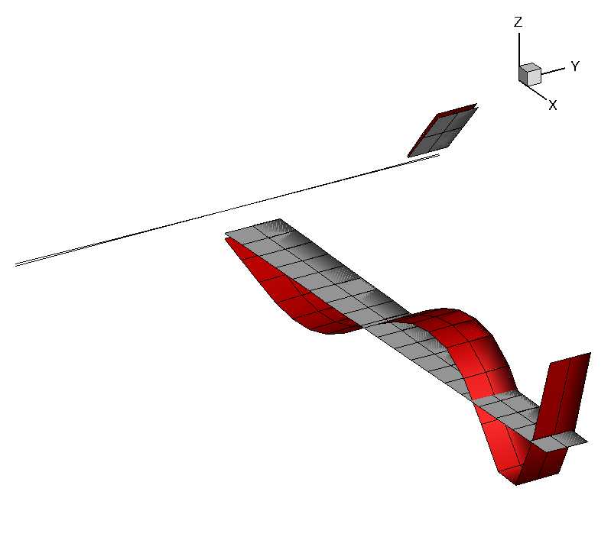
Model Identification
f=1 17.60Hz

Slide 19
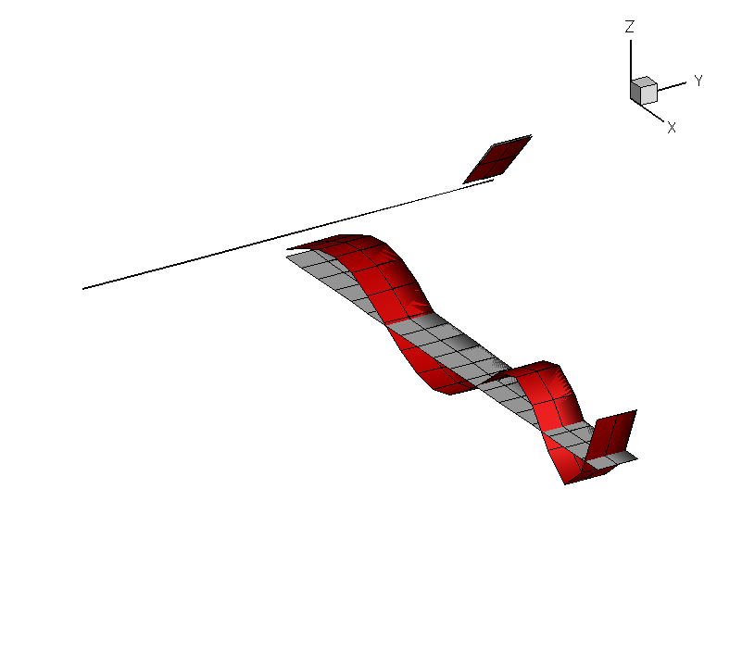
Model Identification
f= 27.6 Hz

Slide 20
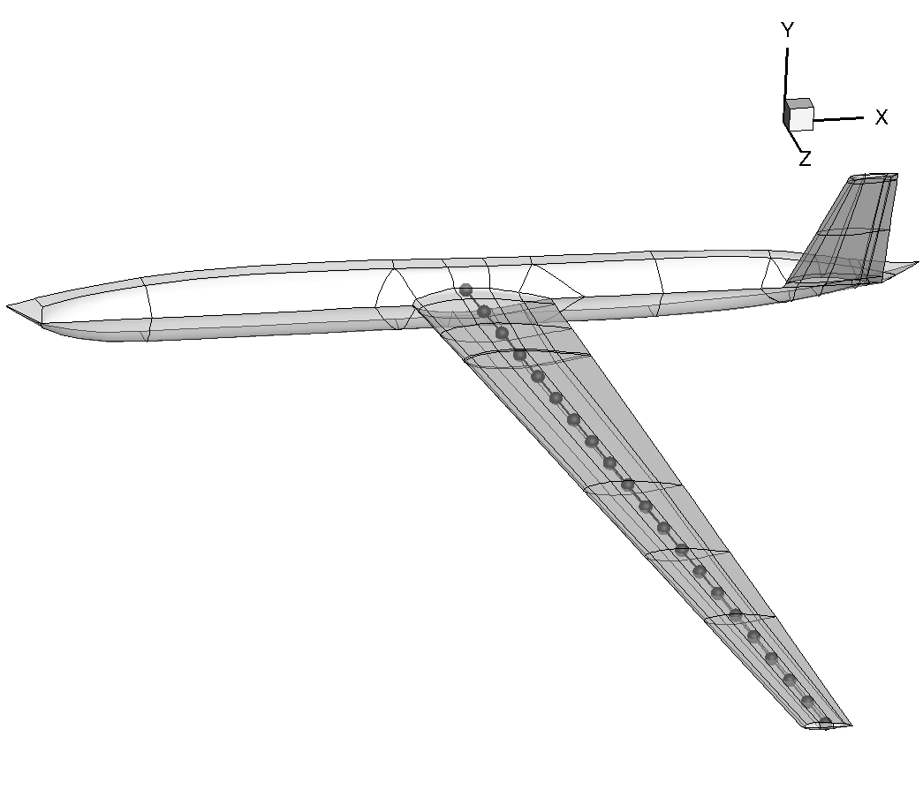
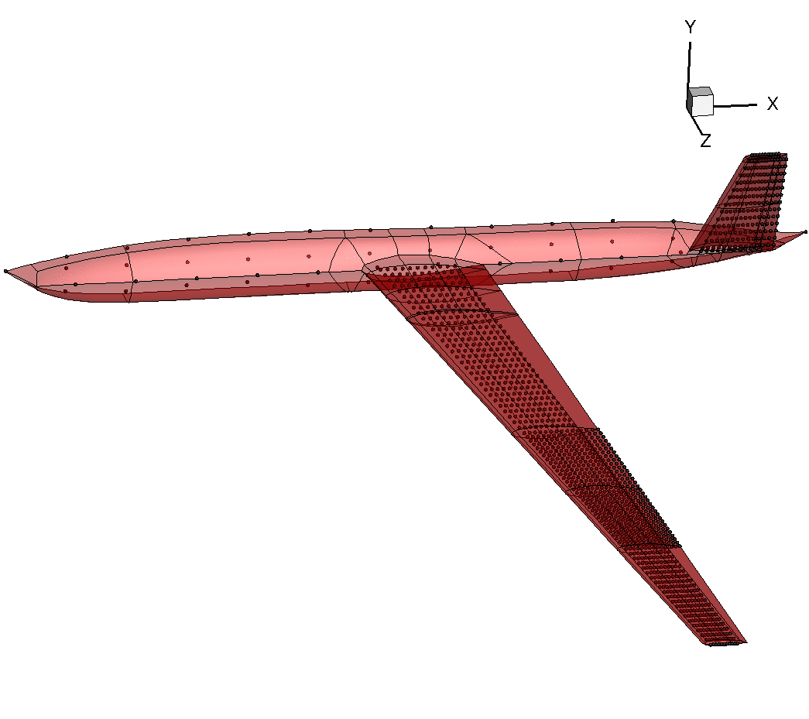
Implementation
Beam Model-20 Nodes

Slide 21
Reduced Models for Worst Case Gust
Assume Gust shape
Generate Matrices for Reduced Model(once)
Identify worst case ROM Reduction In Computational Time
Control Based on ROM->Control applied on the FOM/NFOM
NFOM/FOM
ROM
Worst Case Gust
ROM/NROM

Slide 22
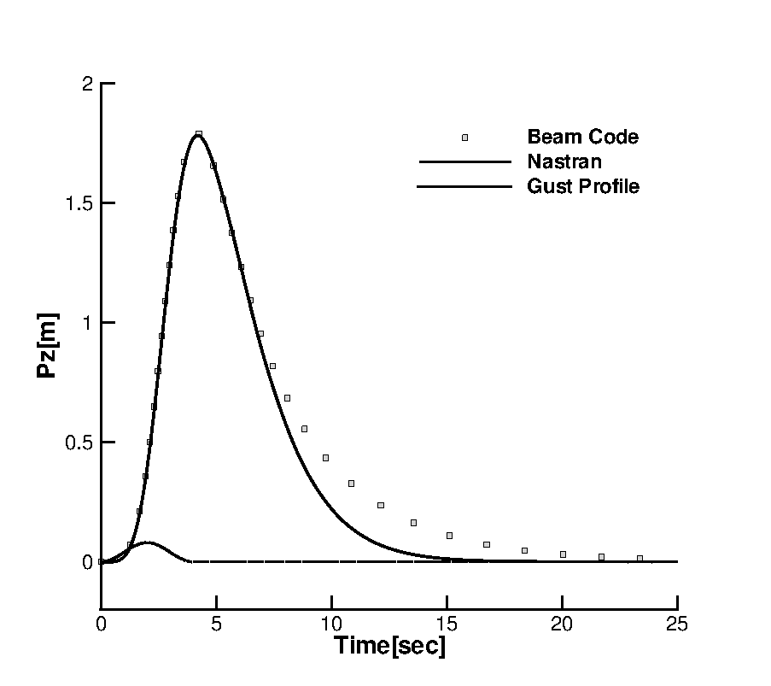
Beam Code Validation-HALE Wing
Nastran-DLM aero

Slide 23
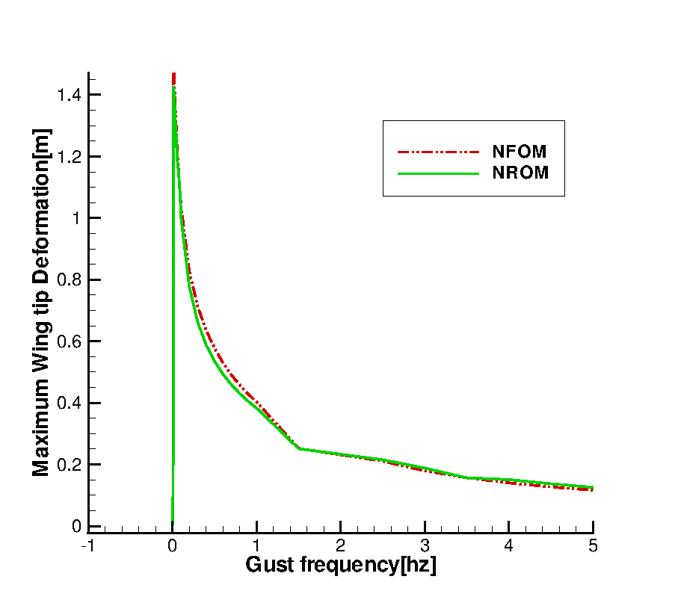
Worst Case Gust/UAV
Reduction:280 -> 6 states
Hallissy,C.E.S.Cesnik
Reduced Models for Worst Case Gust
Notes:
Hallissy,C.E.S. Cesnik,High fidelity aeroelastic analysis of very flexible aircraft.

Slide 24
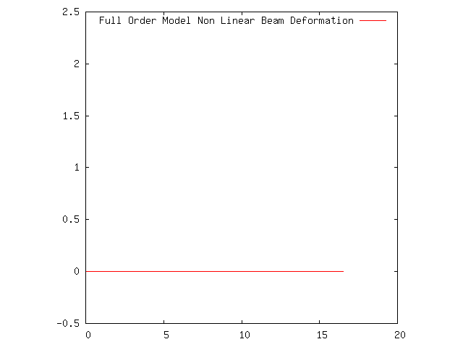
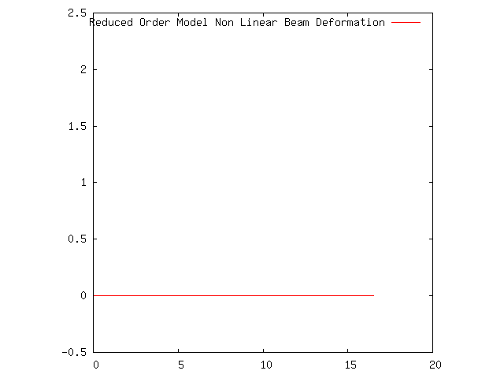
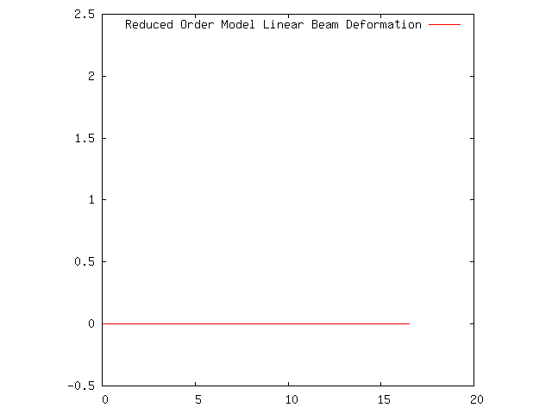
Model Order Reduction

Slide 25
Control Design Using Reduced Models
1)Formulate Control Problem
2) Re-arrange state vector to formulate and H control problem
3)Calculate Controller’s transfer function based on ROM such that:
4) :maximum O/I energy of the system
Da Ronch, A., Tantaroudas, N. D., and Badcock, K. J., ”Reduction of Nonlinear Models for Control
Applications,” AIAA–2013–1491, 54th AIAA/ASME/ASCE/AHS/ASC Structures, Structural Dynamics,
and Materials Conference, Boston, Massachusetts, 8–11 April

Slide 26
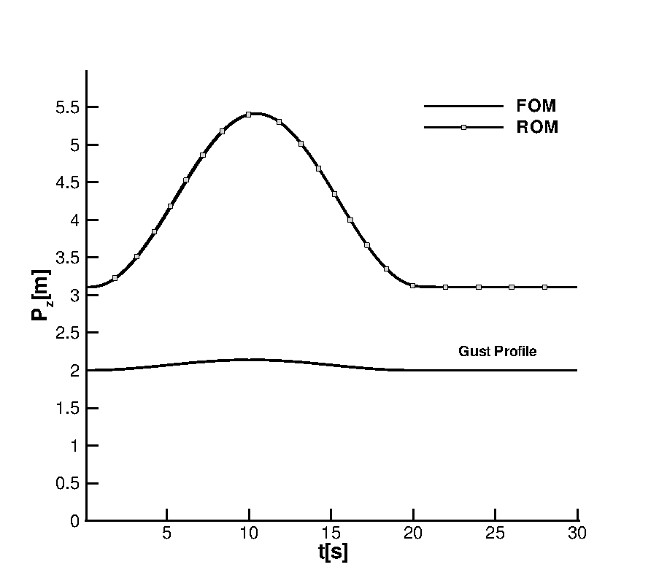
Control Design Using Reduced Models
ROM: 11 Modes
1-cosine gust

Slide 27
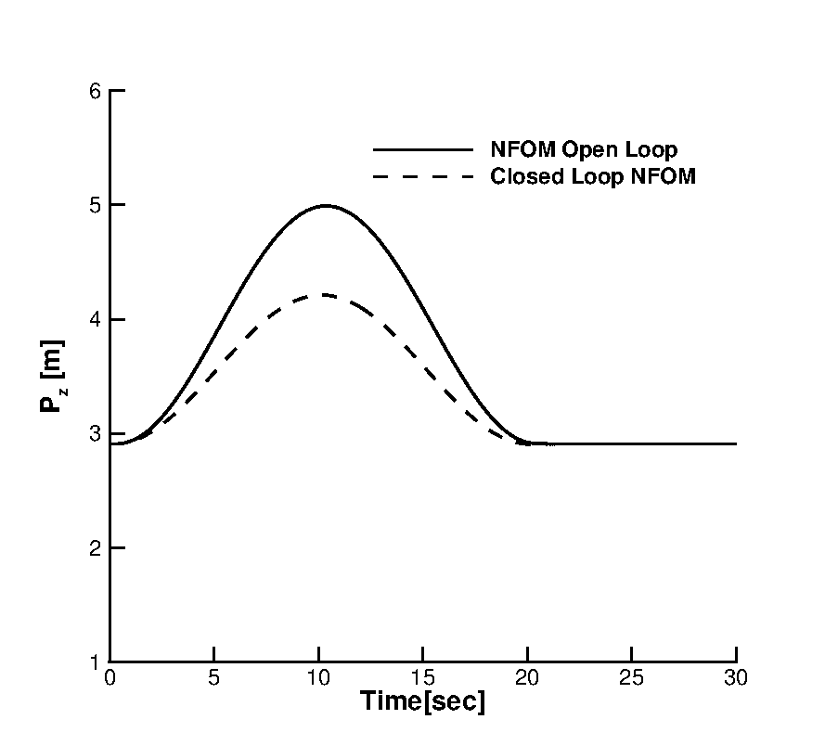
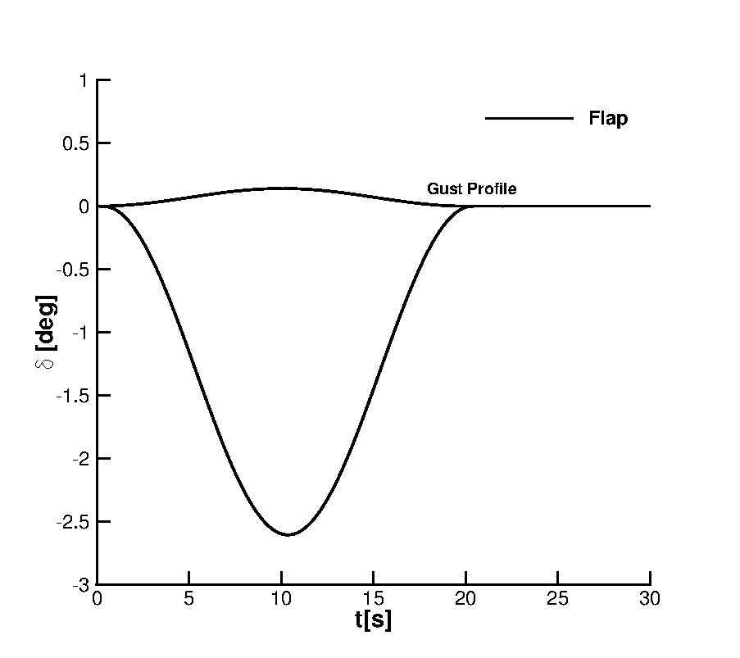
Control Design Using Reduced Models
based on the ROM applied on the NFOM(beam code)

Slide 28
Flight Dynamics/Rigid Case
State Vector:
Global Equations of Motion
F expressed in the beam reference frame
Nonlinear Newmark Integration

Slide 29
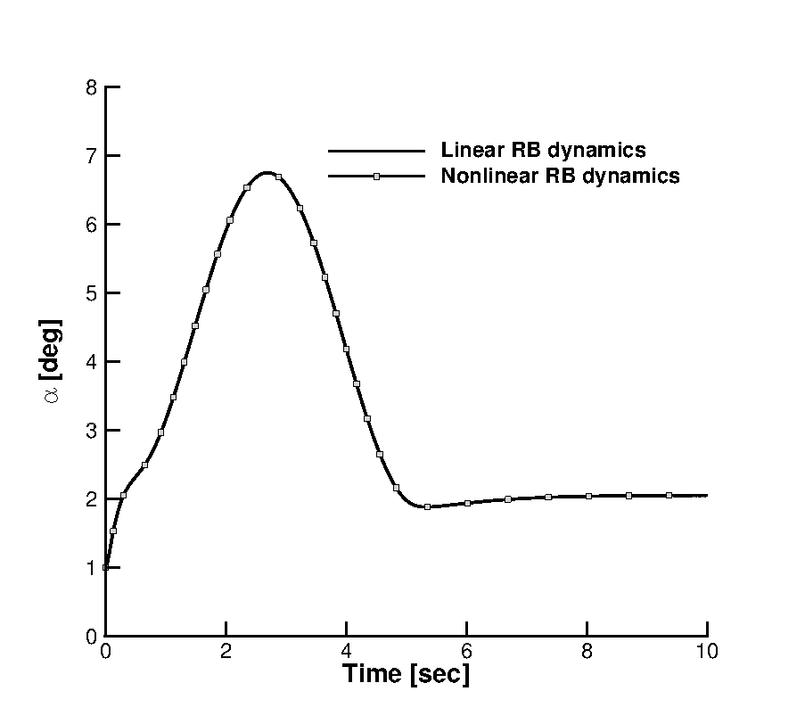
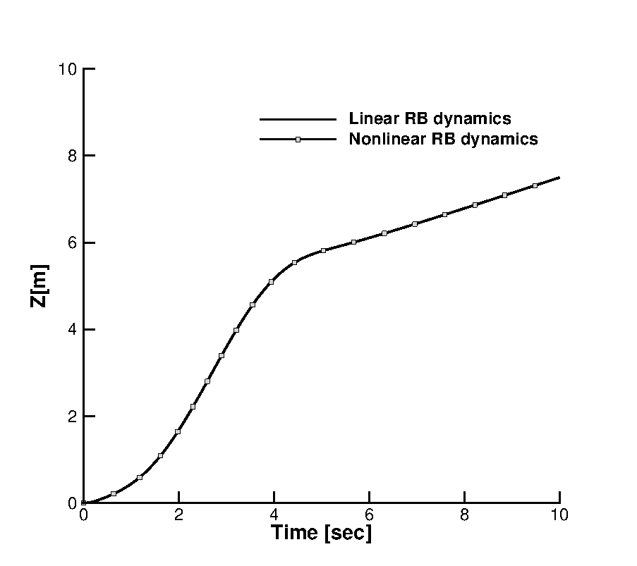
Flight Dynamics/Rigid Case
Plunge and Pitching motion time response
Response at a 1-cos gust:

Slide 30
Animation

Slide 31
Nonlinear Controller Synthesis
Feedback Linearization
I/O Linearization
Sliding Mode
Lyapunov Based
Artstein-Sontag Theorem: If a nonlinear system is globally asymptotically stabilizable by a nonlinear state feedback then a positive,radially and unbounded scalar function exist with :
-Stabilizing nonlinear feedback if Lyapunov is found:
-Which is continuous everywhere except from the origin
-Is it Optimal???
- Modified Sontags formula according to LQR minimization cost function

Slide 32
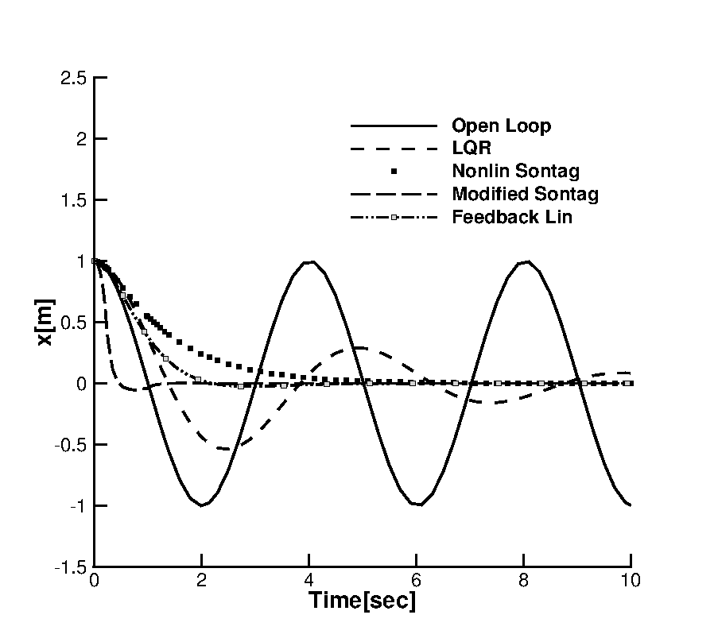
Nonlinear Controller Synthesis
LQR Modified nonlinear formulation
Duffing Oscillator-examplef

Slide 33
Integrated Framework
Adaptive Controllers
MRAC/Self Tuning
MOR/U
Aerodynamics/Flight Dynamics
Worst Case Gust Search
FOM/NFOM
MOR
Structural/rigid
FR/L
SOS-SDP
NROM/ROM
Gust Load Alleviation
Flutter Control
Nonlinear Control

Slide 34
Current Work
Adaptive Control Design for a 3dof Aerofoil for GLA and flutter suppression
Nonlinear Reduced Models parametrised with respect to the freestream speed
Stability analysis-Flutter speed prediction
Worst Case Gust Search-Faster calculations with NROMs
Adaptive Control based on Model Reference Adaptive Control Scheme
Demonstrate for Worst Gust Case when significantly above flutter speed
Investigation of the adaptation parameter on the overall flap response.
Overcome limitations of the design by using the NROMs
Tantaroudas, N. D., A. Da Ronch, G. Gai, Badcock, K. J., ”An adaptive Aeroelastic Control Approach By Using Nonlinear Reduced Order Models,” , Abstract Submitted to AIAA Aviation , Atlanta, Georgia, 16–20 Jun, 2014

Slide 35
Current Work
Aeroelastic Adaptive Control of Flexible Nonlinear Wings
Large Nonlinear Systems (14 Dof for each beam node)
Difficult to identify automatically all eigenvalues associated with the gust influence for ROMs ->Limitations in the adaptive controller design
Generation of Structural ROMs by complex low frequency eigenvalues
These are of small order and will be used for MRAC design
Application of the control on the NFOM aeroelastic system
Tantaroudas, N. D., A. Da Ronch, Badcock, K. J.,” Aeroelastic Adaptive Control for Flexible Nonlinear Wings,” , Abstract Submitted, IFAC Proceedings Volumes,Cape Town, South Africa, 24–29 Aug, 2014

Slide 36
Future Work
Nonlinear Control for an experimental Wind Tunnel Model/Feedback Linearization
Validation of the Flight Mechanics for Nonlinear beams with Imperial College
Model Order Reduction for free flying geometries]
Stability Analysis
Worst Case Gust Search by using NROMs
Optimal ,Adaptive and Nonlinear Control Design based on NROMs->NFOM
Same steps by using CFD aerodynamics with PML(University of Liverpool)
with (A.Da.Ronch)

