Slide 2
Gust Load Alleviation Using Nonlinear Reduced Models For Control Law Design
N.D.Tantaroudas
K.J. Badcock, A. Da Ronch
University of Liverpool, UK
Bristol , 13 December 2012
FlexFlight: Nonlinear Flexibility Effects on Flight Dynamics
Control of Next Generation Aircraft

Slide 3
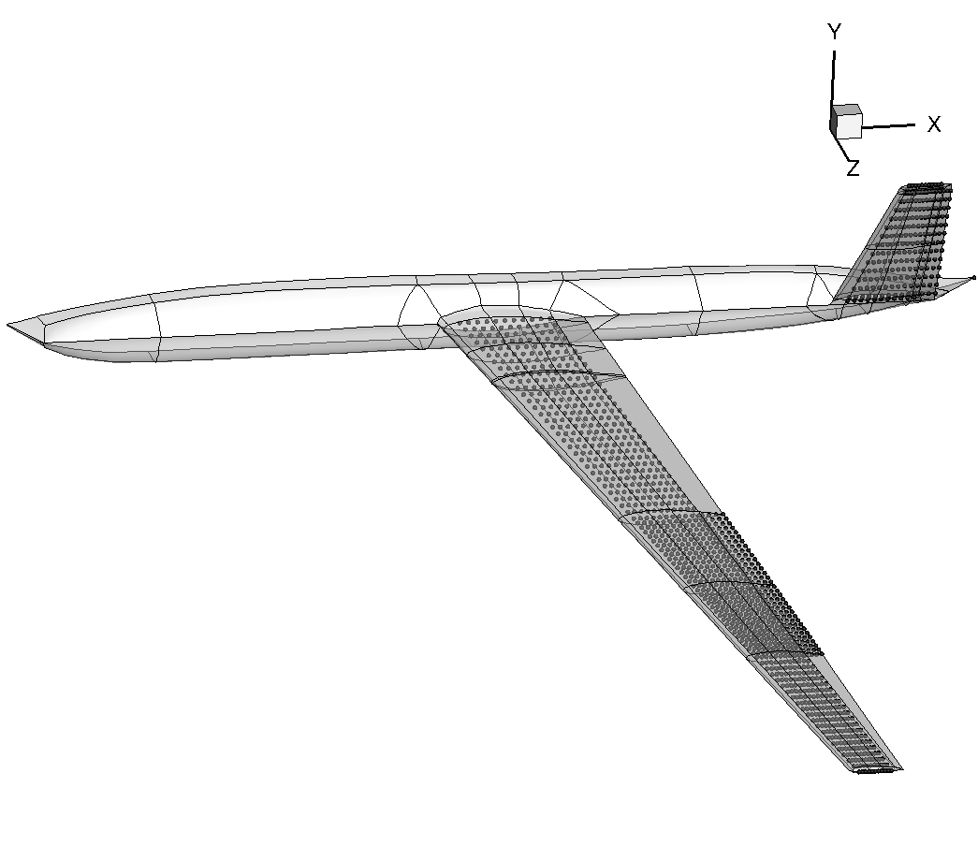
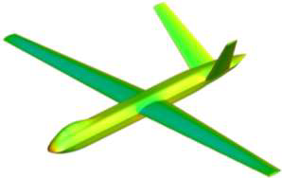
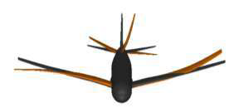
Overview
Very large or very flexible aircraft
- low frequency modes-large amplitudes
- coupled rigid body/structural dynamics
TestCase-UAV configuration
-Modal Analysis(Nastran)
-Model Identification of the Structural Model-Implementation
-Model Order Reduction
-Gust Responses/Linear Aerodynamics(Strip Theory)
-Control design Using Reduced Models for Worst Gust Case

Slide 4
Model Reduction
eigenvalue problem of Jacobian A
FOM projection onto aeroelastic eigenmodes

Slide 5
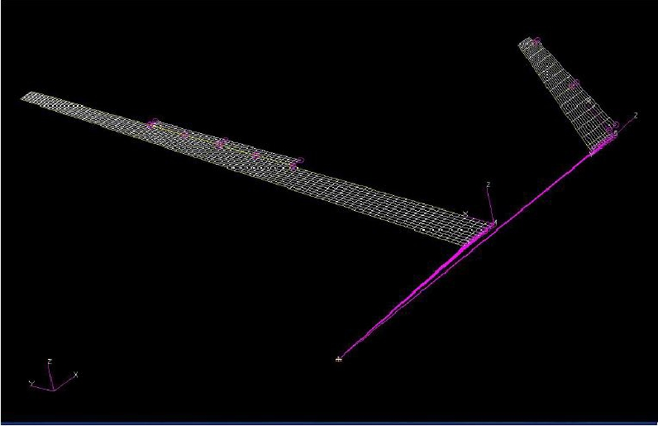
UAV Configuration
DSTL UAV[P. Hopgood]
Wing
-Span:16.98m
-Taper Ratio:0.44
-Root Chord:1.666m
-Tip Chord:0.733m
-Control Surface:16/100chord
Tail
-Dihedral:45deg
-Taper Ratio: 0.487
-Root Chord:1.393m
-Tip Chord:0.678m
-Control Surface:25/100 chord

Slide 6
Model Identification
Beam Reference system –j-node:
Finite Element equation-dimensional form :
Modal Analysis(Nastran)
Match the frequency of the low frequency modes
Match modeshapes
Limitations
High frequency modeshapes difficult to be matched

Slide 7
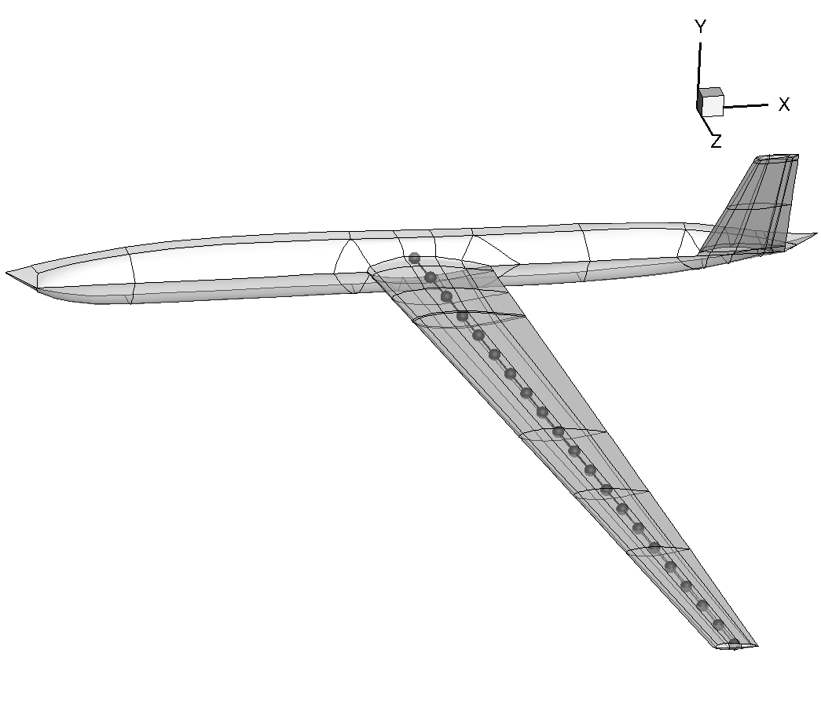
Model Identification
From 2D plate to 1D beam model

Slide 8
Mode Identification
Part | F -Hz | F Tuned -Hz | Modeshape
Wing | 1.51 | 1.45 | First Bending Mode
Wing | 4.92 | 6.27 | Second Bending Mode
Wing | 5.11 | 6.49 | First In Plane Bending Mode
Wing | 10.06 | 13.20 | Third Bending Mode
Wing | 14.48 | 13.99 | First Torsional Mode
Wing | 11.17 | 24.01 | Fourth Bending Mode
Wing | 19.39 | 28.26 | Second In Plane Bending Mode
Tail | 31.76 | 31.42 | First Bending Mode
Tail | 93.81 | 93.61 | Torsional Mode

Slide 9
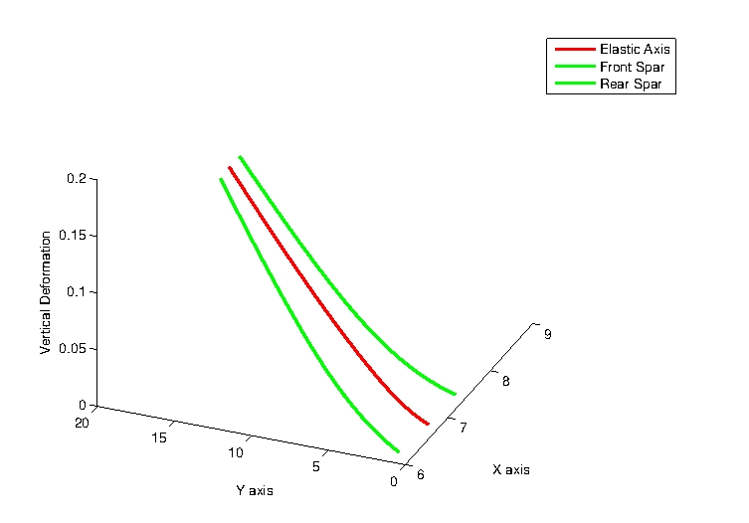
Model Identification
f=1.45Hz

Slide 10
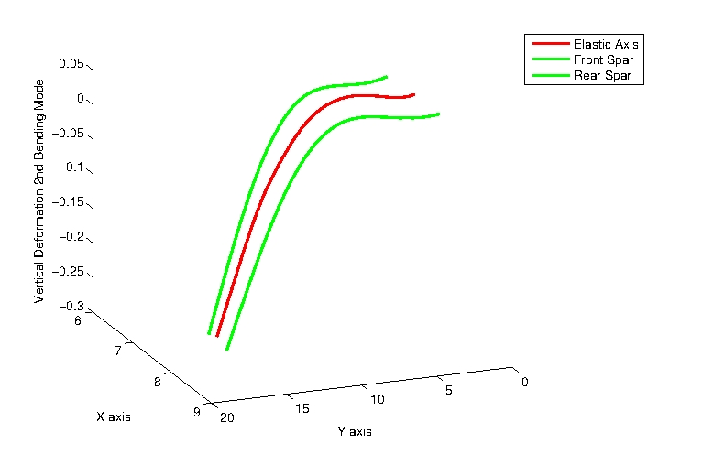
Model Identification
f=6.27Hz

Slide 11
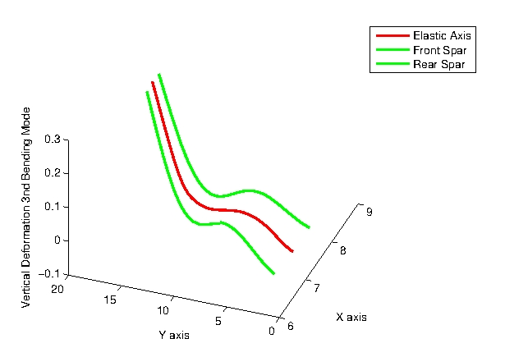
Model Identification
f=13.20Hz

Slide 12
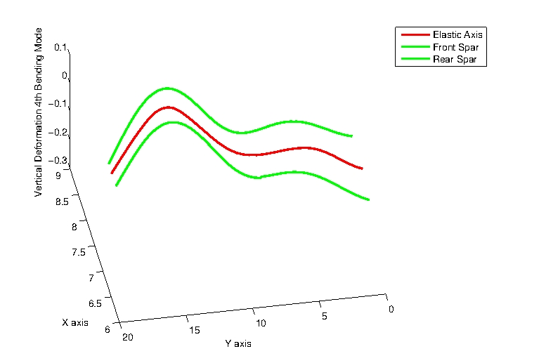
Model Identification
f=24.01Hz

Slide 13
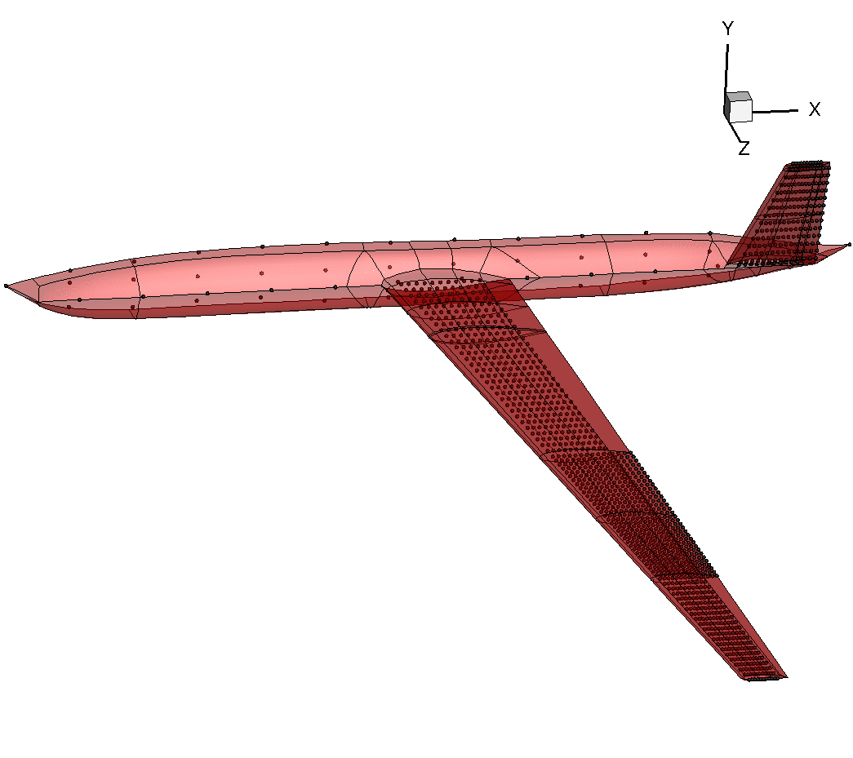
Model Identification

Slide 14
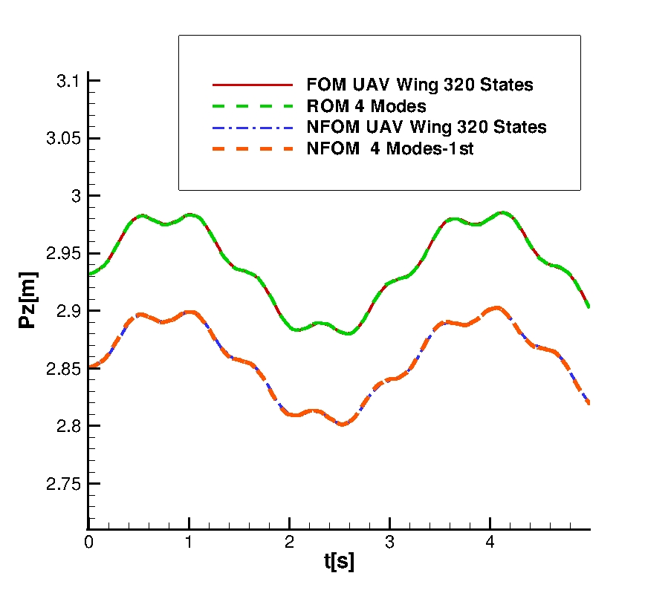
Model Order Reduction
-Wing Tip Vertical Deflection Time Response Without Aerodynamics
Harmonic Follower Force
-ROM/NROM –structural eigenvalues

Slide 15
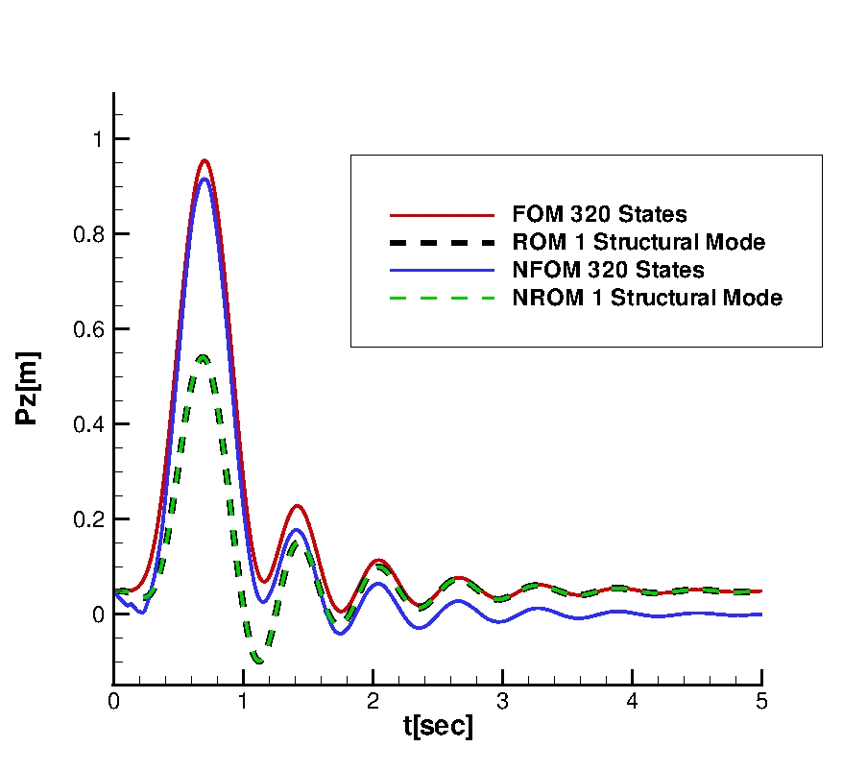
Aeroelastic Gust Responses
-Wing tip vertical displacement
Reduced Basis-Structural

Slide 16
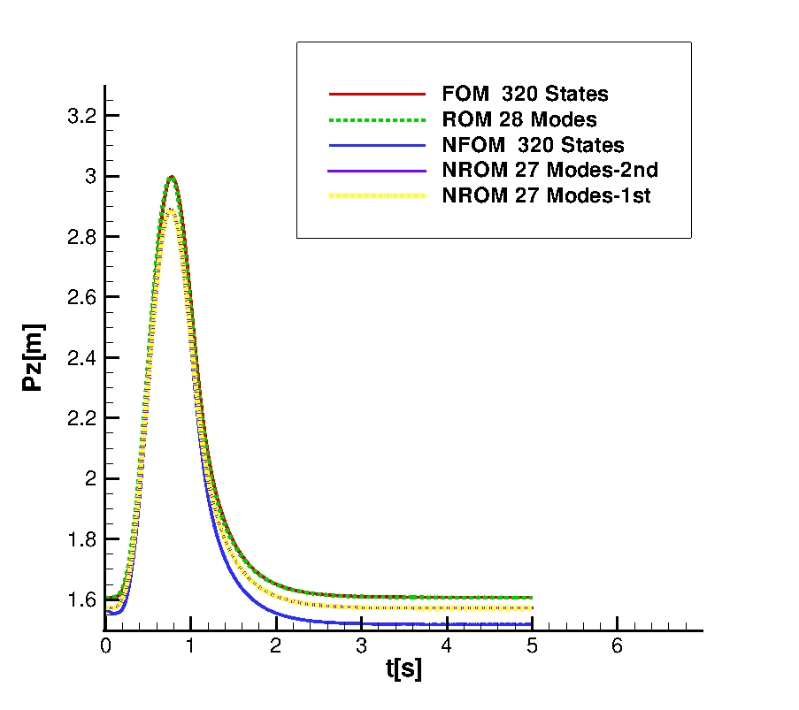
Aeroelastic Gust Responses
-Wing tip vertical displacement
Reduced Basis
-Structural +Aero

Slide 17
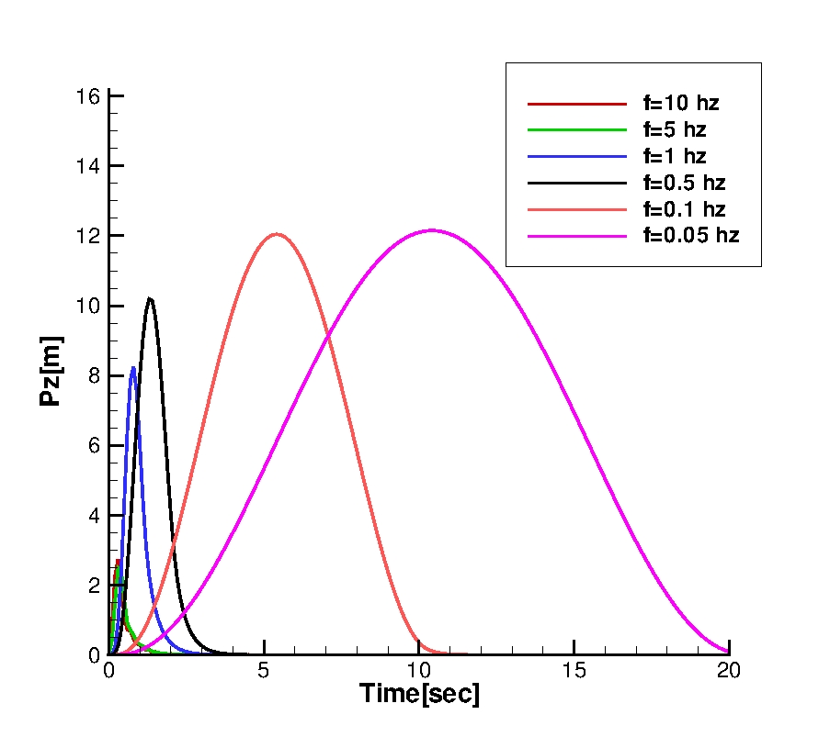
Worst Case Gust
1 minus-Cosine Gust for
several gust lengths

Slide 18
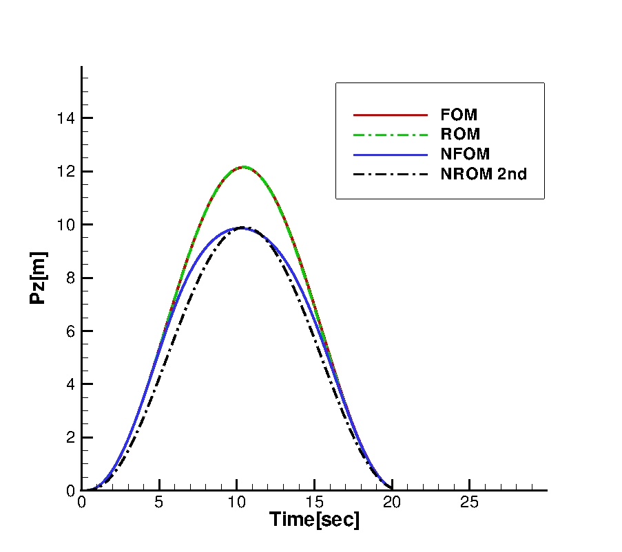
Worst Case Gust-Reduced Models

Slide 19
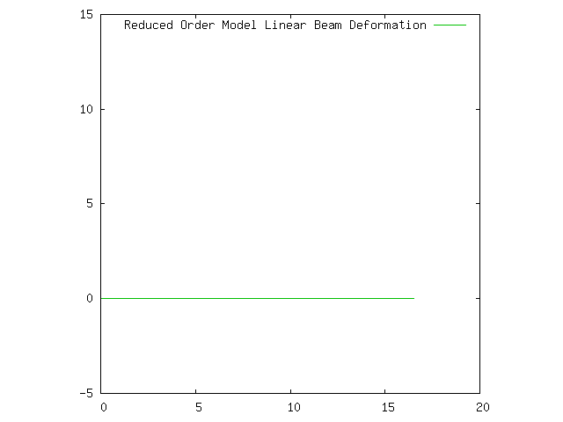
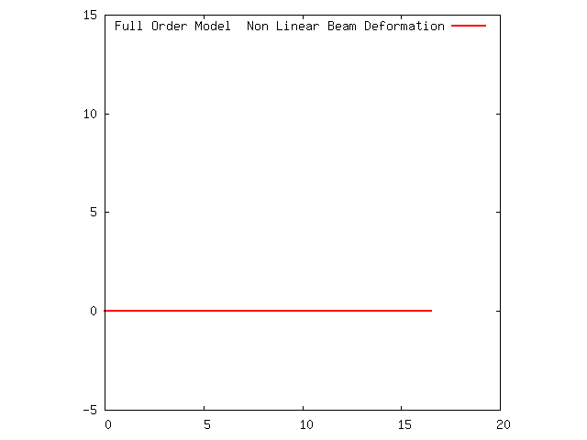
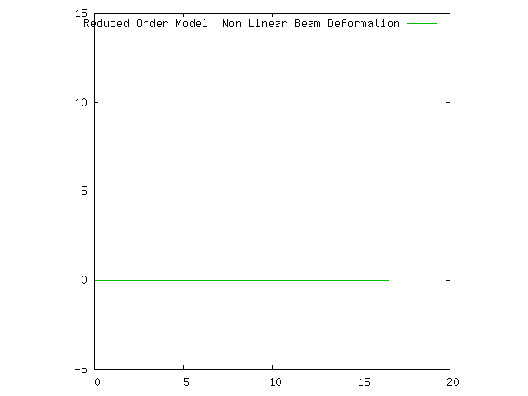
Worst Case Gust-Reduced Models
FOM linear beam
ROM linear beam
FOM nonlinear beam
ROM nonlinear beam

Slide 20
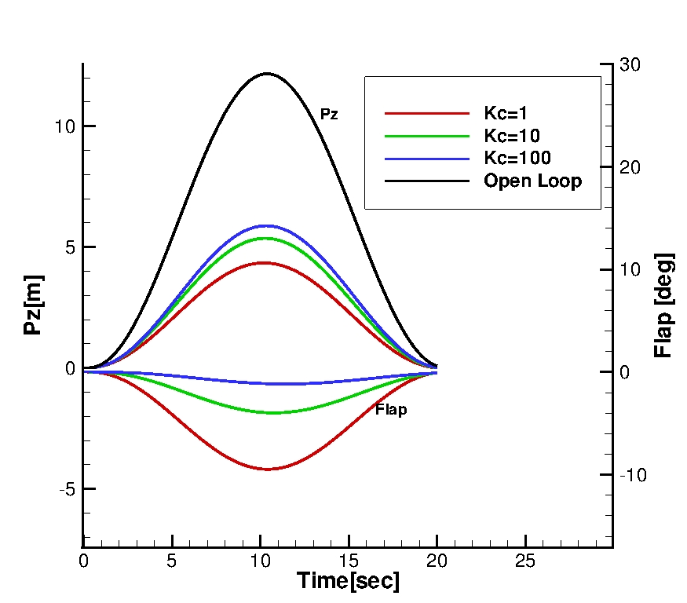
Control Design Using Reduced Models
Linear Controller
Tuning Parameters
:control input
weight
:noise weight
Linear Reduced
Order Model

Slide 21
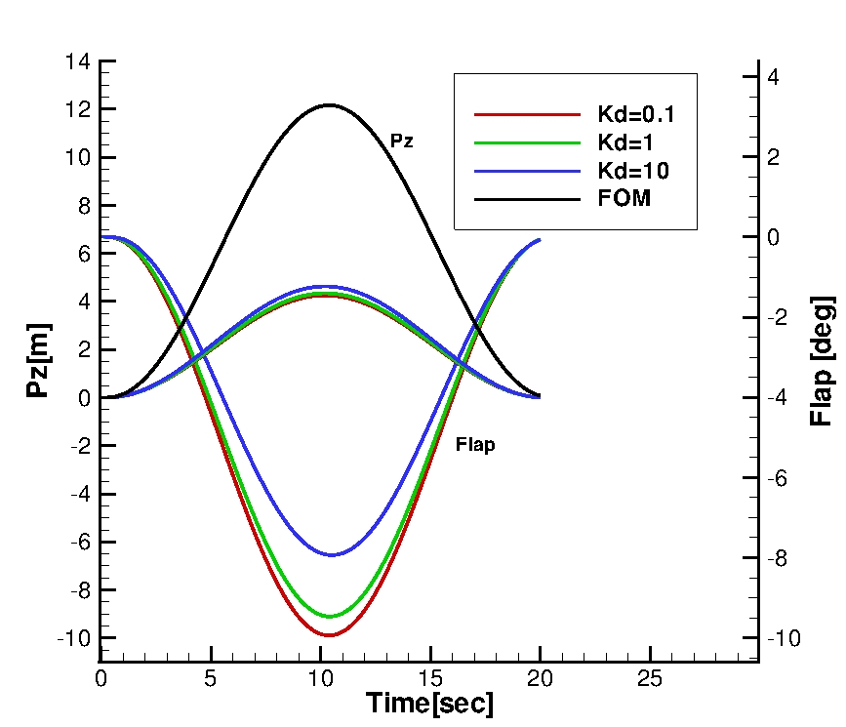
Control Design Using Reduced Models

Slide 22
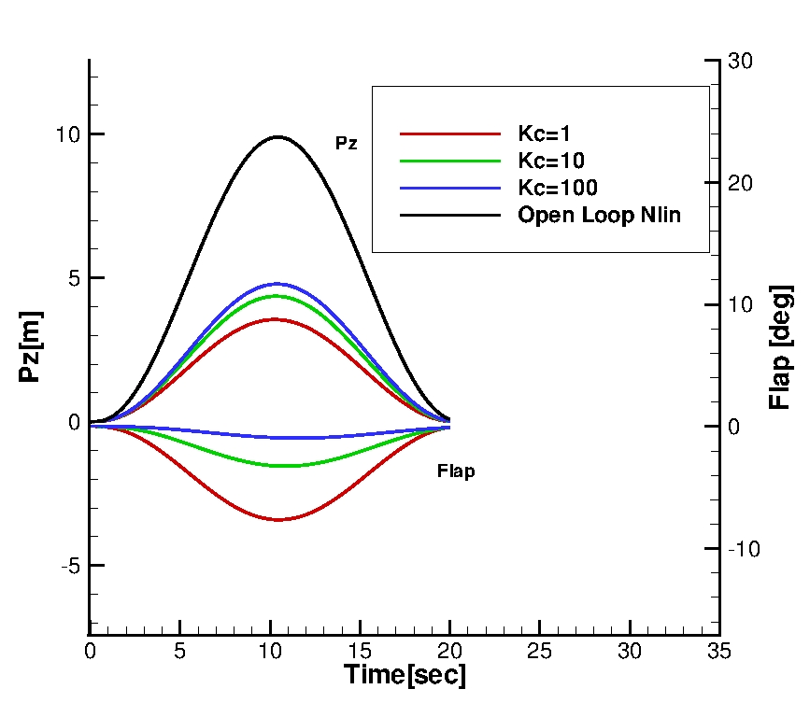
Control Design Using Non Linear Reduced Models

Slide 23
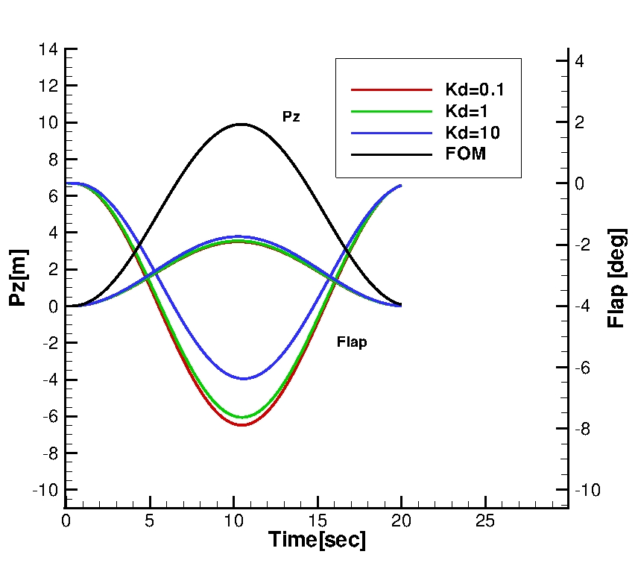
Control Design Using Non Linear Reduced Models

Slide 24
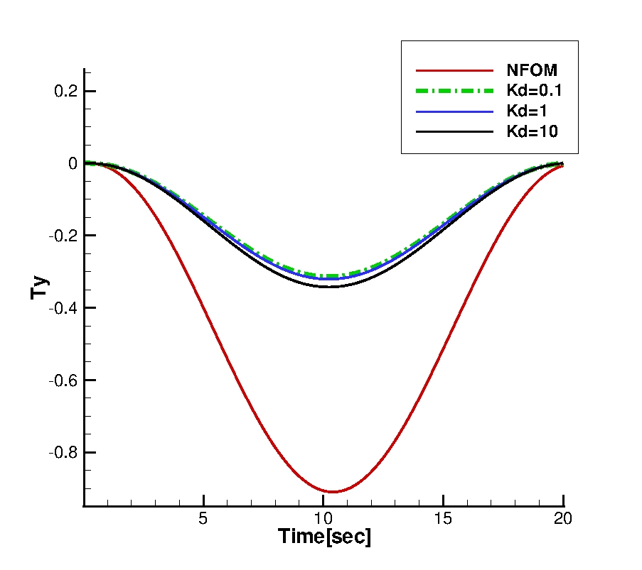
Control Design Using Non Linear Reduced Models

Slide 25
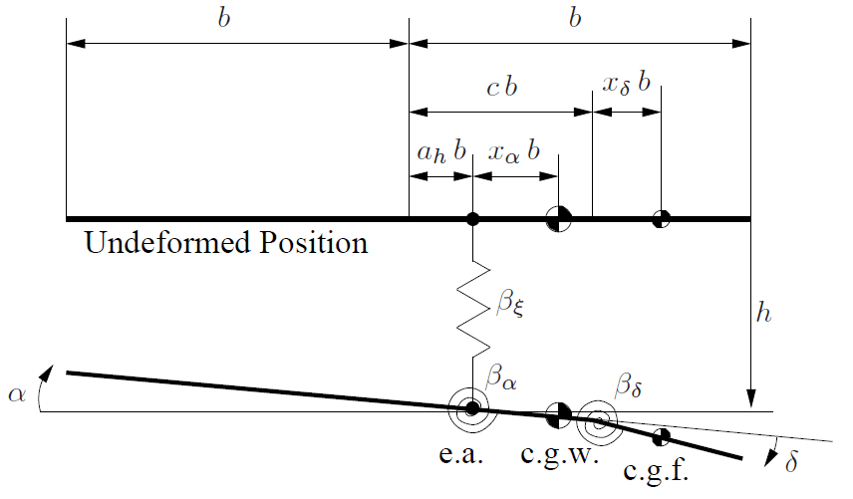
Non Linear Restoring Forces-Stability
3dof of freedom aerofoil

Slide 26
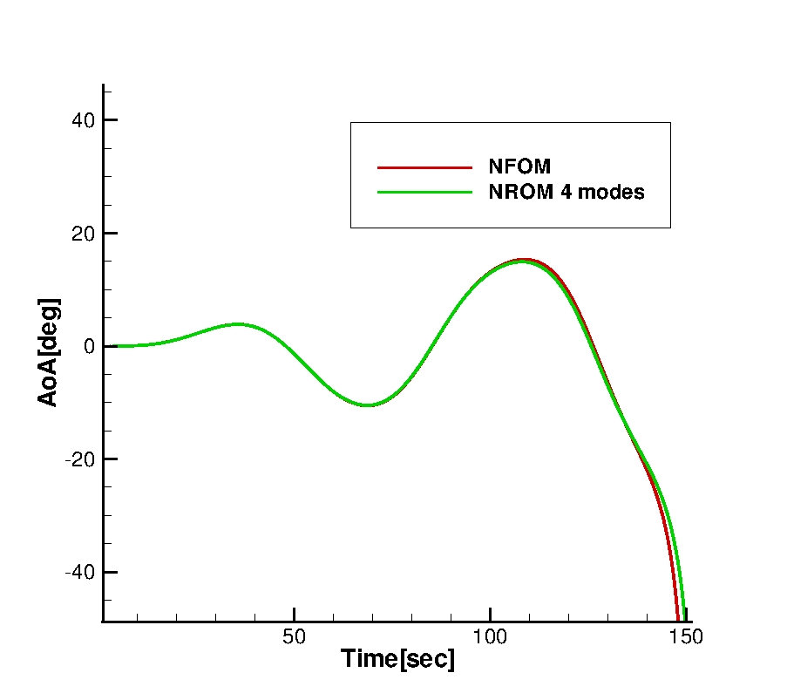
Non Linear Restoring Forces-Stability
hardening spring
softening spring->instability
3dof aerofoil
1 minus cosine Gust
Softening Spring
Linear Control Design in this case??

Slide 27
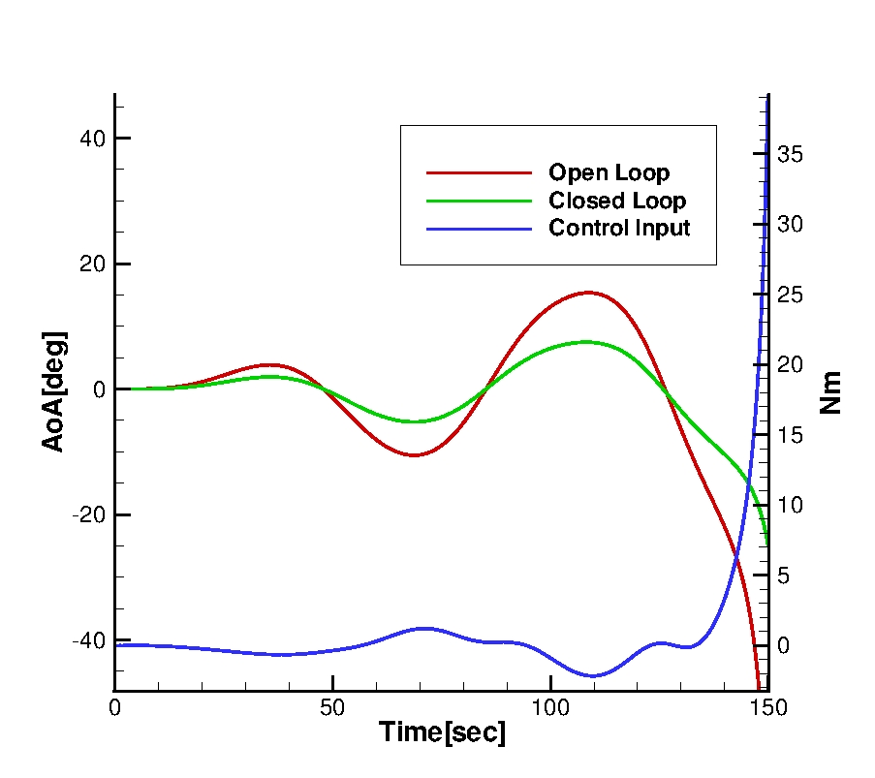
Instability
Instability

Slide 28
Conclusions-Future Work
Reduced Basis identified with Linear Aerodynamics
-Structural eigenvalues - not always perfect descriptions when gust included
-Structural+aero - for improved predictions
Linear Control techniques suitable for Non Linear Structures
-Structural Nonlinearity → stability of the system
Future Work
-Introduction of the rigid body and flight dynamics in Beam Framework
-Control of the DSTL UAV with gust
-Softening nonlinearity → need for Non Linear Control?

