Slide 1
Model Reduction for CFD-based
Gust Loads Analysis
A. Da Ronch & K.J. Badcock
University of Liverpool, U.K.
email: andreadr@liverpool.ac.uk web: http://www.cfd4aircraft.com/
ASRC, Bristol, U.K.
13 December 2012
Notes:
This presentation is about gust loads prediction and alleviation using a reduced model, which potentially comes from a CFD model.

Slide 2
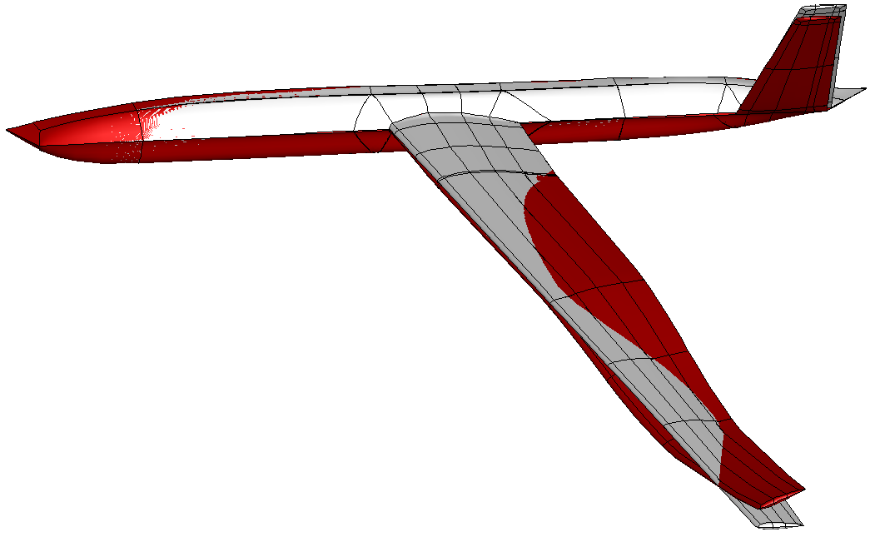
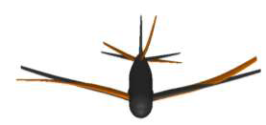
Motivation
Physics-based simulation of very flexible aircraft gust interaction
large amplitude/low frequency modes
coupled rigid body/structural dynamics
nonlinearities from structure/fluid (& control)
Nonlinear model reduction for control design
system identification methods
manipulation of full order residual
Control design for FCS of flexible aircraft
Notes:
We have in mind very flexible aircraft, which are the main driver for the computational framework that I am going to illustrate. Very flexible aircraft can be intrinsically unstable, requiring a stability augmentation system, and sensible to atmospheric gust, you are possibly familiar with the failure of the NASA HELIOS. In addition to these key aspects, very flexible aircraft exhibit low frequency natural modes which are close, or even overlapping, the modes of the flight mechanics. Therefore, it is suspect or erroneous to design a conventional flight control system filtering out the frequencies of structural vibrations. An integrated approach has to be used.
The target we have set is to use a physics-based formulation to realistically predict nonlinearities arising from the structure, large deformations, and the fluid, separation and shock motion. The mathematical model of the coupled system based on nonlinear beams, from IC, and CFD is potentially very large in dimension and expensive to solve. The role of a model reduction for control design is therefore fundamental. The approach based on the manipulation of the coupled residual is chosen, retaining the ability to describe relevant nonlinearities. The other approach to model reduction is system identification, but the lack of robustness and dependence on the training data are well-known issues.

Slide 3
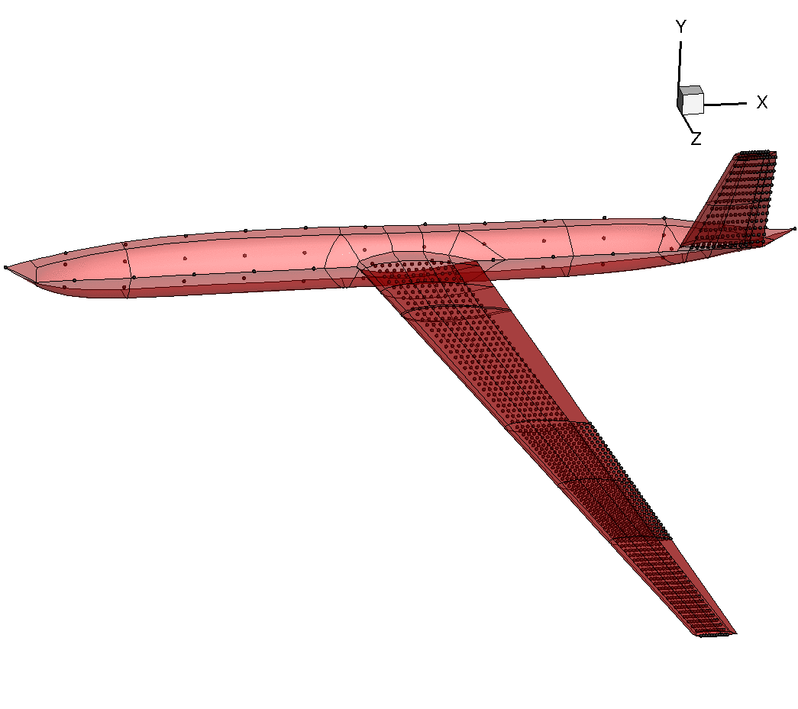
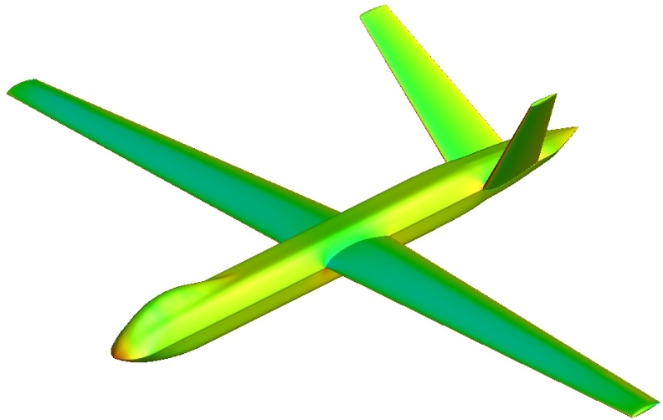
Testcase
Global Hawk type (DSTL UAV)
beam/plate FE model of composite material
control surfaces
struct model > 1,300 points
CFD grid > 6 mio points
- stability augmentation (SAS)
gust load alleviation (GLA)
performance optimization
Notes:
Let me stress the problem. For this UAV model provided by DSTL, the FE structural model is rather detailed, using beams and plates of composite material. The CFD grid has about 6 million points, and control surfaces are included in both structural and fluid models. The control engineer is unable to work with such big model, and what we want is to retain the nonlinear effects into a smaller system so that control design is possible.

Slide 4
Model Reduction
Notes:
The starting point is the original full-order model, formulated as a set of ODEs of the form dwdt = residual. The residual depends nonlinearly on the state vector, which is partitioned into fluid, structure and RB DOFs. A parameter, denoted here by sigma, is independent of the unknown vector and is used to parameterize the system. Recall the example of the global-hawk type aircraft, the state vector has million of unknowns.
To achieve model reduction, the full model is projected onto a small basis of coupled system eigenvectors, which is similar to the normal modes if you are familiar with structural models, but in our case the modes are those of the coupled system.
To calculate the basis, we need to solve an eigenvalue problem. For small systems, Matlab can do the job. For large order systems, as those arising with CFD, the eigenvalue problem can be a difficult task. Fortunately, previous work at the UoL was devoted to this specific problem, and the Schur eigenvalue solver provides the information needed for model reduction. Here, we assume that we have this method and if interested please refer to the article in progress in aerospace sciences.

Slide 5
Model Reduction
Eigenvalue problem of large order system is difficult → Schur complement
Badcock et al., “Transonic Aeroelastic Simulation for Envelope Searches and Uncertainty Analysis”, Progress in Aerospace Sciences; 47(5): 392-423, 2011
Notes:
The starting point is the original full-order model, formulated as a set of ODEs of the form dwdt = residual. The residual depends nonlinearly on the state vector, which is partitioned into fluid, structure and RB DOFs. A parameter, denoted here by sigma, is independent of the unknown vector and is used to parameterize the system. Recall the example of the global-hawk type aircraft, the state vector has million of unknowns.
To achieve model reduction, the full model is projected onto a small basis of coupled system eigenvectors, which is similar to the normal modes if you are familiar with structural models, but in our case the modes are those of the coupled system.
To calculate the basis, we need to solve an eigenvalue problem. For small systems, Matlab can do the job. For large order systems, as those arising with CFD, the eigenvalue problem can be a difficult task. Fortunately, previous work at the UoL was devoted to this specific problem, and the Schur eigenvalue solver provides the information needed for model reduction. Here, we assume that we have this method and if interested please refer to the article in progress in aerospace sciences.

Slide 6
Model Reduction
Need extended order arithmetics: quad-double precision
2nd/3rd Jacobian operators for NROM
Da Ronch et al., “Model Reduction of High-Fidelity Models for Gust Load Alleviation”, AIAA SDM abstract; 2013
Notes:
The starting point is the original full-order model, formulated as a set of ODEs of the form dwdt = residual. The residual depends nonlinearly on the state vector, which is partitioned into fluid, structure and RB DOFs. A parameter, denoted here by sigma, is independent of the unknown vector and is used to parameterize the system. Recall the example of the global-hawk type aircraft, the state vector has million of unknowns.
To achieve model reduction, the full model is projected onto a small basis of coupled system eigenvectors, which is similar to the normal modes if you are familiar with structural models, but in our case the modes are those of the coupled system.
To calculate the basis, we need to solve an eigenvalue problem. For small systems, Matlab can do the job. For large order systems, as those arising with CFD, the eigenvalue problem can be a difficult task. Fortunately, previous work at the UoL was devoted to this specific problem, and the Schur eigenvalue solver provides the information needed for model reduction. Here, we assume that we have this method and if interested please refer to the article in progress in aerospace sciences.

Slide 7
Model Reduction
How to introduce gust into CFD?
control surfaces,
gust encounter,
speed/altitude
Da Ronch et al., “A New Approach to Computational Fluid Dynamics-Based Gust Loads Analysis”, AIAA SDM abstract; 2013
Notes:
The starting point is the original full-order model, formulated as a set of ODEs of the form dwdt = residual. The residual depends nonlinearly on the state vector, which is partitioned into fluid, structure and RB DOFs. A parameter, denoted here by sigma, is independent of the unknown vector and is used to parameterize the system. Recall the example of the global-hawk type aircraft, the state vector has million of unknowns.
To achieve model reduction, the full model is projected onto a small basis of coupled system eigenvectors, which is similar to the normal modes if you are familiar with structural models, but in our case the modes are those of the coupled system.
To calculate the basis, we need to solve an eigenvalue problem. For small systems, Matlab can do the job. For large order systems, as those arising with CFD, the eigenvalue problem can be a difficult task. Fortunately, previous work at the UoL was devoted to this specific problem, and the Schur eigenvalue solver provides the information needed for model reduction. Here, we assume that we have this method and if interested please refer to the article in progress in aerospace sciences.

Slide 8
Model Reduction
Systematic generation of Linear/Nonlinear ROMs
independent of large order model
control design done in the same way
Da Ronch et al., “Nonlinear Model Reduction for Flexible Aircraft Control Design”, AIAA paper 2012-4404; AIAA Atmospheric Flight Mechanics, 2012
Notes:
The method we have described is systematic in the sense that it is applied in the same way to different test cases, and the ROM models look the same. ROMs are in a form familiar to control people, and the control design that we will show for a pitch/plunge aerofoil will be done in the same way for other cases.

Slide 9
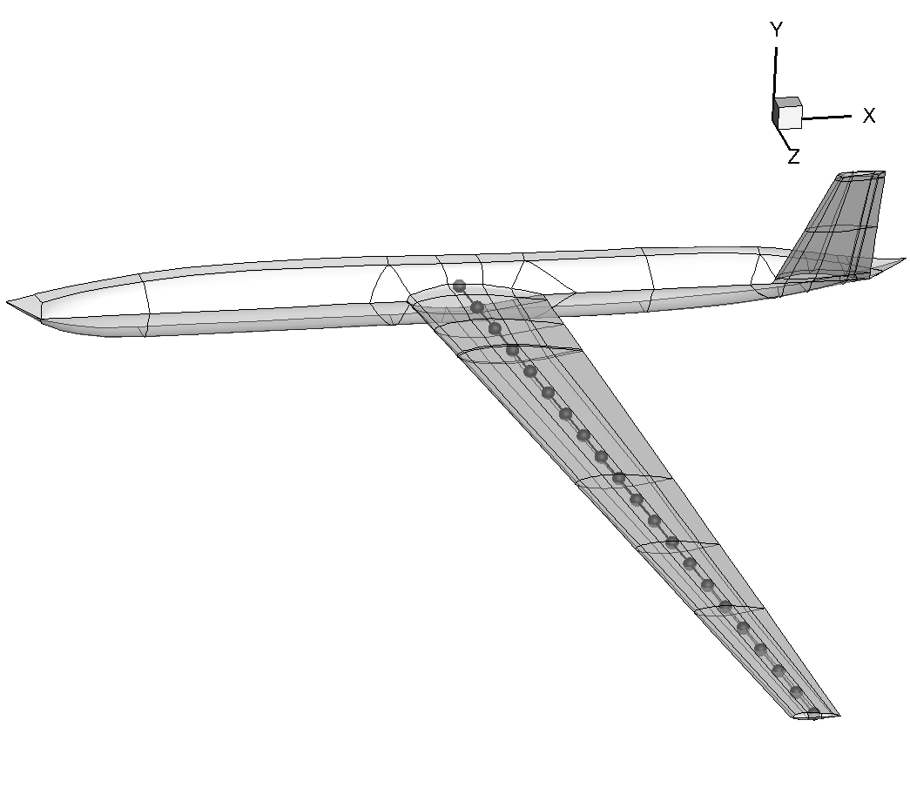
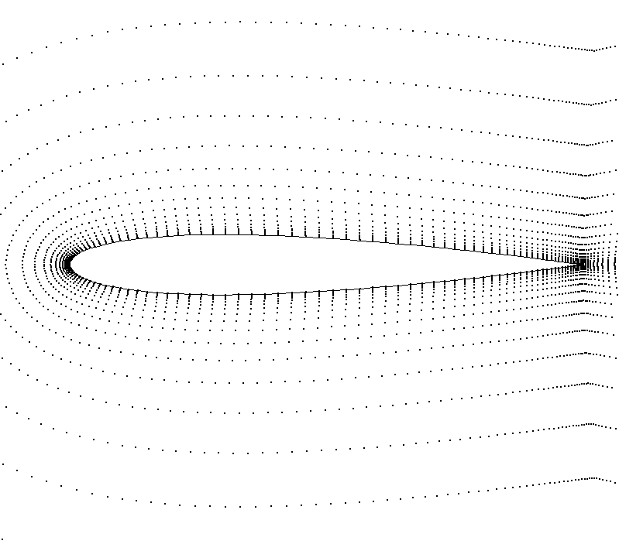
Application Examples
1. Pitch-plunge aerofoil with linear aero
full model → reduced model → GLA
2. DSTL UAV wing (nonlinear beam with linear aero)
full model → reduced model → GLA
N. Tantaroudas at 15.30 today (Stream A)
3. CFD-based analysis
pitch-plunge aerofoil
towards UAV gust simulation (open-, closed-loop)
Notes:
Following a general description of the method, we turn our attention to 3 application examples.
The 1st is an aerofoil free to move in pitch and plunge with strip aerodynamics. The case is a model problem to test the methods.
The 2nd example is a pitch/plunge aerofoil with CFD for aerodynamic predictions. We will address two important issues in this case.
Finally, a nonlinear beam model coupled with strip aerodynamics is used to test all the options.

Slide 10
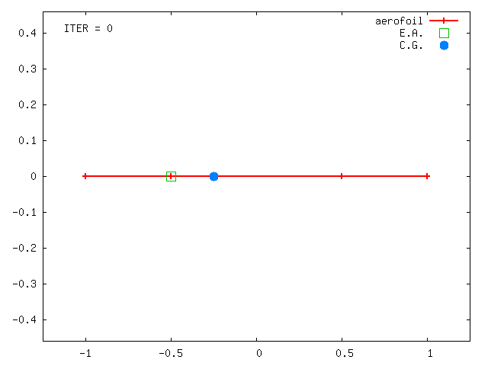
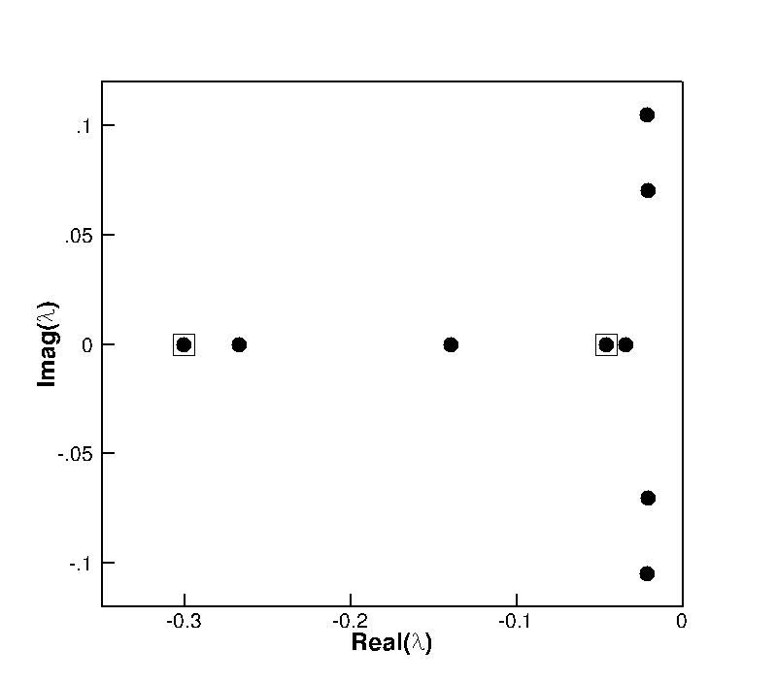
1. Pitch-Plunge Aerofoil
Structural model: linear/nonlinear
cubic stiffness in plunge
K=K(1+β₃ ξ ³)
Aerodynamic model
flap motion (Wagner)
gust encounter (Küssner)
Total of 12 states → model problem
2
1
3
Notes:
The structural model was made nonlinear adopting a polynomial form for the stiffness in plunge. The aerodynamic contributions include the effects of control deflection and penetration into a gust. The extension to any arbitrary input time history is achieved using the convolution integral, with the resulting eqs being integro-differential. The eqs are recast into a ODE form by additional variables for the dynamics of the flow. With only 12 states, the example is used as model problem to test the reduction.

Slide 11
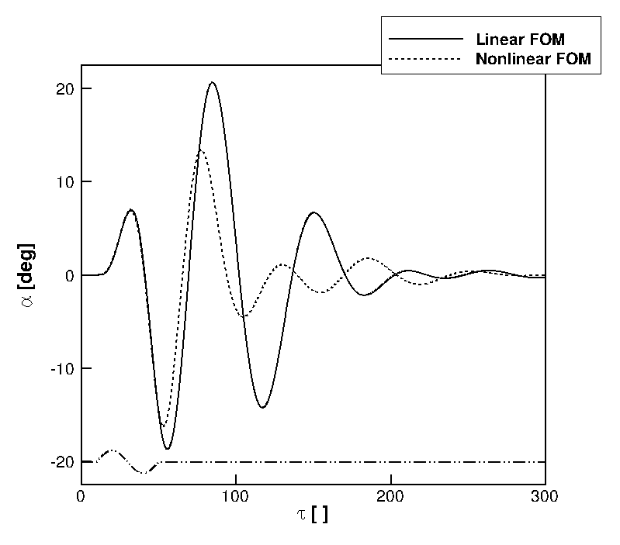
Full order model gust response
Gust param:
“sin”
h_{g} = 40
w₀ = 0.1
Nonlinear:
β_{ξ3} = 3
Notes:
Then, the gust was tuned so to make the influence of structural nonlinearity important in the FOM response. For the nonlinear model, the cubic stiffness coefficient in plunge was set to 3. With increasing plunge displacement, the spring becomes harder. This case, which features a gust of intensity 100 times the intensity of the previous linear case, is used to test the NROM.

Slide 12
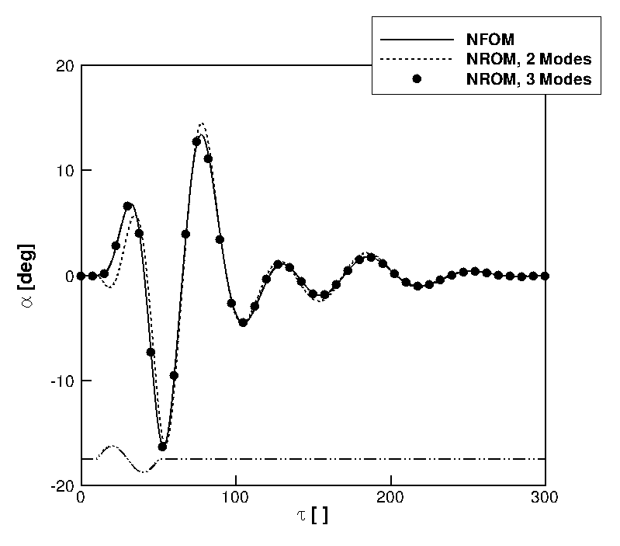
Nonlinear Full/Reduced order model
Gust param:
“sin”
h_{g} = 40
w₀ = 0.1
Nonlinear:
β_{ξ3} = 3
Notes:
With the same nonlinear structural model and same gust parameters, NROMs were generated for increasing number of modes, and the predictions are compared to the NFOM in figure. We note the NROM with 2 modes predicts well the response, and including the 3rd mode makes the prediction to be identical to the FOM.

Slide 13
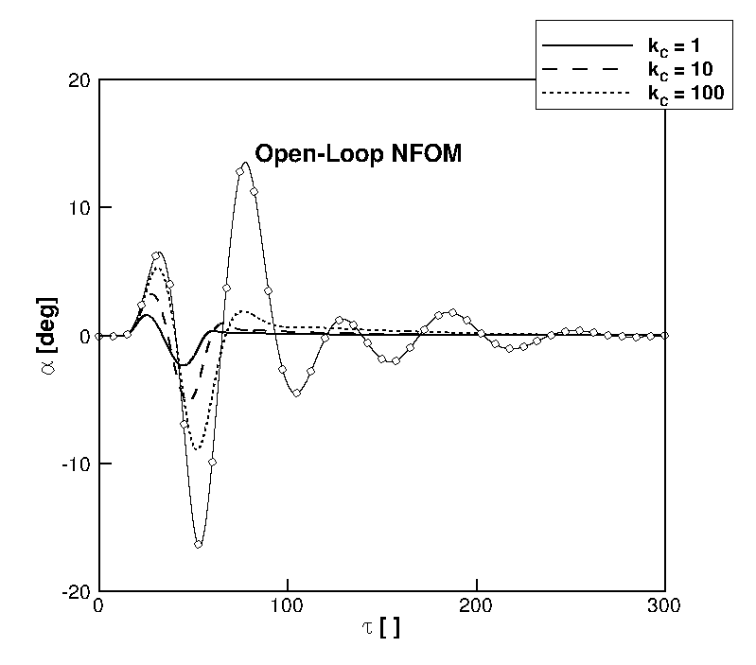
Closed-loop gust response
H∞ design for GLA based on linear ROM
verification on nonlinear system
NROM for nonlinear control?

Slide 14
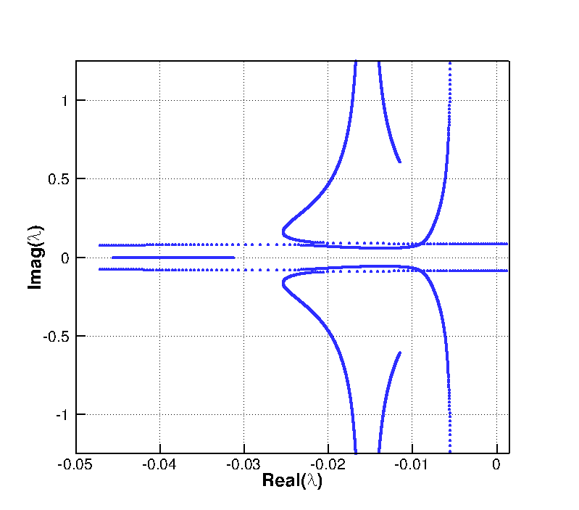
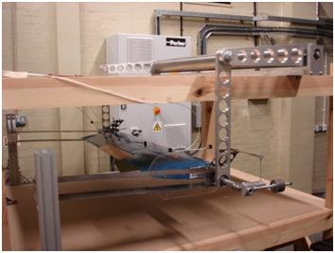
Papatheou et al., “Active Control for Flutter Suppression: An Experimental Investigation”, IFASD abstract; 2013

Slide 15
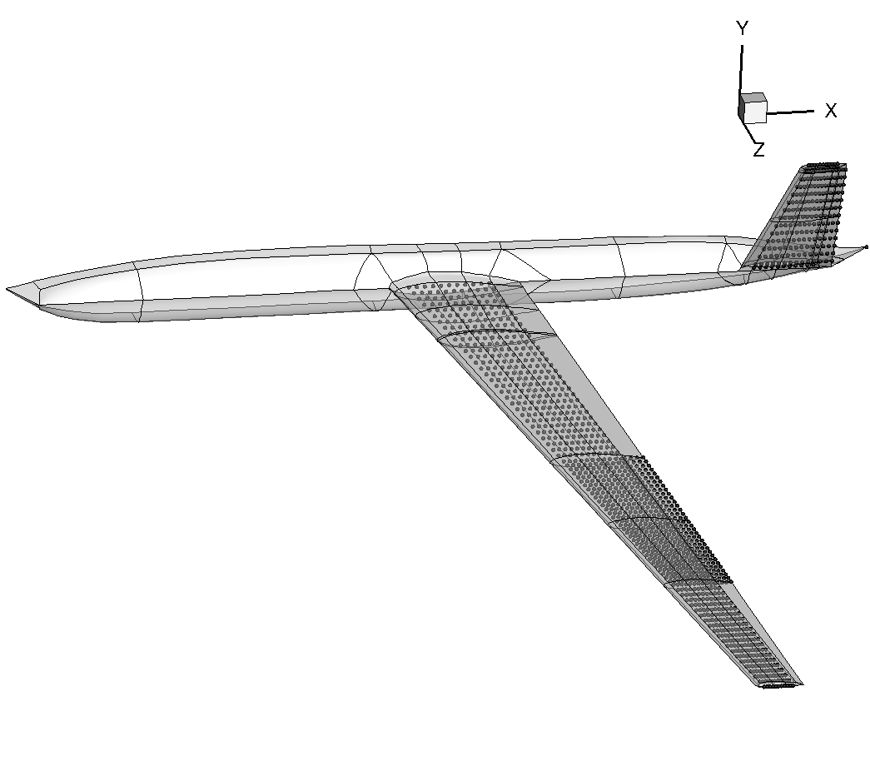
2. DSTL UAV Wing Model
From 2D plate model to 1D beam model
Geometrically-exact nonlinear beam + linear aero
Worst-case gust search
GLA on NROM-based controller → N. Tantaroudas at 15.30 today

Slide 16
3. Pitch-Plunge Aerofoil using CFD
Structural model: linear/nonlinear
Aerodynamic model: CFD
Euler equations
point distribution, 7974 points
“Heavy” case
Aeroelastic | r_{α} = 0.539
 | µ = 100
 | ω_{ξ}/ω_{α} = 0.343
Badcock et al., “Hopf Bifurcation Calculations for a Symmetric Airfoil in Transonic Flow”, AIAA Journal; 42(5): 883-892, 2004
Notes:
Coming to the last application example, which features a pitch-plunge aerofoil model coupled with CFD where a dramatic reduction of number of states can be made. The Euler eqs are solved on a distribution of about 8000 points. The aeroelastic parameters correspond to the heavy case described in previous work.

Slide 17
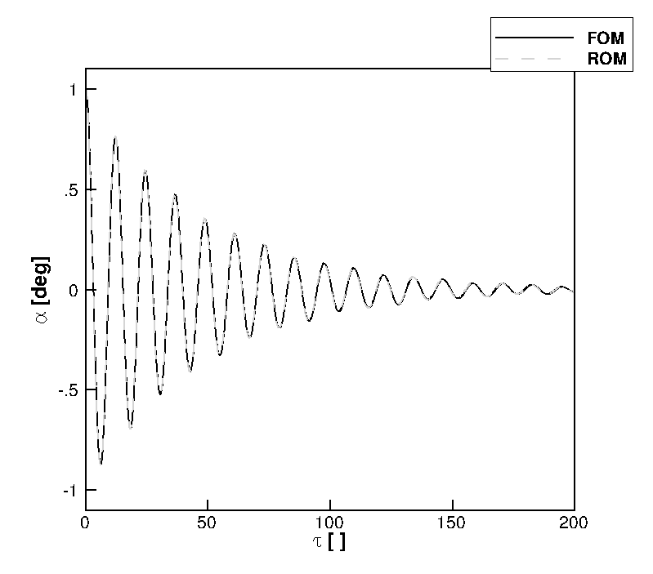
Full/Reduced order model free response
Parameters:
U* = 2.0
M = 0.6
α₀ = 1 deg
Full model dofs > 32,000
Reduced model dofs = 2
Notes:
The Schur method was used to generate a linear ROM to predict the free response of the coupled system at 0.6 Mach. The 2 normal modes were tracked and the predictions of both pitch and plunge response are in excellent agreement with the full order model calculations.

Slide 18
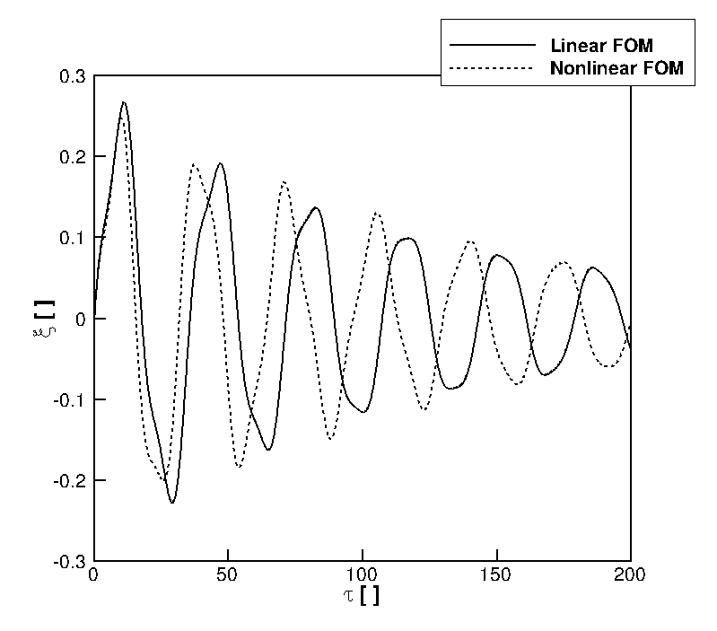
Full order model free response
Parameter:
α₀ = 15 deg
U* = 2.0
M = 0.3
Nonlinear:
β_{ξ3} = 10
Notes:
The performance of the 2 approaches was tested for a relatively short gust, about 12 times the aerofoil semi-chord. The approximation introduced with the ROM in vector form has a negative impact in this case. The ROM in matrix form is found to have a good agreement. ROMs were generated at a fraction of the cost of the FOM calculation, and their use in searching for a worst-case is possible.

Slide 19
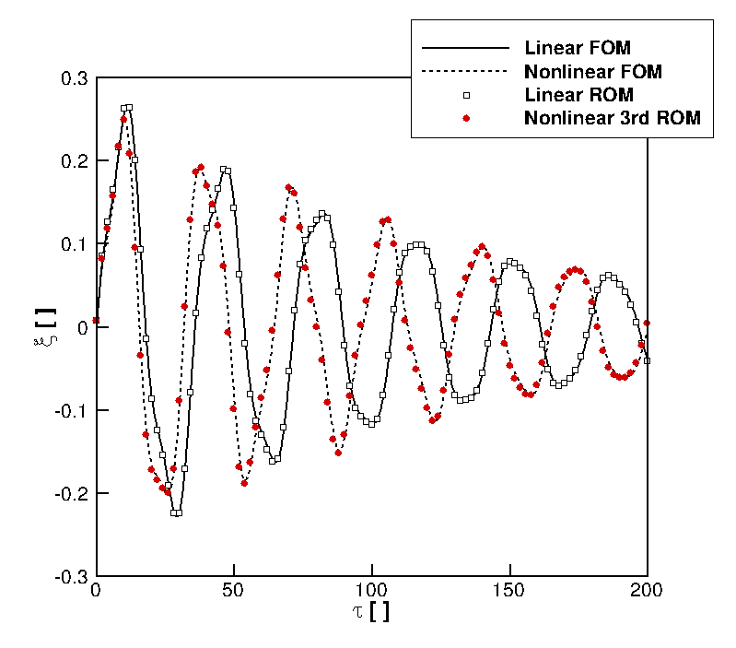
Full model dofs > 32,000
Reduced model dofs = 2
Notes:
The performance of the 2 approaches was tested for a relatively short gust, about 12 times the aerofoil semi-chord. The approximation introduced with the ROM in vector form has a negative impact in this case. The ROM in matrix form is found to have a good agreement. ROMs were generated at a fraction of the cost of the FOM calculation, and their use in searching for a worst-case is possible.

Slide 20
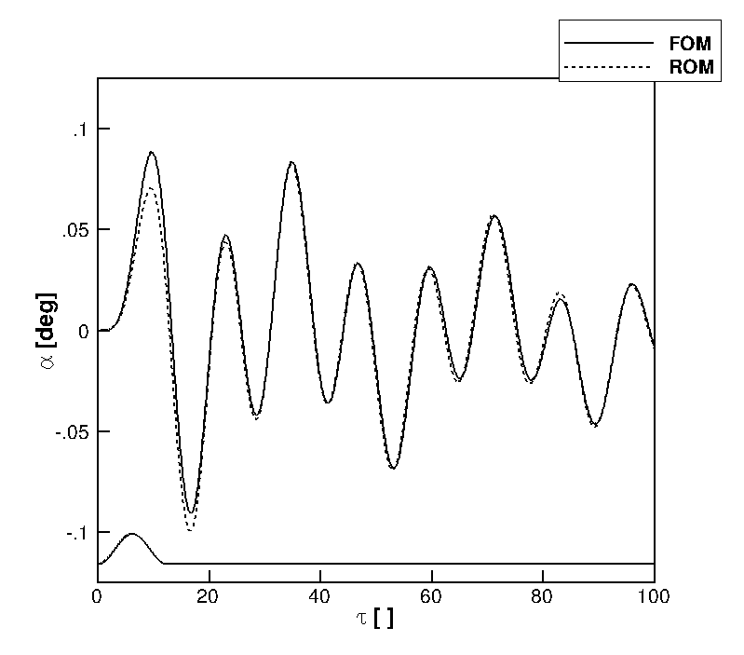
Full/Reduced order model gust response
Gust param:
“1-cos”
h_{g} = 12.5
w₀ = 0.01
Full model dofs > 32,000
Reduced model dofs = 2
Notes:
The performance of the 2 approaches was tested for a relatively short gust, about 12 times the aerofoil semi-chord. The approximation introduced with the ROM in vector form has a negative impact in this case. The ROM in matrix form is found to have a good agreement. ROMs were generated at a fraction of the cost of the FOM calculation, and their use in searching for a worst-case is possible.

Slide 21
Full/Reduced order model gust response
Gust param:
“1-cos”
h_{g} = 12.5
w₀ = 0.01
Linear method implemented in TAU DLR code
Gust loads prediction
→ S. Timme at 15.30 today (Stream B)
Full model dofs > 32,000
Reduced model dofs = 2
Notes:
The performance of the 2 approaches was tested for a relatively short gust, about 12 times the aerofoil semi-chord. The approximation introduced with the ROM in vector form has a negative impact in this case. The ROM in matrix form is found to have a good agreement. ROMs were generated at a fraction of the cost of the FOM calculation, and their use in searching for a worst-case is possible.

Slide 22
Fluid-Structure Interface
Interfacing CFD with CSD
incompatible topology
transfer forces/displacements between domains
Moving Least Square method
mesh-free, conservative, linear, ...
Quaranta et al., “A Conservative Mesh-Free Approach for Fluid-Structure Interface Problems”, Coupled Problems, 2005

Slide 23
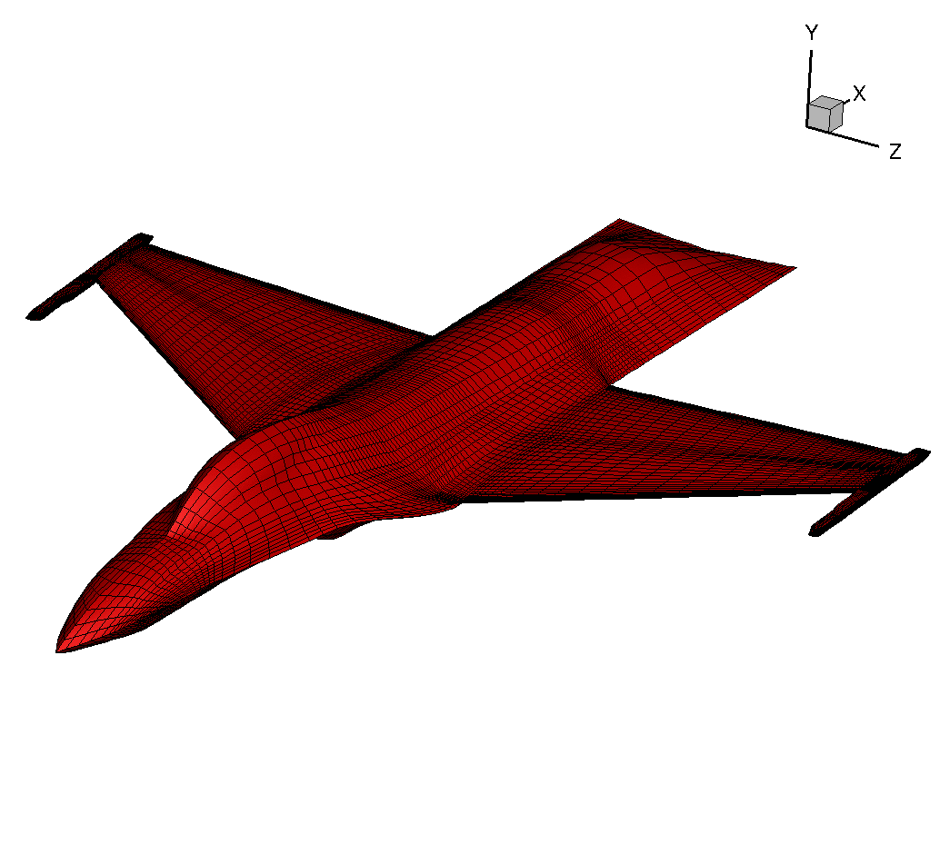
Fluid-Structure Interface
Open Source Fighter
struct points: 429
fluid points : 32,208
DSTL UAV
struct points: 1336
fluid points : 8310
More at http://www.cfd4aircraft.com/research_flexflight_fsi.html

Slide 24
Conclusion
Systematic approach to model reduction
applicable to any (fluid/structure/flight) systems
control design done in the same way
Enabling CFD-based analysis for
gust loads prediction, worst case search, GLA
SAS, performance optimization
Next step will be UAV gust analysis with control
gust loads prediction with CFD → S. Timme at 15.30 today
worst case gust search/GLA → N. Tantaroudas at 15.30 today
email: andreadr@liverpool.ac.uk web: http://www.cfd4aircraft.com/

