Slide 2
Nonlinear Model Reduction for Flexible Aircraft Control Design
A. Da Ronch and K.J. Badcock
University of Liverpool, UK
Bristol, 8 December 2011
FlexFlight: Nonlinear Flexibility Effects on Flight Dynamics & Control of Next Generation Aircraft

Slide 3
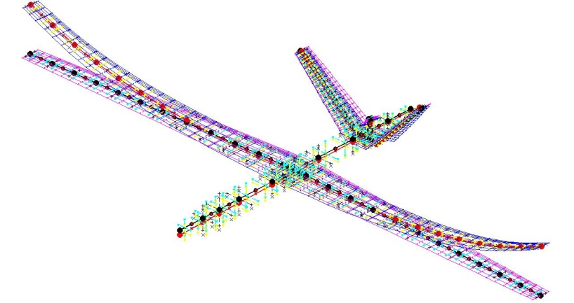
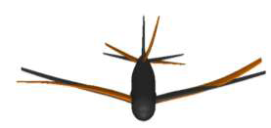
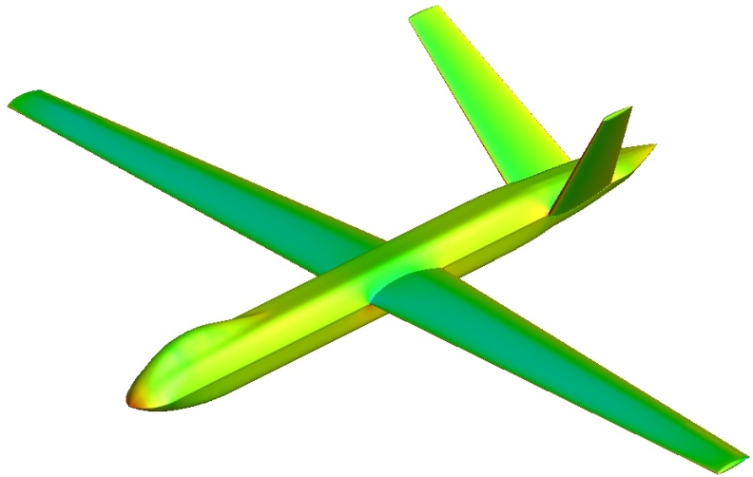
Overview
Very large or very flexible aircraft
- low frequency modes
coupled rigid body/structural dynamics
nonlinearities from structure and fluid
Control design for flexible aircraft FCS
Are nonlinear effects important? How much? Time/cost saving?

Slide 4
Nonlinearities from structure and fluid
physics-based simulation
How to reduce size for control design?
nonlinear model reduction
How to test the FCS for 100k runs?
model hierarchy^{1,2}
1. Da Ronch et al., “On the generation of flight dynamics aerodynamic tables by computational fluid dynamics,” Progress in Aerospace Sciences 2011; 47(8): 597-620
2. Badcock et al., “Transonic aeroelastic simulation for envelope searches and uncertainty analysis,” Progress in Aerospace Sciences 2011; 47(5): 392-423

Slide 5
Full Order Model
Nonlinear system (aeroelastic + rigid body modes)
Large dimension (CFD)
Expensive to solve in routine manner

Slide 6
Taylor Series
Taylor series expansion of R
Equilibrium point, w₀: w’ = w-w₀
Manipulable control, u_{c}, and external disturbance, u_{d}
Jacobian

Slide 7
Model Reduction
Eigenvalue problem of Jacobian, A
Modal matrices, m<n
Biorthogonality conditions
Project the FOM onto a small basis of aeroelastic eigenmodes

Slide 8
Linear Reduced Model
Linear FOM around w₀
Transformation of coordinates: linear ROM

Slide 9
Nonlinear Reduced Model
Higher order terms in the FOM residual
B involves ~m² terms and C ~m³ (matrix-free products)

Slide 10
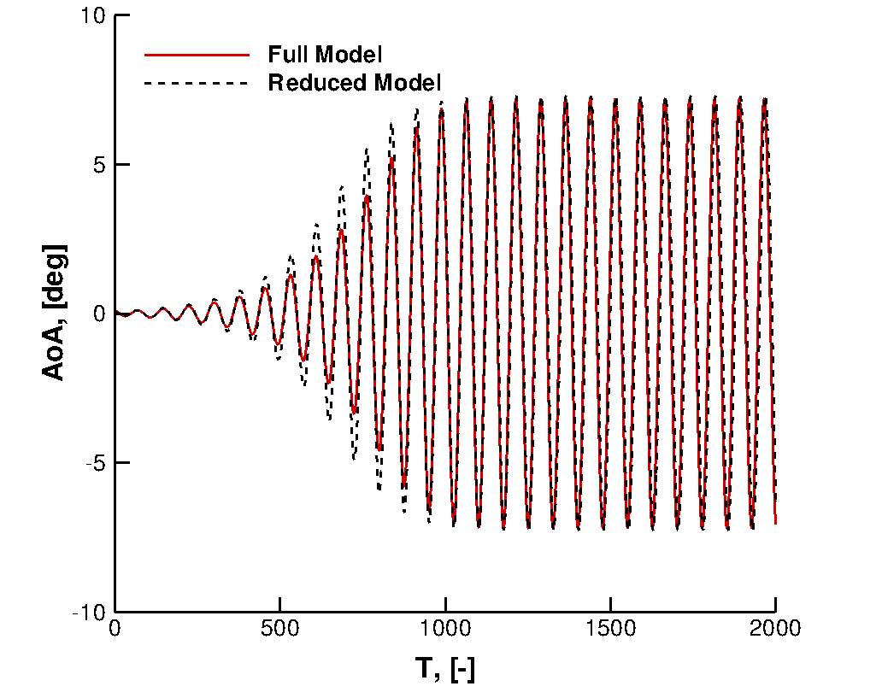
Flutter suppression/LCO control → 1 frequency, 1 mode
Gust alleviation → large frequency spectrum, several modes

Slide 11
Example
Linear(ized) structural model
Wagner+Küssner functions, convolution (IDEs→ODEs)
Imposed (external) gust

Slide 12
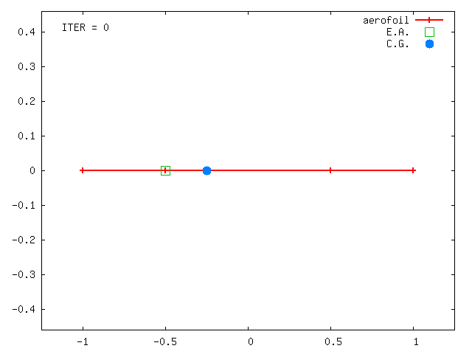
Aerofoil Section
2 DoFs structural model
Flap for control
Gust perturbation
12 states
Nonlinear restoring forces

Slide 13
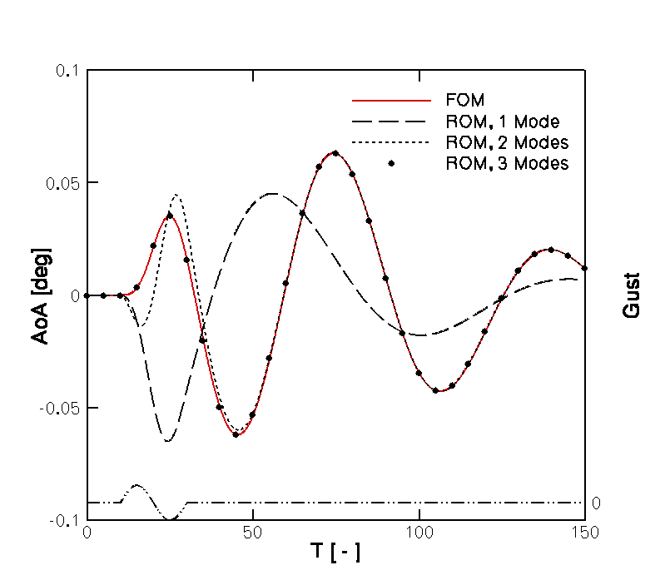
FOM/ROM gust response – linear structural model

Slide 14
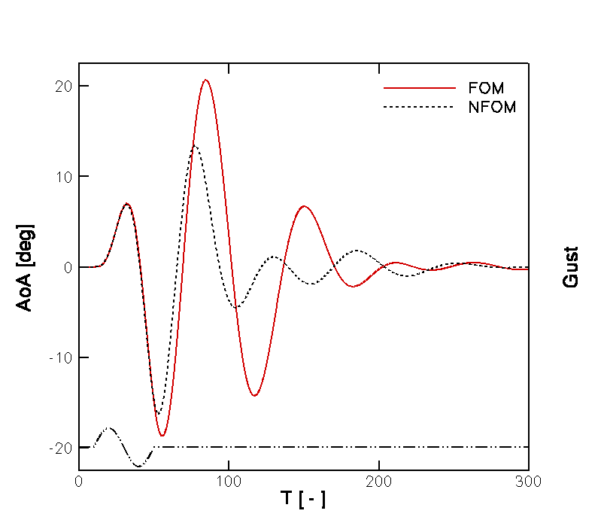
FOM gust response – linear/nonlinear structural model

Slide 15
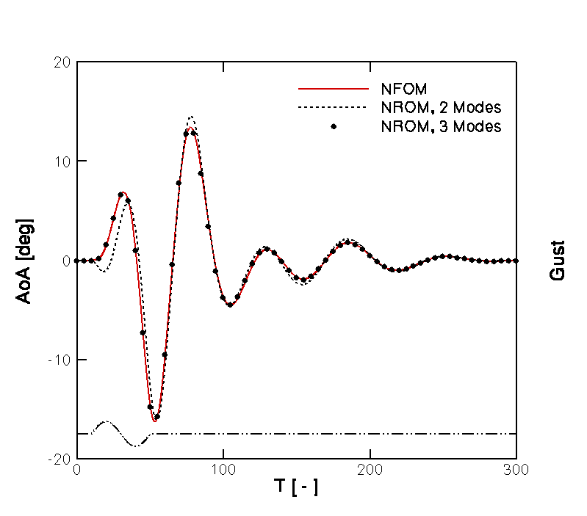
FOM/ROM gust response – nonlinear structural model

Slide 16
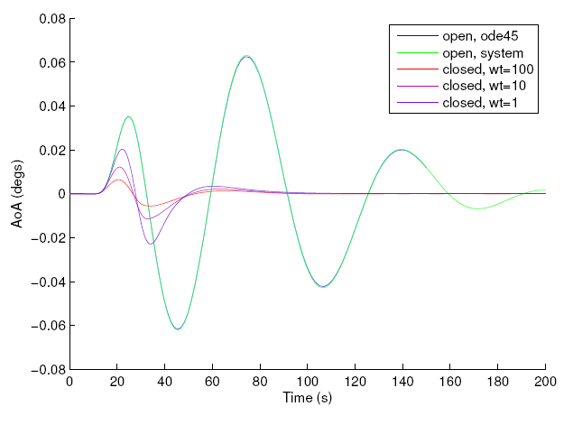
Linear control law - H∞ (with Yinan Wang and Andrew Wynn)
C_{L}

Slide 17
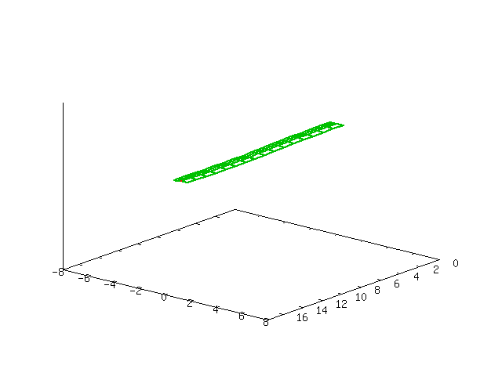
HALE wing
Linear stability analysis (ρ∞ = 0.0899 kg/m, h = 20000 m)
Stability around trimmed point? → large deflection
 | U_{F} [m/s] | ω_{F} [rad/s]
Present (2D) | 102 | 69.7
VLM¹ | 104 | 72.4
1. Murua et al., “Stability and open-loop dynamics of very flexible aircraft including free-wake effects,” AIAA paper 2011-1915

Slide 18
Conclusions
Nonlinear model reduction (large dynamical system)
Gust alleviation based on ROMs → FOM
Include rigid body dynamics – test model reduction
Extend aerodynamics to CFD
Control design for beam model

Slide 19
Confirmed meeting 2011
To be confirmed first quarter 2012

