Slide 1
Python-based Framework for CFD-based Simulation of Free-Flying Flexible Aircraft: Progress
A. Da Ronch
University of Liverpool, U.K.
email: andreadr@liverpool.ac.uk web: http://www.cfd4aircraft.com/
IC, London, U.K.
07 February 2013
Notes:
This presentation is about gust loads prediction and alleviation using a reduced model, which potentially comes from a CFD model.

Slide 2
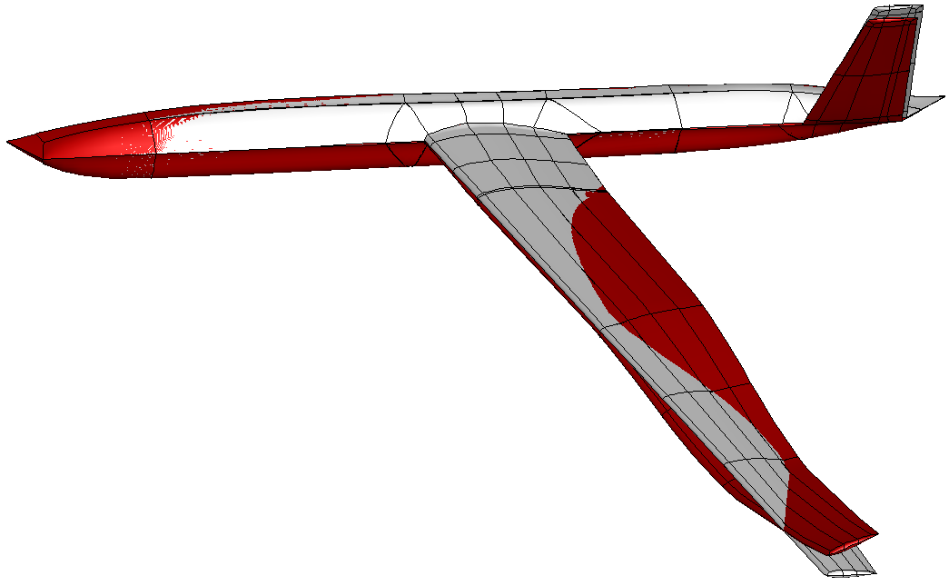
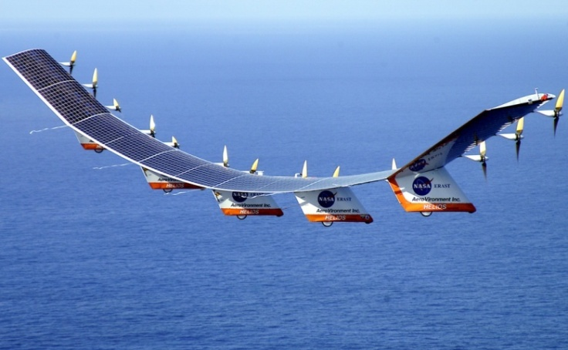
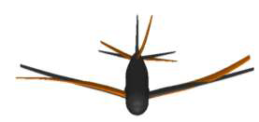
Motivation
Physics-based simulation of very flexible aircraft gust interaction
large amplitude/low frequency modes
coupled rigid body/structural dynamics
nonlinearities from structure/fluid (& control)
Nonlinear model reduction for control design
system identification methods
manipulation of full order residual
Control design for FCS of flexible aircraft
Notes:
We have in mind very flexible aircraft, which are the main driver for the computational framework that I am going to illustrate. Very flexible aircraft can be intrinsically unstable, requiring a stability augmentation system, and sensible to atmospheric gust, you are possibly familiar with the failure of the NASA HELIOS. In addition to these key aspects, very flexible aircraft exhibit low frequency natural modes which are close, or even overlapping, the modes of the flight mechanics. Therefore, it is suspect or erroneous to design a conventional flight control system filtering out the frequencies of structural vibrations. An integrated approach has to be used.
The target we have set is to use a physics-based formulation to realistically predict nonlinearities arising from the structure, large deformations, and the fluid, separation and shock motion. The mathematical model of the coupled system based on nonlinear beams, from IC, and CFD is potentially very large in dimension and expensive to solve. The role of a model reduction for control design is therefore fundamental. The approach based on the manipulation of the coupled residual is chosen, retaining the ability to describe relevant nonlinearities. The other approach to model reduction is system identification, but the lack of robustness and dependence on the training data are well-known issues.

Slide 3
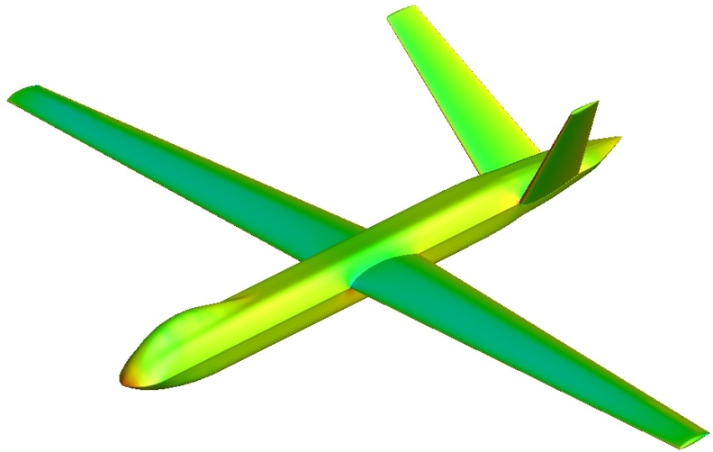
Full Model
fluid/structure/flight
large order

Slide 4
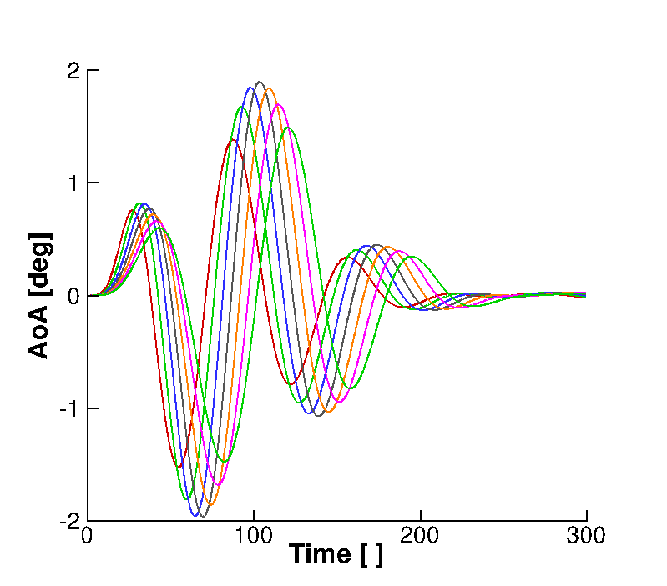
Full Model
fluid/structure/flight
large order
Worst-case Gust
shape
wavelength
altitude

Slide 5
Full Model
fluid/structure/flight
large order
Reduced Model
build once
time integration
Worst-case Gust
shape
wavelength
altitude

Slide 6
Full Model
fluid/structure/flight
large order
Reduced Model
build once
time integration
Worst-case Gust
shape
wavelength
altitude
Candidate Gust

Slide 7
Full Model
fluid/structure/flight
large order
Reduced Model
build once
time integration
Worst-case Gust
shape
wavelength
altitude
Candidate Gust

Slide 8
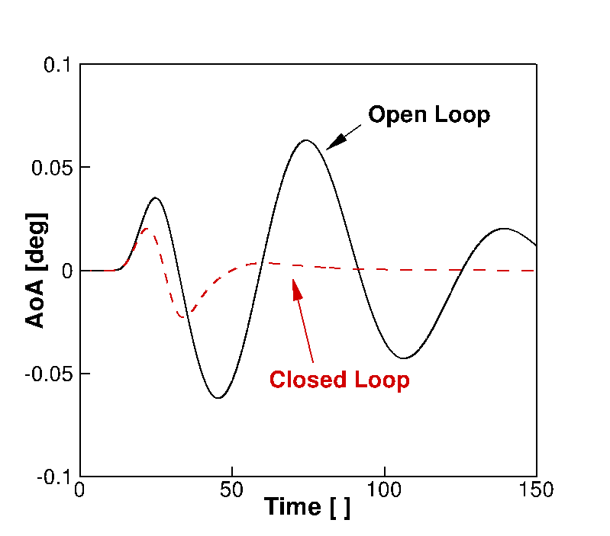
Full Model
fluid/structure/flight
large order
Reduced Model
build once
time integration
Worst-case Gust
shape
wavelength
altitude
GLA
- control on SS form
Candidate Gust

Slide 9
Full Model
fluid/structure/flight
large order
Reduced Model
build once
time integration
Worst-case Gust
shape
wavelength
altitude
GLA
- control on SS form
Candidate Gust
done for linear aero + nonlinear beam
ready for CFD + aerofoil
to be done for CFD + nonlinear beam

Slide 10
PML: Parallel MeshLess
Simulation of complex geometries in relative motion
Cloud of points
Euler, laminar and RANS
Schur complement
Kennett et al., “An Implicit Meshless Method for Application in Computational Fluid Dynamics”, International Journal for Numerical Methods in Fluids; 2012
Notes:
The CFD solver used is a research code developed at the UoL. It has been developed to overcome the burden of grid generation and to enable flow simulations around complex geometries in relative motion, like the store release from an aircraft. It solves the Euler, laminar and RANS eqs on clouds of points as opposed to traditional finite volume grids. The solver is implicit and uses a preconditioned Krylov subspace method and dual-time stepping to perform the time integration.

Slide 11
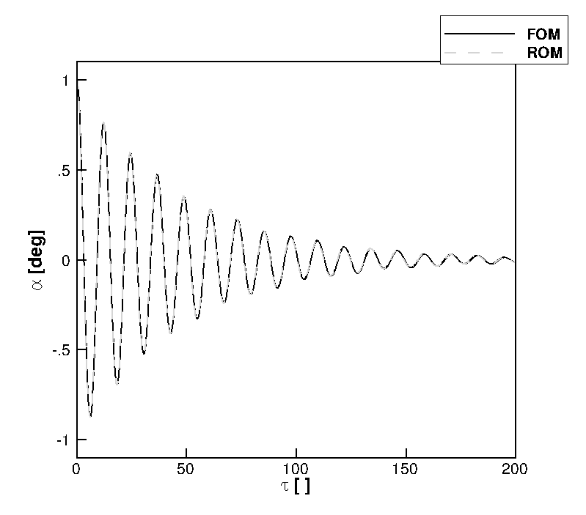
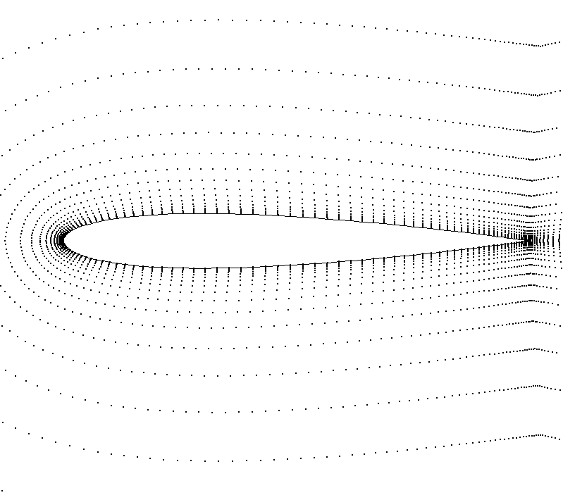
Pitch-Plunge Aerofoil with CFD
Structure: linear/nonlinear
Euler equations
7974 points
“Heavy” case
r_{α} = 0.539
µ = 100
ω_{ξ}/ω_{α} = 0.343
Notes:
Coming to the last application example, which features a pitch-plunge aerofoil model coupled with CFD where a dramatic reduction of number of states can be made. The Euler eqs are solved on a distribution of about 8000 points. The aeroelastic parameters correspond to the heavy case described in previous work.

Slide 12
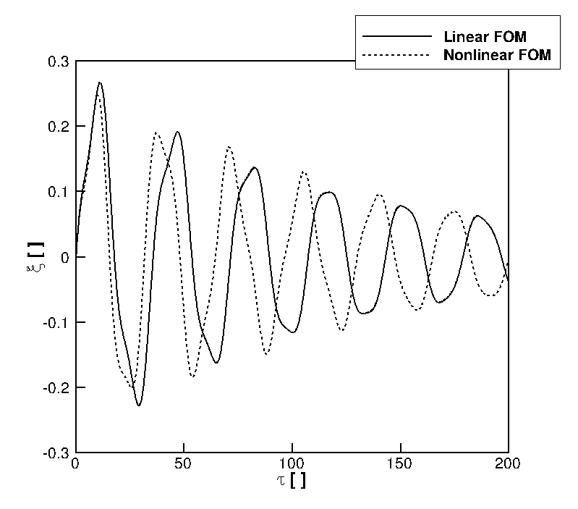
Free response - full model
Parameter:
α₀ = 15 deg
U* = 2.0
M = 0.3
Nonlinear:
β_{ξ3} = 10
Notes:
The performance of the 2 approaches was tested for a relatively short gust, about 12 times the aerofoil semi-chord. The approximation introduced with the ROM in vector form has a negative impact in this case. The ROM in matrix form is found to have a good agreement. ROMs were generated at a fraction of the cost of the FOM calculation, and their use in searching for a worst-case is possible.

Slide 13
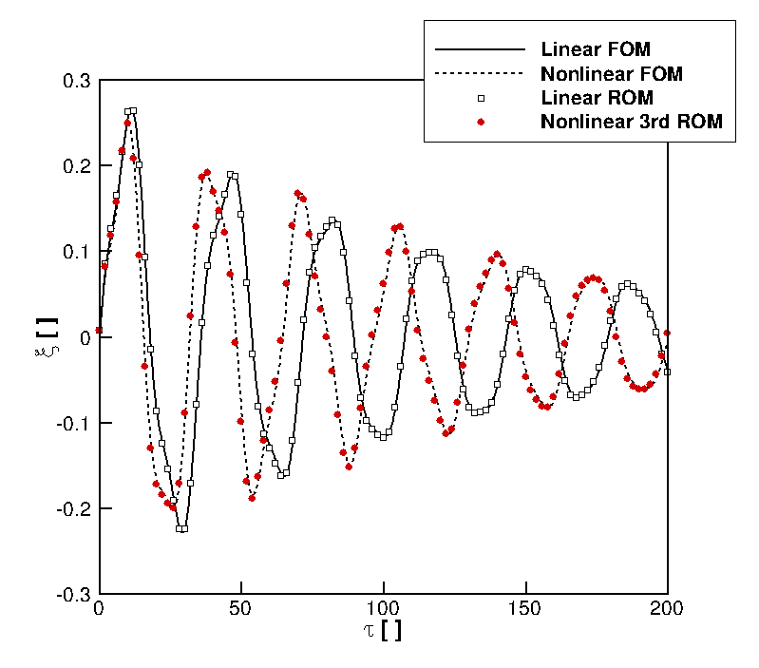
Free response - full/reduced model
Full model dofs > 32,000
Reduced model dofs = 2
Notes:
The performance of the 2 approaches was tested for a relatively short gust, about 12 times the aerofoil semi-chord. The approximation introduced with the ROM in vector form has a negative impact in this case. The ROM in matrix form is found to have a good agreement. ROMs were generated at a fraction of the cost of the FOM calculation, and their use in searching for a worst-case is possible.

Slide 14
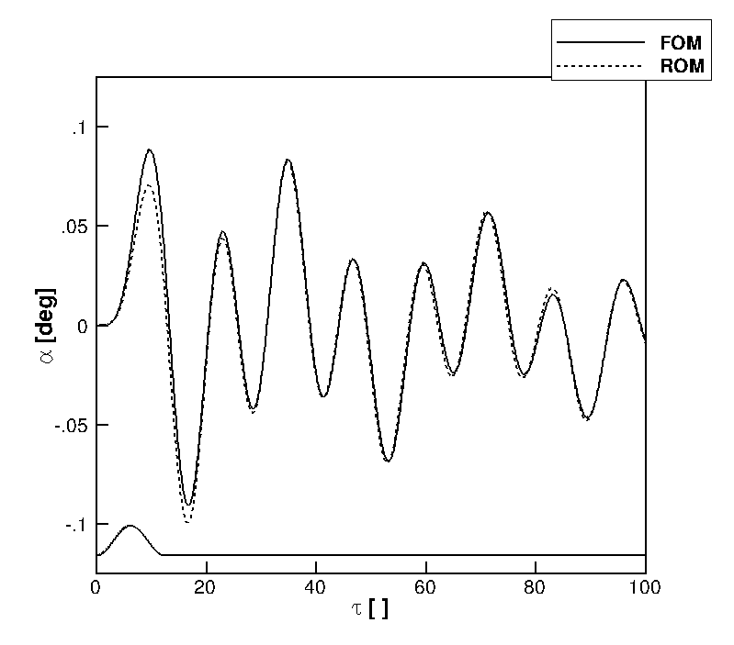
Gust response - full/reduced model
Gust param:
“1-cos”
h_{g} = 12.5
w₀ = 0.01
Full model dofs > 32,000
Reduced model dofs = 2
Notes:
The performance of the 2 approaches was tested for a relatively short gust, about 12 times the aerofoil semi-chord. The approximation introduced with the ROM in vector form has a negative impact in this case. The ROM in matrix form is found to have a good agreement. ROMs were generated at a fraction of the cost of the FOM calculation, and their use in searching for a worst-case is possible.

Slide 15
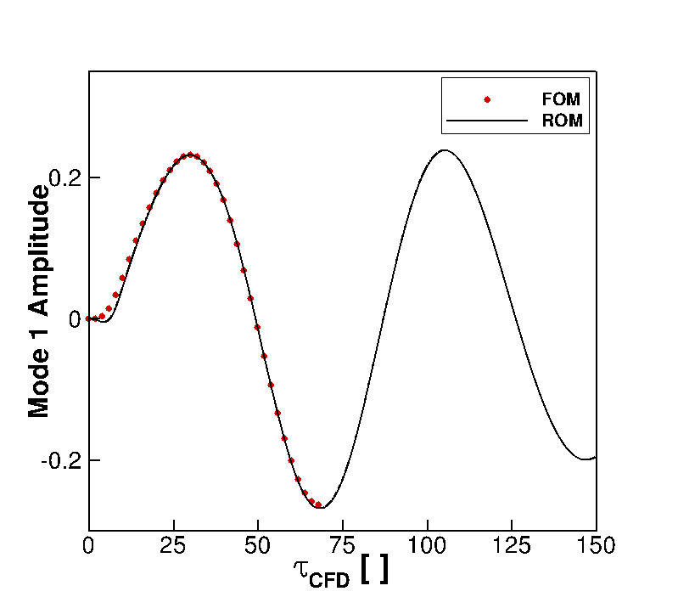
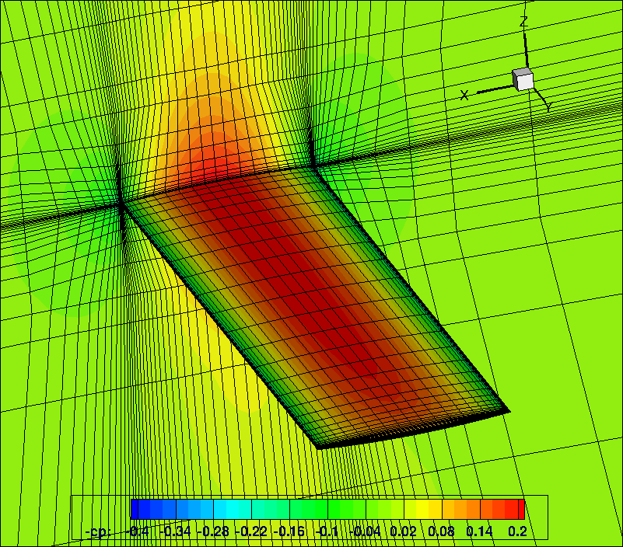
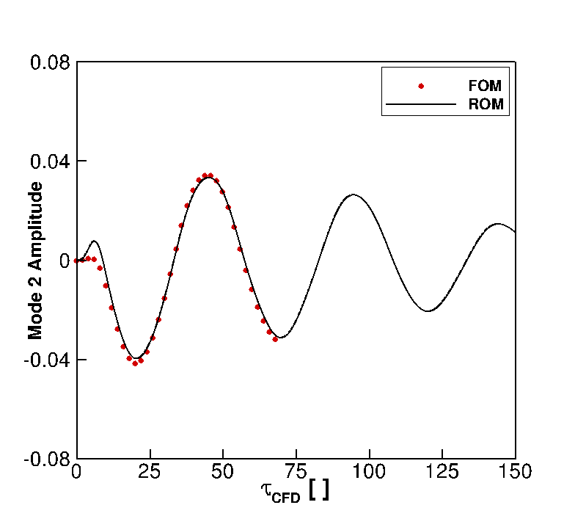
Goland Wing with CFD
Gust response - full/reduced model
Full model dofs > 100,000
Reduced model dofs = 2

Slide 16
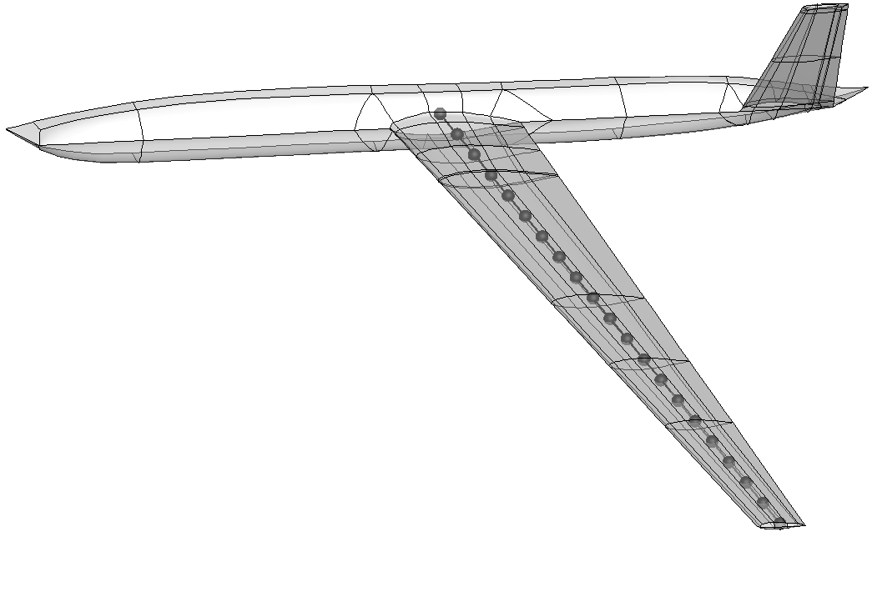
Fluid-Structure Interaction
Coupling CFD + CSD
incompatible topology
transfer forces/displacements between domains
Surface mesh deformation
Moving Least Square method (MLS) [1]
mesh-free, conservative, linear, ...
Volume mesh deformation
Inverse Distance Weighting (IDW) [2] or MLS
[1] Quaranta et al., “A Conservative Mesh-Free Approach for Fluid-Structure Interface Problems”, Coupled Problems, 2005
[2] Witteveen, “Explicit and Robust Inverse Distance Weighting Mesh Deformation for CFD”, AIAA-2010-0165

Slide 17
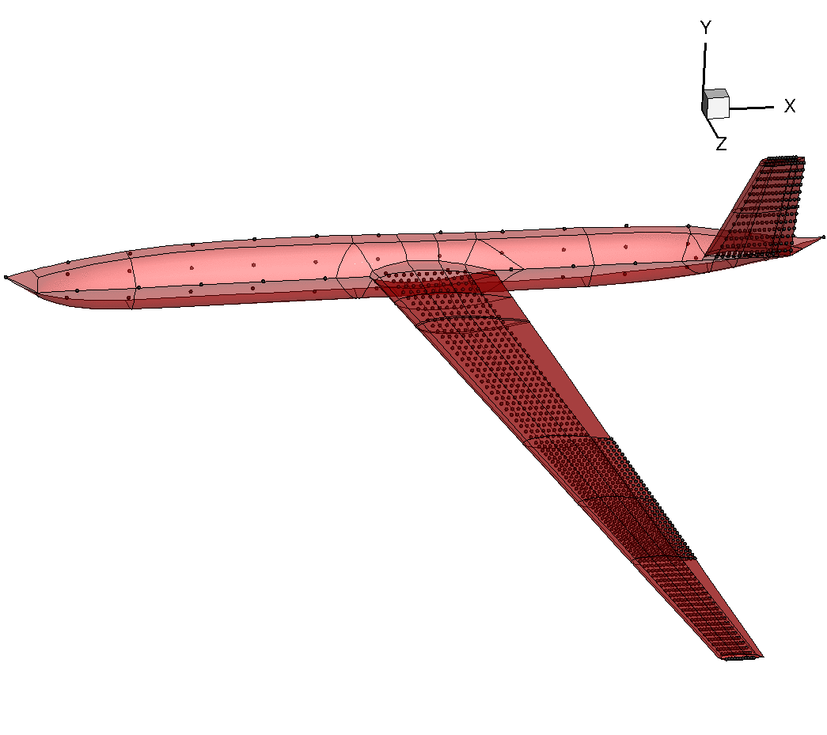
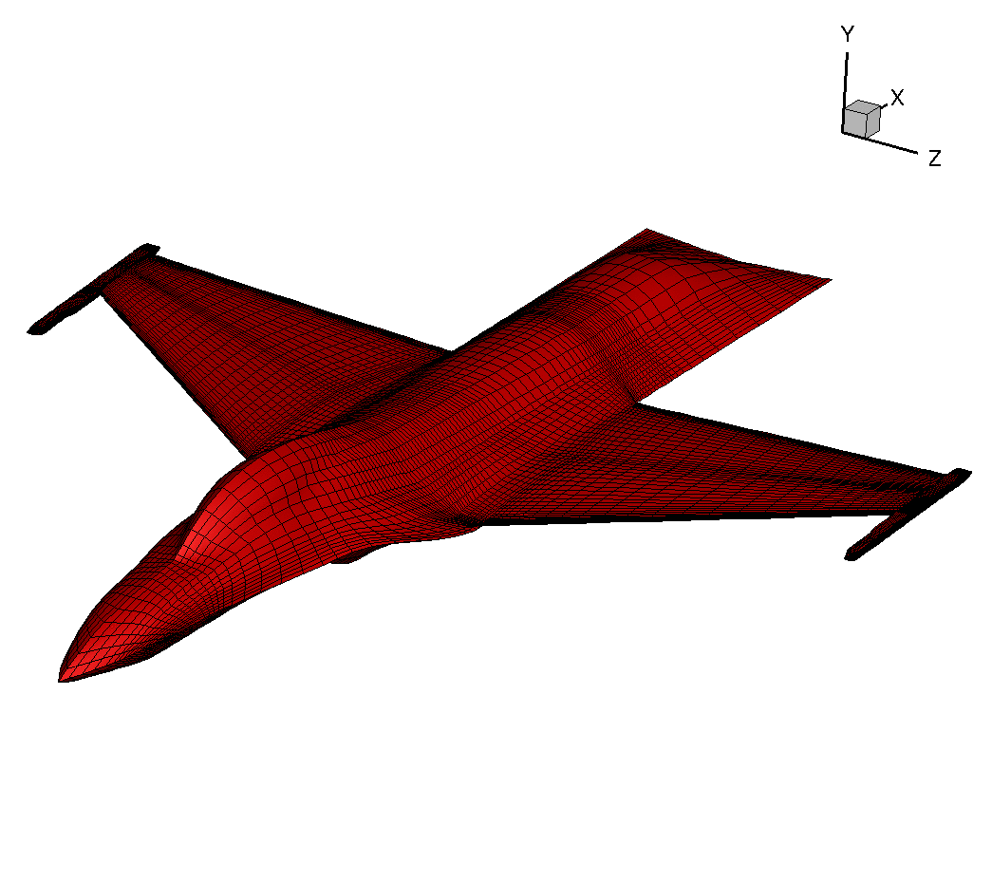
Open Source Fighter
struct points: 429
fluid points : 32,208
DSTL UAV
struct points: 1336
fluid points : 8310
More at http://www.cfd4aircraft.com/research_flexflight_fsi.html

Slide 18
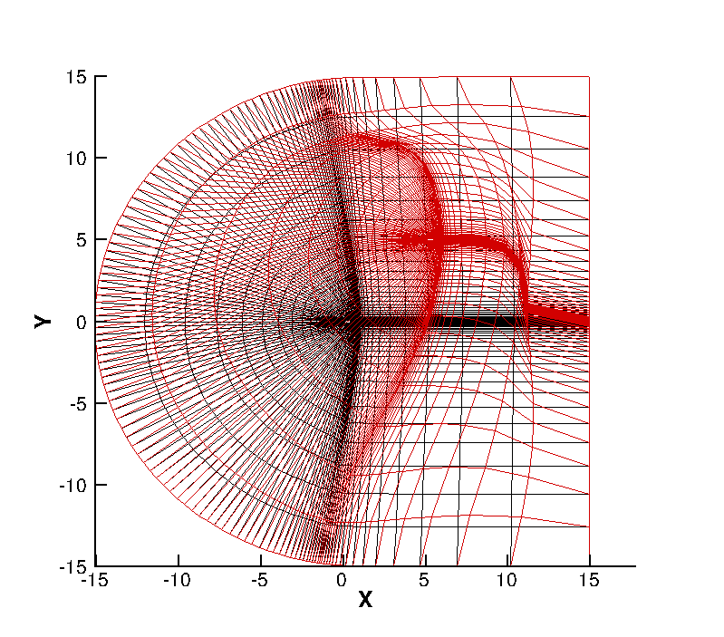
Deformation:
Δx = 5 chords
Δy = 5 chords

Slide 19
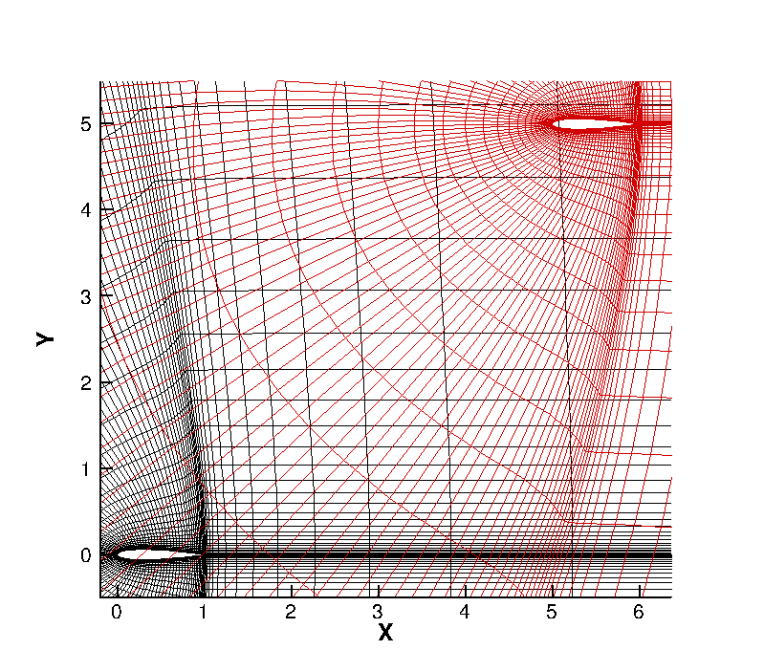

Slide 20
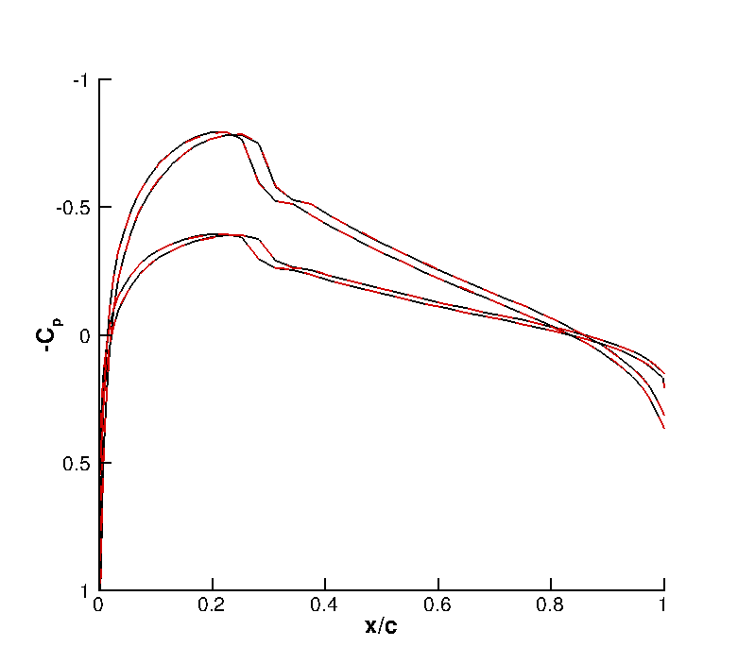
Simulation:
M = 0.755
α = 0.016 deg
conv = 10⁻¹⁴

Slide 21
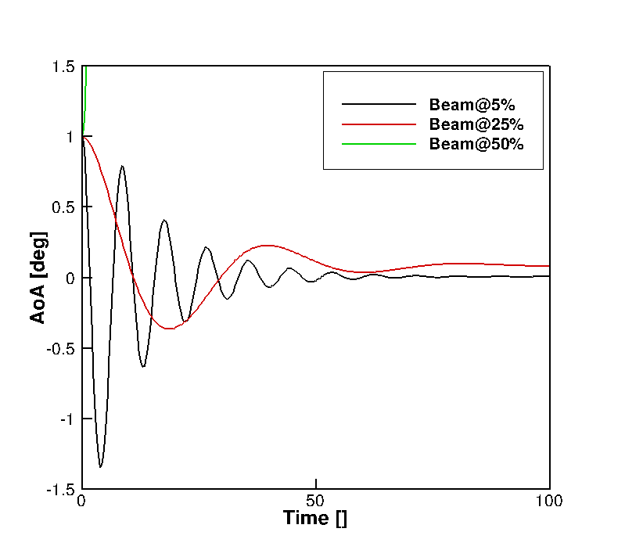
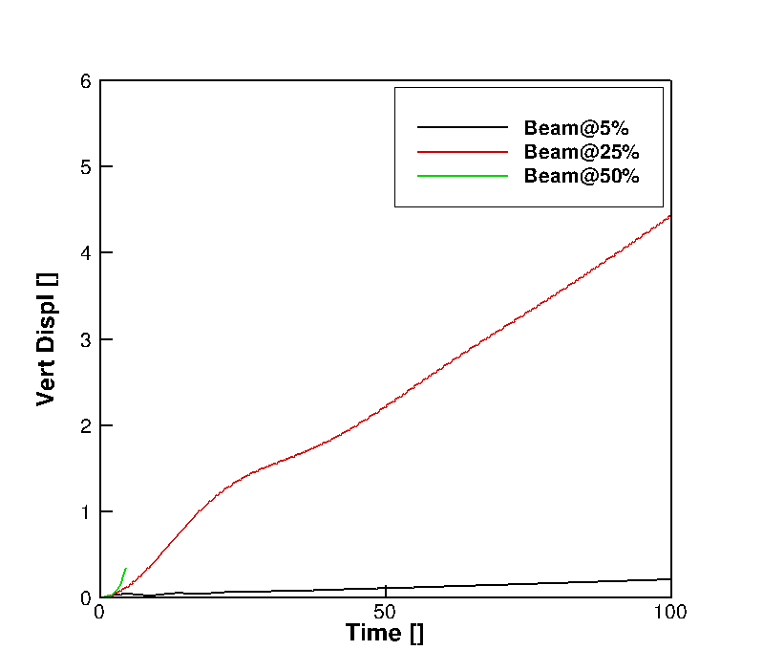
Flight Dynamics with CFD

Slide 22
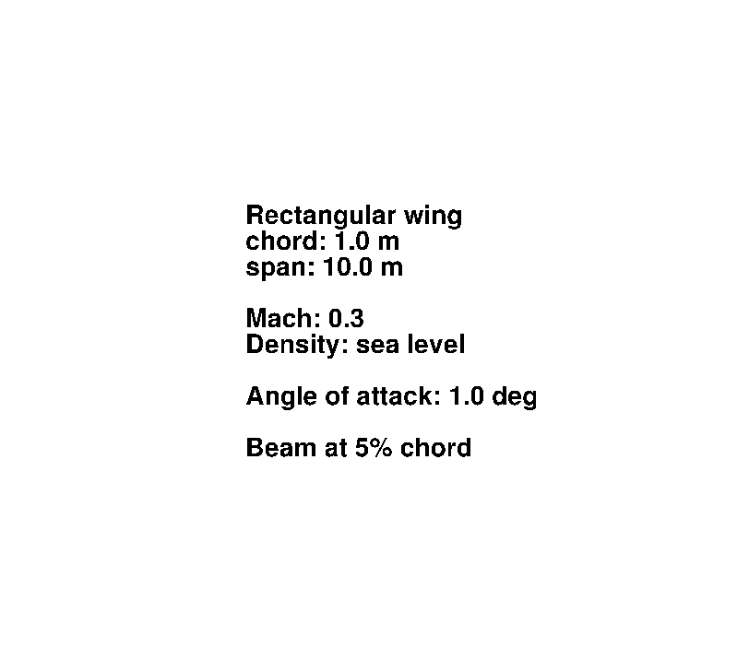

Slide 23
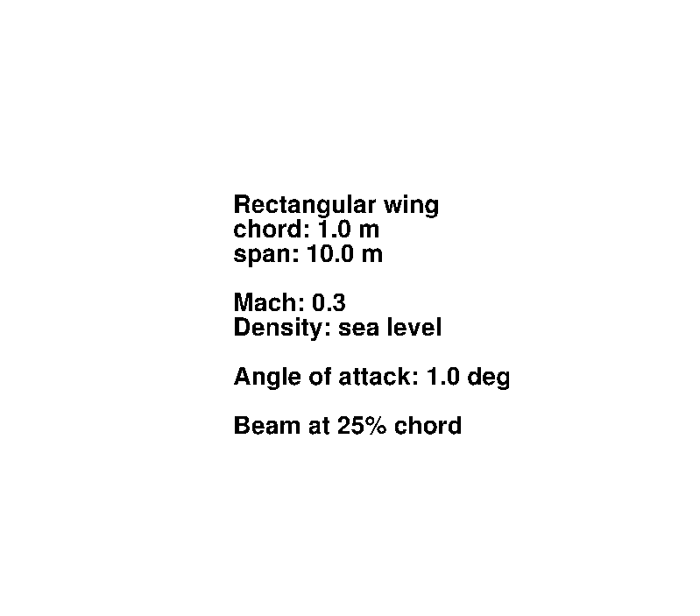

Slide 24
# PyFlexFlight.py
import Aerodynamics
import RigidBodyDyn
...
# Coupled unsteady simulation
for n in range(nstep):
self.RunTimestep()
# Aerodynamics.py
from wrap_CFD import *
# Wrap C/C++/F77 code
# Access dynamic shared library
# RigidBodyDyn.py
from wrap_Beam import *
# Wrap F90 code
# Access dynamic shared library
# MeshDeformation.py
from wrap_MeshDef import *
# Wrap C code
# Access dynamic shared library
A “new” framework implemented to add flexibility/coupling different codes

Slide 25
# PyFlexFlight.py
import Aerodynamics
import RigidBodyDyn
...
# Coupled unsteady simulation
for n in range(nstep):
self.RunTimestep()
# Perform inner iterations
def RunIteration():
Aerodynamics.UpdateRigidMotion()
Aerodynamics.RunIteration()
Aerodynamics.GetBodyLoads()
self.TransferLoads()
RigidBodyDyn.RunIteration()
RigidBodyDyn.GetPosVel()
self.TransferMotion()

Slide 26
# PyFlexFlight.py
import Aerodynamics
import RigidBodyDyn
...
# Coupled unsteady simulation
for n in range(nstep):
self.RunTimestep()
# Perform time-step iteration
def RunTimeStep():
Aerodynamics.AdvanceTime()
RigidBodyDyn.AdvanceTime()
while(not converged):
self.RunIteration()
Aerodynamics.WriteData()
RigidBodyDyn.WriteData()
# Perform inner iterations
def RunIteration():
Aerodynamics.UpdateRigidMotion()
Aerodynamics.RunIteration()
Aerodynamics.GetBodyLoads()
self.TransferLoads()
RigidBodyDyn.RunIteration()
RigidBodyDyn.GetPosVel()
self.TransferMotion()

Slide 27
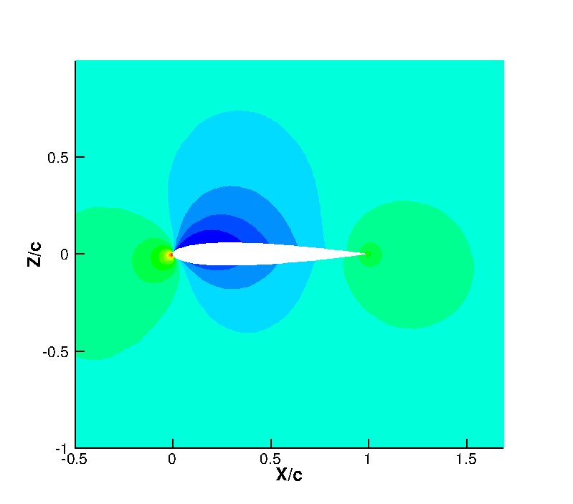
# PyFlexFlight.py
import Aerodynamics
import RigidBodyDyn
...
# Coupled unsteady simulation
for n in range(nstep):
self.RunTimestep()
# Perform time-step iteration
def RunTimeStep():
Aerodynamics.AdvanceTime()
RigidBodyDyn.AdvanceTime()
while(not converged):
self.RunIteration()
Aerodynamics.WriteData()
RigidBodyDyn.WriteData()
# Perform inner iterations
def RunIteration():
Aerodynamics.UpdateRigidMotion()
Aerodynamics.RunIteration()
Aerodynamics.GetBodyLoads()
self.TransferLoads()
RigidBodyDyn.RunIteration()
RigidBodyDyn.GetPosVel()
self.TransferMotion()

Slide 28
Conclusion
Systematic approach to model reduction
applicable to any (fluid/structure/flight) systems
control design done in the same way
Python-based framework
flight dynamics + CFD shown
FSI method implemented
to add structural flexibility
Towards CFD-based analysis of free-flying flexible aircraft
gust loads prediction, worst case search, GLA
SAS, performance optimization
email: andreadr@liverpool.ac.uk web: http://www.cfd4aircraft.com/

