Slide 1
Update on FlexFlight
G. Guanqun, N.D. Tantaroudas, and A. Da Ronch
A.Da-Ronch@soton.ac.uk
Imperial College London
London, U.K., 16 August 2013

Slide 2
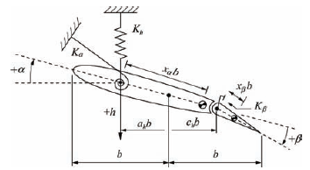
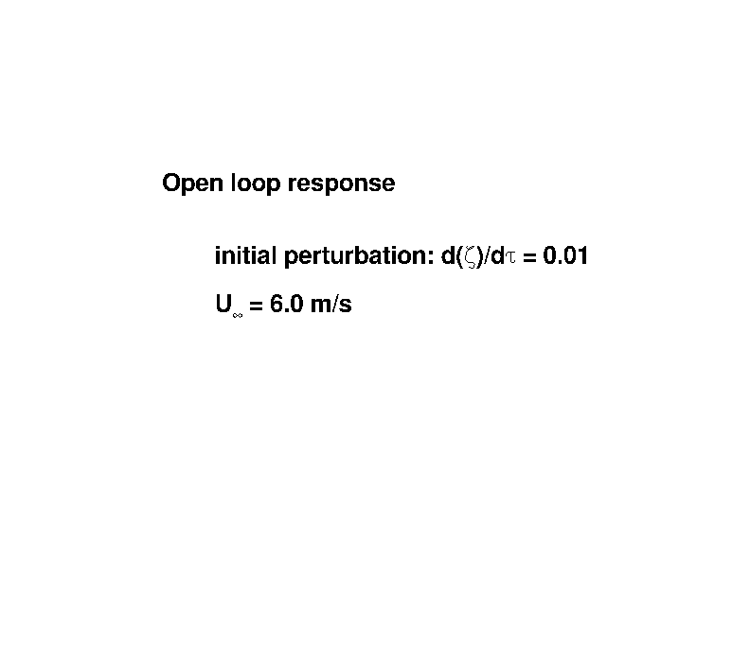
3 dofs Pitch-Plunge Aerofoil
Validation against Ref. [1]
Features:
- control surface free-play
- closed-loop response
- (non-linear) model reduction
Ref. [1]
µ = 100.
ω_{r1} = 1.2
r_{α} = 0.5
x_{α} = 0.25
a_{h} = -0.5
x_{β} = 0.0125
ω_{r2} = 3.5
r_{β} = 0.0791
c_{h} = 0.6
[1] Irani et al., “Bifurcation in a 3-DOF Airfoil with Cubic Structural Nonlinearity”, Chinese Journal of Aeronautics, 2011; 24(3): 265-278

Slide 3
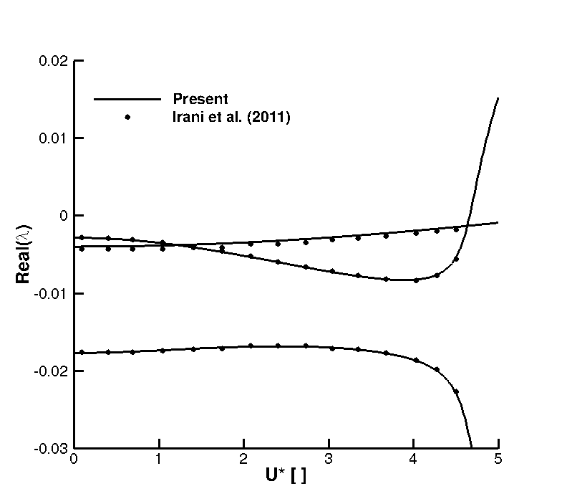

Slide 4
2 dofs Pitch-Plunge Aerofoil
Validation against Ref. [2]
Control surface free-play: 0.25deg < α < 0.75deg
µ = 100.
ω_{r} = 0.2
r_{α} = 0.5
x_{α} = 0.25
a_{h} = -0.5
[2] Liu et al., “Non-linear Aeroelastic Analysis using the Point Transformation Method Part 1: Freeplay Model”, Journal of Sound and Vibrations, 2002; 253(2): 447-469

Slide 5
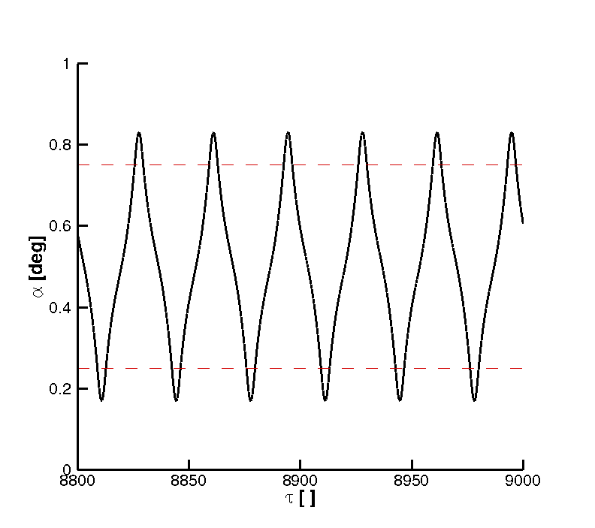
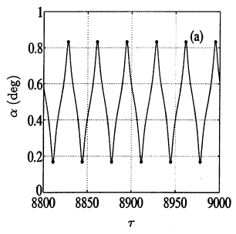
U/U_{L} = 0.20
Ref. [2]

Slide 6
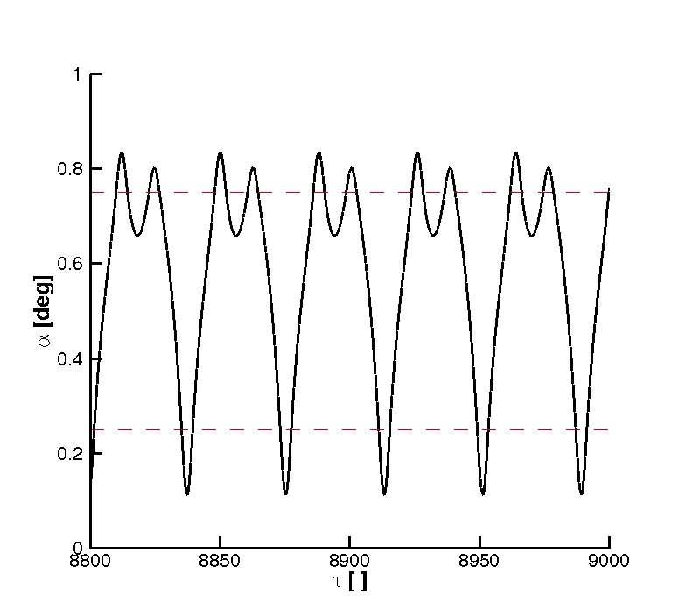
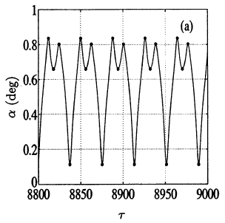
U/U_{L} = 0.22
Ref. [2]

Slide 7
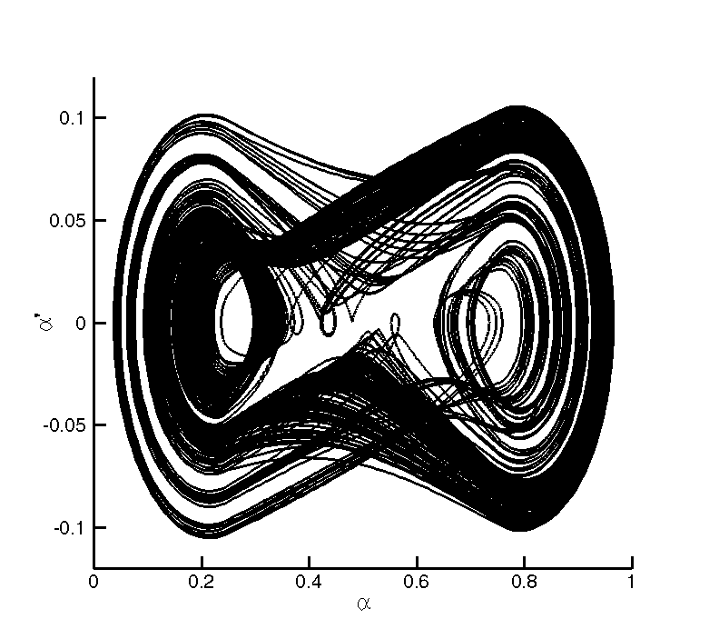
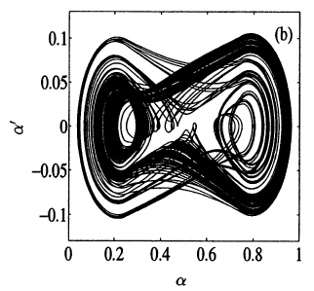
U/U_{L} = 0.30
Ref. [2]

Slide 8
pyFlexFlight
Linear Aero + Nonlinear Beam
Validation against NASTRAN
Gust response of clamped wing
Structural Properties
E = 7.1·10¹⁰ N m⁻²
ν = 0.33
ρ_{m}= 2.703·10⁴ N m⁻³
Geometry/FEM Properties
L = 16 m
Square cross-section (28 cm)
16 elements (CBAR)
Gust Properties
“one-minus-cosine”
W₀/U = 0.08
f = 0.25 Hz
Flow Properties
U = 10 m s⁻¹
ρ_{a} = 0.08 kg m⁻³

Slide 9
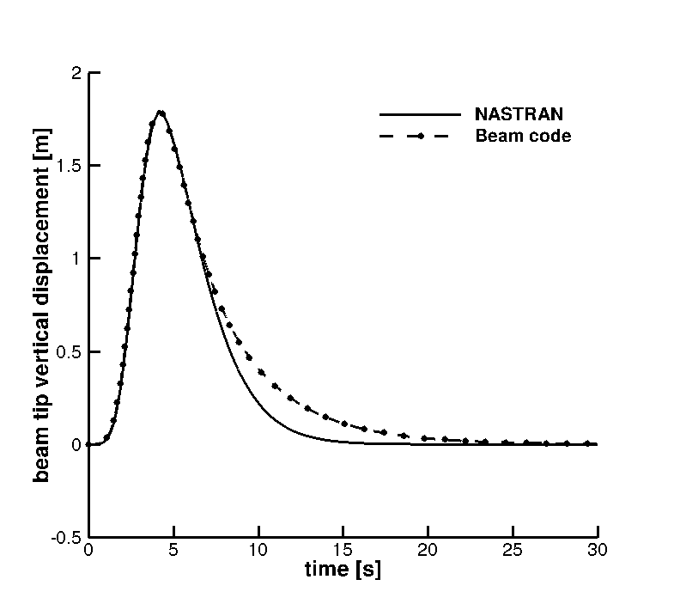

Slide 10
pyFlexFlight
Linear Aero + Nonlinear Beam + Nonlinear Flight
Gust response of flexible flying wing
U = 20 m/s
α = 0 deg
ρ = 0.726 kg/m³

Slide 11
Animation

Slide 12
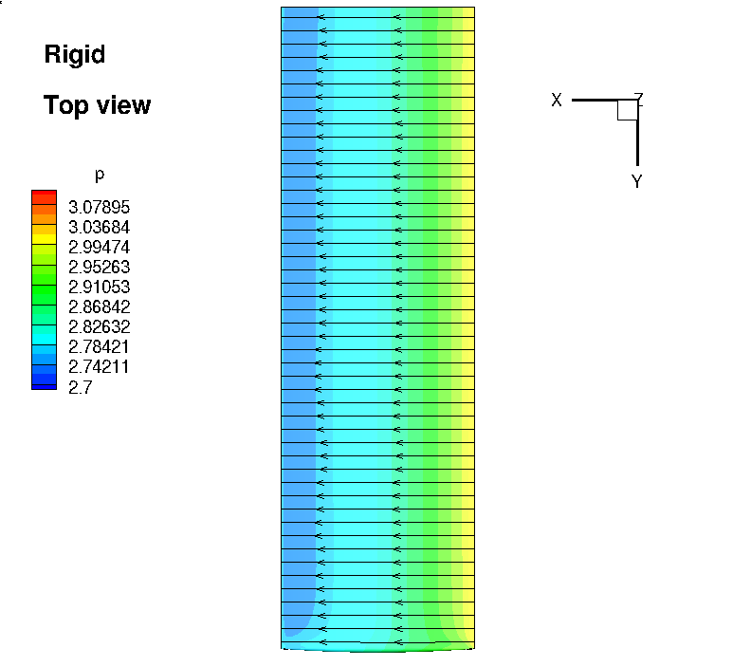
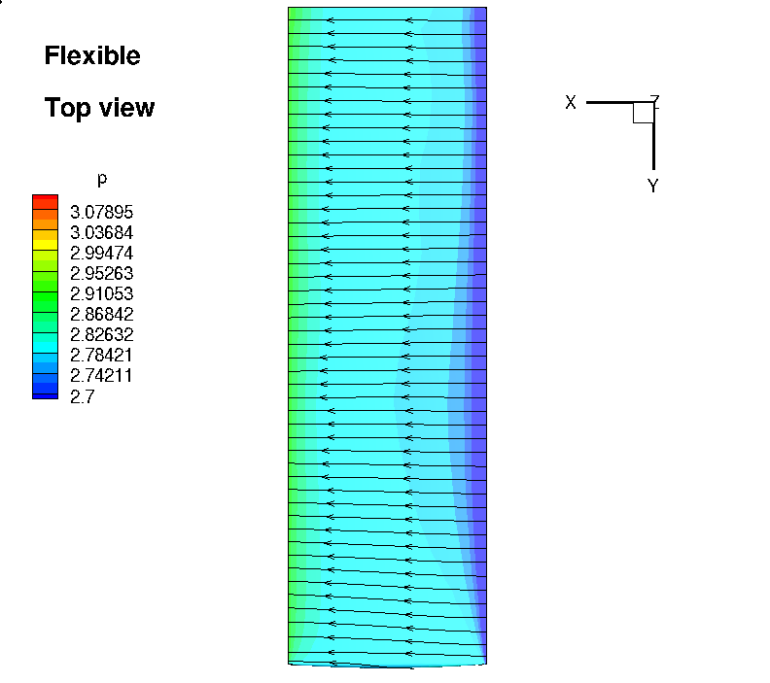
pyFlexFlight
CFD + Nonlinear Beam
Static aeroelastic response of Goland wing
M = 0.5
α = 0.8 deg
h = 9000 ft

Slide 13
Animation

Slide 14
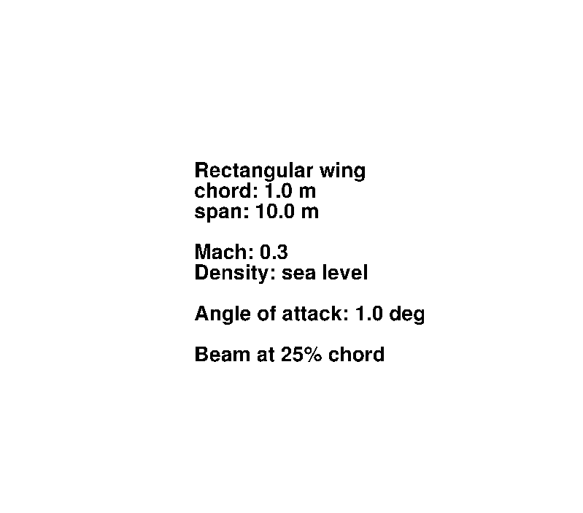
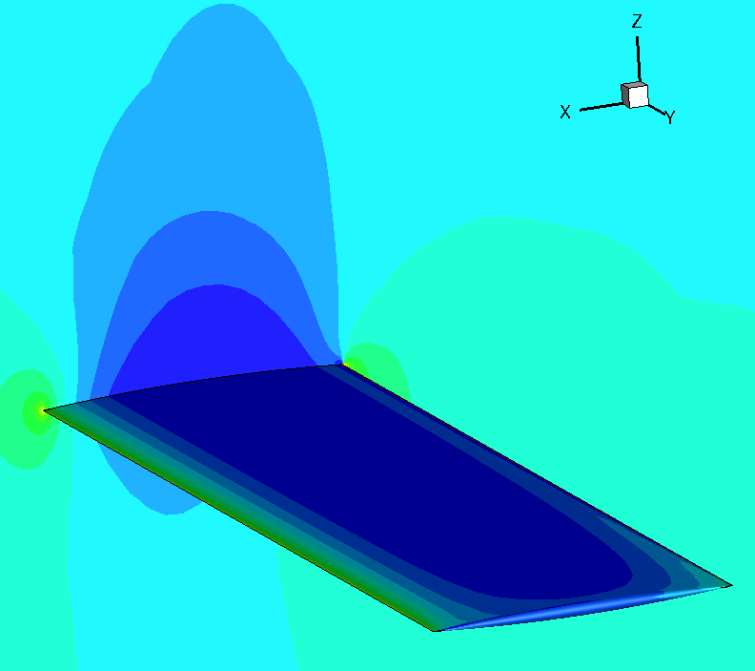
pyFlexFlight
CFD + Nonlinear Flight
Free response of rigid flying wing
M = 0.75
α = 1.0 deg
h = 0 m
M = 0.3

Slide 15
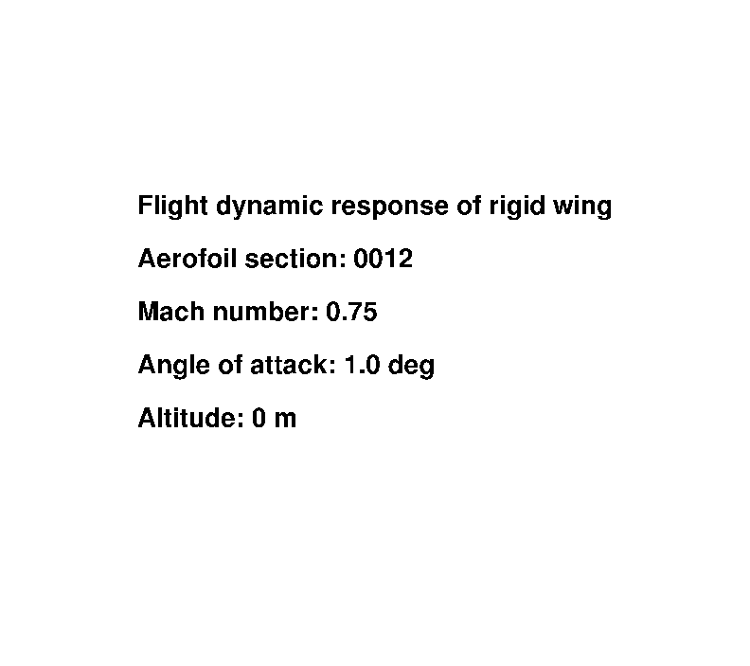
Animation

