Slide 1
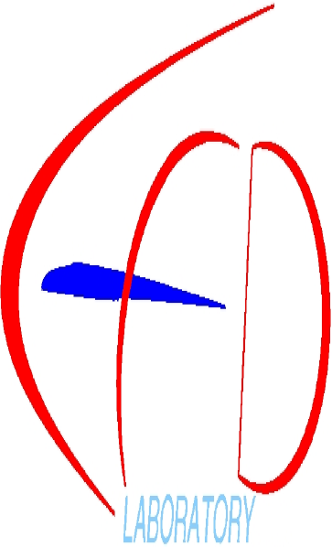

Slide 2
Status of Nonlinear Model Reduction Framework in Py
A. Da Ronch
University of Liverpool, UK
Liverpool, 16 March 2012
Notes:
The subject of this talk is nonlinear model reduction of aeroelastic systems for control design.

Slide 3
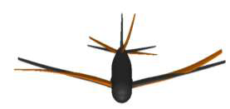
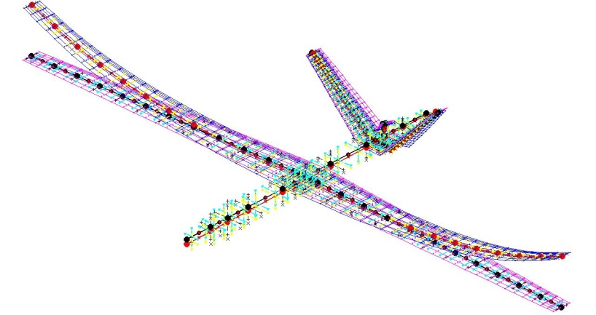
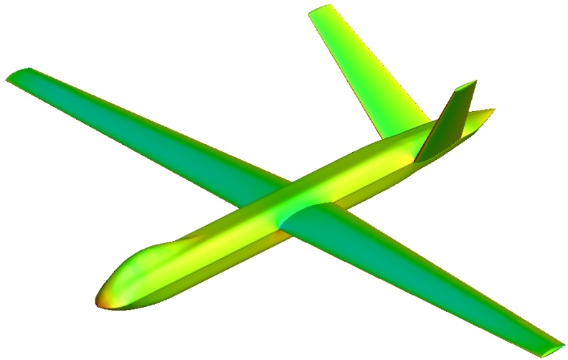
Target
Nonlinear models for flexible aircraft (hierarchy)
Nonlinear model reduction for control implementation
Develop nonlinear control strategies
→ Py framework - data exchange to/from control people
Notes:
There is an increasing interest for more efficient aircraft configurations. This trend is driven by the requirements to carry more payload and extend the mission profile. These systems are inevitably lightweight and with high AR wings for max aerodynamic efficiency. This design characteristics will be even more important in the next-generation aircraft. With large deformations, inertia and stiffness properties may change, and frequencies of natural modes become closer to the time scales of the flight dynamics. Coupling between aeroelasticity and flight dynamics should be considered. For accurate predictions of the structural behaviour, a nonlinear formulation is required. Nonlinearities in the fluid are due to operating in the transonic regime, or at low speed and high AoA. Focus is put on the FCS design of such flexible aircraft. The integrated computational framework will provide information on how much nonlinear effects are important, and their impact on the aircraft design process.

Slide 4
Where do we stand?
Model case
Nonlinear p/p aerofoil
ROM/NROM generation
Control - gust alleviation
Extend approach along 2 paths
Introduce CFD to p/p aerofoil (with Nik)
Nonlinear beam + linear aerodynamics
Combine models of varying fidelity
→ UVLM++ to be included in Py
Notes:
There is an increasing interest for more efficient aircraft configurations. This trend is driven by the requirements to carry more payload and extend the mission profile. These systems are inevitably lightweight and with high AR wings for max aerodynamic efficiency. This design characteristics will be even more important in the next-generation aircraft. With large deformations, inertia and stiffness properties may change, and frequencies of natural modes become closer to the time scales of the flight dynamics. Coupling between aeroelasticity and flight dynamics should be considered. For accurate predictions of the structural behaviour, a nonlinear formulation is required. Nonlinearities in the fluid are due to operating in the transonic regime, or at low speed and high AoA. Focus is put on the FCS design of such flexible aircraft. The integrated computational framework will provide information on how much nonlinear effects are important, and their impact on the aircraft design process.

Slide 5
Model reduction
FOM
Taylor expansion of R
Project onto a small basis of aeroelastic modes
z is complex-valued
ROM/NROM
Notes:
There is an increasing interest for more efficient aircraft configurations. This trend is driven by the requirements to carry more payload and extend the mission profile. These systems are inevitably lightweight and with high AR wings for max aerodynamic efficiency. This design characteristics will be even more important in the next-generation aircraft. With large deformations, inertia and stiffness properties may change, and frequencies of natural modes become closer to the time scales of the flight dynamics. Coupling between aeroelasticity and flight dynamics should be considered. For accurate predictions of the structural behaviour, a nonlinear formulation is required. Nonlinearities in the fluid are due to operating in the transonic regime, or at low speed and high AoA. Focus is put on the FCS design of such flexible aircraft. The integrated computational framework will provide information on how much nonlinear effects are important, and their impact on the aircraft design process.

Slide 6
Where do we stand?
Model case
Nonlinear p/p aerofoil
ROM/NROM generation
Control - gust alleviation
Extend approach along 2 paths
Introduce CFD to p/p aerofoil (with Nik)
Nonlinear beam + linear aerodynamics
Combine models of varying fidelity
→ UVLM++ to be included in Py
Notes:
There is an increasing interest for more efficient aircraft configurations. This trend is driven by the requirements to carry more payload and extend the mission profile. These systems are inevitably lightweight and with high AR wings for max aerodynamic efficiency. This design characteristics will be even more important in the next-generation aircraft. With large deformations, inertia and stiffness properties may change, and frequencies of natural modes become closer to the time scales of the flight dynamics. Coupling between aeroelasticity and flight dynamics should be considered. For accurate predictions of the structural behaviour, a nonlinear formulation is required. Nonlinearities in the fluid are due to operating in the transonic regime, or at low speed and high AoA. Focus is put on the FCS design of such flexible aircraft. The integrated computational framework will provide information on how much nonlinear effects are important, and their impact on the aircraft design process.

Slide 7
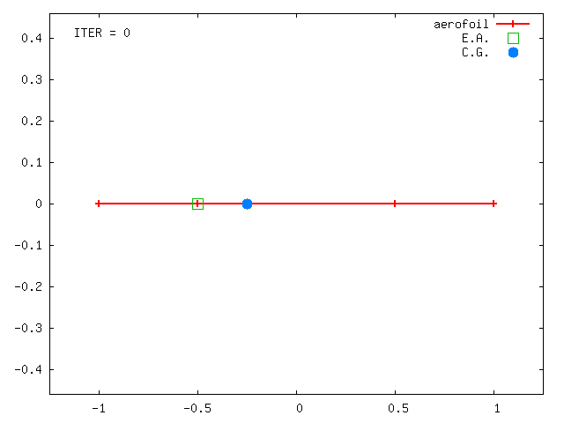
Aerofoil section
12 states: p/p aerofoil + flap + gust
Nonlinear restoring forces (polynomial form)
Notes:
Now we look at some numerical results. We start first with a wing section. The system has the pitch and plunge DoF, it can be excited by any gust shape and a flap is used to control and alleviate the dynamic response. The system has a total of 12 DoFs. To exercise the nonlinear model reduction, nonlinearities are considered – spring hardening or softening effects.

Slide 8
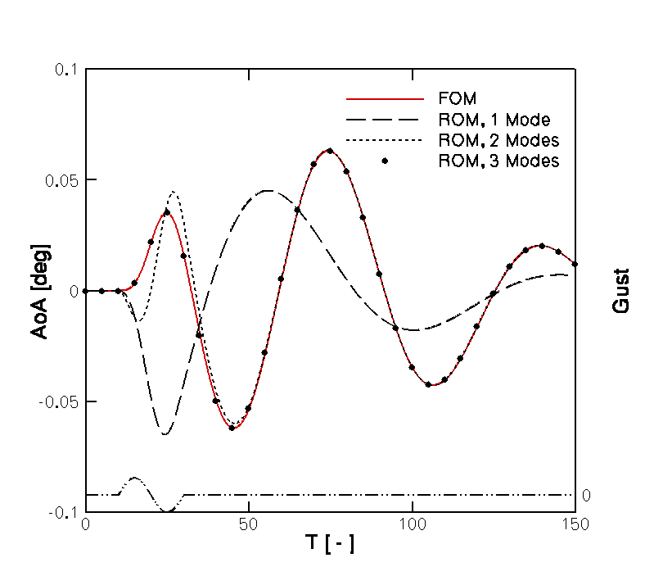
FOM/ROM gust response – linear structural model
Notes:
In this case, nonlinearities are switched off. The wing section encounters a discrete sinusoidal gust – the particular shape is not a fundamental problem – and the AoA time history representative of the FOM is the red line – the reference curve. Several ROMs were generated for increasing number of modes. The prediction using 1 single mode is far away from the red line. When including the 2nd mode, the system free response – when the aerofoil moves away from the gust – is well predicted, but differences are seen when travelling inside the gust. The ROM overlaps the FOM when the mode bringing information from the gust input to the system is included.

Slide 9
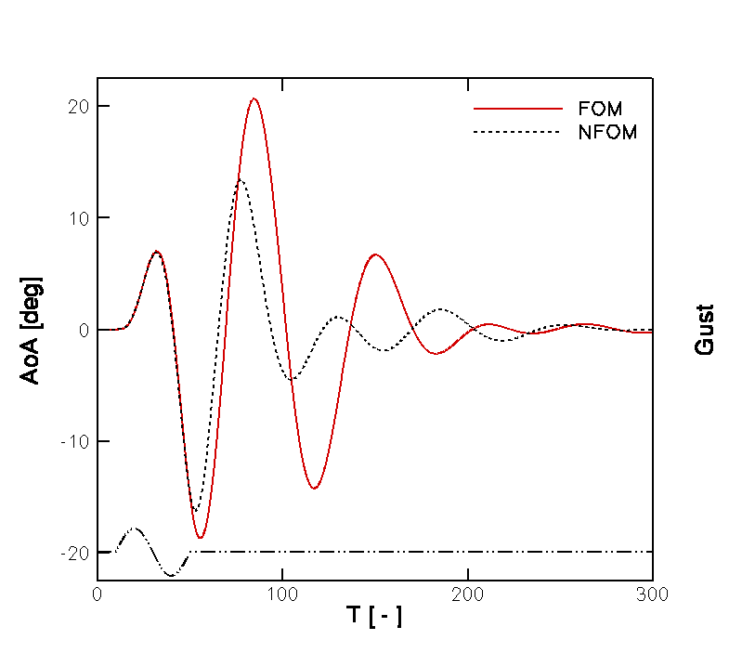
FOM gust response – linear/nonlinear structural model
Notes:
A case was then considered for which differences in the system response are attributable to nonlinearities in the restoring forces. The red line is the linear system. The amplitude of the linear system is larger than the nonlinear counterpart because the nonlinearity is of a hardening spring type.

Slide 10
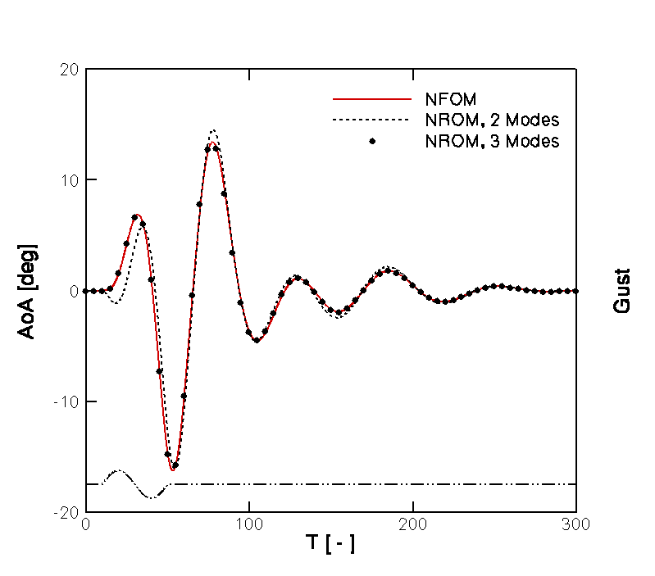
NFOM/NROM gust response – nonlinear structural model
Notes:
Nonlinear ROMs were generated for this case. Again, the prediction based on two modes shows differences when the system travels inside the gust, and the free response approaches the reference curve. Perfect agreement is seen when including an additional mode, as in the previous case.

Slide 11
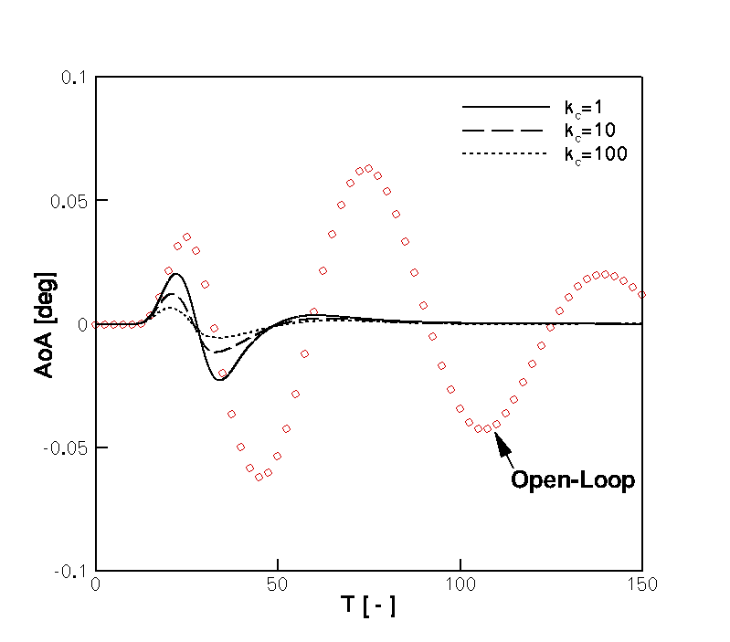
Linear control law on ROM - H∞ (with Y. Wang and A. Wynn)
C_{L}
Notes:
Back to the linear case, a ROM was generated for the gust alleviation using a feedback control based on H_{\infty}. Some results are presented in the figure.

Slide 12
Aerofoil section
Linear control done on linear ROM
but
issues with NROM data interpretation
Alternative way suggested (and implemented) to export NROM coefficients
→ afternoon session

Slide 13
Exporting NROM data for control
1) Complex-valued ROM system
3) Real-valued variable
4) Real-valued system
2) Isolate real/imag parts

Slide 14
Exporting NROM data for control
Quadratic term in NROM
Real-valued system

Slide 15
Exporting NROM data for control
Linear terms → tensor of order 2
Quadratic terms → tensor of order 3
Cubic terms → tensor of order 4
in “easy to use” format for control applications - good

Slide 16
Where do we stand?
Model case
Nonlinear p/p aerofoil
ROM/NROM generation
Control - gust alleviation
Extend approach along 2 paths
Introduce CFD to p/p aerofoil (with Nik)
Nonlinear beam + linear aerodynamics
Combine models of varying fidelity
→ UVLM++ to be included in Py
Notes:
There is an increasing interest for more efficient aircraft configurations. This trend is driven by the requirements to carry more payload and extend the mission profile. These systems are inevitably lightweight and with high AR wings for max aerodynamic efficiency. This design characteristics will be even more important in the next-generation aircraft. With large deformations, inertia and stiffness properties may change, and frequencies of natural modes become closer to the time scales of the flight dynamics. Coupling between aeroelasticity and flight dynamics should be considered. For accurate predictions of the structural behaviour, a nonlinear formulation is required. Nonlinearities in the fluid are due to operating in the transonic regime, or at low speed and high AoA. Focus is put on the FCS design of such flexible aircraft. The integrated computational framework will provide information on how much nonlinear effects are important, and their impact on the aircraft design process.

Slide 17
Py framework
F90 routines
Py script
Py-driven simulations
High-level programming
Beam code
Low-level programming

Slide 18
Py framework
F90 routines
Py script
Wrapper in F90
Wrapper.f90
Memory storage C/Fortran like
No derived types
LAPACK/BLAS calls removed
Derived types

Slide 19
Py framework
F90 routines
Py script
Wrapper in F90
BeamLib.so
Memory storage C/Fortran like
No derived types
1d Py array to multi-dim F90 array
Assembly variables to derived types
Pass data back to Py
LAPACK/BLAS calls removed
Derived types
Dynamic library .so
# Sample .py code - import shared library
libso = cdll.LoadLibrary(“./BeamLib.so”)

Slide 20
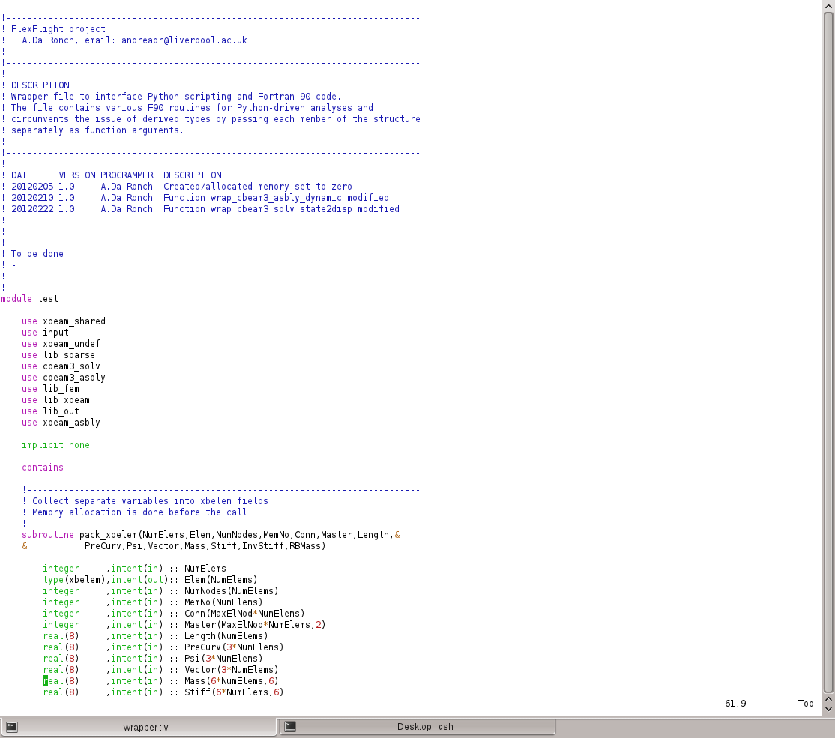
Wrapper.f90
Py → F90: reconstruct derived types
F90 → Py: disassemble derived types

Slide 21
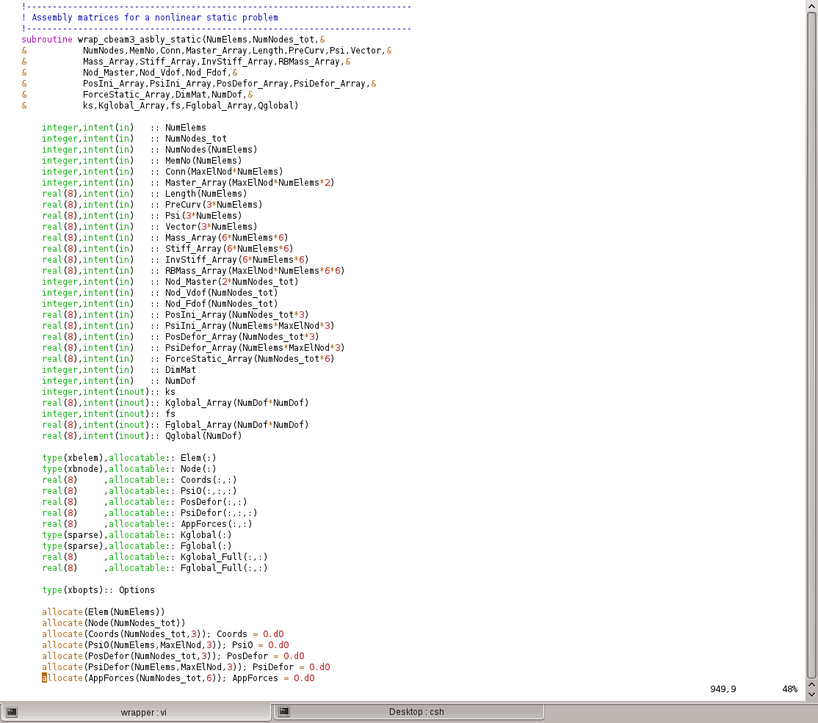
Wrapper.f90
Py → F90: from 1d array to 2d/3d
F90 → Py: convert back to 1d array

Slide 22
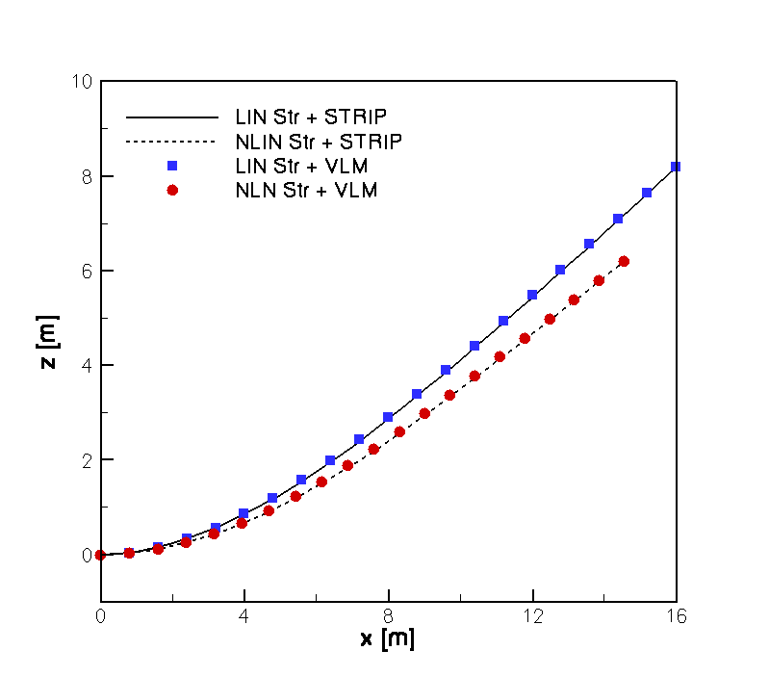
Static Aeroelastic Run, HALE wing - Py is LIN/NLN struct + STRIP
Notes:
In this case, nonlinearities are switched off. The wing section encounters a discrete sinusoidal gust – the particular shape is not a fundamental problem – and the AoA time history representative of the FOM is the red line – the reference curve. Several ROMs were generated for increasing number of modes. The prediction using 1 single mode is far away from the red line. When including the 2nd mode, the system free response – when the aerofoil moves away from the gust – is well predicted, but differences are seen when travelling inside the gust. The ROM overlaps the FOM when the mode bringing information from the gust input to the system is included.

Slide 23
Py framework
Static aeroelastic (linear/nonlinear trim) ok
but
work needed for dynamic aeroelastic analysis
→ afternoon session

Slide 24
Py framework
FOM
Newmark for 2nd order ODEs (unconditionally stable)
rewrite aerodynamics as 2nd order system
expand size of system to solve
ROM/NROM
rewrite system as 1st order ODEs
ROM generation should apply without modifications

Slide 25
Code integration
lib/
src/
linux64/
fortran/
main/
install/
bin/
wrapper/
Wrapper.f90
Makefile
BeamLib.so
Modified source code
LAPACK/BLAS removed
New routines *_clean.f90

Slide 26
Code integration - suggestion
lib/
src/
linux64/
fortran/
main/
install/
bin/
wrapper/
Conditional compilation
Add flag -DNOLAPACK to use LU factorization
Default remains LAPACK calls
One single code (UL/IC), easiness to replace/update beam code
! Sample .f90 code
#ifdef NOLAPACK
! LU factorization
#else
! default solver
#endif

Slide 27
Project webpage
cfd4aircraft new layout, dedicated sections to research themes
Flexflight page could have
section for open-access documents
pswd-protected member area (meeting archives, etc.)
→ see current status

Slide 28
Conclusions
p/p aerofoil
NROM generation demonstrated
NROM data for control design
Py framework for beam code
dynamic solver to be completed
model reduction for gust response
test approach to larger systems
(Suggestions for data exchange/code integration/...)
Notes:
To briefly summarize:
A nonlinear model reduction applicable to large dynamical systems for control design has been presented
Reduced models were efficiently used for the gust alleviation of a wing section
In the framework, there is a need to have models of different fidelity: linear/nonlinear for the structural and rigid body dynamics, and down to strip theory, VLM and CFD for more realistic simulations.
Need to include rigid body dynamics and CFD.

