Slide 2
Nonlinear Model Reduction of an Aeroelastic System
A. Da Ronch and K.J. Badcock
University of Liverpool, UK
Bristol, 20 October 2011

Slide 3
Objective
Framework for control of a flexible nonlinear aeroelastic system
Rigid body dynamics
CFD for realistic predictions
Model reduction to reduce size and cost of the FOM
Design of a control law to close the loop

Slide 4
Full-Order Model
Aeroelastic system in the form of ODEs
Large dimension
Expensive to solve in routine manner
Independent parameter, U* (altitude, density)

Slide 5
Taylor Series
Equilibrium point, w₀
Expand residual in a Taylor series
Manipulable control, u_{c}, and external disturbance, u_{d}

Slide 6
Generalized Eigenvalue Problem
Calculate right/left eigensolutions of the Jacobian, A(w’)
Biorthogonality conditions
Small number of eigenvectors, m<n

Slide 7
Model Reduction
Project the FOM onto a small basis of aeroelastic eigenmodes (slow modes)
Transformation of coordinates FOM to ROM
where m<n

Slide 8
Linear Reduced-Order Model
Linear dynamics of FOM around w₀
From the transformation of coordinates, a linear ROM

Slide 9
Nonlinear Reduced-Order Model
Include higher order terms in the FOM residual
B involves ~m² Jacobian evaluations, while C ~m³. Look at the documentation

Slide 10
Governing Equations
FE matrices for structure
Linear potential flow (Wagner, Küssner), convolution
IDEs to ODEs by introducing aerodynamic states

Slide 11
State Space Form

Slide 12
Procedure
FOM
Time-integration
ROM
Right/left eigensolution of Jacobian, A(w’)
Transformation of coordinates w’ to z
Form ROM terms: matrix-free product for Jacobian evaluations
Time-integration of a small system

Slide 13
Examples
Aerofoil section
nonlinear struct + linear potential flow
Wing model
nonlinear struct + linear potential flow
Wing model
nonlinear struct + CFD

Slide 14
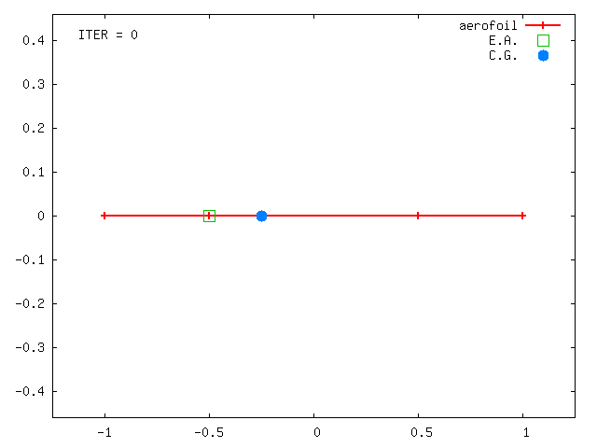
Aerofoil Section

Slide 15
Aerofoil Section
2 dof structural model
Flap for control
Gust perturbation
Nonlinear restoring forces
Gust as external disturbance (not part of the problem)

Slide 16
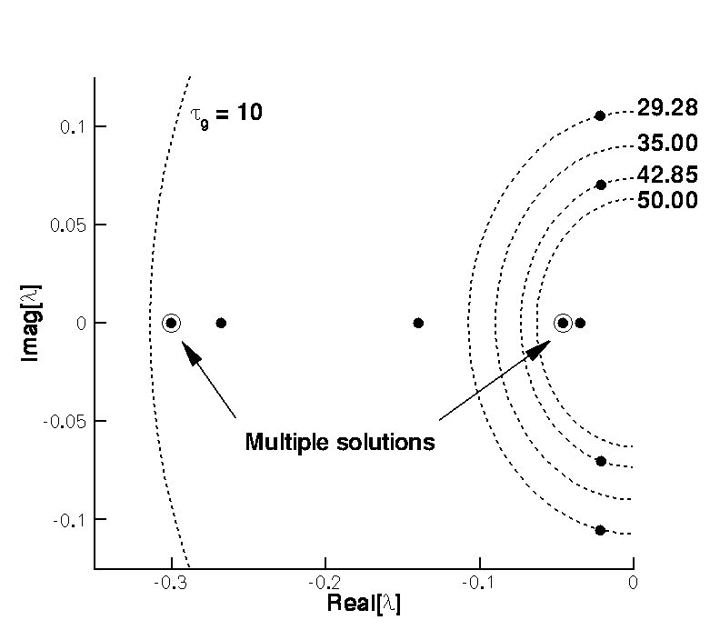
Aeroelastic Eigenvalues at 0.95 of linear flutter speed

Slide 17
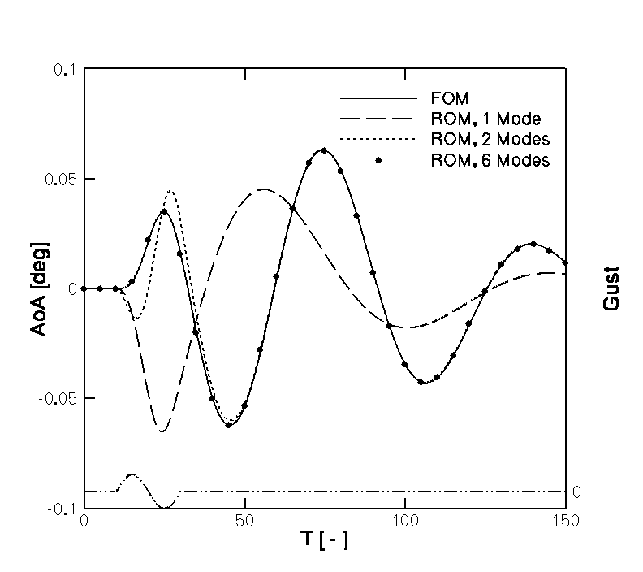
FOM/ROM gust response – linear structural model

Slide 18
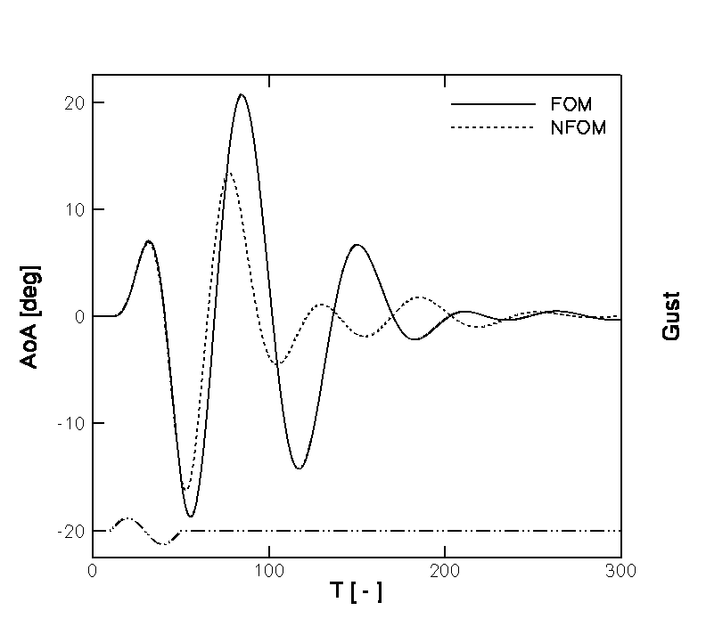
FOM gust response – linear/nonlinear structural model

Slide 19
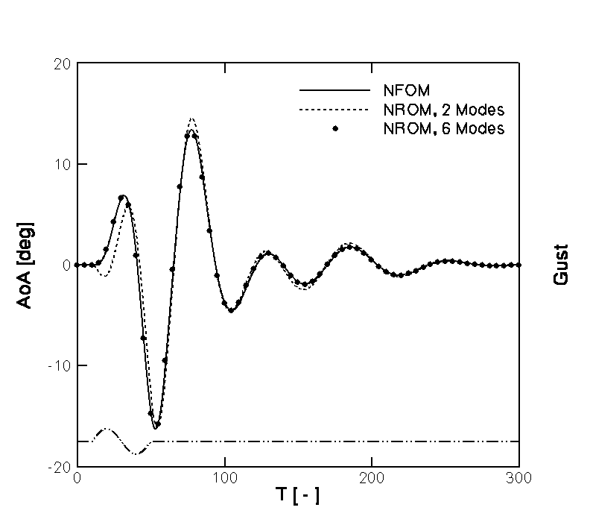
FOM/ROM gust response – nonlinear structural model

Slide 20
Wing model
Slender wing with aileron
20 states per node

Slide 21
Wing model
Linear flutter speed: 13m/s
First bending: 7.0Hz
Highest modes: 10⁶Hz
For time integration of FOM: dt~10⁻⁷
ROM with few slow aeroelastic modes: dt~10⁻²
Span | 1.2m
Width | 0.3m
Thickness | 0.003m
E | 50GPa

Slide 22
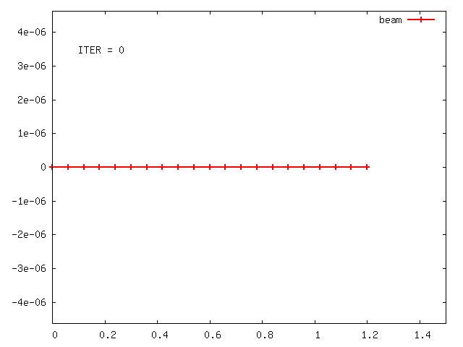
Gust disturbance at 0.01 of linear flutter speed

Slide 23
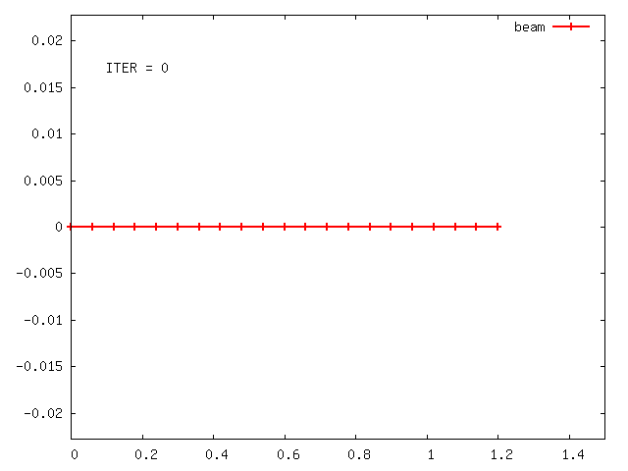
Gust disturbance at 0.99 of linear flutter speed

Slide 24
Ongoing work
Control problem for linear aerofoil section: apply control law to the FOM
Same iteration for a wing model
Include rigid body dynamics and test model reduction
Extend aerodynamic models to CFD

