Slide 1
Accelerating Convergence of the CFD Linear Frequency Domain Method by a Preconditioned Linear Solver
Andrew McCracken
Supervisor: Professor Ken Badcock
University of Liverpool

Slide 2
Summary
Frequency Domain Methods in CFD
Linear Frequency Domain
LFD Solution Methods
LFD Linear Solver Approach
ILU Weighted Preconditioner
Extension of Method
Conclusions

Slide 3
Frequency Domain Methods in CFD
Originally developed for turbomachinery flows
Models time-domain flow equations in frequency domain
Quicker solution time compared with time-domain

Slide 4
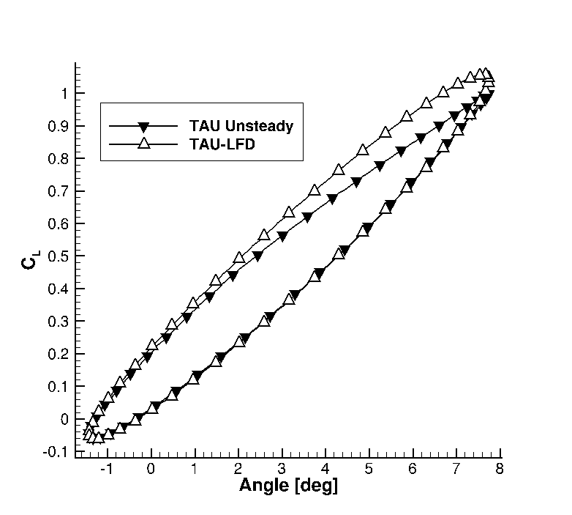
Frequency Domain Methods in CFD
Useful for flutter analyses
Useful for flight dynamics purposes

Slide 5
Linear Frequency Domain
Linearise assuming small perturbations:
Solve resulting linear system:

Slide 6
Previous Solution Methods
LU-SGS - Semi-implicit
- Face-based matrix
- Can use GMRes method
PETSc - Many options including implicit linear solvers
- Many preconditioning options

Slide 7
Preconditioned Linear Solver
GCR Krylov solver
ILU preconditioning
A is second order Jacobian
Approximation of P to A determined viewing solution of:

Slide 8
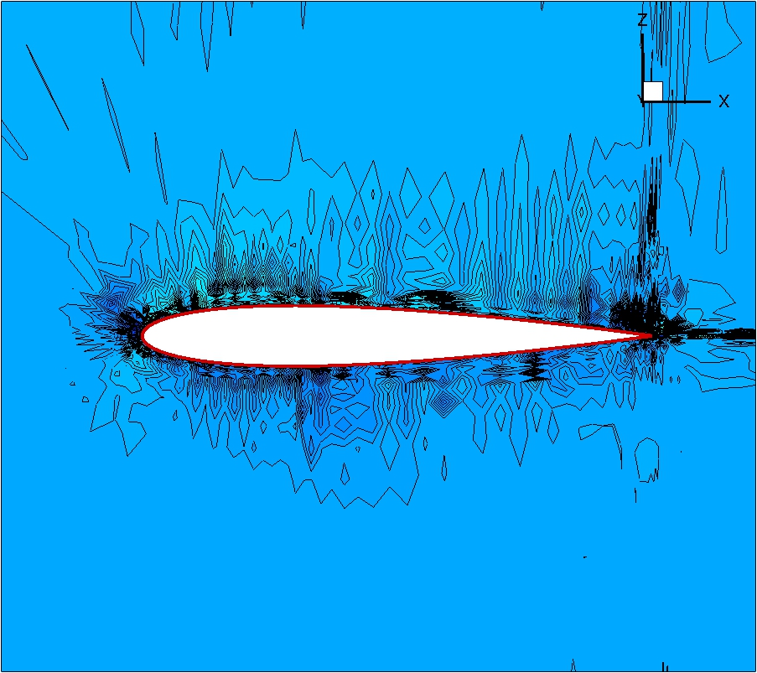
Preconditioned Linear Solver
Second Order Preconditioner

Slide 9
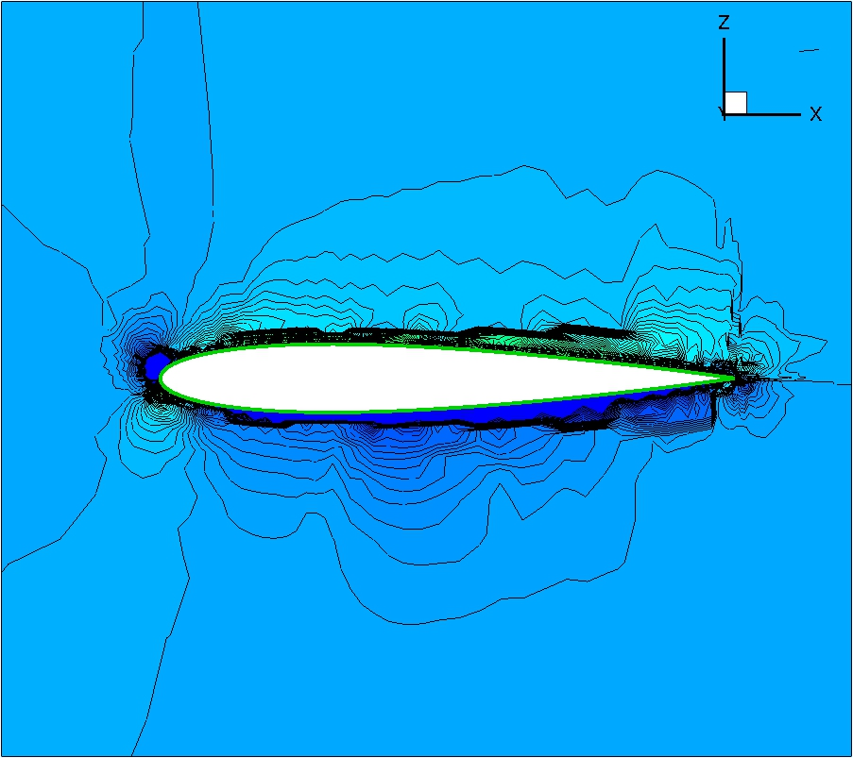
Preconditioned Linear Solver
First Order Preconditioner

Slide 10
Preconditioned Linear Solver
Good Approximation
Effective conditioning
Second Order Jacobian
First Order Jacobian
Unstable
Stable
Mixed-order??

Slide 11
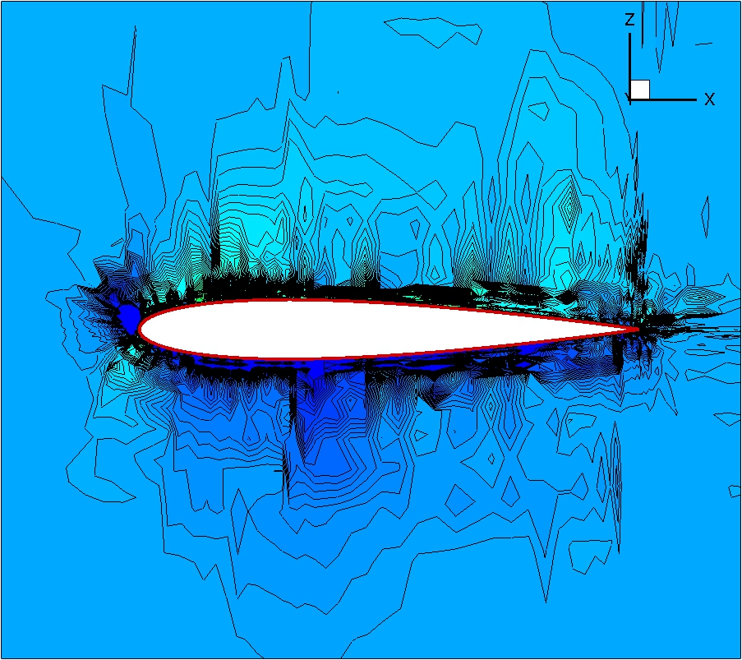
Preconditioned Linear Solver
Mixed Order Preconditioner

Slide 12
ILU Preconditioner Formulation
Form the exact first and second order Jacobian matrices A₁ and A₂
Form mixed matrix A_{α} where α is second order weight
Form preconditioner P_{α} from A_{α}

Slide 13
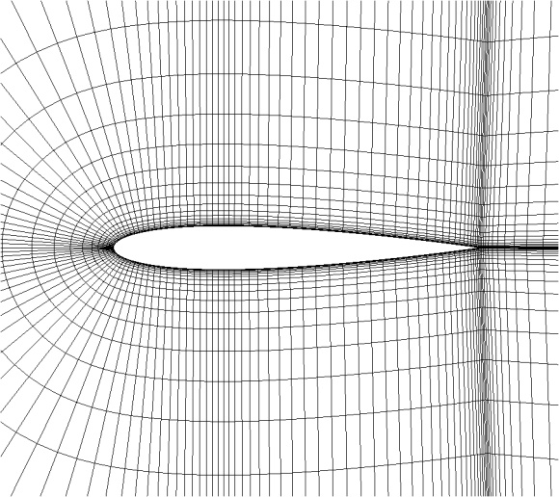
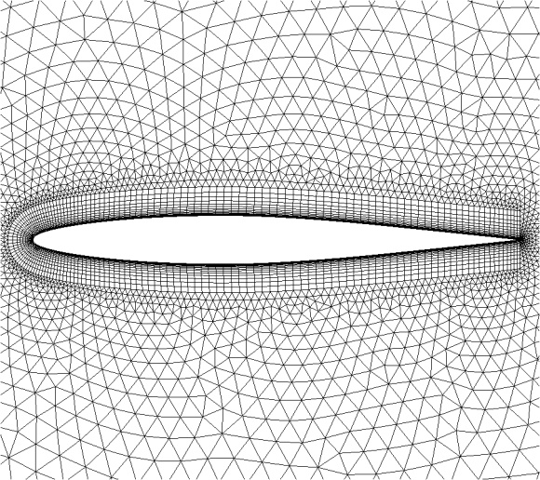
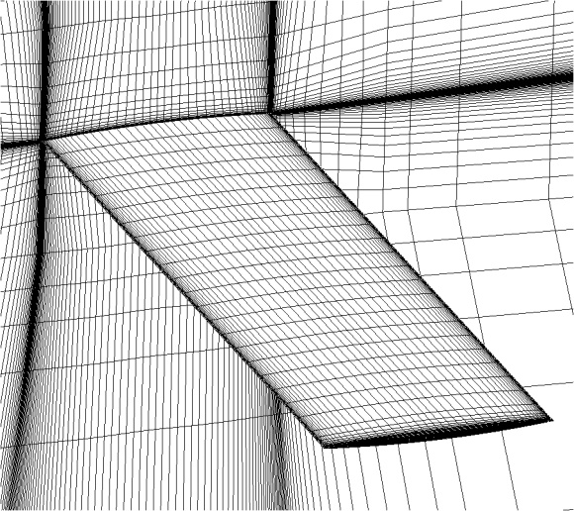
Test Cases
2D test cases - NACA 0012 AGARD CT2 (Euler)
- NACA 64A010 AGARD CT8 (RANS)
3D test cases - Goland Wing (Euler)
- Goland Wing (RANS)

Slide 14
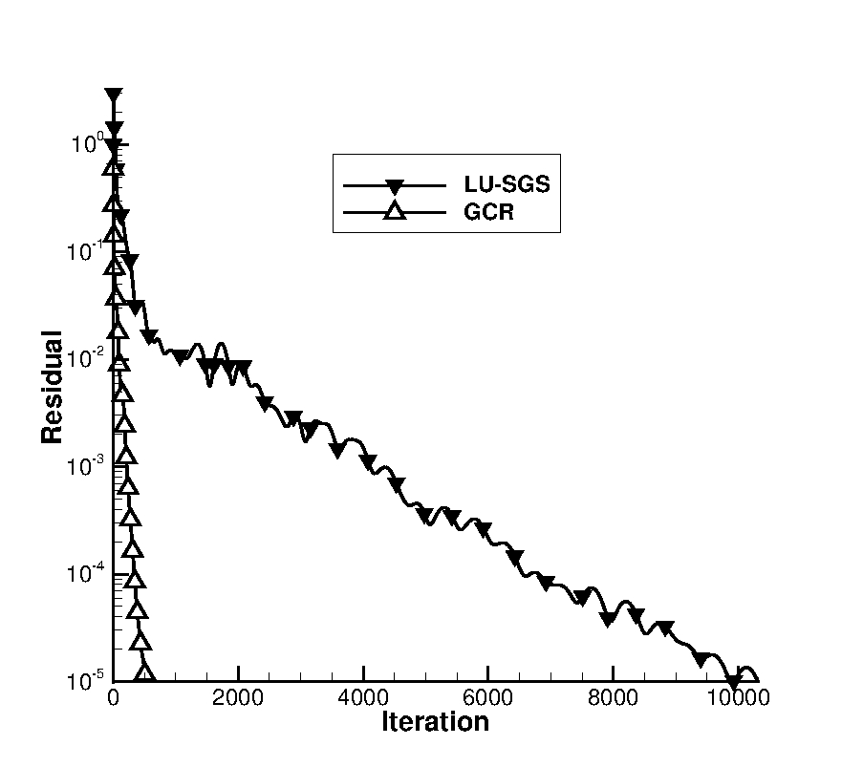
Convergence
Goland Wing
M = 0.925
α₀ = 0.0°
α_{A} = 1.0°
k = 0.025
Re = 15x10⁶

Slide 15
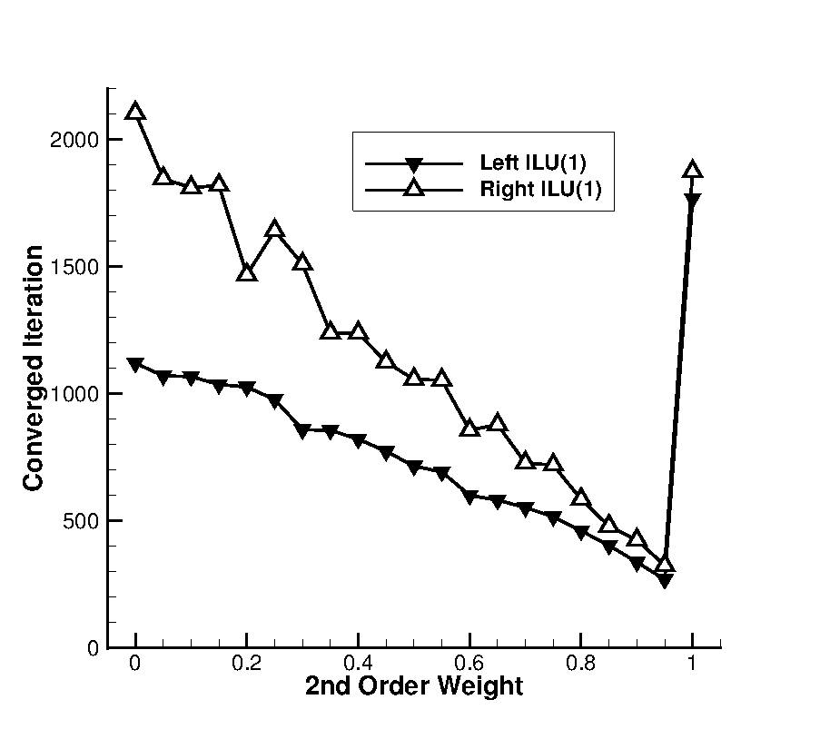
Effect of Weighting
NACA 64A010
M = 0.8
α₀ = 0.0°
α_{A} = 0.5°
k = 0.1
Re = 12.5x10⁶
Pure First Order
Pure Second Order

Slide 16
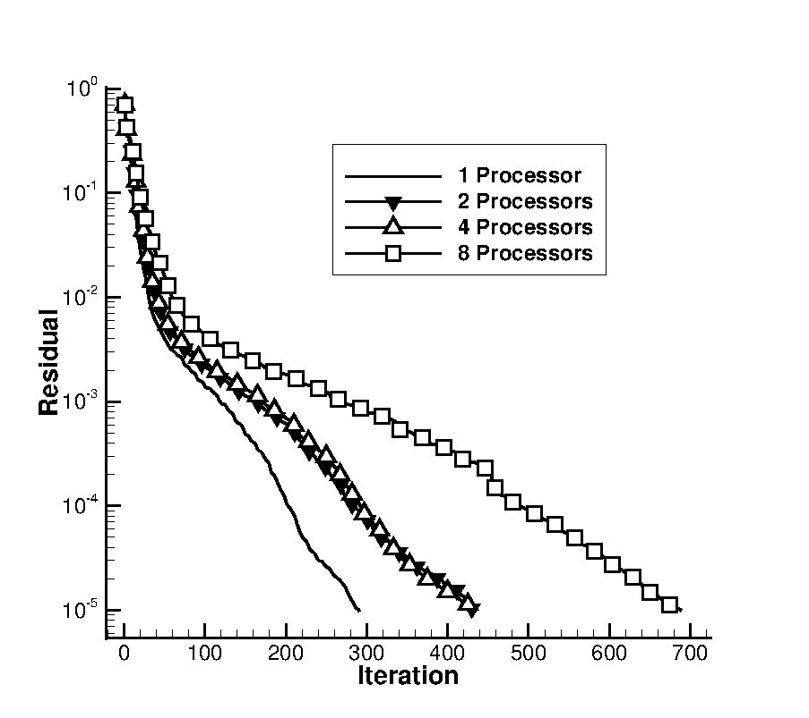
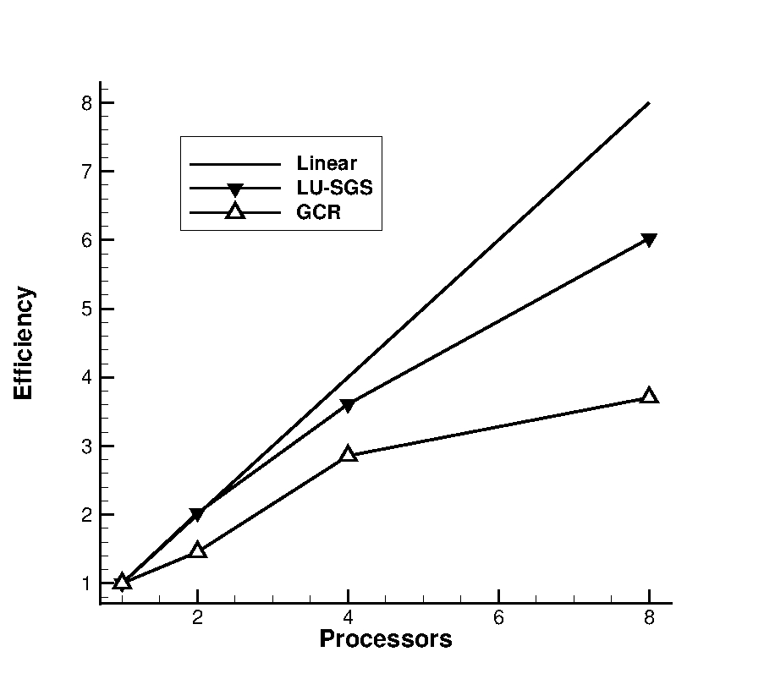
Parallelisation
Goland Wing (inviscid), M = 0.8, α₀ = 0.0°,α_{A} = 1.0°, k = 0.025

Slide 17
Conclusions
ILU-GCR solver implemented for LFD in TAU
Weighted ILU offers greater speed up of LFD over time domain
Preconditioned solver has allowed flutter analysis on an Airbus full aircraft test case
Flight dynamics analysis of other large test cases has been carried out

