Slide 1



Model Reduction for Linear and Nonlinear Gust Loads Analysis
A. Da Ronch, N.D. Tantaroudas, S.Timme and K.J. Badcock
University of Liverpool, U.K.
email: | K.J.Badcock@liverpool.ac.uk
AIAA Paper 2013-1942
Boston, MA, 08 April 2013
Notes:
This presentation is about gust loads prediction and alleviation using a reduced model, which potentially comes from a CFD model.

Slide 2
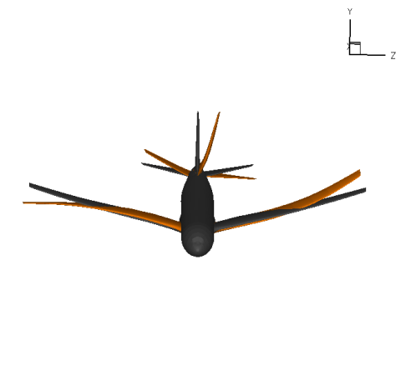
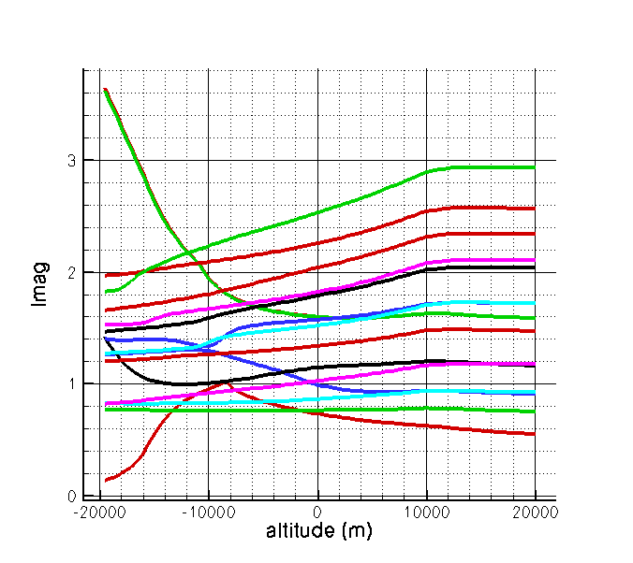
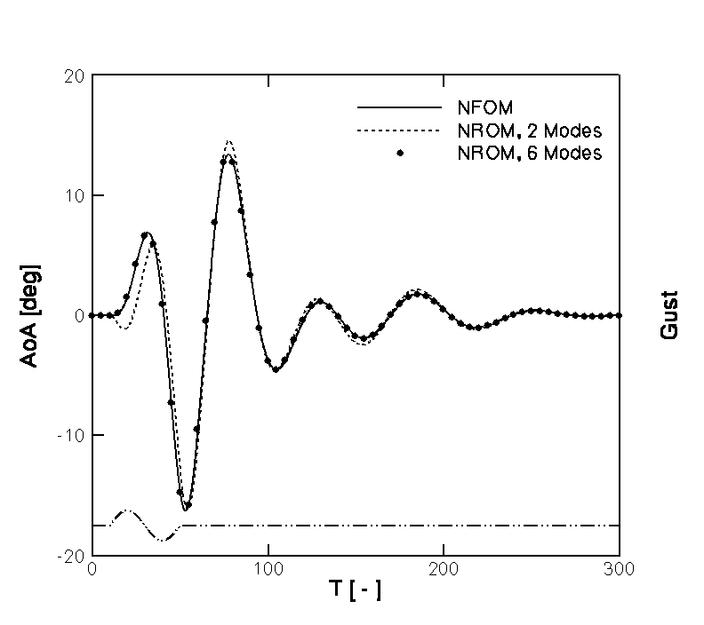
Mini Process Chain Based on CFD
CFD Grids
FE Models
Shape Optimisation
eigenvectors
Flutter Calculations
+ iterations
Gust Loads

Slide 3
Flutter Calculations
Stability studied from an eigenvalue problem:
Schur Complement formulation:
Badcock et al., Progress in Aerospace Sciences; 47(5): 392-423, 2011

Slide 4
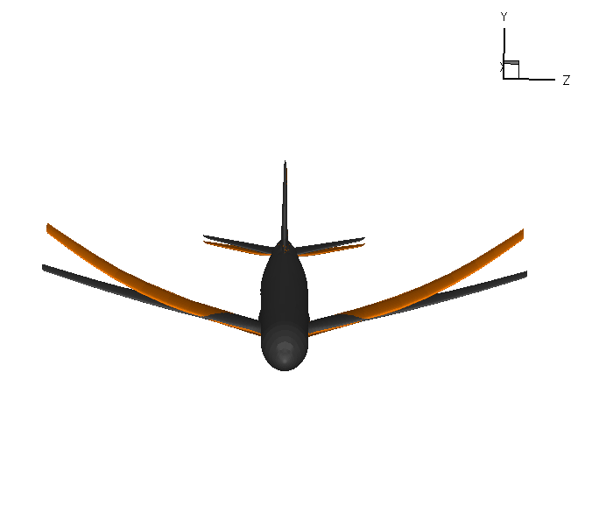
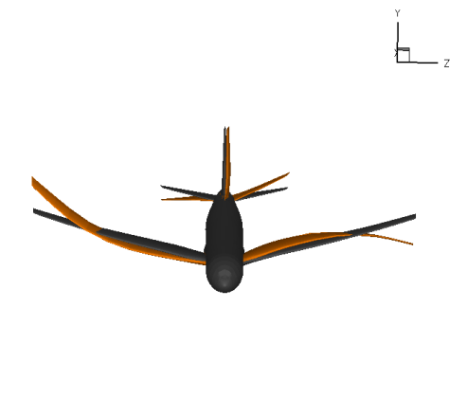
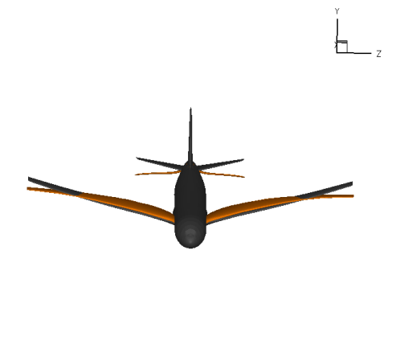


Slide 5
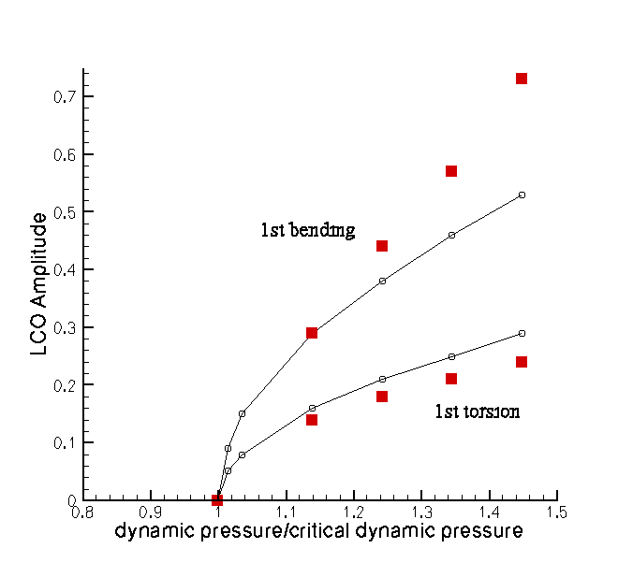
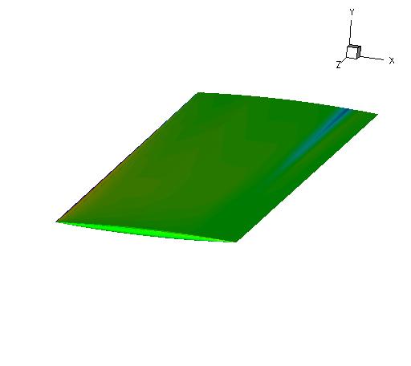
Badcock, K.J. and Woodgate, M.A., On the Fast Prediction of Transonic Aeroelastic Stability and Limit Cycles, AIAA J 45(6), 2007.

Slide 6
Mini Process Chain Based on CFD
CFD Grids
FE Models
Shape Optimisation
eigenvectors
Flutter Calculations
+ iterations
This Talk
Gust Loads

Slide 7
Model Reduction
Notes:
The starting point is the original full-order model, formulated as a set of ODEs of the form dwdt = residual. The residual depends nonlinearly on the state vector, which is partitioned into fluid, structure and RB DOFs. A parameter, denoted here by sigma, is independent of the unknown vector and is used to parameterize the system. Recall the example of the global-hawk type aircraft, the state vector has million of unknowns.
To achieve model reduction, the full model is projected onto a small basis of coupled system eigenvectors, which is similar to the normal modes if you are familiar with structural models, but in our case the modes are those of the coupled system.
To calculate the basis, we need to solve an eigenvalue problem. For small systems, Matlab can do the job. For large order systems, as those arising with CFD, the eigenvalue problem can be a difficult task. Fortunately, previous work at the UoL was devoted to this specific problem, and the Schur eigenvalue solver provides the information needed for model reduction. Here, we assume that we have this method and if interested please refer to the article in progress in aerospace sciences.

Slide 8
Model Reduction
Project against left eigenvectors Ψ to obtain differential equations for z
Badcock et al., “Transonic Aeroelastic Simulation for Envelope Searches and Uncertainty Analysis”, Progress in Aerospace Sciences; 47(5): 392-423, 2011
Notes:
The starting point is the original full-order model, formulated as a set of ODEs of the form dwdt = residual. The residual depends nonlinearly on the state vector, which is partitioned into fluid, structure and RB DOFs. A parameter, denoted here by sigma, is independent of the unknown vector and is used to parameterize the system. Recall the example of the global-hawk type aircraft, the state vector has million of unknowns.
To achieve model reduction, the full model is projected onto a small basis of coupled system eigenvectors, which is similar to the normal modes if you are familiar with structural models, but in our case the modes are those of the coupled system.
To calculate the basis, we need to solve an eigenvalue problem. For small systems, Matlab can do the job. For large order systems, as those arising with CFD, the eigenvalue problem can be a difficult task. Fortunately, previous work at the UoL was devoted to this specific problem, and the Schur eigenvalue solver provides the information needed for model reduction. Here, we assume that we have this method and if interested please refer to the article in progress in aerospace sciences.

Slide 9
Model Reduction
2nd/3rd Jacobian operators for NROM
Da Ronch et al., “Nonlinear Model Reduction for Flexible Aircraft Control Design”, AIAA paper 2012-4404; AIAA Atmospheric Flight Mechanics, 2012
Notes:
The starting point is the original full-order model, formulated as a set of ODEs of the form dwdt = residual. The residual depends nonlinearly on the state vector, which is partitioned into fluid, structure and RB DOFs. A parameter, denoted here by sigma, is independent of the unknown vector and is used to parameterize the system. Recall the example of the global-hawk type aircraft, the state vector has million of unknowns.
To achieve model reduction, the full model is projected onto a small basis of coupled system eigenvectors, which is similar to the normal modes if you are familiar with structural models, but in our case the modes are those of the coupled system.
To calculate the basis, we need to solve an eigenvalue problem. For small systems, Matlab can do the job. For large order systems, as those arising with CFD, the eigenvalue problem can be a difficult task. Fortunately, previous work at the UoL was devoted to this specific problem, and the Schur eigenvalue solver provides the information needed for model reduction. Here, we assume that we have this method and if interested please refer to the article in progress in aerospace sciences.

Slide 10
Model Reduction
control surfaces,
gust encounter,
speed/altitude
Da Ronch et al., “Model Reduction for Linear and Nonlinear Gust Loads Analysis”, AIAA paper 2013-1942; AIAA Structural Dynamics and Materials, 2013
Notes:
The starting point is the original full-order model, formulated as a set of ODEs of the form dwdt = residual. The residual depends nonlinearly on the state vector, which is partitioned into fluid, structure and RB DOFs. A parameter, denoted here by sigma, is independent of the unknown vector and is used to parameterize the system. Recall the example of the global-hawk type aircraft, the state vector has million of unknowns.
To achieve model reduction, the full model is projected onto a small basis of coupled system eigenvectors, which is similar to the normal modes if you are familiar with structural models, but in our case the modes are those of the coupled system.
To calculate the basis, we need to solve an eigenvalue problem. For small systems, Matlab can do the job. For large order systems, as those arising with CFD, the eigenvalue problem can be a difficult task. Fortunately, previous work at the UoL was devoted to this specific problem, and the Schur eigenvalue solver provides the information needed for model reduction. Here, we assume that we have this method and if interested please refer to the article in progress in aerospace sciences.

Slide 11
CFD Solver Overview
Euler (Inviscid) results shown in this paper
  Solvers include RANS also
Implicit Formulation
2 Spatial Schemes
  2d results → meshless formulation
  3d results → block structured grids
Osher/MUSCL + exact Jacobians
Time domain: Pseudo Time Stepping
Linearised Frequency Domain Solver

Slide 12
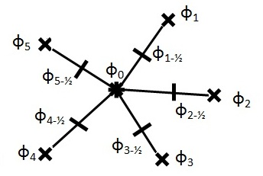

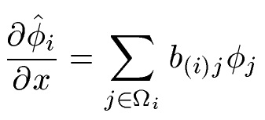

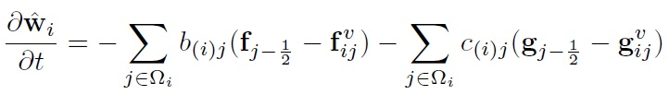
Overview of Meshless Solver
Kennett, D. J., Timme, S., Angulo, J., and Badcock, K. J., “An Implicit Meshless Method for Application in Computational Fluid Dynamics,” International Journal for Numerical Methods in Fluids, Vol. 71, No. 8, 2013, pp. 1007–1028.
Notes:
Shows flow structure and schematic showing some aerodynamic problems helicopters encounter in forward flight.
The total loads that a rotor experiences is dependant on the local loads experienced by each part of the blade. In hover flight alone, the loads vary along the blade, from low speed at the root and compressible flow at the tip, and so the blade design changes along the span. In addition, you have blade-tip vortex interaction.
With the addition of relative air flow in forward flight, you also have stall and flow reversal on the retreating blade, and transonic flow causing shock waves on the advancing side.
All of these complicate the design of the blade as more compromises must be made.
12

Slide 13
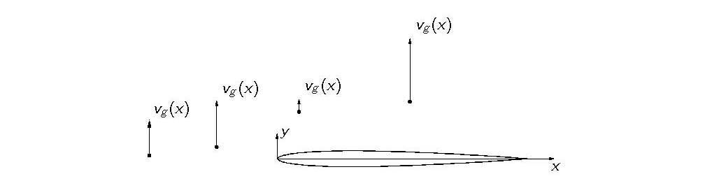
Gust Representation: Full order method (Baeder et al 1997)
Apply gust in CFD Code to grid velocities only
No modification of gust from interaction
No diffusion of gust from solver
Can represent gusts defined for synthetic atmosphere

Slide 14
Precomputed
Evaluated in ROM

Slide 15
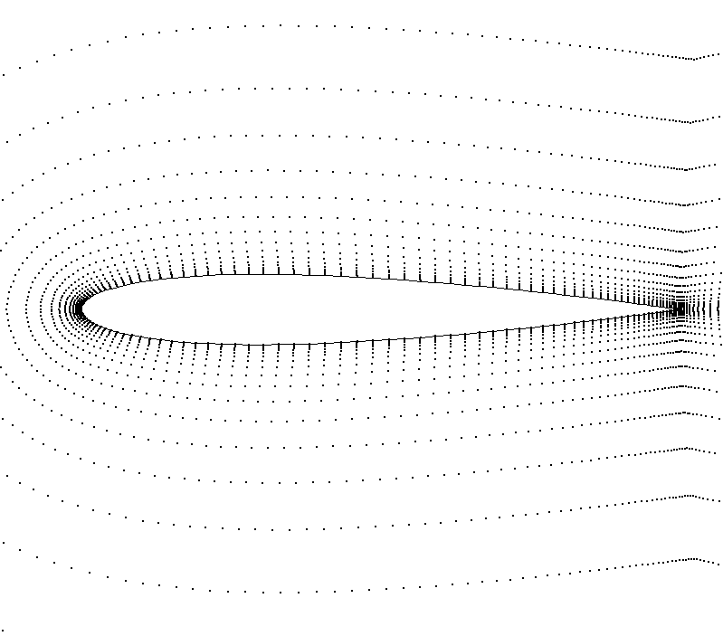
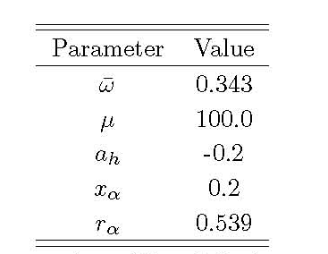
NACA 0012 Aerofoil point cloud
Coarse 7974 points
Medium 22380 points
Fine 88792 points
Badcock, K. J. and Woodgate, M. A, AIAA Journal, Vol. 48, No. 6, 2010, pp. 1037–1046

Slide 16
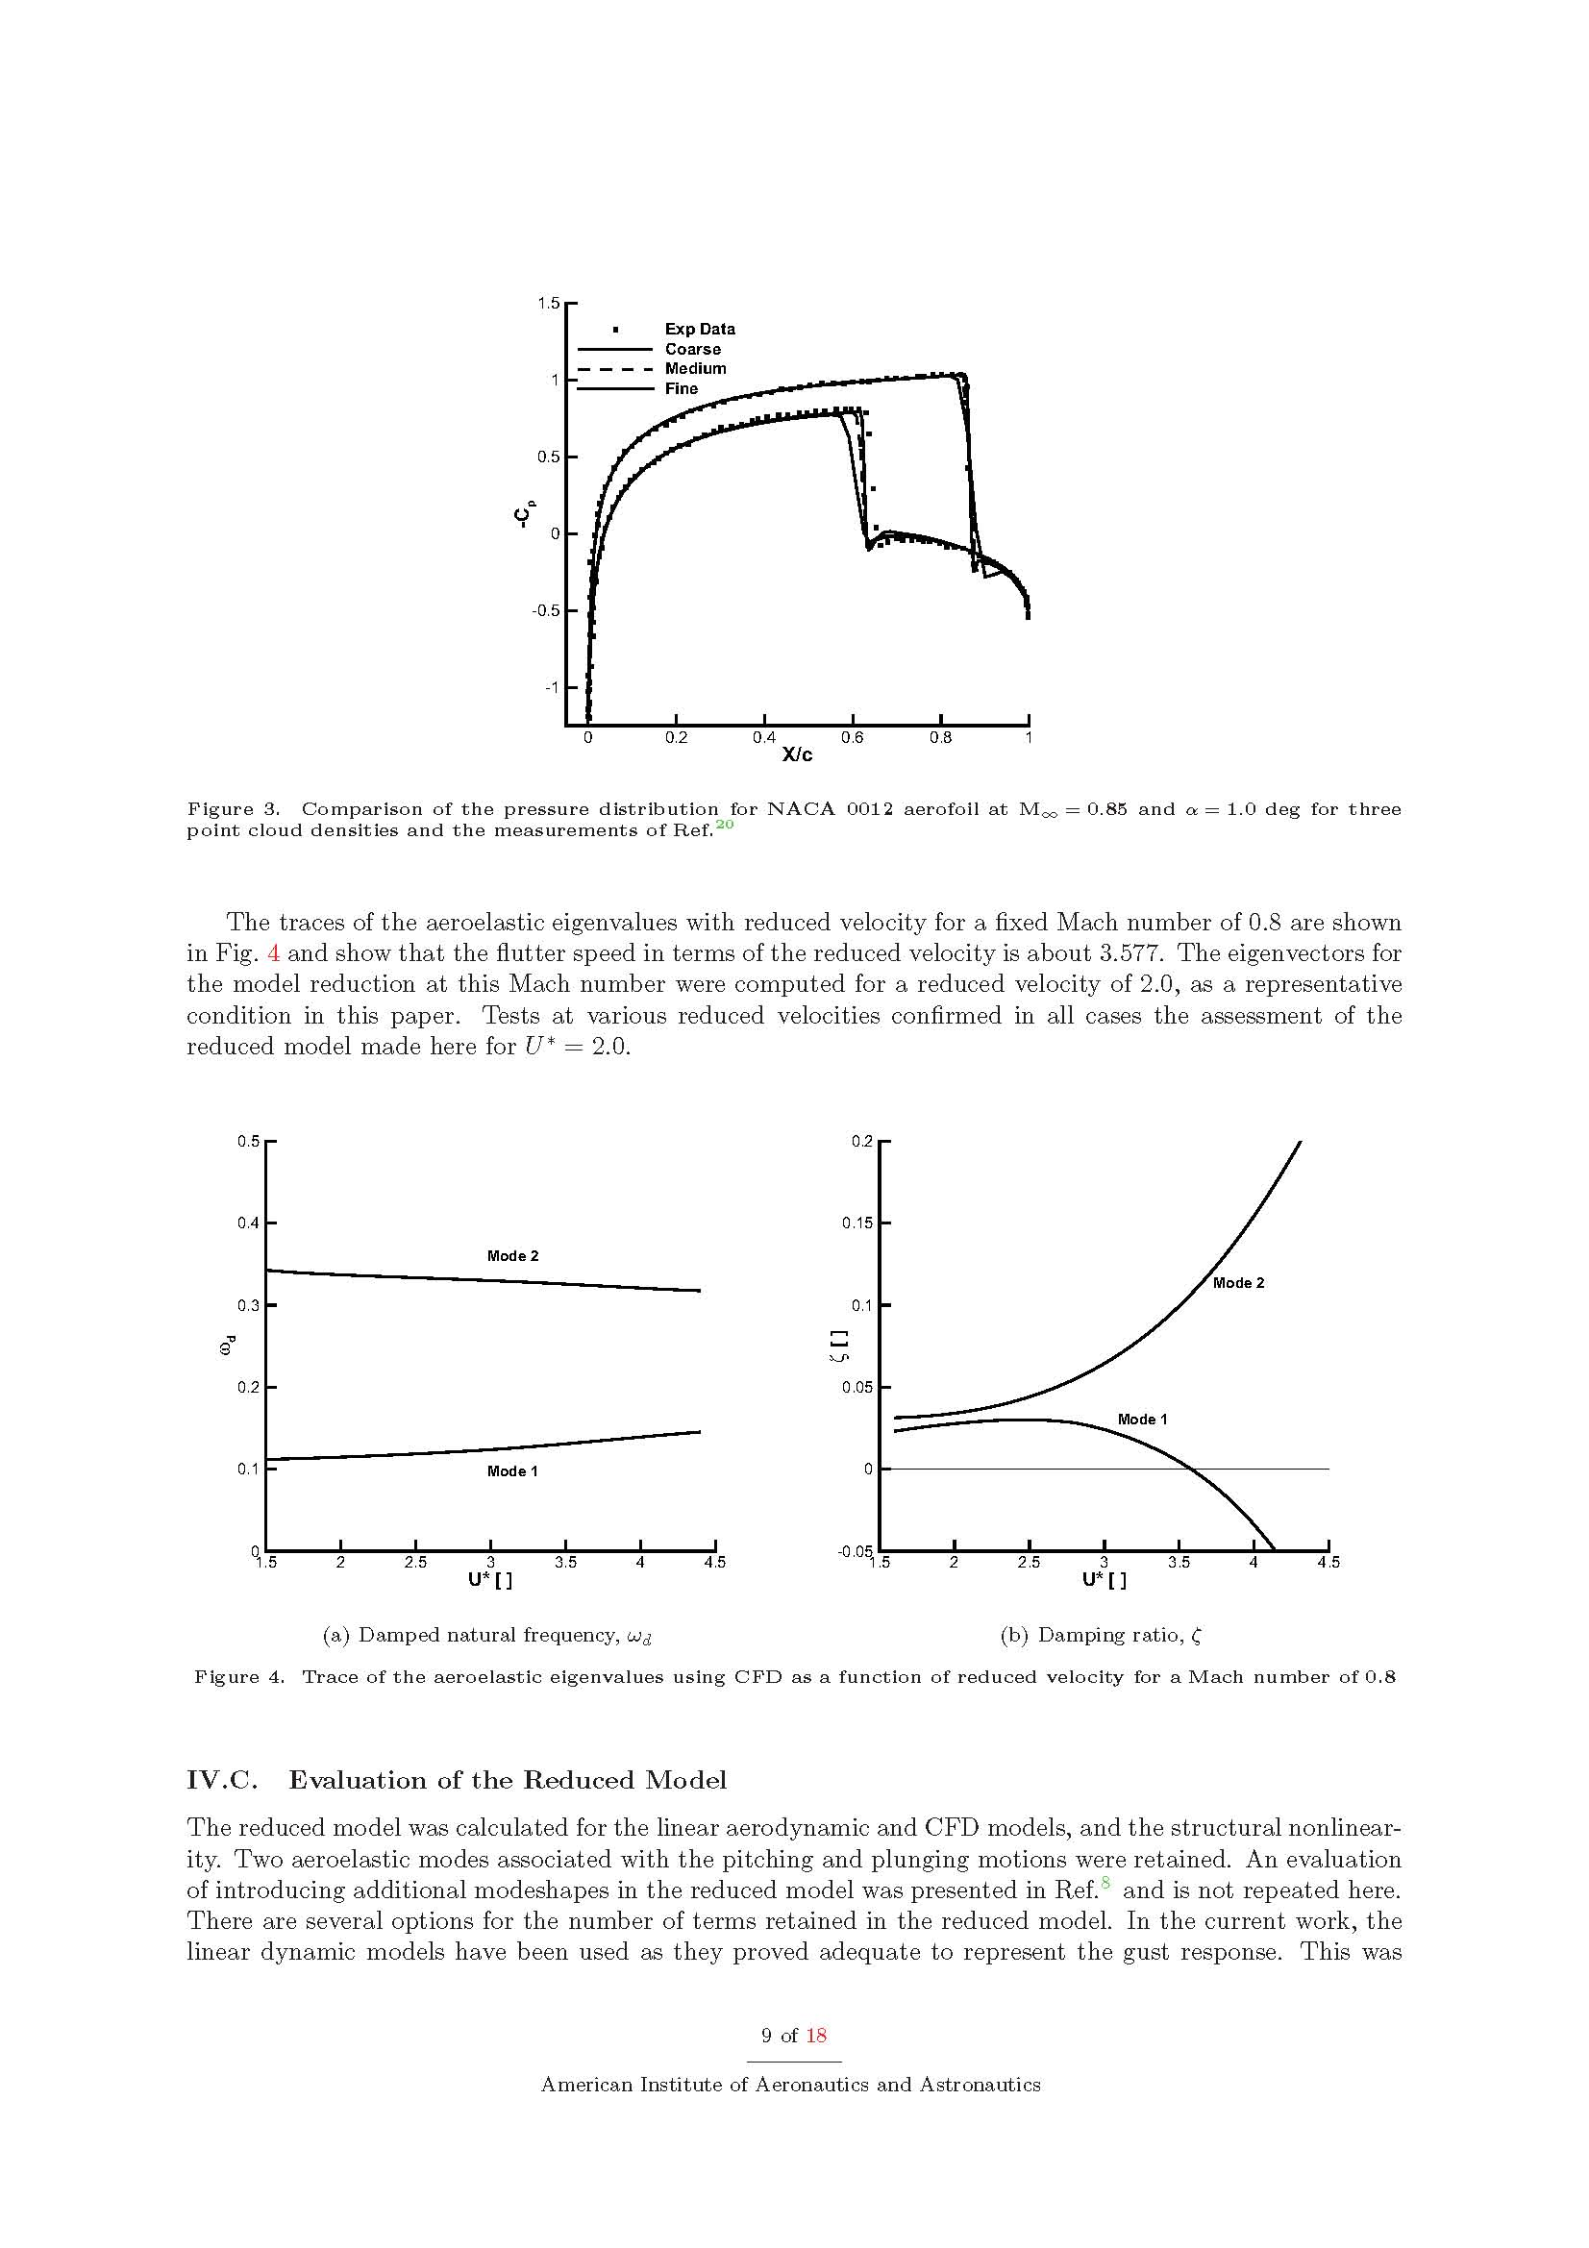
Steady state: Mach 0.85; α=1 deg

Slide 17
Mach 0.8; Pitch-Plunge “Heavy Case”
Flutter Speed Ubar=3.577
Speed for ROM Ubar=2.0
Modes corresponding to pitch/plunge retained for ROM
→ 2 modes; 4 DoF

Slide 18
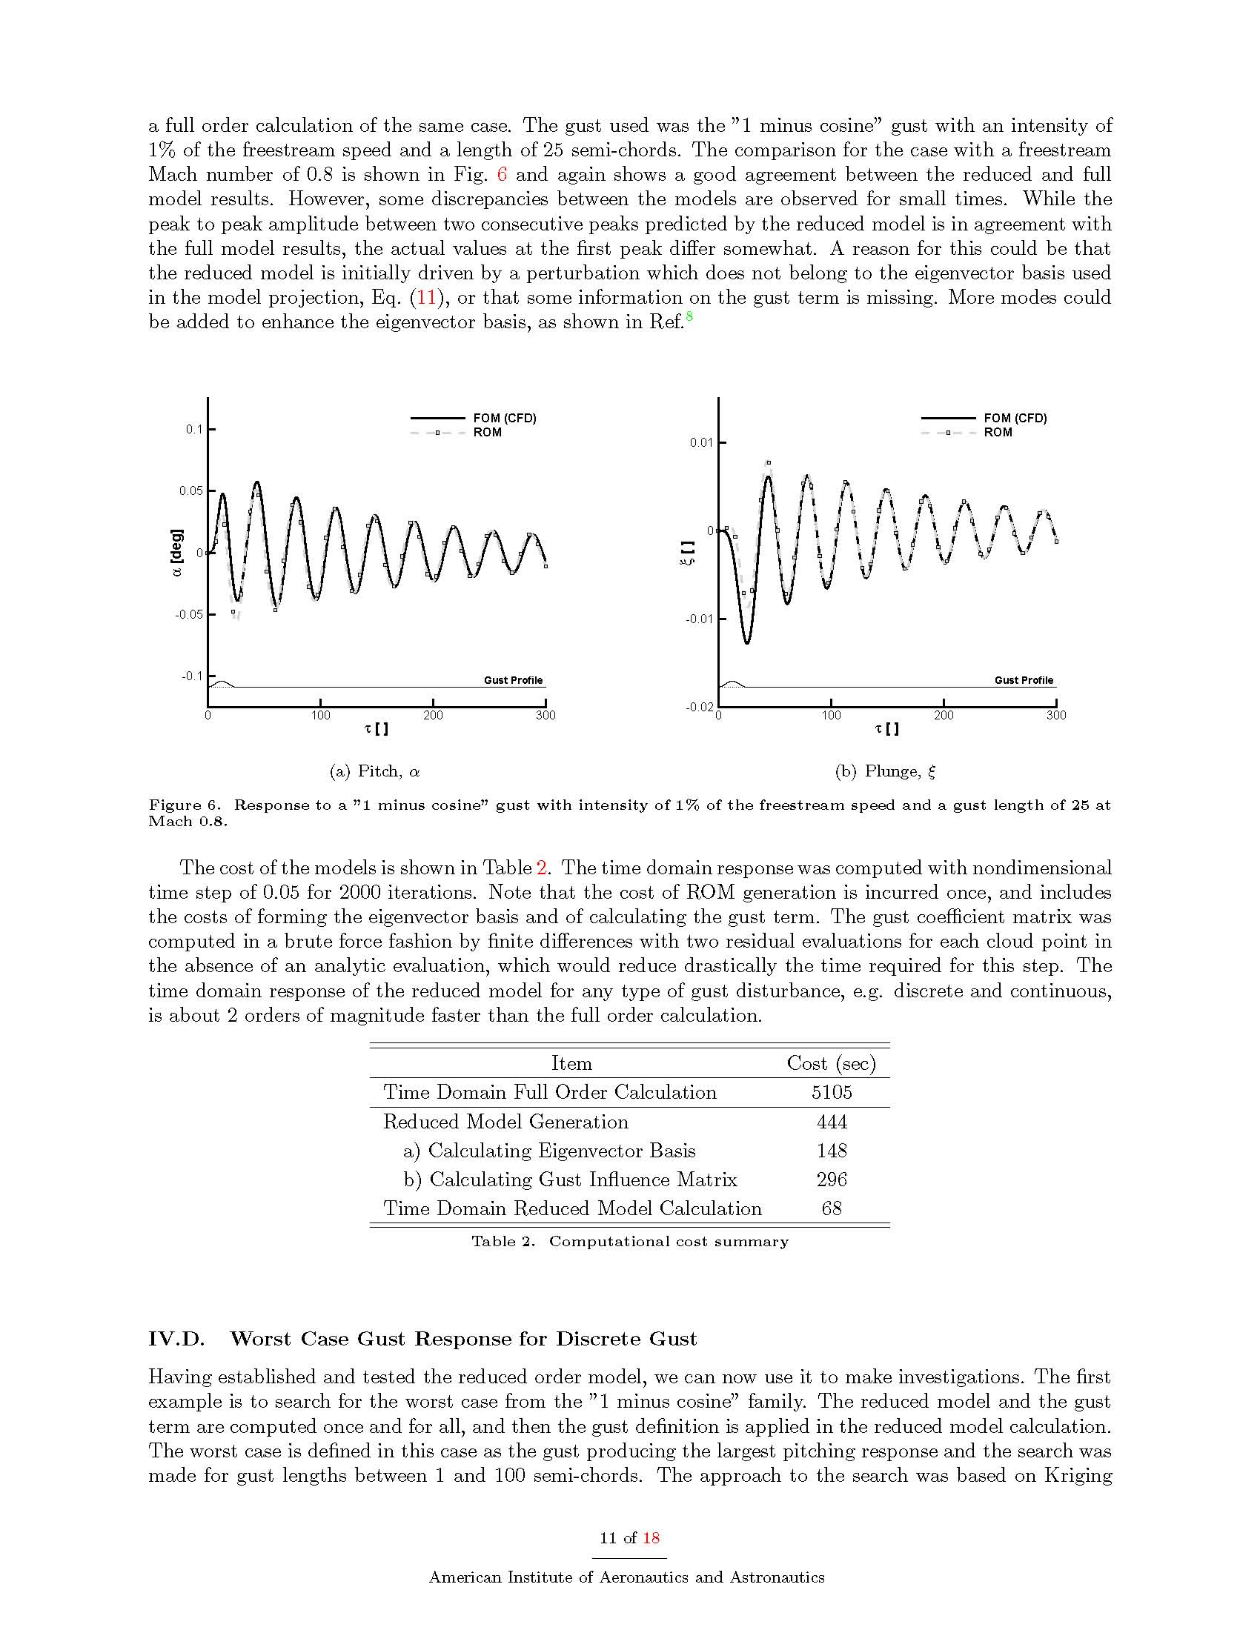
1-cosine gust: Intensity 1%
Gust length 25 semi-chords

Slide 19
Peak-Peak very similar
Discrepancies in magnitude
→ enrich basis
1-cosine gust: Intensity 1%
Gust length 25 semi-chords

Slide 20
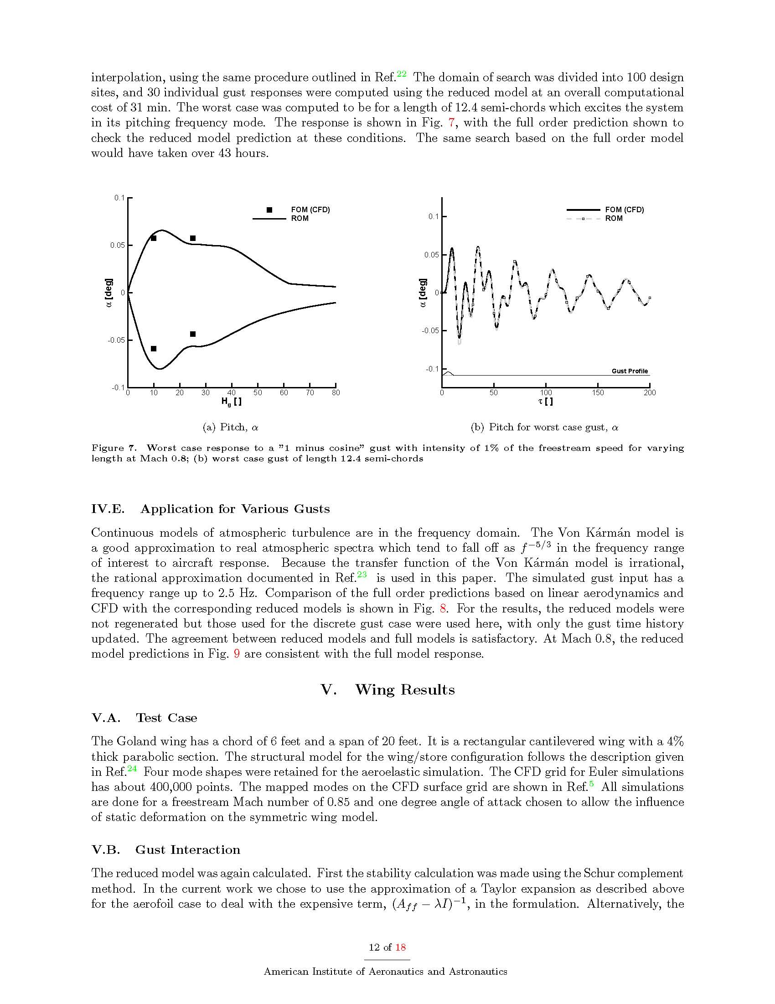
Worst Gust Search at M=0.8: 1-cos family
Gust Lengths between 1 and 100 chords
Kriging Method and Worst Case Sampling: 31 evaluations of ROM
Worst Case: 12.4 semi chords (excites pitching mode)

Slide 22
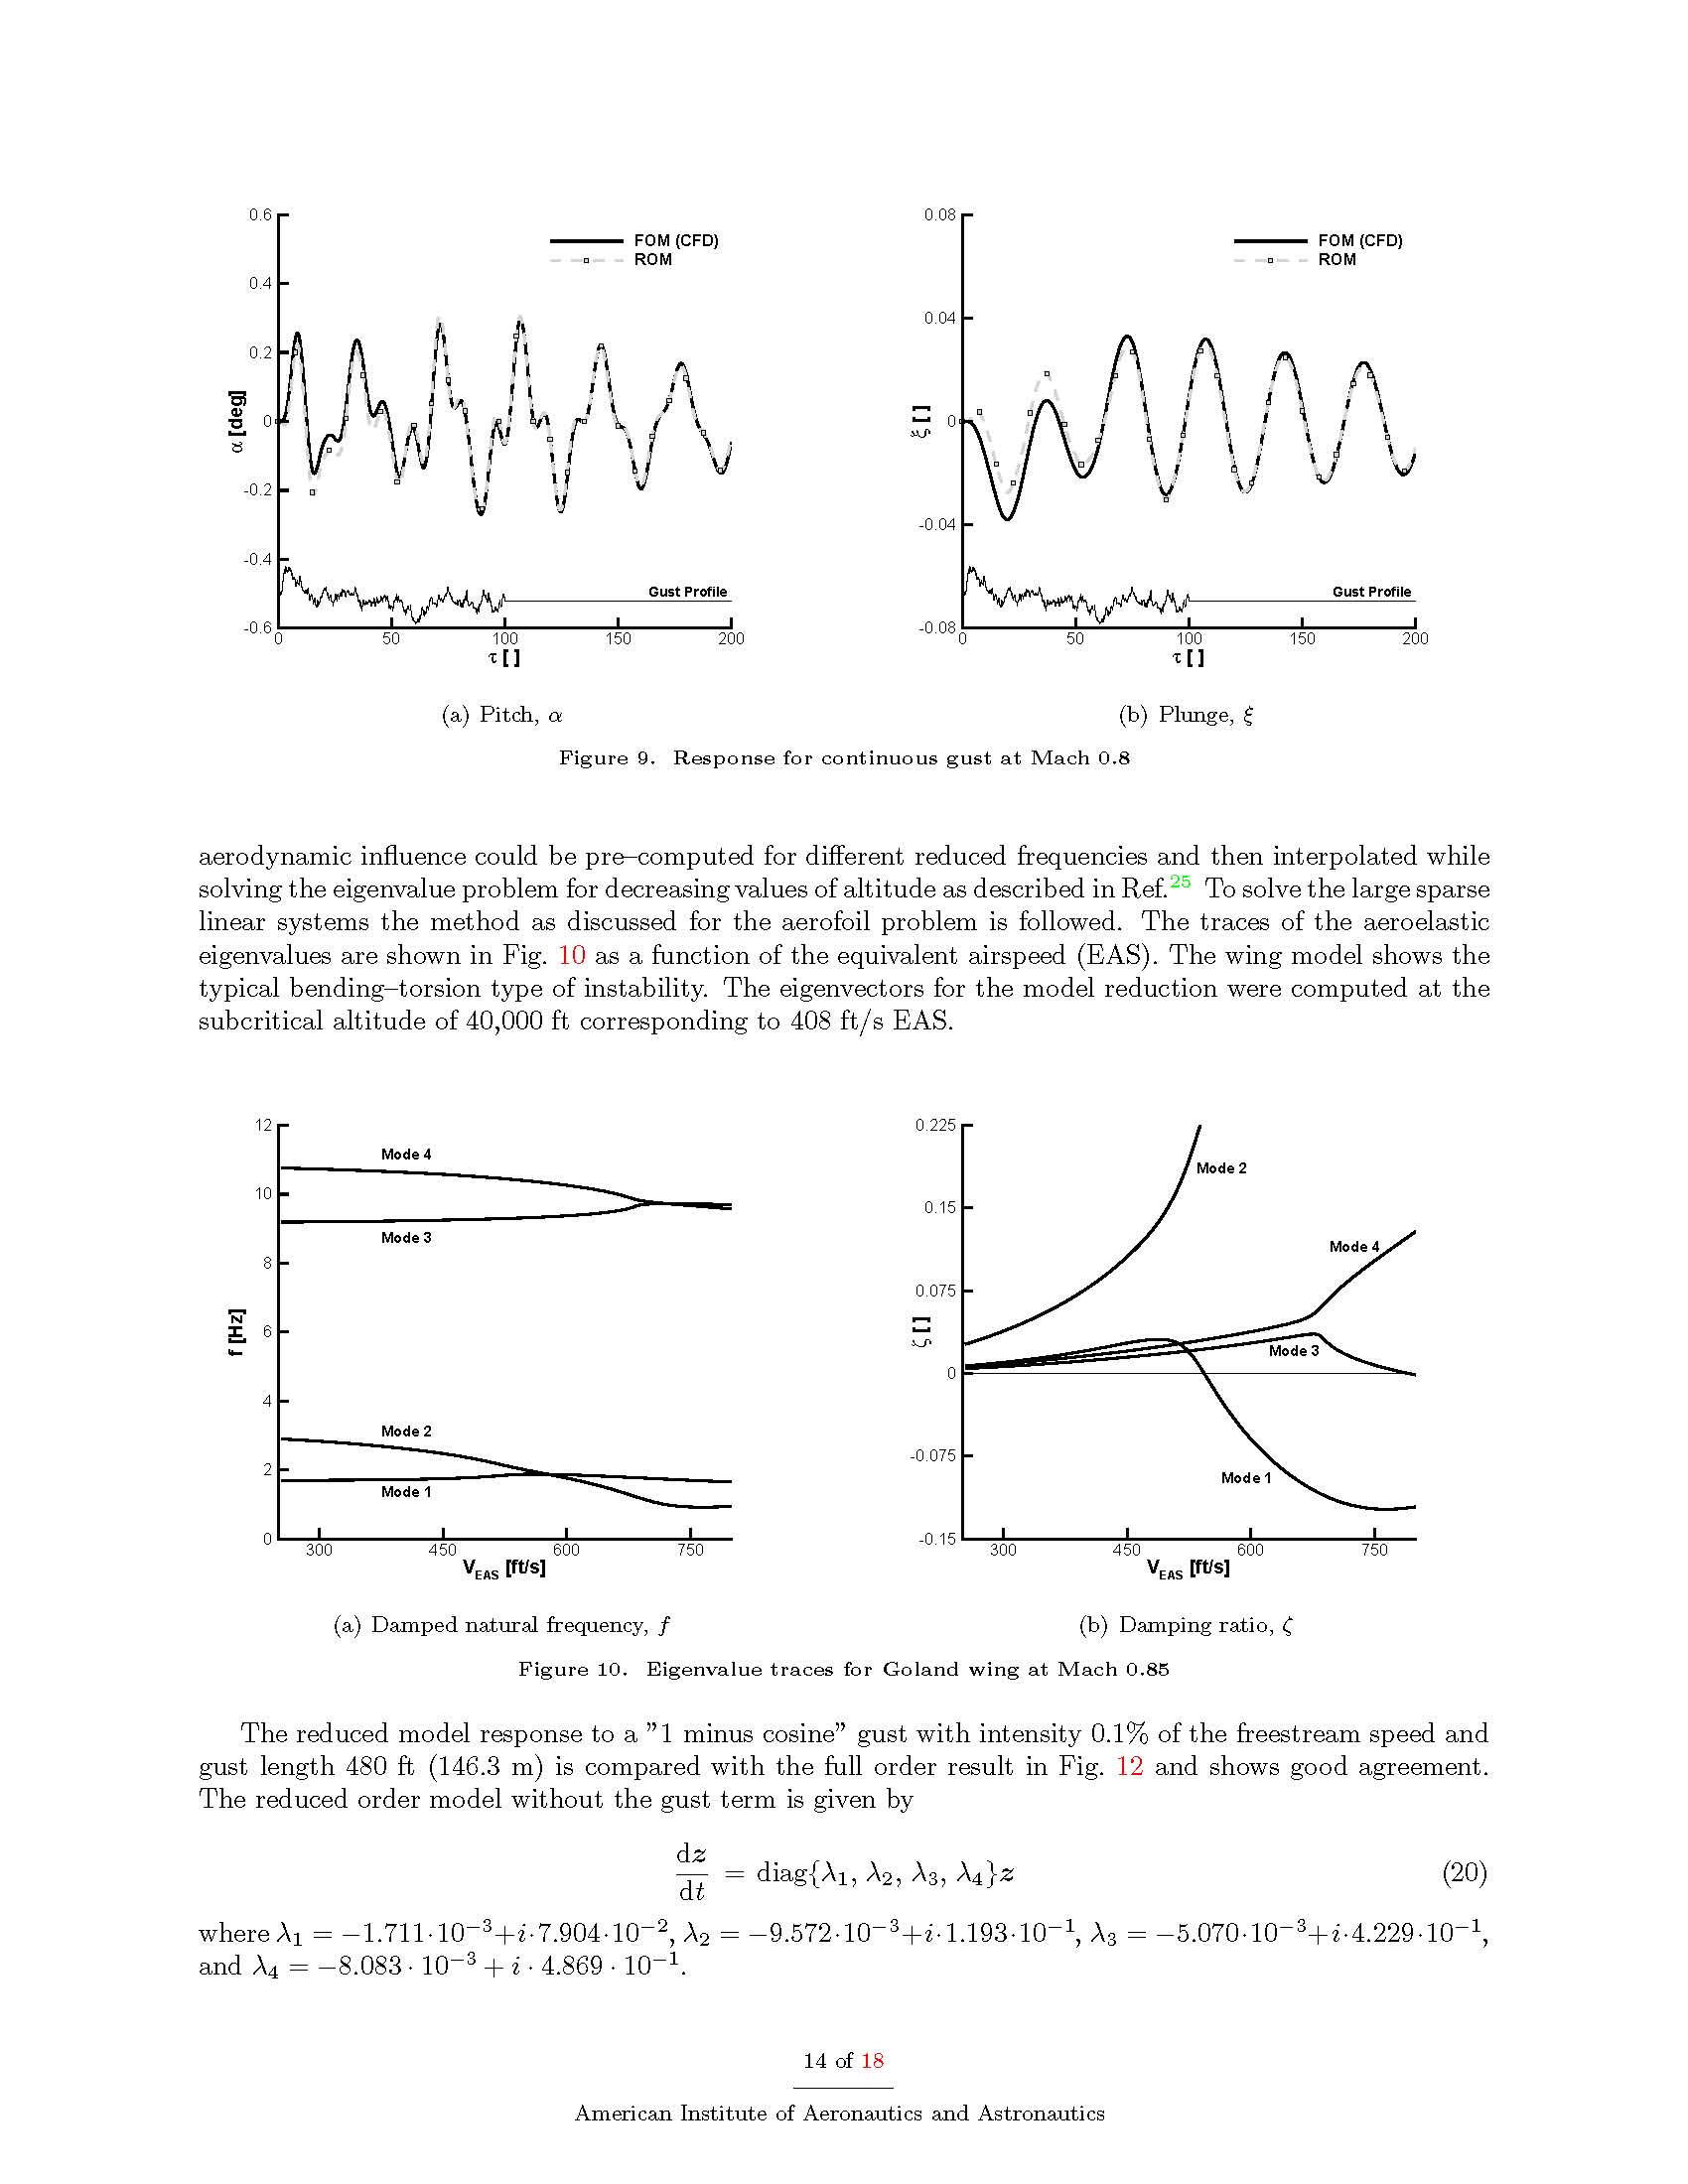
Response to Von Karman gust, frequencies to 2.5 Hz

Slide 23
Finite Differences for Gust Influence
→ reduce to virtually zero by analytical evaluation

Slide 24
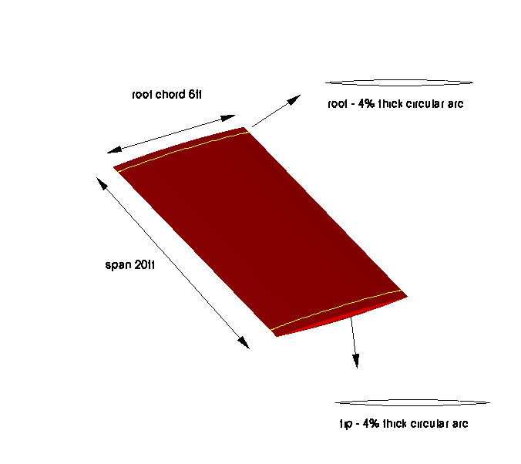
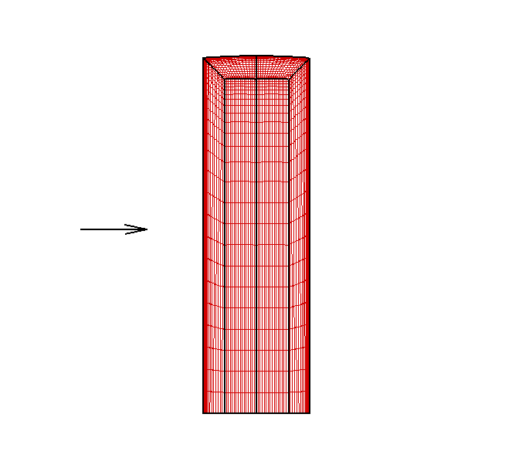
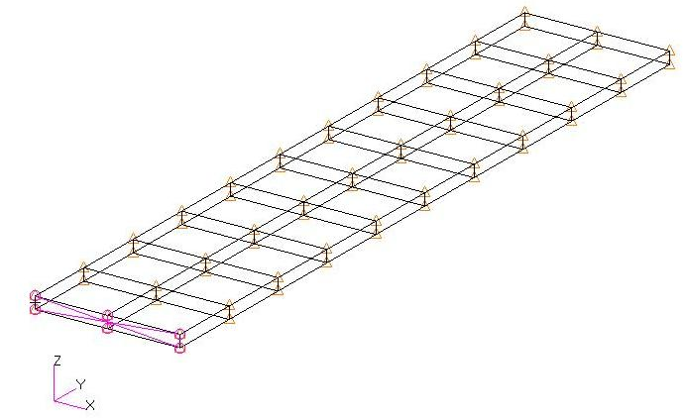
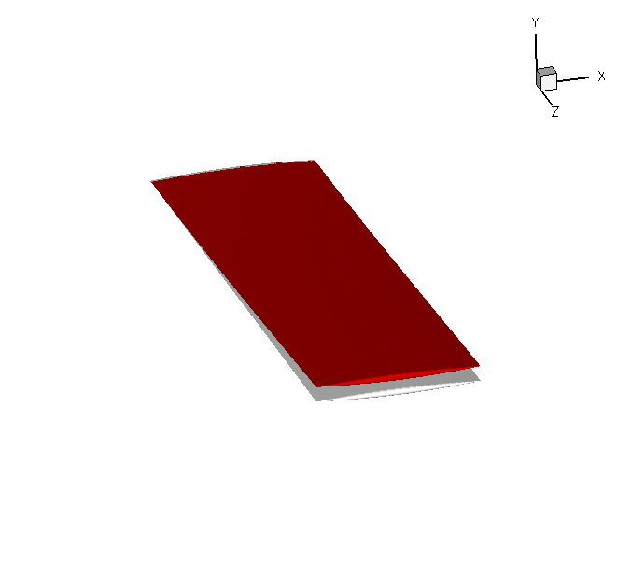
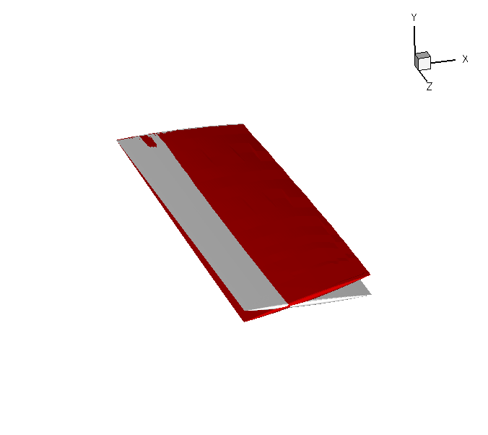
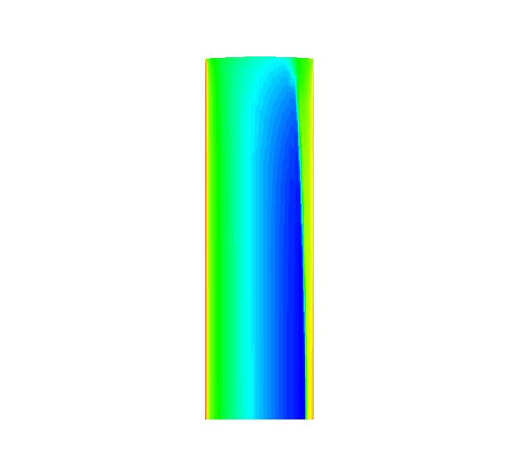
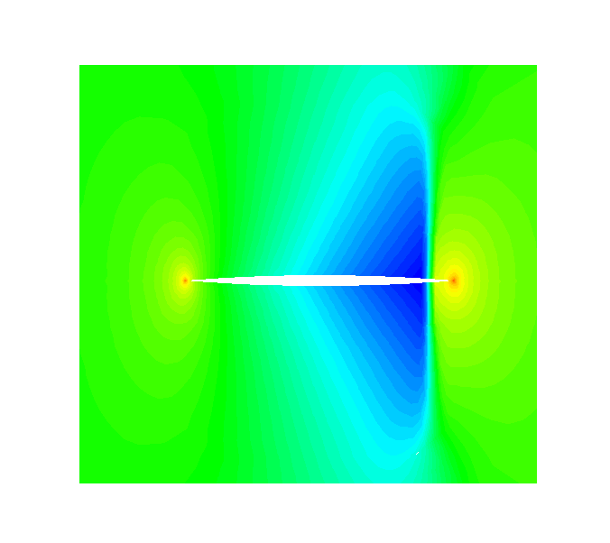
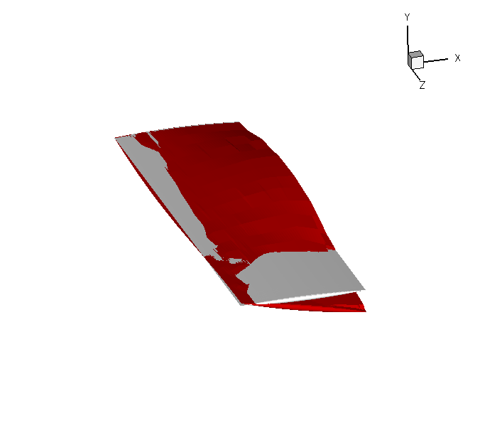
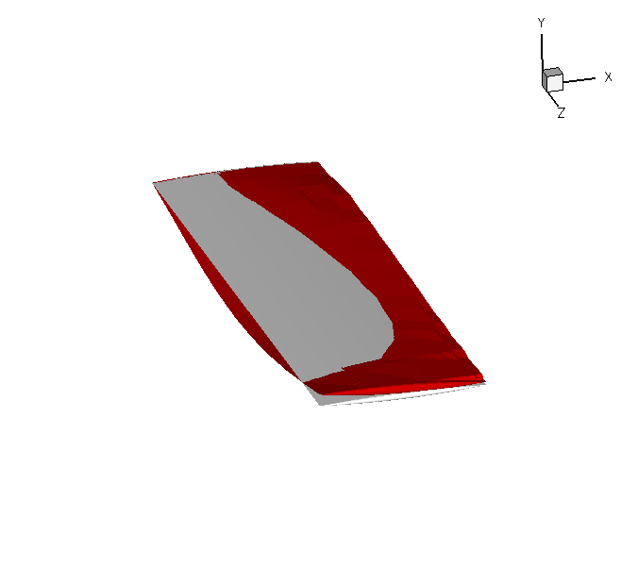
GOLAND WING
400k points
1.72 Hz
3.05 Hz
9.18 Hz
11.10 Hz
Mach 0.92
Notes:
4%thick circular arc aerofoil
24

Slide 25
Mach 0.85; α=1deg
ROM calculated at 405 ft/sec EAS
Modes corresponding to normal modes retained
→ 4 modes; 8 DoF

Slide 26
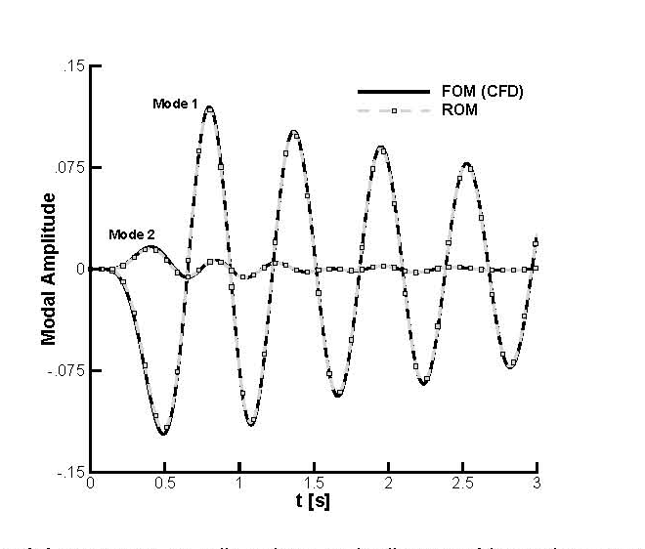
1-cosine gust: Intensity 0.1%
Gust length 480 ft

Slide 27
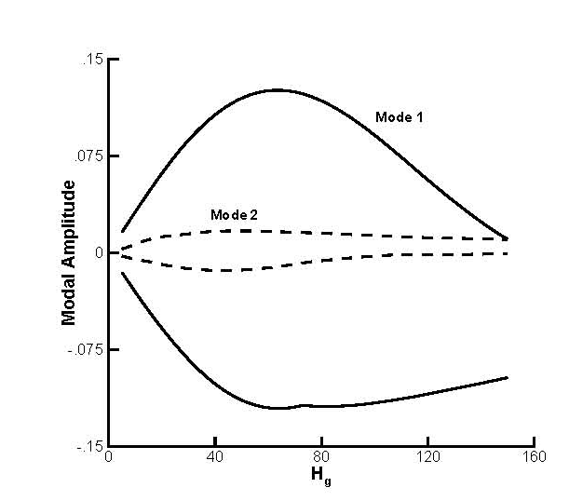
Worst Gust Search at M=0.8; 1-cos family
Gust Lengths between 5 and 150 chords
Kriging Method, Worst Case Sampling: 20 ROM evaluations
Worst Case: 65 chords (excites first bending mode)

Slide 28
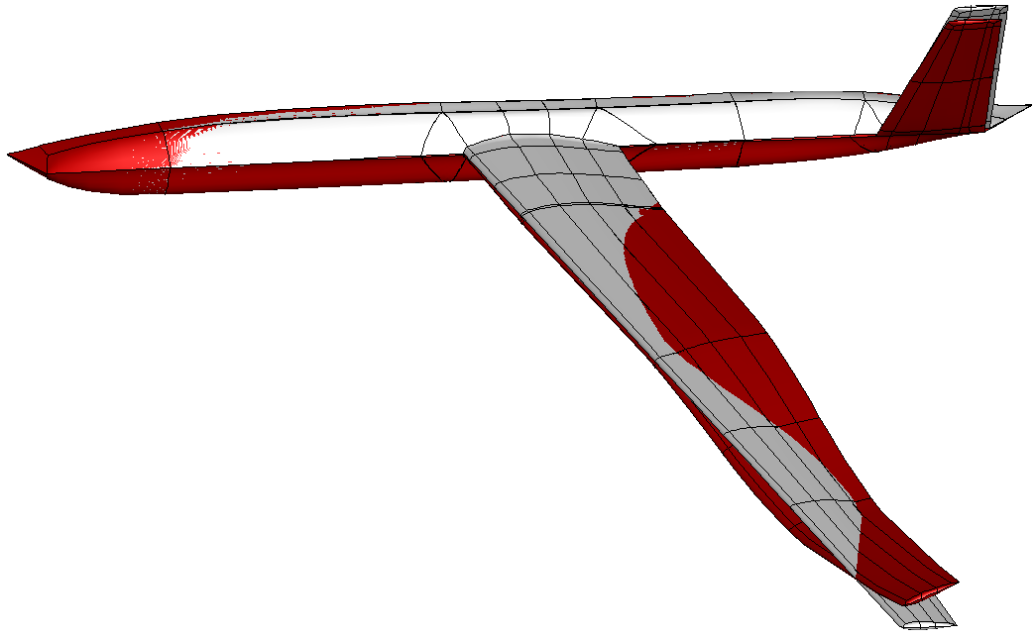
Conclusions
Model Reduction method formulated
Tests on pitch-plunge, flexible wing case
Future
RANS
Rigid Body DoFs
Alleviation

