Slide 1
Reduction of Nonlinear Models for Control Applications
A. Da Ronch, N.D. Tantaroudas, and K.J. Badcock
University of Liverpool, U.K.
email: | A.Da-Ronch@[liverpool, soton].ac.uk
AIAA Paper 2013-1941
Boston, MA, 08 April 2013
Notes:
This presentation and the next one will report on the development of an approach to model reduction for control of flexible aircraft. In particular, this presentation focuses on the exploitation of the reduced model of nonlinear systems for control, and the next talk will show application examples based on CFD

Slide 2
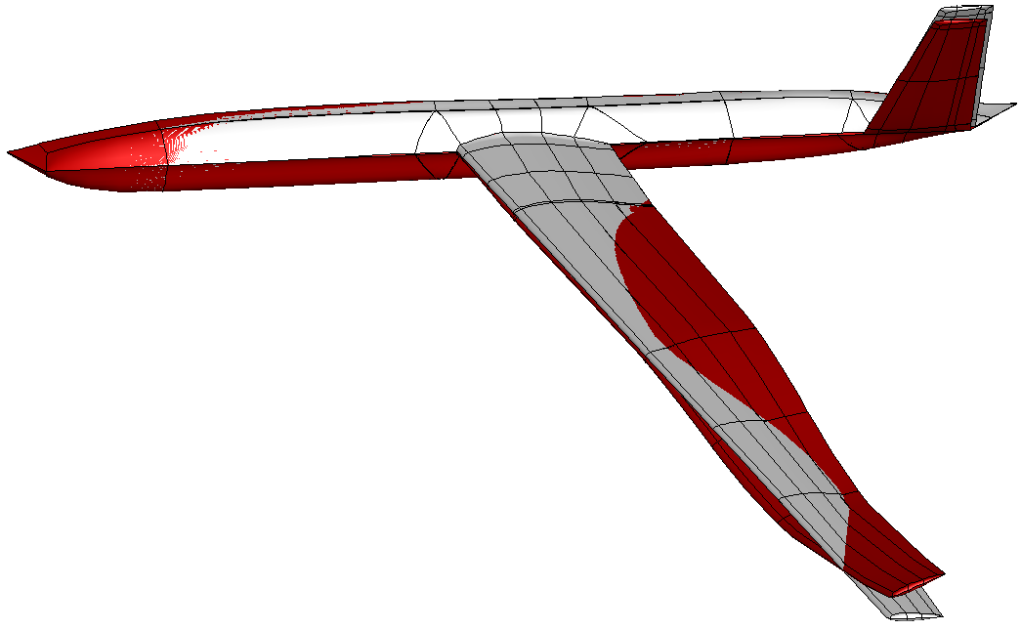
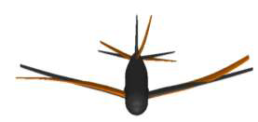
Motivation
Physics-based simulation of very flexible aircraft gust interaction
large amplitude/low frequency modes
coupled rigid body/structural dynamics
nonlinearities from structure/fluid (& control)
Nonlinear model reduction for control design
system identification methods
manipulation of full order residual
Control design for FCS of flexible aircraft
Notes:
Flexible aircraft are very interesting because the frequencies of the flight mechanics are close to the frequencies of the structure, and control design should be done in a careful way to account for this overlapping. Now, if you want to simulate the aircraft gust response and use control surfaces the problem is even more difficult because there is a range of nonlinearities which cannot be neglected, arising from large deformations, flow development and control effector dynamics. In this context, we think that we should go back to a physical description of the governing equations. However, this will come at the cost of solving a large nonlinear problem, which is in conflict with control applications or using it for parametric search. At this point, an approach to model reduction is required. Common approaches based on system identification lack of a robust parameterization and their validity is restricted to the training data used to generate them. The approach which is exploited our framework is based on the manipulation of the system residual.
We have in mind very flexible aircraft, which are the main driver for the computational framework that I am going to illustrate. Very flexible aircraft can be intrinsically unstable, requiring a stability augmentation system, and sensible to atmospheric gust, you are possibly familiar with the failure of the NASA HELIOS. In addition to these key aspects, very flexible aircraft exhibit low frequency natural modes which are close, or even overlapping, the modes of the flight mechanics. Therefore, it is suspect or erroneous to design a conventional flight control system filtering out the frequencies of structural vibrations. An integrated approach has to be used.
The target we have set is to use a physics-based formulation to realistically predict nonlinearities arising from the structure, large deformations, and the fluid, separation and shock motion. The mathematical model of the coupled system based on nonlinear beams, from IC, and CFD is potentially very large in dimension and expensive to solve. The role of a model reduction for control design is therefore fundamental. The approach based on the manipulation of the coupled residual is chosen, retaining the ability to describe relevant nonlinearities. The other approach to model reduction is system identification, but the lack of robustness and dependence on the training data are well-known issues.

Slide 3
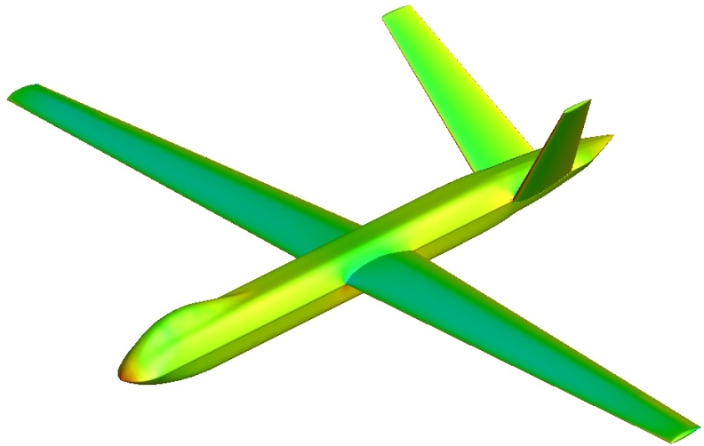
Testcase
Global Hawk type (P. Hopgood of DSTL)
beam/plate FE model of composite material
control surfaces
structural model > 1,300 points
CFD grid > 6 mio points
- stability augmentation (SAS)
worst case gust search
gust load alleviation (GLA)
performance optimization
Notes:
Let me stress the problem. For this UAV model provided by DSTL, the FE structural model is rather detailed, using beams and plates of composite material. The CFD grid has about 6 million points, and control surfaces are included in both structural and fluid models. The control engineer is unable to work with such big model, and what we want is to retain the nonlinear effects into a smaller system so that control design is possible.

Slide 4
Model Reduction
Notes:
The starting point is the original full-order model, formulated as a set of ODEs of the form dwdt = residual. The residual depends nonlinearly on the state vector, which is partitioned into fluid, structure and RB DOFs. A parameter, denoted here by sigma, is independent of the unknown vector and is used to parameterize the system. Recall the example of the global-hawk type aircraft, the state vector has million of unknowns.
To achieve model reduction, the full model is projected onto a small basis of coupled system eigenvectors, which is similar to the normal modes if you are familiar with structural models, but in our case the modes are those of the coupled system.
To calculate the basis, we need to solve an eigenvalue problem. For small systems, Matlab can do the job. For large order systems, as those arising with CFD, the eigenvalue problem can be a difficult task. Fortunately, previous work at the UoL was devoted to this specific problem, and the Schur eigenvalue solver provides the information needed for model reduction. Here, we assume that we have this method and if interested please refer to the article in progress in aerospace sciences.

Slide 5
Model Reduction
Eigenvalue problem of large order system is difficult
Badcock et al., “Transonic Aeroelastic Simulation for Envelope Searches and Uncertainty Analysis”, Progress in Aerospace Sciences; 47(5): 392-423, 2011
Notes:
The starting point is the original full-order model, formulated as a set of ODEs of the form dwdt = residual. The residual depends nonlinearly on the state vector, which is partitioned into fluid, structure and RB DOFs. A parameter, denoted here by sigma, is independent of the unknown vector and is used to parameterize the system. Recall the example of the global-hawk type aircraft, the state vector has million of unknowns.
To achieve model reduction, the full model is projected onto a small basis of coupled system eigenvectors, which is similar to the normal modes if you are familiar with structural models, but in our case the modes are those of the coupled system.
To calculate the basis, we need to solve an eigenvalue problem. For small systems, Matlab can do the job. For large order systems, as those arising with CFD, the eigenvalue problem can be a difficult task. Fortunately, previous work at the UoL was devoted to this specific problem, and the Schur eigenvalue solver provides the information needed for model reduction. Here, we assume that we have this method and if interested please refer to the article in progress in aerospace sciences.

Slide 6
Model Reduction
2nd/3rd Jacobian operators for NROM
Da Ronch et al., “Nonlinear Model Reduction for Flexible Aircraft Control Design”, AIAA paper 2012-4404; AIAA Atmospheric Flight Mechanics, 2012
Notes:
The starting point is the original full-order model, formulated as a set of ODEs of the form dwdt = residual. The residual depends nonlinearly on the state vector, which is partitioned into fluid, structure and RB DOFs. A parameter, denoted here by sigma, is independent of the unknown vector and is used to parameterize the system. Recall the example of the global-hawk type aircraft, the state vector has million of unknowns.
To achieve model reduction, the full model is projected onto a small basis of coupled system eigenvectors, which is similar to the normal modes if you are familiar with structural models, but in our case the modes are those of the coupled system.
To calculate the basis, we need to solve an eigenvalue problem. For small systems, Matlab can do the job. For large order systems, as those arising with CFD, the eigenvalue problem can be a difficult task. Fortunately, previous work at the UoL was devoted to this specific problem, and the Schur eigenvalue solver provides the information needed for model reduction. Here, we assume that we have this method and if interested please refer to the article in progress in aerospace sciences.

Slide 7
Model Reduction
How to add gust term in CFD-based ROM?
control surfaces,
gust encounter,
speed/altitude
Da Ronch et al., “Model Reduction for Linear and Nonlinear Gust Loads Analysis”, AIAA paper 2013-1942; AIAA Structural Dynamics and Materials, 2013
Notes:
The starting point is the original full-order model, formulated as a set of ODEs of the form dwdt = residual. The residual depends nonlinearly on the state vector, which is partitioned into fluid, structure and RB DOFs. A parameter, denoted here by sigma, is independent of the unknown vector and is used to parameterize the system. Recall the example of the global-hawk type aircraft, the state vector has million of unknowns.
To achieve model reduction, the full model is projected onto a small basis of coupled system eigenvectors, which is similar to the normal modes if you are familiar with structural models, but in our case the modes are those of the coupled system.
To calculate the basis, we need to solve an eigenvalue problem. For small systems, Matlab can do the job. For large order systems, as those arising with CFD, the eigenvalue problem can be a difficult task. Fortunately, previous work at the UoL was devoted to this specific problem, and the Schur eigenvalue solver provides the information needed for model reduction. Here, we assume that we have this method and if interested please refer to the article in progress in aerospace sciences.

Slide 8
Model Reduction
Systematic generation of Linear/Nonlinear ROMs
independent of large order model
control design done in the same way
Lin/Nln ROM dynamics
Linear Aerodynamics | Linear Structure
 | Nonlinear Structure
Nonlinear Aerodynamics | Linear Structure
 | (Nonlinear Structure)
Notes:
The method we have described is systematic in the sense that it is applied in the same way to different test cases, and the ROM models look the same. ROMs are in a form familiar to control people, and the control design that we will show for a pitch/plunge aerofoil will be done in the same way for other cases.

Slide 9
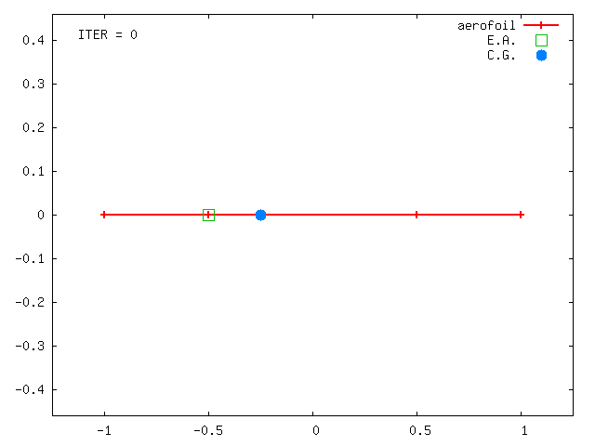
Pitch-Plunge Aerofoil
Structure: linear/nonlinear
- cubic stiffness, K = K(1+β_{x} x ³)
Aerodynamics: 2D strip
flap motion (Wagner)
gust encounter (Küssner)
IDEs to ODEs by adding 8 aero states
Total of 12 states → model problem
Notes:
The structural model was made nonlinear adopting a polynomial form for the stiffness in plunge. The aerodynamic contributions include the effects of control deflection and penetration into a gust. The extension to any arbitrary input time history is achieved using the convolution integral, with the resulting eqs being integro-differential. The eqs are recast into a ODE form by additional variables for the dynamics of the flow. With only 12 states, the example is used as model problem to test the reduction.

Slide 10
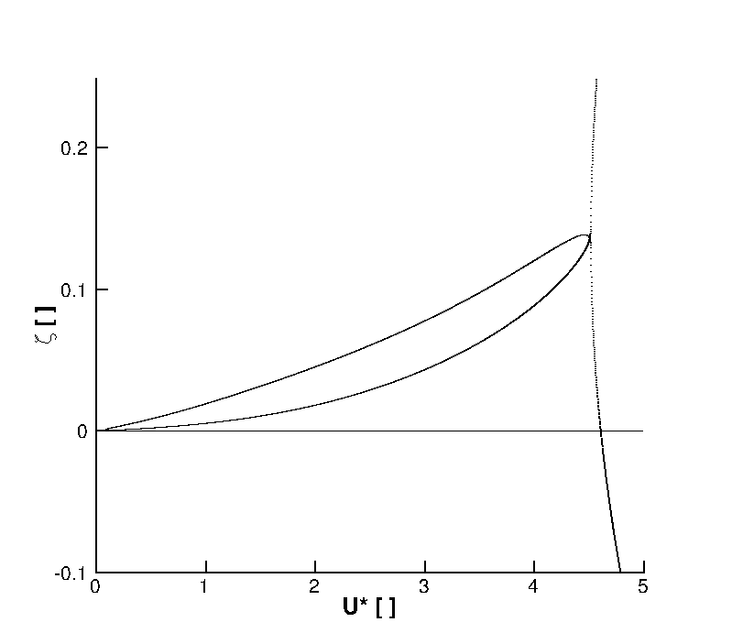
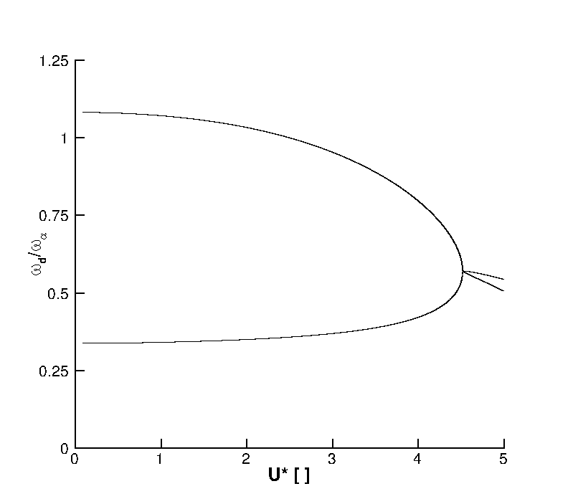
Stability Analysis
“heavy case”
ω_{ξ}/ω_{α} = 0.343 µ = 100 a_{h} = -0.2 x_{α} = 0.2 r_{α} = 0.539
ROM basis
2 modes (related to pitch & plunge)
U*_{L} = 4.6137
U* = 4.6 (99.7% of U*_{L})
Notes:
These figures are the tracing of the pitch and plunge modes with reduced velocity. The left figure shows the damped frequency normalized by the natural frequency in pitch, and the right figure shows the damping ratio. The coupled system becomes unstable when the damping ratio becomes negative, at 4.6137. To generate the terms in the ROM, a reduced velocity of 4.6 was used, which is very close to the flutter speed. This can be an interesting situation because a strong gust encounter could trigger a system instability even if we are below the flutter point.

Slide 11
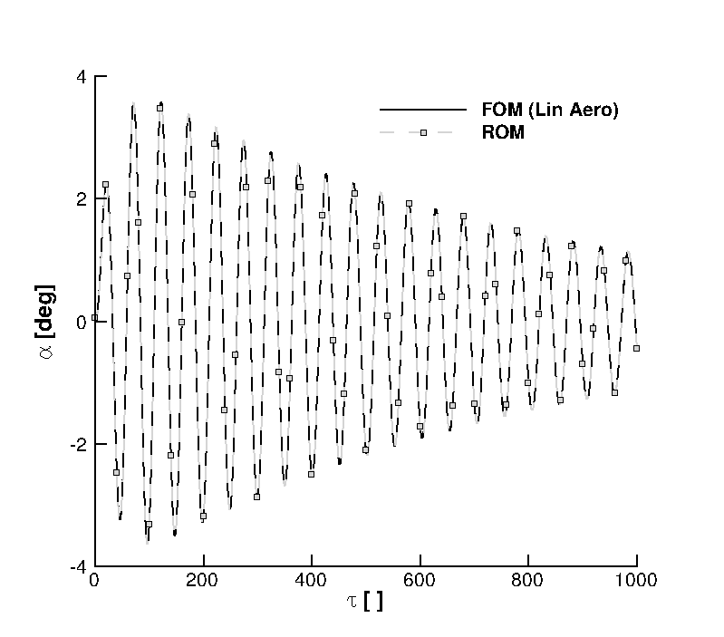
ROM evaluation: free response
dξ₀/dτ = 0.01
Notes:
Starting with a ROM without gust terms, the figure shows the pitch response to an initial perturbation in plunge velocity. Because we are very close to the flutter speed, the decay of oscillations is very slow. The prediction of the ROM is identical to the FOM, and this is also true for the plunge response, here not shown.

Slide 12
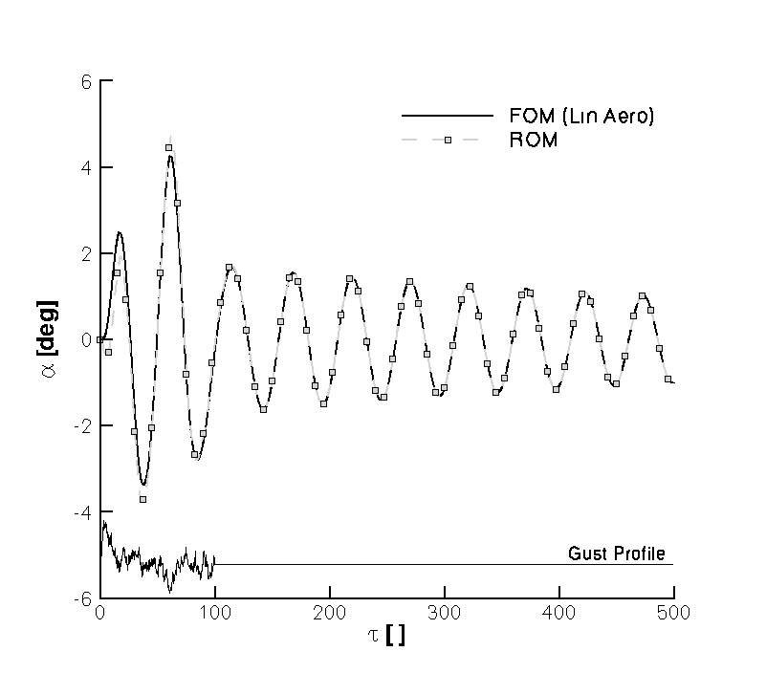
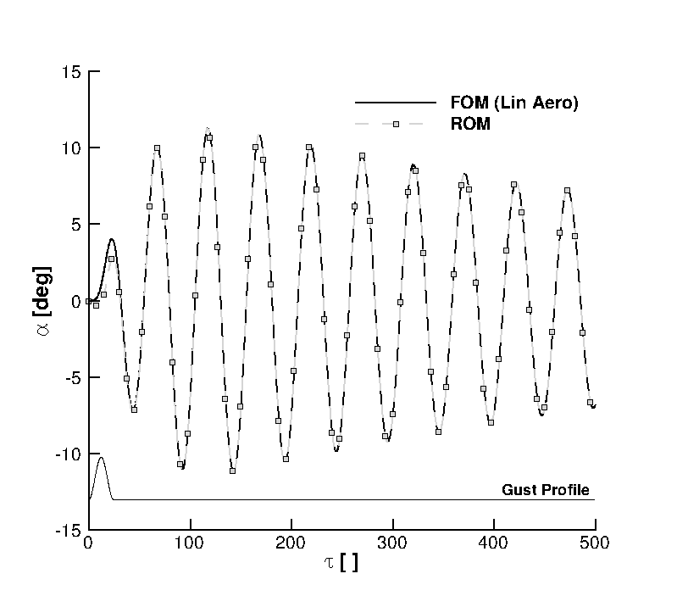
ROM evaluation: gust response
Von Kármán spectrum
“1 minus cosine”
H_{g} = 25
w_{g} = 0.05 U*
Notes:
Then, the gust term was included in the ROM. The gust term is independent of the gust formulation, so one ROM can be used to simulate the response to any gust of interest. In this slide, for example, we can see the pitch response to a common discrete gust (left side) and a continuous model (right side). The continuous model is based on the VK spectrum.

Slide 13
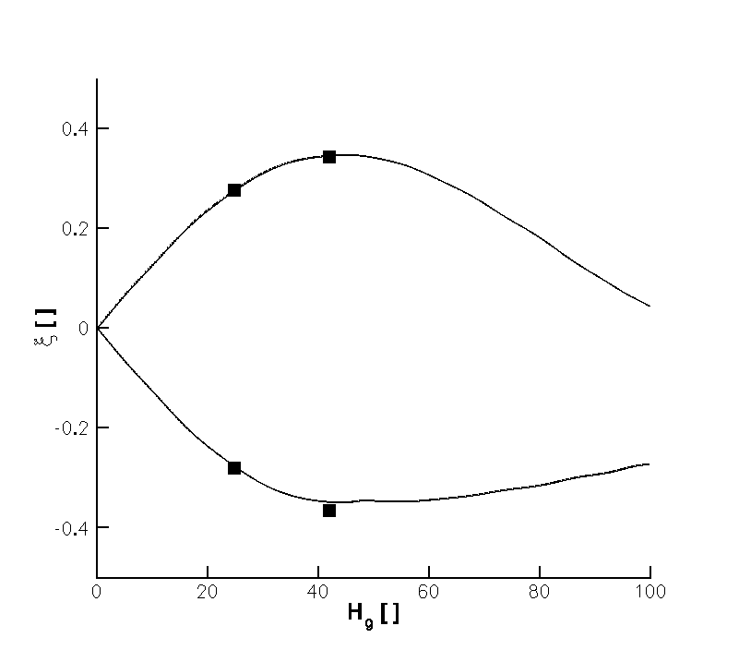
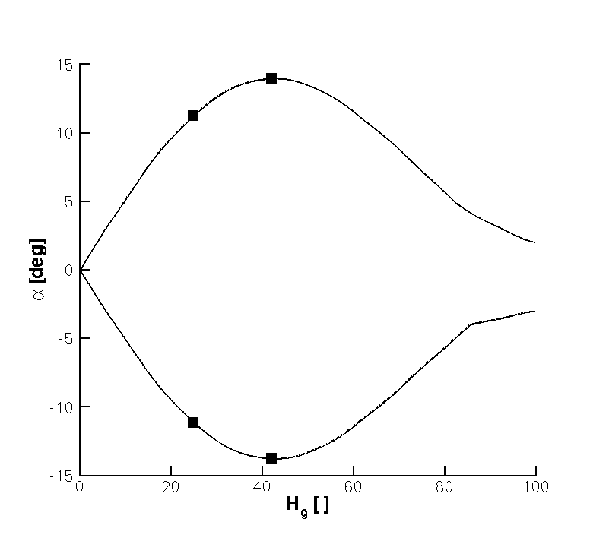
Worst-case gust search
“1 minus cosine”
w_{g} = 0.05 U*
Search for H_{g} < 100
1,000 design sites
ROM-based Kriging
Cost (based on CFD)
ROM-based search: 31 min
FOM-based search: 43 h
Notes:
In this slide we can see how the ROM, created once, can be used efficiently to search for the worst case gust, which is important for structural sizing. The search was done considering the “1 minus cosine” gust to find the gust gradient which causes the largest response (in absolute value) in pitch. 1000 design points were used, and because there are methods out there to reduced the number of calculations, we used Kriging interpolation. The figures tell us, for a given gust gradient, what maximum and minimum values of pitch and plunge should be expected. If you compare the lines from the ROM with few full model calculations, the predictions are really close. A side comment on cost borrowed from the next presentation; based on CFD, the search based on the ROM took 31 min, and the same search on the FOM would have taken 43 h, that is 2 orders of magnitude.

Slide 14
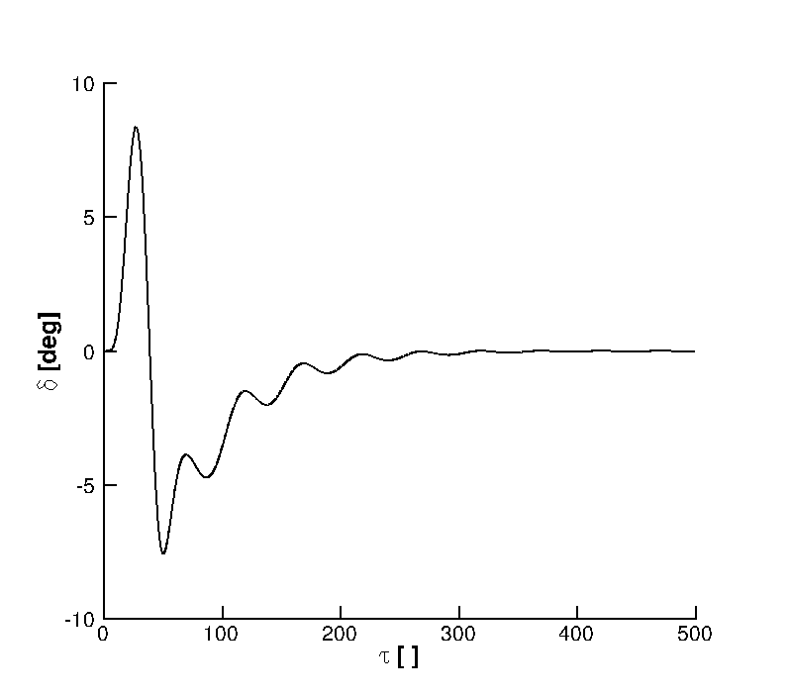
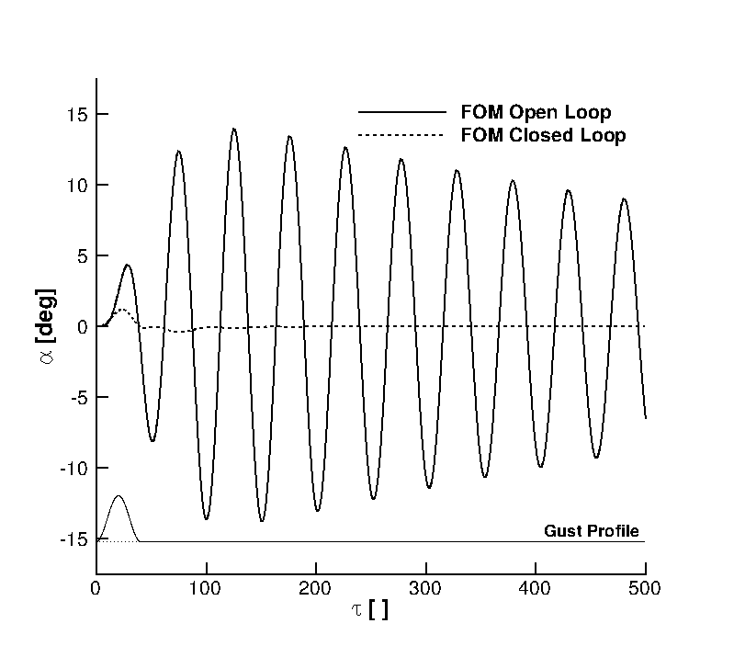
Closed loop response: worst-case gust
“1 minus cosine”
H_{g} = 41
w_{g} = 0.05 U*
H∞ control on ROM
measured input: pitch
control input: flap
Notes:
Having established the validity of the ROM, it is now used to design a controller for gust loads alleviation. A standard Hinf technique was used, measuring the pitch degree of freedom and using the trailing-edge flap for control. The left figure shows the open and closed loop responses, and the right figure shows the required flap deflection.

Slide 15
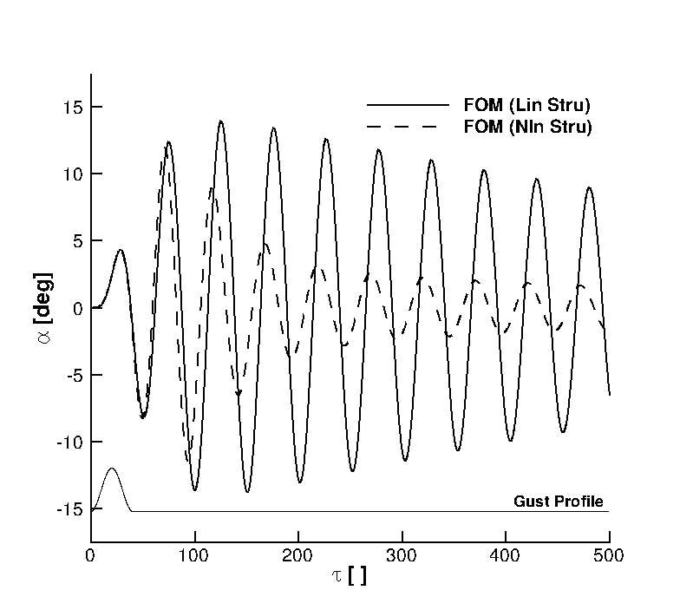
Nonlinear structure: worst-case gust
“1 minus cosine”
H_{g} = 41
w_{g} = 0.05 U*
β_{ξ} = 3
β_{α} = 3
Notes:
Will the ROM work if the model is nonlinear? To answer this question, we are now looking at the pitch response to the worst case gust for 2 full-order models, one is linear and one has a cubic restoring force in both pitch and plunge. It is clear the full model is affected by the structure nonlinearity. In the next slide, we compare the nonlinear full model with a reduced model

Slide 16
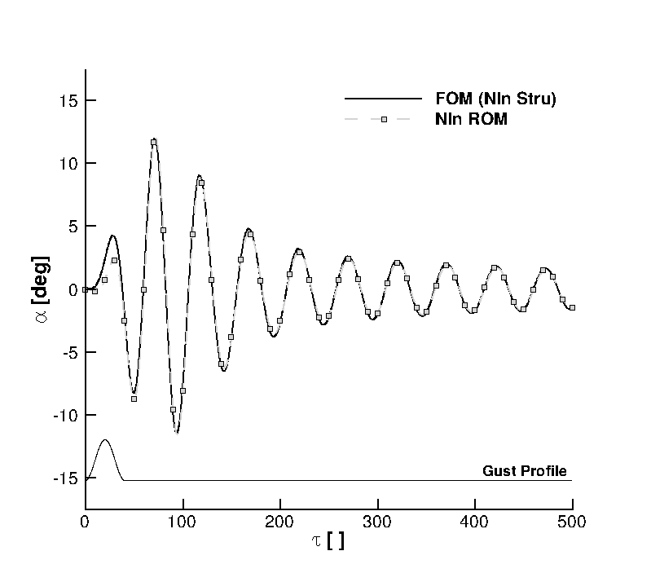
Nonlinear ROM evaluation: worst-case gust
“1 minus cosine”
H_{g} = 41
w_{g} = 0.05 U*
β_{ξ} = 3
β_{α} = 3
Notes:
The nonlinear terms were included in the ROM, and the gust response predicted is very close to the full model response.

Slide 17
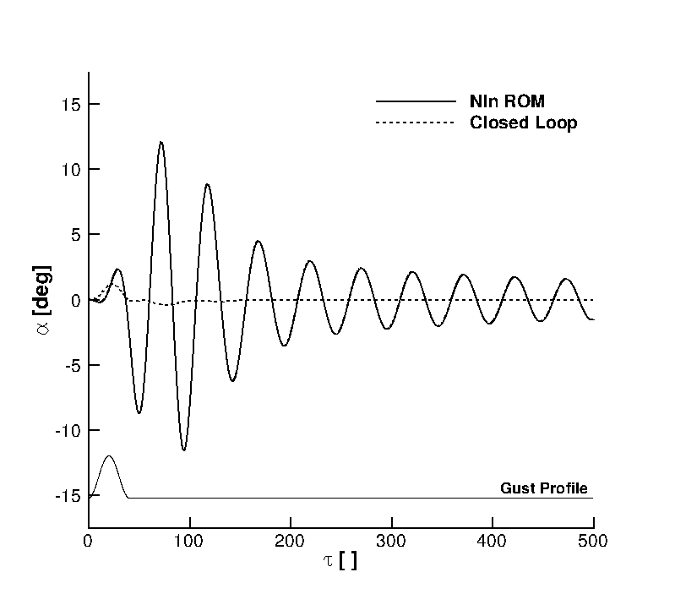
Closed loop response: worst-case gust
“1 minus cosine”
H_{g} = 41
w_{g} = 0.05 U*
β_{ξ} = 3
β_{α} = 3
Notes:
Having a nonlinear ROM, it is possible to include the nonlinearity when designing a controller or use a fancy nonlinear control technique. What we have done here is simpler, as the controller was designed on the linear ROM and the nonlinearity was added on the closed loop.

Slide 18
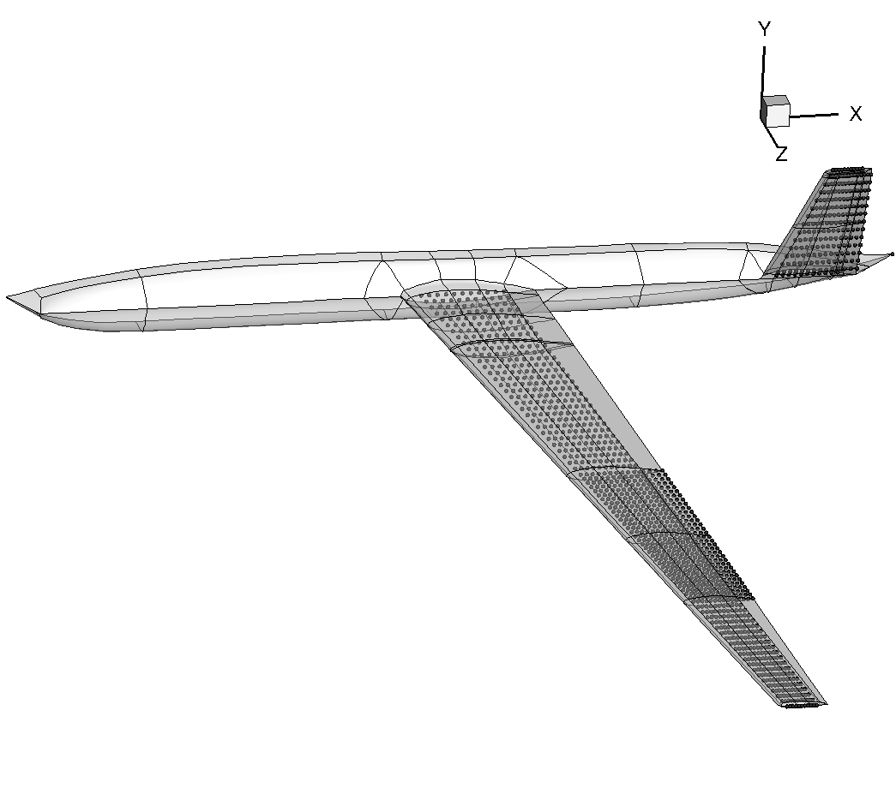
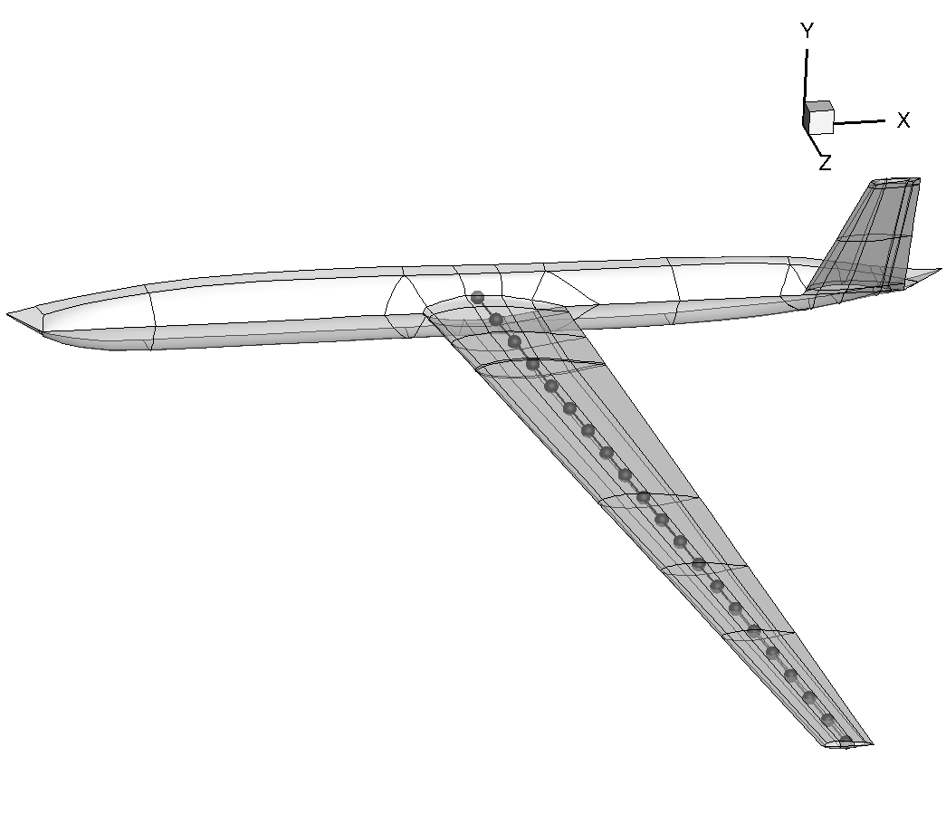
UAV Model
Structure: geometrically non-linear beam (from Imperial College)
Nastran plate model to 1D beam
model tuning
Aerodynamics: 2D strip
control surface, gust encounter
20 states for each beam node
FOM of 540 states (20 wing + 4 tail + 3 fuse)
 | Nastran [Hz] | Beam [Hz]
1st bending | 3.56 | 3.48
2nd bending | 7.75 | 6.99
1st torsion | 14.9 | 12.2
Notes:
The 2nd test case is for the UAV model. The original plate model was reduced to a beam description for half configuration trying to match the lowest frequencies and modeshapes. The coupled system is based on the nonlinear beam equations (from IC) coupled with 2D linear aerodynamics at each beam node, in which forces are treated as follower forces. For each beam node, there are 20 states, making the FOM of dimension 540. What I am going to show next is the vertical displacement of the wing tip.

Slide 19
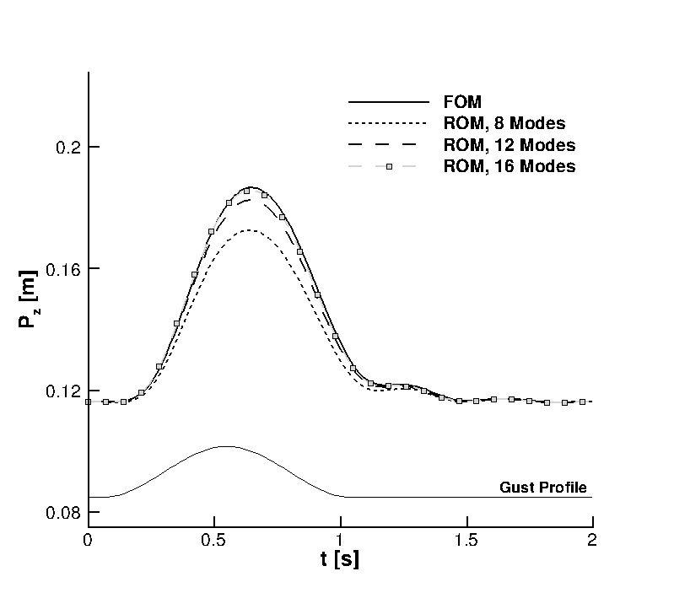
ROM convergence
M = 0.08
h = 20,000 m
α∞ = 5 deg
“1 minus cosine”
H_{g} = 26
w_{g} = 0.06 U∞
From 540 states to 16 states
Notes:
There are several options to select the basis for the reduced model. Low frequency structural modes modified by the fluid are first included, and then aerodynamic modes related to the gust encounter are added. This slide shows what happens when including more modes, all those modes are related to the lowest constant in the Kussner function.

Slide 20
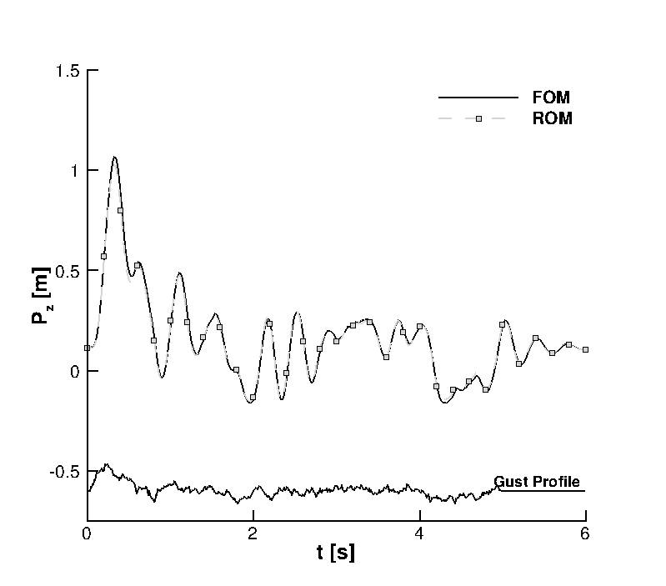
ROM evaluation: continuous gust
M = 0.08
h = 20,000 m
α∞ = 5 deg
Von Kármán
Cost
FOM time domain: 55 s
ROM time domain: 5.4 s
Notes:
Using the same ROM, the gust response to a continuous turbulence model is in very good agreement with the full model. For the linear case, the ROM is one order of magnitude faster, which enable search for the worst-case gust.

Slide 21
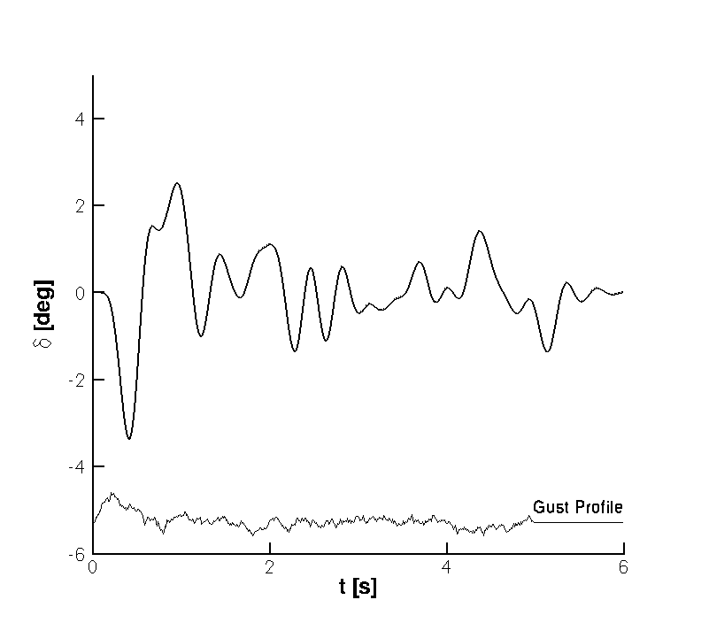
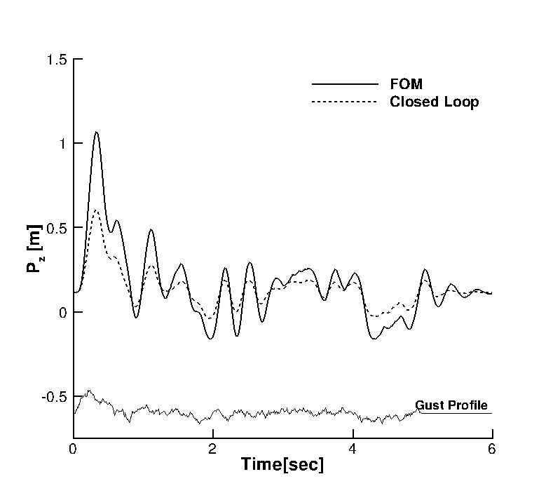
Closed loop response: continuous gust
M = 0.08
h = 20,000 m
α∞ = 5 deg
Von Kármán
H∞ control on ROM
measured input: wing tip deflection
control input: flap
Notes:
A controller was designed on the ROM for the worst-case gust, and it is tested here for a continuous gust model. So, the control problem was done in the same way as for the aerofoil test case.

Slide 22
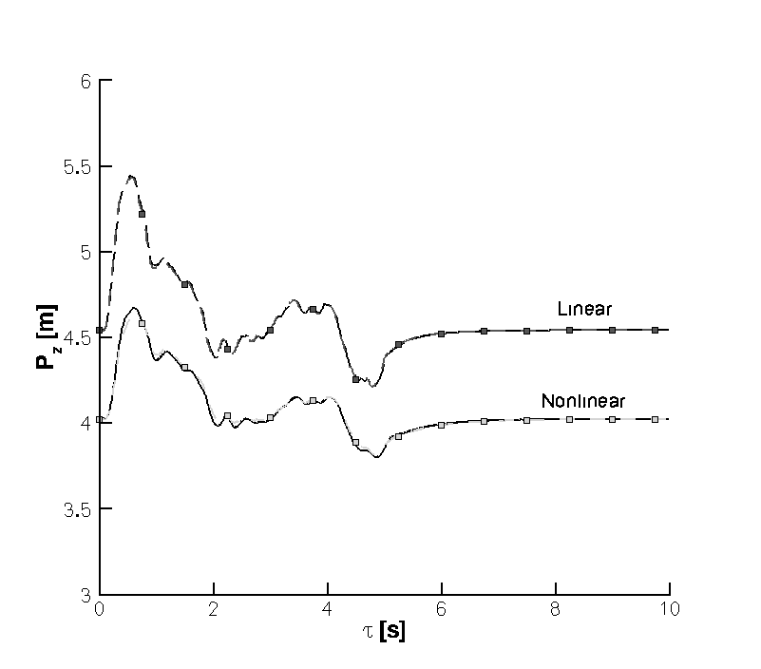
Nonlinear effects: continuous gust
M = 0.08
h = 2,900 m
α∞ = 10 deg
Von Kármán
Notes:
By decreasing the altitude, the effect of structural nonlinearity modelled using the geometrically nonlinear beam equations starts to be clear. The differences between linear and nonlinear models is not dramatic, but differences between peaks can be noted. The point here is that the ROMs are in very good agreement with the underlying full model. The data for the nonlinear case are finally used for a control exercise.

Slide 23
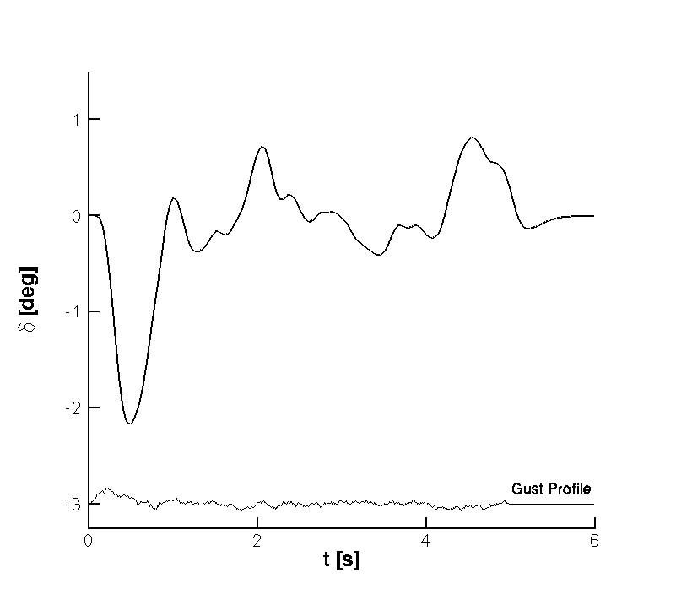
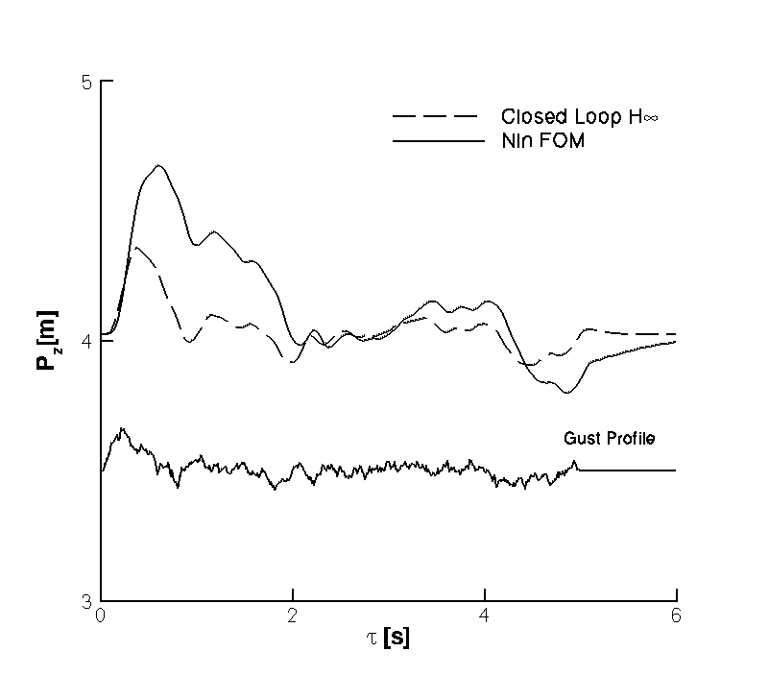
Closed loop response: continuous gust
M = 0.08
h = 2,900 m
α∞ = 10 deg
Von Kármán
H∞ control on ROM
measured input: wing tip deflection
control input: flap
Notes:
Just as done for the aerofoil, control was possible with no changes in the nonlinear case.

Slide 24
Conclusion
Systematic approach to model reduction
applicable to any (fluid/structure/flight) systems
control design done in the same way
Nonlinear ROM is straightforward
include nonlinearity in small size system
assess limitations from using linear models
Enabling 10,000 calcs
worst case search, GLA
SAS, performance optimization
... demonstration of UAV model with CFD, gust and flight dynamics
email: A.Da-Ronch@[liverpool, soton].ac.uk web: http://www.cfd4aircraft.com/

