Slide 2
Nonlinear Model Reduction for Flexible Aircraft Control Design
A. Da Ronch, K. J. Badcock
University of Liverpool, Liverpool, U.K.
Y. Wang, A. Wynn, and R. Palacios
Imperial College, London, U.K.
AIAA Paper 2012-4404
Minneapolis, 13 August 2012
andreadr@liverpool.ac.uk
Notes:
The presentation is about a systematic approach to model reduction applicable to large dimension fluid/structure systems. The work is supported by U.K. EPSRC and is made in collaboration with IC.

Slide 3
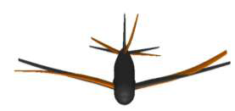
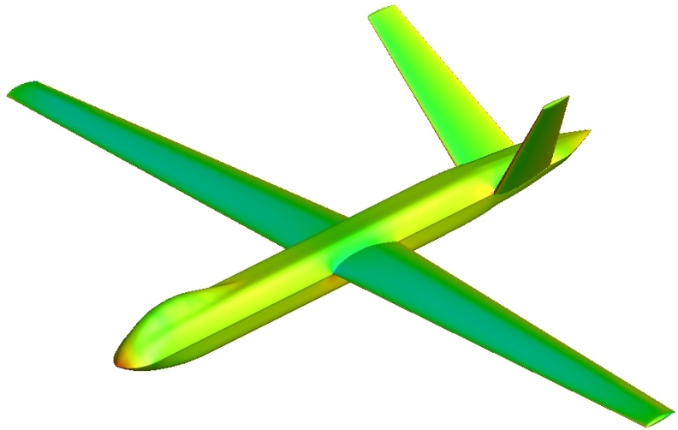
Objectives
Physics-based simulation of very flexible aircraft gust interaction
large amplitude/low frequency modes
coupled rigid body/structural dynamics
nonlinearities from structure/fluid (& control)
Nonlinear model reduction for control design
system identification methods
manipulation of full order residual (more)
- Control design for FCS of flexible aircraft
Project webpage:
http://www.cfd4aircraft.com/
Notes:
The objective is to be able to simulate the dynamics of very flexible aircraft interacting with gust with controls. Our approach is to use a physics-based formulation because this class of aircraft is intrinsically nonlinear. Nonlinearities in the structure arise because lightweight materials are selected to optimize design, large wing deformations associated with low frequency modes couple with the flight dynamics, and aeroelasticity and flight dynamics are coupled; the flow around lifting surfaces with large deformations and angles of attack may separate; and controls introduce nonlinearities. The use of high fidelity methods, with nonlinear structural models and CFD, comes at the price of a large dimension system which is incompatible with control design. A systematic method to model reduction is really a fundamental problem, and has to have the ability to retain the nonlinear effects of the large order model. There are 2 approaches to model reduction; the 1st is based on system identification methods, which use a I/O relationship to model the system dynamics; they are in widespread use because they are simple but they lack any physics which is not included in the data used to generate them (are only applicable within the support of the data used to generated them); the 2nd approach, which is our choice, is to manipulate the full order residual; while this introduces a complication, it retains a general validity to describe the nonlinearities.

Slide 4
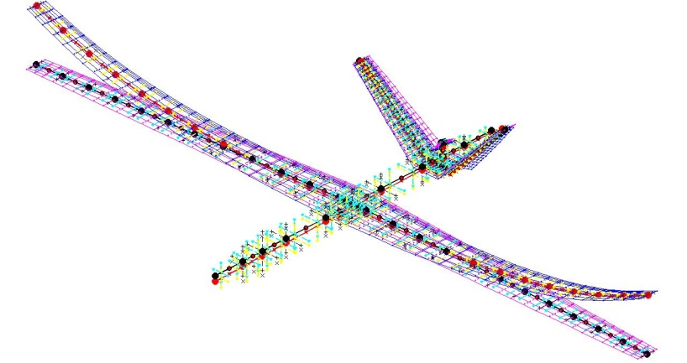
Global Hawk type
CFD grid: ~ 6 million grid points
Control surfaces on wing & V-tail
Structural model
Notes:
For this aircraft, for example, the CFD model we have has about 6 million points and a detailed structural model. The control engineer is unable to work with such a big model, and what we want is to retain the nonlinear effects into a smaller system so that control design is possible.

Slide 5
Model Reduction
- Nonlinear full order model (FOM)
- Nonlinear reduced order model (ROM)
from n ~ 10⁶ unknowns to m ~ 10 (few dominant modes)
Eigenvalue problem of large dimension system is difficult
Schur complement eigenvalue solver
Badcock et al., “Transonic Aeroelastic Simulation for Envelope Searches and Uncertainty Analysis”, Progress in Aerospace Sciences; 47(5): 392-423, 2011
Notes:
The starting point is the original full-order model, formulated as a set of ODEs of the form dwdt = residual. The residual depends nonlinearly on the state vector, which is partitioned into fluid, structure and RB DOFs. A parameter, denoted here by sigma, is independent of the unknown vector and is used to parameterize the system. Recall the example of the global-hawk type aircraft, the state vector has million of unknowns.
To achieve model reduction, the full model is projected onto a small basis of coupled system eigenvectors, which is similar to the normal modes if you are familiar with structural models, but in our case the modes are those of the coupled system.
To calculate the basis, we need to solve an eigenvalue problem. For small systems, Matlab can do the job. For large order systems, as those arising with CFD, the eigenvalue problem can be a difficult task. Fortunately, previous work at the UoL was devoted to this specific problem, and the Schur eigenvalue solver provides the information needed for model reduction. Here, we assume that we have this method and if interested please refer to the article in progress in aerospace sciences.

Slide 6
Model Reduction
Taylor expansion around equilibrium point
Nonlinear terms B & C with matrix-free products
need extended order arithmetic with CFD
2nd/3rd Jacobian operators for NROM
Badcock et al., “Transonic Aeroelastic Simulation for Envelope Searches and Uncertainty Analysis”, Progress in Aerospace Sciences; 47(5): 392-423, 2011
Notes:
How we manipulate the full order equations to perform model reduction is through a Taylor expansion up to third order, so that we can expose the nonlinearities of the coupled system in the reduced model. The calculation of the eigenvalue problem is a difficult task but we assume here to have the way of computing it. The calculation of the 2nd and 3rd Jacobian operators is the next challenging operation, required for nonlinear ROM. Because for ROM generation it is only their action on vectors which is required, we compute these terms with matrix-free products, so avoiding the need to form these tensors of dimension 3 and 4 in explicit form. For the aerofoil and the beam models coupled with linear aerodynamics, finite differences can be used. For systems arising from CFD, we know that we need expended order arithmetic to perform accurate calculations.

Slide 7
Model Reduction
Taylor expansion around equilibrium point
How to introduce gust into CFD?
field-velocity approach
dependence on control, gust, etc.
Notes:
The system is also expanded in the parameter sigma, so the introduce the dependence of control deflections and interaction with gust. For linear aerodynamics, the dependence of the residual on the gust perturbations can be derived analytically, and for CFD-based systems the calculation of this term is a challenge, but it is not presented here. For this work, we assume to know how to calculate the contribution arising from gust.

Slide 8
Model Reduction
Linear ROM
Nonlinear ROM
Notes:
The method we have described is systematic in the sense that it is applied in the same way to different test cases, and the ROM models look the same. ROMs are in a form familiar to control people, and the control design that we will show for a pitch/plunge aerofoil will be done in the same way for other cases.

Slide 9
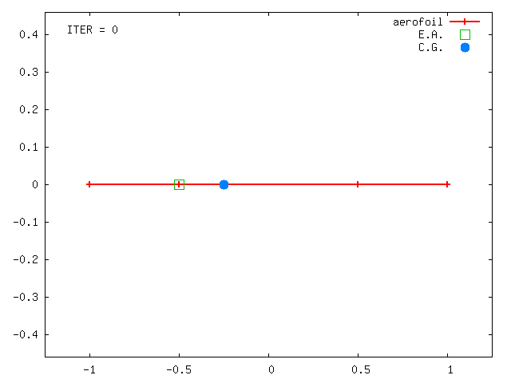
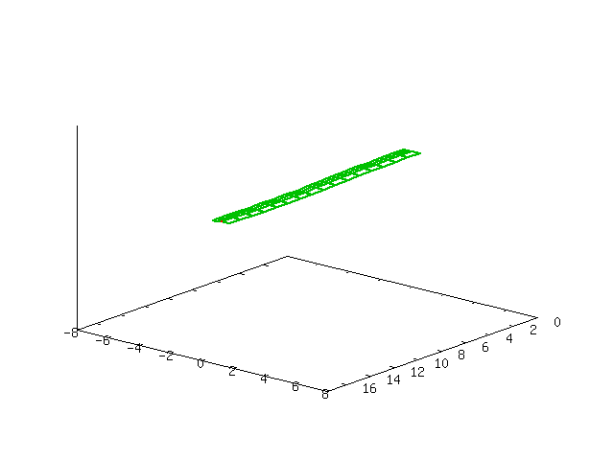
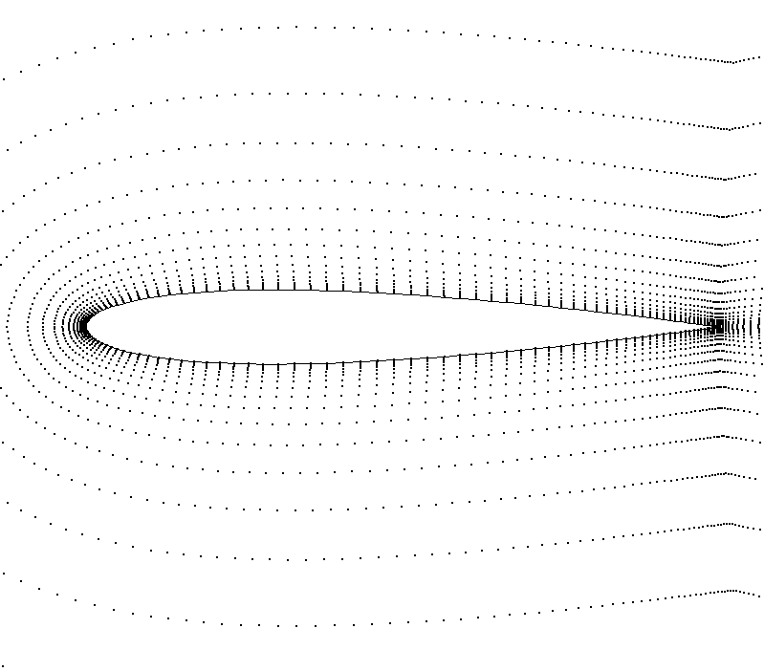
Application Examples
1. Pitch-plunge aerofoil with strip aero
FOM → NROM generation → control design
model problem to test methods
2. Geometrically-exact nonlinear beam with strip aero
static deflection + small/large deformation
set of FOM/ROM analyses
3. Pitch-plunge aerofoil with CFD
how to solve large sparse system?
how to calculate gust terms?
Notes:
Following a general description of the method, we turn our attention to 3 application examples.
The 1st is an aerofoil free to move in pitch and plunge with strip aerodynamics. The case is a model problem to test the methods.
The 2nd example is a pitch/plunge aerofoil with CFD for aerodynamic predictions. We will address two important issues in this case.
Finally, a nonlinear beam model coupled with strip aerodynamics is used to test all the options.

Slide 10
1. Pitch-Plunge Aerofoil
Struct model: linear/nonlinear
cubic stiffness in plunge
K=K(1+β₃ ξ ³)
Aero model: strip
flap motion (Wagner)
gust encounter (Küssner)
IDEs to ODEs by adding 8 aero states
Total of 12 states → model problem
Notes:
The structural model was made nonlinear adopting a polynomial form for the stiffness in plunge. The aerodynamic contributions include the effects of control deflection and penetration into a gust. The extension to any arbitrary input time history is achieved using the convolution integral, with the resulting eqs being integro-differential. The eqs are recast into a ODE form by additional variables for the dynamics of the flow. With only 12 states, the example is used as model problem to test the reduction.

Slide 11
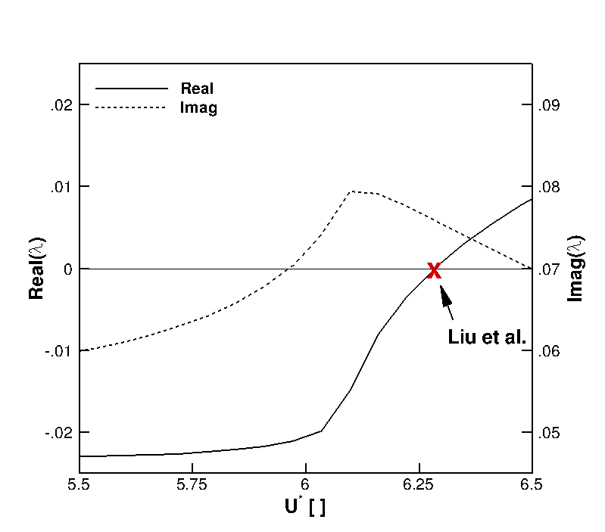
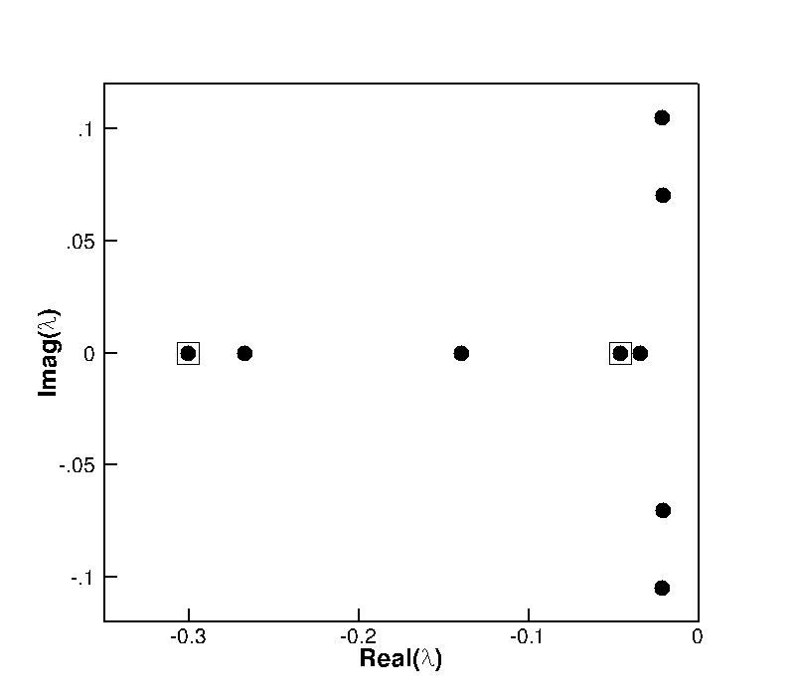
FOM validation
Aeroelastic | r_{α} = 0.5
 | µ = 100
 | ω_{ξ}/ω_{α} = 0.2
2
1
3
mode tracing: U*_{L} = 6.285
eigenspectrum at U*/U*_{L} = 0.95
Liu et al., “Application of the Centre Manifold Theory in Non-Linear Aeroelasticity”, Journal of Fluids and Structures; 11(3): 225-246, 1997
Notes:
Tests were made to check the formulation of the full model. Using the same aeroelastic parameters as reported in the reference, the coupled system was found to loose its stability at a reduced velocity of 6.285, which is exactly the same value reported by Liu and colleagues. Gust responses illustrated next were generated at 95% of this value. The eigenspectrum of the FOM is illustrated in the left figure. There are 2 complex conjugate eigenvalues related to the normal modes of the structure under influence of the fluid, and 8 real eigenvalues for the aerodynamics. In the tests run, it was found that ROM had good agreement to the FOM with the 2 structural modes, and perfect agreement when including the 3rd eigenvalue highlighted in the right figure. This eigenvalue introduces the influence of the gust on the structural modes, and it can be seen that it corresponds to the smallest time constant in the Kussner function. This is a feature of linear aerodynamics only, because fluidic eigenvalues based on CFD are complex.

Slide 12
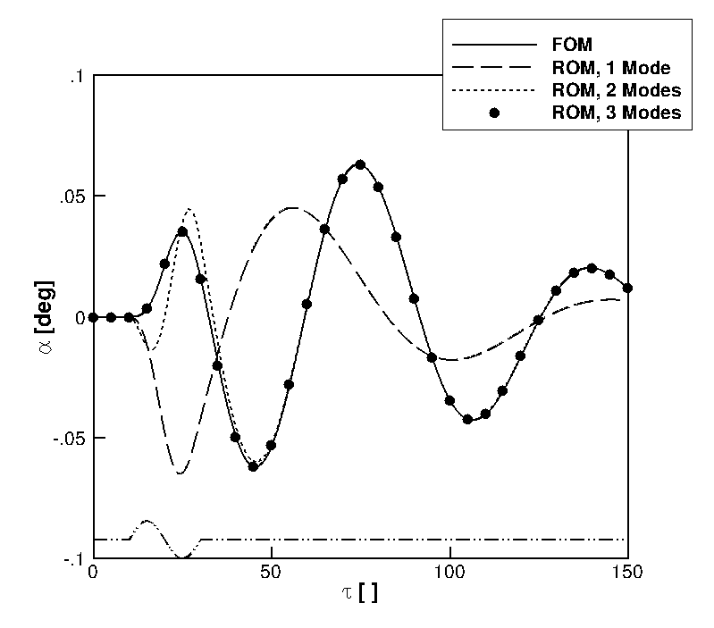
FOM/ROM gust response - linear structural model
Gust: | “sin”
 | h_{g} = 20
 | w₀ = 10⁻³
Simulation: | dt = 0.10
Notes:
To start with, a linear structural model was considered. A set of calculations were run using the FOM and ROM for the aerofoil interacting with a sinusoidal gust. Various shapes for the gust were also tested. The figure shows the pitch response. The black solid line is the FOM. We note that 1 mode is inadequate to fully represent the system dynamics; the ROM projected onto 2 modes as a perfect agreement when the aerofoil moves away from the gust, and small deviations during the gust interaction. The 3 mode prediction obtains a perfect agreement for all times.

Slide 13
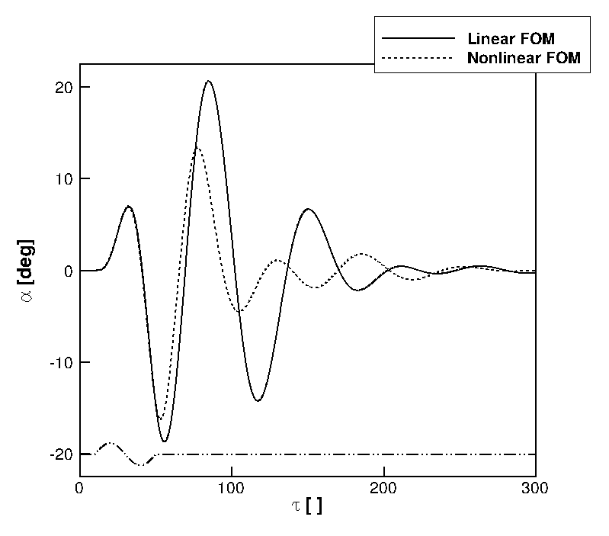
Full order model gust response
Gust: | “sin”
 | h_{g} = 40
 | w₀ = 10⁻¹
Simulation: | dt = 0.10
 | β_{ξ3} = 3
Notes:
Then, the gust was tuned so to make the influence of structural nonlinearity important in the FOM response. For the nonlinear model, the cubic stiffness coefficient in plunge was set to 3. With increasing plunge displacement, the spring becomes harder. This case, which features a gust of intensity 100 times the intensity of the previous linear case, is used to test the NROM.

Slide 14
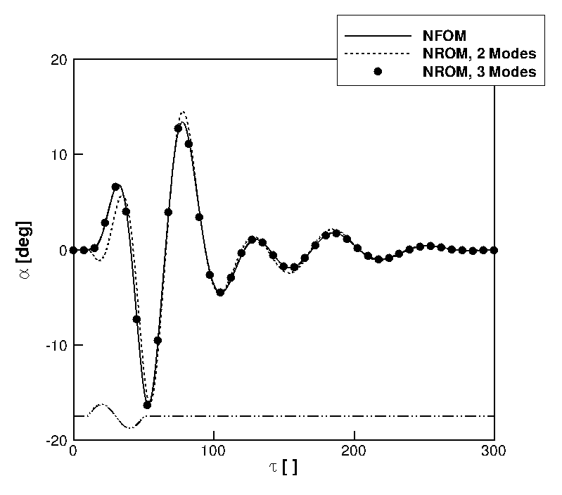
NFOM/NROM gust response - nonlinear structural model
Gust: | “sin”
 | h_{g} = 40
 | w₀ = 10⁻¹
Simulation: | dt = 0.10
 | β_{ξ3} = 3
Notes:
With the same nonlinear structural model and same gust parameters, NROMs were generated for increasing number of modes, and the predictions are compared to the NFOM in figure. We note the NROM with 2 modes predicts well the response, and including the 3rd mode makes the prediction to be identical to the FOM.

Slide 15
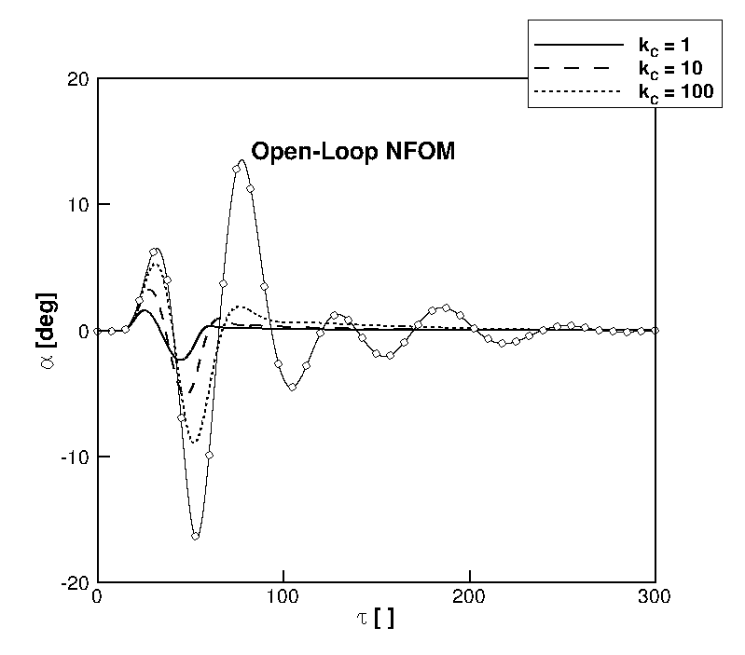
Closed-loop gust response
Gust: | “sin”
 | h_{g} = 40
 | w₀ = 10⁻¹
Simulation: | dt = 0.10
H∞ designed on ROM to minimize pitch response
NROM to be used for nonlinear control techniques?
parametric study on control/noise weights
Notes:
We then show how the reduced models can be used for control design. The idea is to minimize the system response to gust in the pitch degree of freedom, using a conventional control technique and assuming the full state is available. The flap is used for control. The control design was made on the linear ROM with 3 modes, and then it was applied to control the NROM with nonlinearities. Althougth not requiring reduction, this case shows that control is possible on the ROMs generated, and shows that control design will be the same for larger order systems because the ROMs have the same form.

Slide 16
2. Geometrically-Exact Nonlinear Beam
Geometrically-exact nonlinear equations for unrestrained body
Research code at Imperial College
Two-noded displacement-based elements
Coupled with strip aerodynamics (UVLM and CFD ongoing)
Set of linear/nonlinear analyses for FOM/ROM
Palacios et al., “Structural and Aerodynamic Models in Nonlinear Flight Dynamics of Very Flexible Aircraft”, AIAA Journal; 48(11): 2648-2659, 2010
Notes:
The 2nd application uses a multi-body flexible code for unrestrained bodies, with the structure based on the geometrically-nonlinear beam equations. The case we are looking is for a clamped wing, so that rigid-body and gyroscopic terms vanish. In this case, the source of nonlinearity is for the description of large beam deformations. The code has been coupled with strip aerodynamics, and will be coupled with CFD.

Slide 17
HALE Wing
Flexible HALE wing
Stability analysis at ρ∞ = 0.0889 kg/m³
(h = 20000 m):
U_{L} = 102 m/s
ω_{L} = 69.7 rad/s
DoF : 16*(12+8) = 320
span | 16 m
chord | 1 m
e.a. & c.g. | 50% chord from LE
bending rigidity | 1·10⁵ N·m²
torsional rigidity | 2·10⁵ N·m²
beam elements | 16
Murua et al., “Stability and Open-Loop Dynamics of Very Flexible Aircraft Including Free-Wake Effects”, AIAA paper 2011-1915
Notes:
The testcase is for a wing of span 16m and chord 1m representative of a very flexible aircraft. The beam code was coupled with strip aerodynamics and it was found to loose its stability at 102 m/s, which is close to the value of previous work.

Slide 18
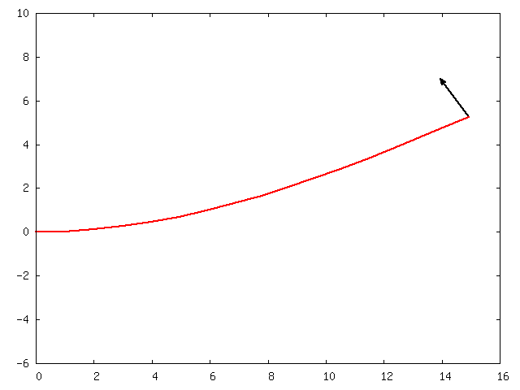
vertical displacement [m]
beam span [m]
Notes:
We now imagine to look at the wing model, with the horizontal axis running along the span and the vertical axis indicating the vertical displacements. What I’m going to show in the next slides is the time history of the wing tip vertical displacement.

Slide 19
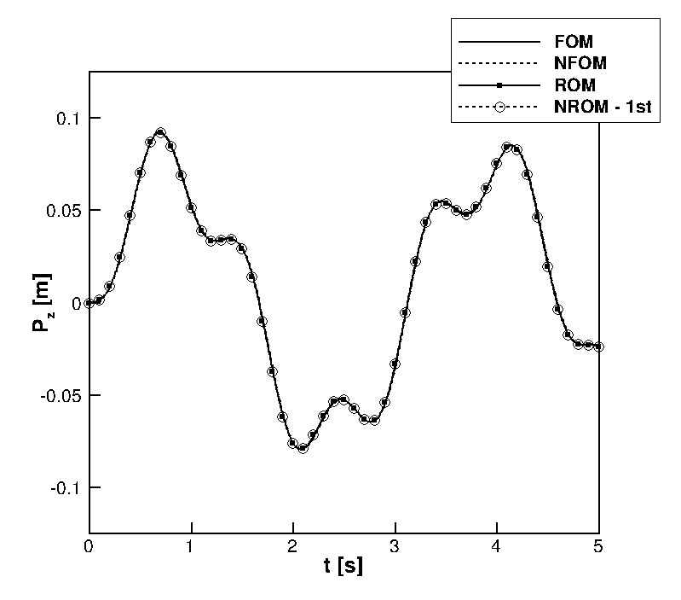
FOM/ROM response to follower force - small deflections
F_{A} = 10 N, ω = 2 rad/s
FOM DoF: 320
ROM/NROM DoF: 3
Notes:
The coupling with the fluid was made small by decreasing the density. A follower force was applied at the wing tip, acting in the vertical direction. The force varies harmonically and the wing undergoes small deflections around the undeformed configuration. Comparing the nonlinear and linearized version of the full model, we can see that the system response is linear. Various ROMs were generating by projecting the coupled system onto 3 modes, and they all achieve a perfect agreement to the FOMs.

Slide 20
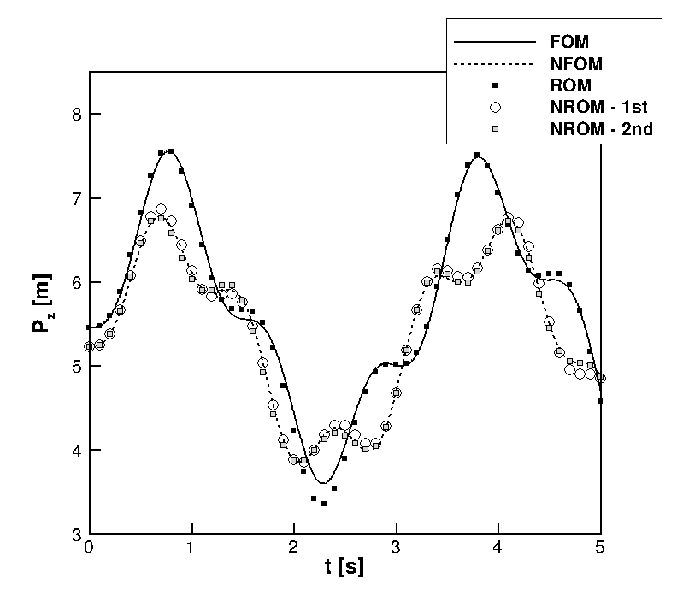
FOM/ROM response to follower force - large deflections
large deformation around large (static) deflection:
F₀ = 800 N
F_{A} = 200 N
ω = 2 rad/s
FOM DoF: 320
ROM/NROM DoF: 3
Notes:
The next case was selected to make the effect of nonlinearity important. A static force produces a large wing deformation, and then it was made to vary harmonically. Comparing the FOM responses based on the linearized and nonlinear equations reveals large differences in the system response. Consider that we are looking at deformations of 8 meters for a beam of 16 meters span, so the nonlinear effects have to be large. Various options were used for the ROMs. The ROM follows the linearized predictions. For the NROM, the dependence of the residual on the follower force was also included, and the 1st NROM agrees well with the NFOM. The predictions using the 2 mode NROM are virtually identical to the NFOM.

Slide 21
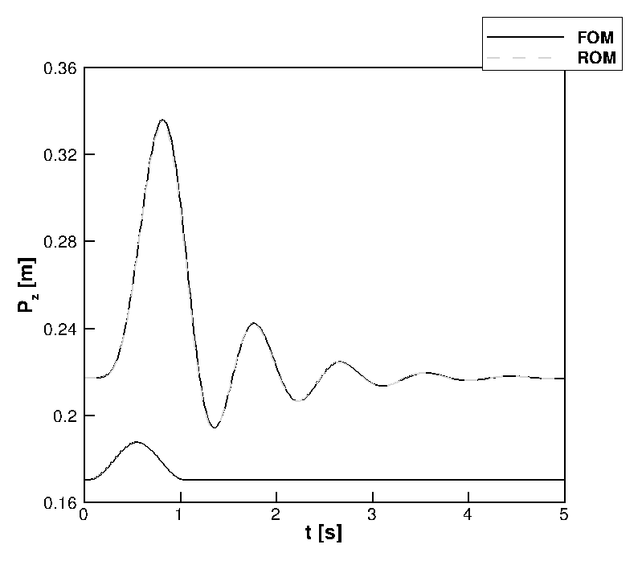
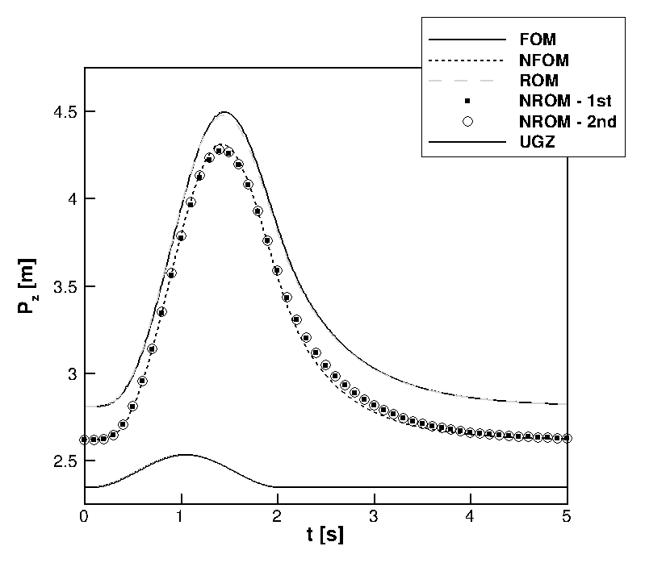
NFOM/NROM gust response
Gust: | “1-cos”
 | w₀ = 10⁻²
FOM DoF: 320
ROM/NROM DoF: 8
Control is made possible using ROMs
U∞ = 10 m/s, α∞ = 10 deg
U∞ = 60 m/s, α∞ = 2.5 deg
Notes:
The various ROMs were also tested for gust responses at an altitude of 20000 m at various speeds and combination of gust parameters.
ROMs can be used in principle for control design in this case, but this has not been done.

Slide 22
3. Pitch-Plunge Aerofoil using CFD
Struct model: linear/nonlinear
polynomial form for stiffness
K=K(1+β₃ α³+ β₅ α⁵)
Aero model: CFD
Euler equations
point distribution, 7974 points
“Heavy” case
Aeroelastic | r_{α} = 0.539
 | µ = 100
 | ω_{ξ}/ω_{α} = 0.343
Badcock et al., “Hopf Bifurcation Calculations for a Symmetric Airfoil in Transonic Flow”, AIAA Journal; 42(5): 883-892, 2004
Notes:
Coming to the last application example, which features a pitch-plunge aerofoil model coupled with CFD where a dramatic reduction of number of states can be made. The Euler eqs are solved on a distribution of about 8000 points. The aeroelastic parameters correspond to the heavy case described in previous work.

Slide 23
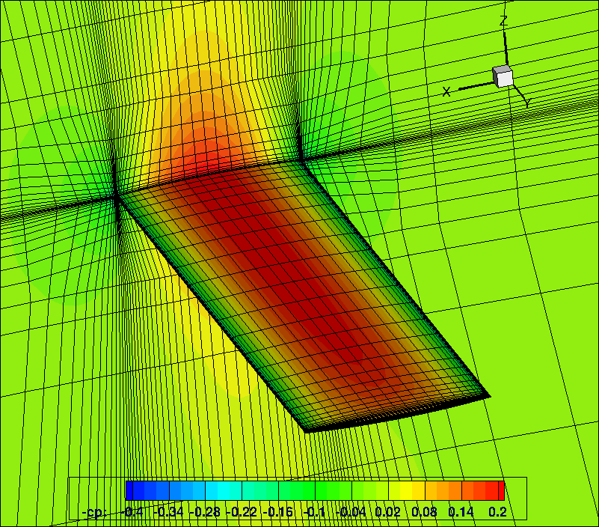
Parallel Meshless
- Research code, University of Liverpool
Simulation of complex geometries in relative motion
Cloud of points
Euler, laminar and RANS
Schur complement eigenvalue solver
Kennett et al., “An Implicit Meshless Method for Application in Computational Fluid Dynamics”, International Journal for Numerical Methods in Fluids; 2012
Notes:
The CFD solver used is a research code developed at the UoL. It has been developed to overcome the burden of grid generation and to enable flow simulations around complex geometries in relative motion, like the store release from an aircraft. It solves the Euler, laminar and RANS eqs on clouds of points as opposed to traditional finite volume grids. The solver is implicit and uses a preconditioned Krylov subspace method and dual-time stepping to perform the time integration.

Slide 24
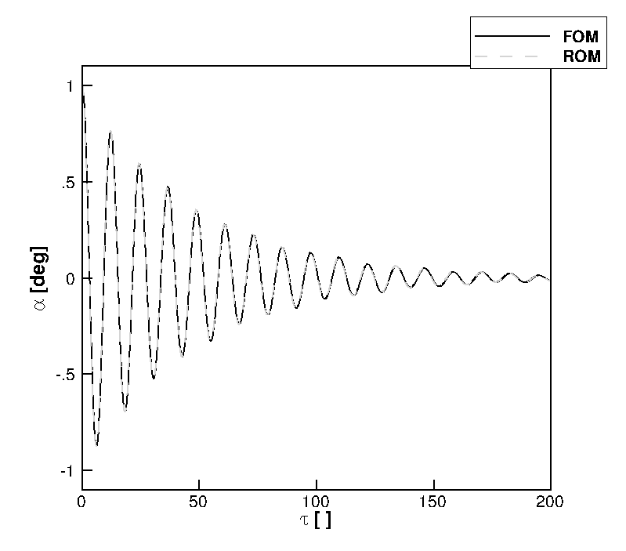
FOM/ROM free response
FOM DoF: approx. 32000
ROM Dof: 2
Simulation: | U* = 2
 | M = 0.6
 | α₀ = 1 deg
 | dt = 0.10
Notes:
The Schur method was used to generate a linear ROM to predict the free response of the coupled system at 0.6 Mach. The 2 normal modes were tracked and the predictions of both pitch and plunge response are in excellent agreement with the full order model calculations.

Slide 25
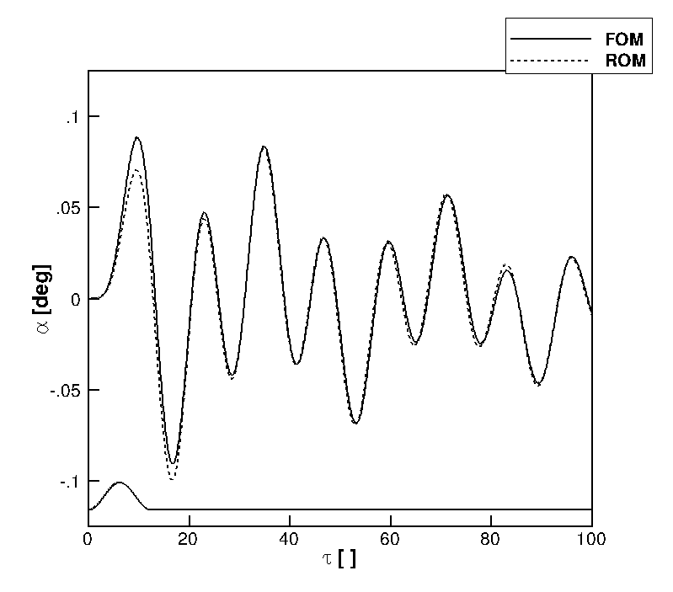
FOM/ROM gust response
FOM DoF: approx. 32000
ROM Dof: 2
Gust: | “1-cos”
 | h_{g} = 12.5
 | w₀ = 10⁻²
→ Worst-case gust search
Notes:
The performance of the 2 approaches was tested for a relatively short gust, about 12 times the aerofoil semi-chord. The approximation introduced with the ROM in vector form has a negative impact in this case. The ROM in matrix form is found to have a good agreement. ROMs were generated at a fraction of the cost of the FOM calculation, and their use in searching for a worst-case is possible.

Slide 26
Future Work
Need to have extended order arithmetic for NROM with CFD
Coupling CFD with nonlinear beam
More on control studies
so that
flexible aircraft gust interaction using CFD, nonlinear beam with controls
→ many ROM calculations
Project webpage:
http://www.cfd4aircraft.com/
Notes:
To generate a nonlinear ROM based on CFD, we know that we need to use extended order arithmetic to have accurate predictions. This work is done in these days, and the next challenge is to coupled the CFD with the nonlinear beam. More control studies will be done for the nonlinear beam model and for the CFD-based system. These steps are needed to achieve the objective I have mentioned earlier in the presentation.

Slide 27
Conclusion
Systematic approach to model reduction detailed
scalable to large order problems
3 application examples with CFD, nonlinear beams and control
FOM calcs, ROM generation for control
Schur complement for large sparse systems
How to calculate gust terms with CFD
- Good performance with nonlinearities at reduced cost
Project webpage:
http://www.cfd4aircraft.com/
Notes:
This brings me to the conclusions. A systematic approach to model reduction applicable to large order fluid/structure systems is presented. The word “systematic” is used in the sense that the model reduction is applied in the same way to different cases and models look the same, and control problem done for the pitch/plunge aerofoil will be done in the same way for the other cases, no matter what is the starting full-order model. The method was applied to various test cases, featuring nonlinear structures and nonlinear aerodynamics. Linear and nonlinear ROMs were found to predict well the coupled system dynamics, with the nonlinear ROM retaining the nonlinear effects of the full physics system into a smaller system that can be used by control people. In all cases, the cost of model generation was negligible compared to the cost of full order calculations, and applications to CFD-based systems will show this. For the time to simulate one single FOM calculations, we’ll be able to run an entire set of ROM calculations for various parameters.

